Slide 1
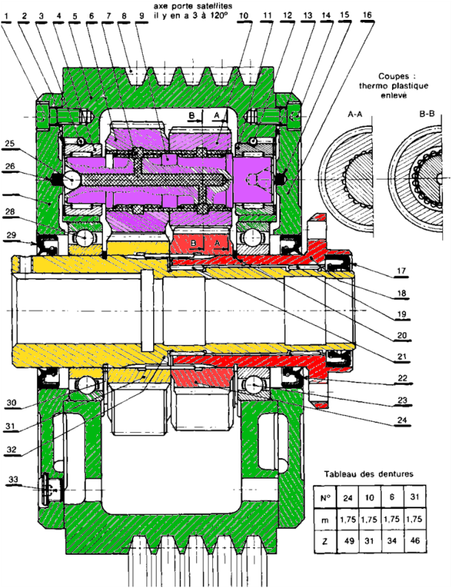




$Z=3$1
$$Z=34$$
2
0
3
$$Z=46$$
$$Z=49$$
1

