Slide 1
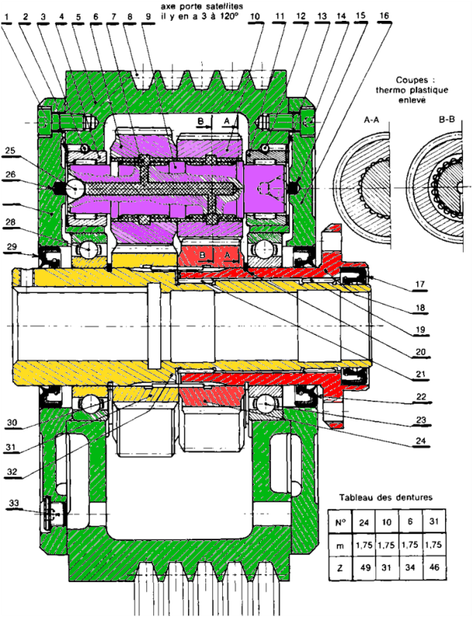




${Z′}_{2}=3$1
$$Z_{2}=34$$
2
0
3
$$Z_{3}=46$$
$$Z_{0}=49$$
1

