Slide 2
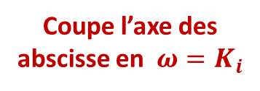
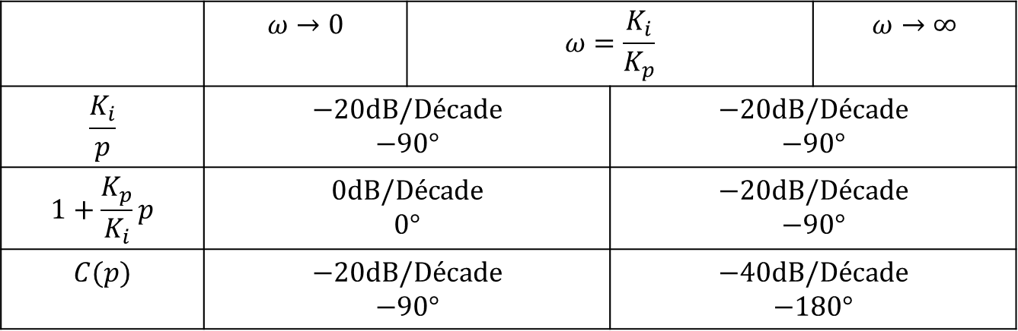
 | $$ω→0$$ | $$ω=\frac{K_{i}}{K_{p}}$$ |  | $$ω→∞$$
$$\frac{K_{i}}{p}$$ | $$−20dB/Décade$$ $$−90°$$ |  | $$−20dB/Décade$$ $$−90°$$
$$1+\frac{K_{p}}{K_{i}}p$$ | $$0dB/Décade$$ $$0°$$ |  | $$−20dB/Décade$$ $$−90°$$
$$C(p)$$ | $$−20dB/Décade$$ $$−90°$$ |  | $$−40dB/Décade$$ $$−180°$$
Coupe l’axe des abscisse en $ω=K_{i}$

