Slide 1
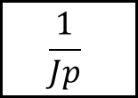
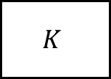


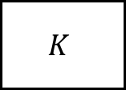
$$E(p)$$
$$K$$
$$\frac{1}{Jp}$$
$$S(p)$$
+
-
$$K$$

Slide 2
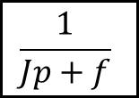
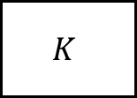
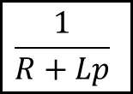
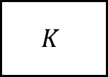

$$E(p)$$
$$\frac{1}{R+Lp}$$
$$K$$
$$\frac{1}{Jp+f}$$
$$S(p)$$
+
-
$$K$$

