Slide 1
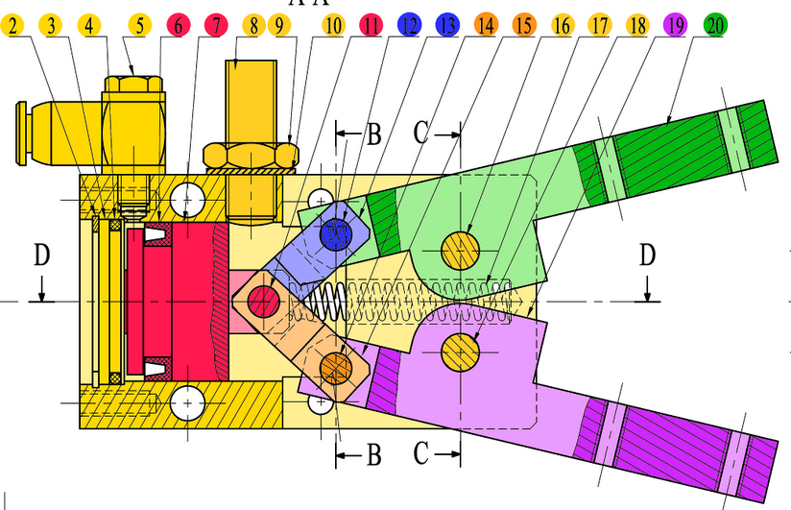
3
4
3
1
D
C
D
C
A
1
B
2
A
1
B
2
6
5
3
1
F
E
F
E

Slide 2
3
2
1
0
D
C
D
C
A
0
B
1
A
0
B
1
5
4
1
0
F
E
F
E

