Slide 1

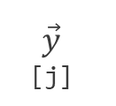
$$\vec{y}$$
[j]
[0][0]
[0][1]
[1][0]
[1][3]
[[1, 1, 1, 1, 1, 1],
[1, 1, 1, 0, 1, 1],
[1, 1, 1, 1, 1, 1],
[1, 1, 1, 1, 1, 1]]
[2][5]
[3][4]
[3][5]
$\vec{x}$ [i]

Slide 2
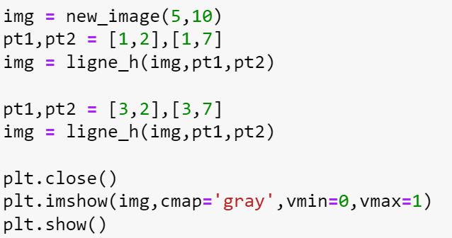
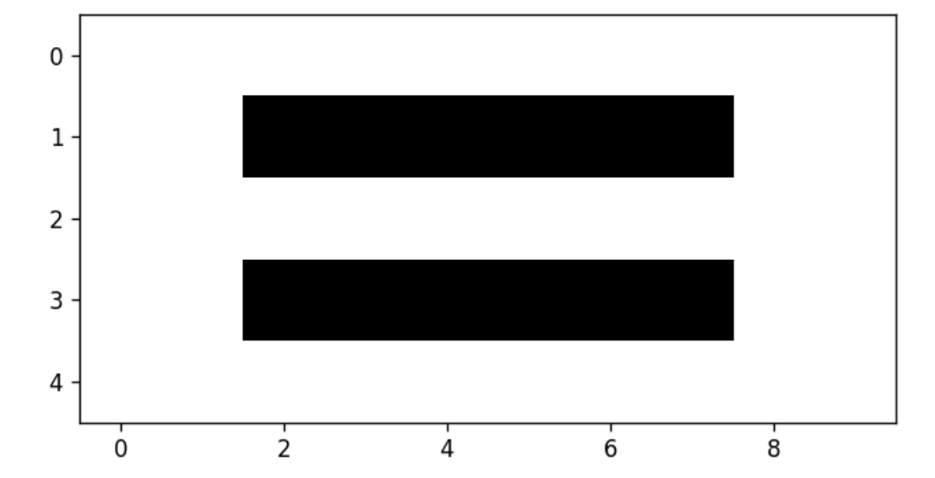

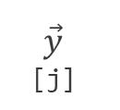
$$\vec{y}$$
[j]
$\vec{x}$ [i]

Slide 3
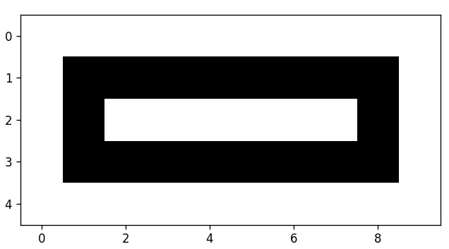
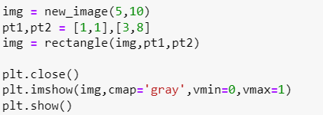


$$\vec{y}$$
[j]
$\vec{x}$ [i]

Slide 4
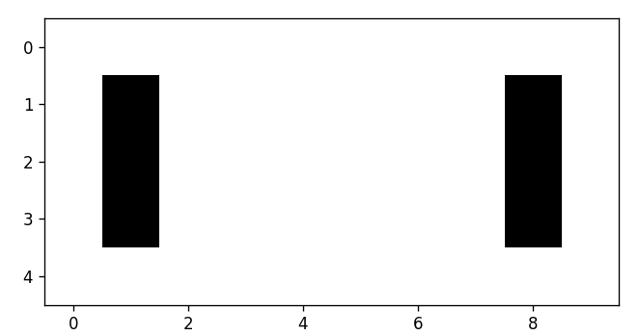
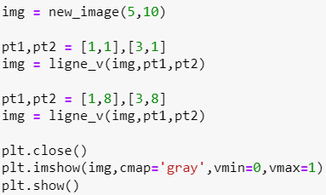
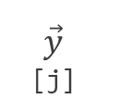
$$\vec{y}$$
[j]
$\vec{x}$ [i]

