Slide 1












Mur
$$T_{ext}$$
$$T_{int}$$
$$T_{ext}$$
$$T_{ext}^{1}$$
$$0$$
$$e$$
$$T_{ext}^{2}$$
$$\vec{z}$$
$$t$$
$$0$$
$$\vec{x}$$
$$\vec{y}$$

Slide 2
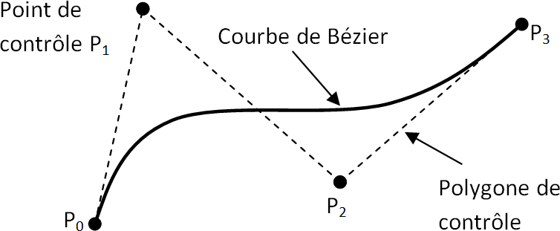
Pôle P₁

Slide 3










$$0$$
Mur
$$Δx$$
$$0$$
$$e$$
$$0$$
$$1$$
$$2$$
$$…$$
$$…$$
$$N$$
$$N+1$$

Slide 4




















Mur
$$Δx$$
$$e$$
Indice $i$
$$0$$
$$1$$
$$2$$
$$…$$
$$…$$
$$N$$
$$N+1$$
Instant $0$
$$T_{0}^{0}$$
$$T_{1}^{0}$$
$$T_{2}^{0}$$
$$T_{N}^{0}$$
$$T_{N+1}^{0}$$
Instant $1$
$$T_{0}^{1}$$
$$T_{1}^{1}$$
$$T_{2}^{1}$$
$$T_{N}^{1}$$
$$T_{N+1}^{1}$$

