Slide 2




























Pivot glissant
$$\vec{z_{1}}$$
$$\vec{z_{1}}$$
$$\vec{z_{2}}$$
$$\vec{z_{1}}$$
$$\vec{z_{2}}$$
$$\vec{z_{1}}$$
$$\vec{y_{2}}$$
(2)
(2)
$$O$$
(2)
(2)
$$O_{1}$$
$$\vec{x_{1}}$$
$$\vec{y_{1}}$$
$$\vec{x_{1}}$$
$$O_{1}$$
$$\vec{y_{1}}$$
$$\vec{y_{1}}$$
$$O_{2}$$
$$O_{1}$$
(1)
(1)
(1)
(1)
$$\vec{z_{1}}$$
$$\vec{z_{2}}$$
$$\vec{z_{2}}$$
$$\vec{z_{1}}$$
$$\vec{y_{2}}$$
(2)
$$\vec{x_{1}}$$
$$O_{1}$$
(2)
$$θ(t)$$
$$O_{2}$$
$$\vec{y_{1}}$$
$$λ(t)$$
$$O_{2}$$
(1)
(1)

Slide 3















Pivot
$$\vec{z_{1}}$$
$$\vec{z_{1}}$$
$$\vec{z_{2}}$$
$$\vec{z_{1}}$$
$$\vec{z_{2}}$$
$$\vec{z_{1}}$$
$$\vec{y_{2}}$$
(2)
(2)
$$O$$
(2)
(2)
$$O$$
$$\vec{x_{1}}$$
$$\vec{y_{1}}$$
$$\vec{x_{1}}$$
$$O$$
$$\vec{y_{1}}$$
$$\vec{y_{1}}$$
(1)
(1)
$$O$$
(1)
(1)
$$\vec{z_{1}}$$
$$\vec{z_{2}}$$
$$\vec{z_{1}}$$
$$\vec{y_{2}}$$
$$\vec{z_{2}}$$
(2)
$$\vec{x_{1}}$$
(2)
$$θ(t)$$
$$O$$
$$\vec{y_{1}}$$
$$O$$
(1)
(1)

Slide 4










Glissière hélicoïdale
$$\vec{z_{1}}$$
$$O$$
(2)
$$\vec{x_{1}}$$
$$\vec{y_{1}}$$
(1)
$$\vec{z_{1}}$$
$$\vec{z_{2}}$$
$$\vec{z_{1}}$$
$$\vec{z_{2}}$$
$$\vec{y_{2}}$$
$$\vec{x_{1}}$$
(2)
(2)
$$O$$
$$O$$
$$\vec{y_{1}}$$
(1)
(1)
$$\vec{z_{1}}$$
$$\vec{z_{2}}$$
$$\vec{x_{1}}$$
(2)
$$O_{1}$$
$$O_{2}$$
(1)
$$λ\left(t\right)=θ\left(t\right)⋅\frac{p}{2π}$$

Slide 5
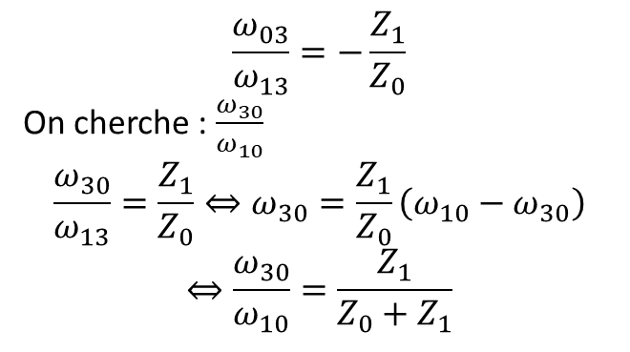






$$Z_{2}$$
$$\frac{ω_{03}}{ω_{13}}=−\frac{Z_{1}}{Z_{0}}$$
On cherche : $\frac{ω_{30}}{ω_{10}}$
$$\frac{ω_{30}}{ω_{13}}=\frac{Z_{1}}{Z_{0}}⇔ω_{30}=\frac{Z_{1}}{Z_{0}}\left(ω_{10}−ω_{30}\right)$$
$$⇔\frac{ω_{30}}{ω_{10}}=\frac{Z_{1}}{Z_{0}+Z_{1}}$$
2
$$B$$
$$\vec{x_{2}}$$
1
3
$$A$$
$$Z_{1}$$
$$Z_{0}$$
0

Slide 6
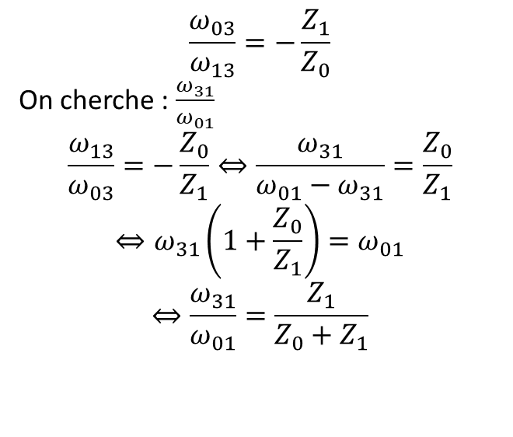
$$Z_{2}$$
$$\frac{ω_{03}}{ω_{13}}=−\frac{Z_{1}}{Z_{0}}$$
On cherche : $\frac{ω_{31}}{ω_{01}}$
$$\frac{ω_{13}}{ω_{03}}=−\frac{Z_{0}}{Z_{1}}⇔\frac{ω_{31}}{ω_{01}−ω_{31}}=\frac{Z_{0}}{Z_{1}}$$
$$⇔ω_{31}\left(1+\frac{Z_{0}}{Z_{1}}\right)=ω_{01}$$
$$⇔\frac{ω_{31}}{ω_{01}}=\frac{Z_{1}}{Z_{0}+Z_{1}}$$
2
$$B$$
$$\vec{x_{2}}$$
3
1
$$A$$
$$Z_{1}$$
$$Z_{0}$$
0

