Slide 3
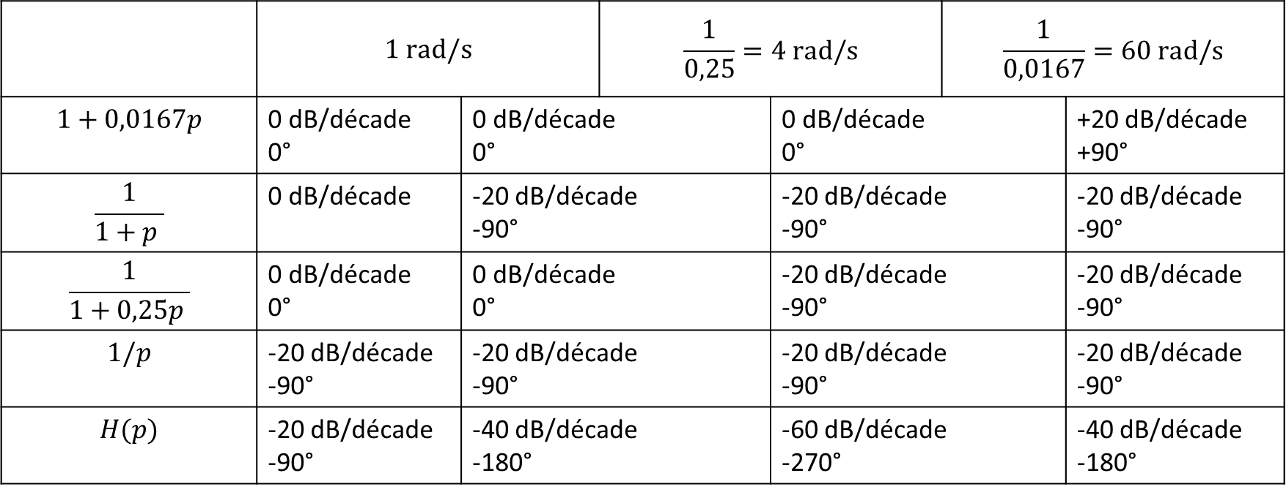
 | $$1 rad/s$$ |  | $$\frac{1}{0,25}=4 rad/s$$ |  | $$\frac{1}{0,0167}=60 rad/s$$
$$1+0,0167p$$ | 0 dB/décade 0° | 0 dB/décade 0° |  | 0 dB/décade 0° |  | +20 dB/décade +90°
$$\frac{1}{1+p }$$ | 0 dB/décade | -20 dB/décade -90° |  | -20 dB/décade -90° |  | -20 dB/décade -90°
$$\frac{1}{1+0,25p }$$ | 0 dB/décade 0° | 0 dB/décade 0° |  | -20 dB/décade -90° |  | -20 dB/décade -90°
$$1/p$$ | -20 dB/décade -90° | -20 dB/décade -90° |  | -20 dB/décade -90° |  | -20 dB/décade -90°
$$H(p)$$ | -20 dB/décade -90° | -40 dB/décade -180° |  | -60 dB/décade -270° |  | -40 dB/décade -180°

