Slide 2
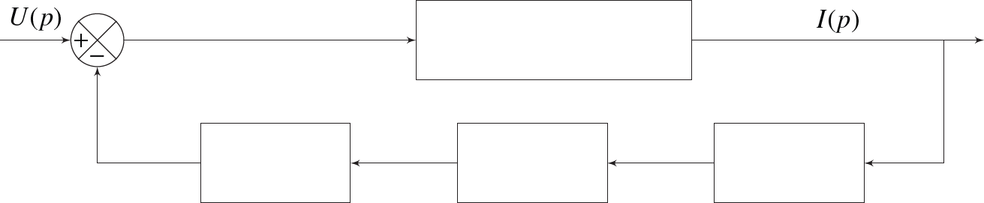

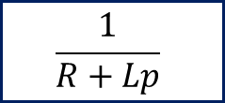



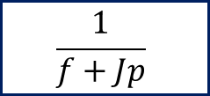



$$U(p)$$
$$\frac{1}{R+Lp}$$
$$I(p)$$
+
–
$$Ω(p)$$
$$C(p)$$
$$E(p)$$
$$K_{e}$$
$$\frac{1}{f+Jp}$$
$$K_{e}$$

Slide 3
$$U(p)$$
$$\frac{1}{R+Lp}$$
$$I(p)$$
+
–
$$Ω(p)$$
$$C(p)$$
$$E(p)$$
$$K_{e}$$
$$\frac{1}{f+Jp}$$
$$K_{e}$$

Slide 4
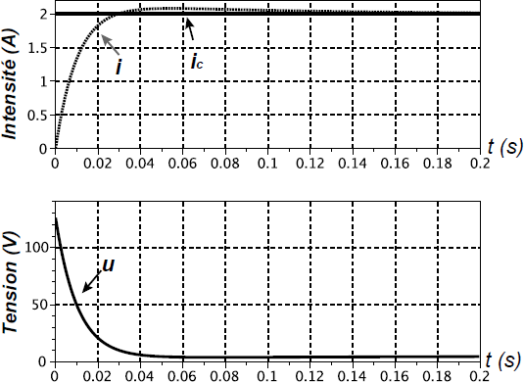


$$ε_{S}=0$$
$$t_{5\%}=0,025 s$$

Slide 5
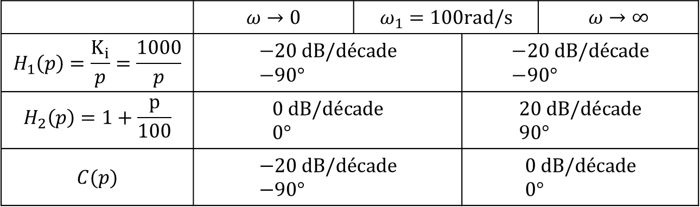
 | $$ω→0$$ | $$ω_{1}=100rad/s$$ |  | $$ω→∞$$
$$H_{1}\left(p\right)=\frac{K_{i}}{p}=\frac{1000}{p}$$ | $$−20 dB/décade \\ −90°$$ |  | $$−20 dB/décade \\ −90°$$ | $$−20 dB/décade \\ −90°$$
$$H_{2}\left(p\right)=1+\frac{p}{100}$$ | $$0 dB/décade \\ 0°$$ |  | $$20 dB/décade \\ 90°$$ | $$−20 dB/décade \\ −90°$$
$$C(p)$$ | $$−20 dB/décade \\ −90°$$ |  | $$0 dB/décade \\ 0°$$ | $$−40 dB/décade \\ −180°$$

Slide 6
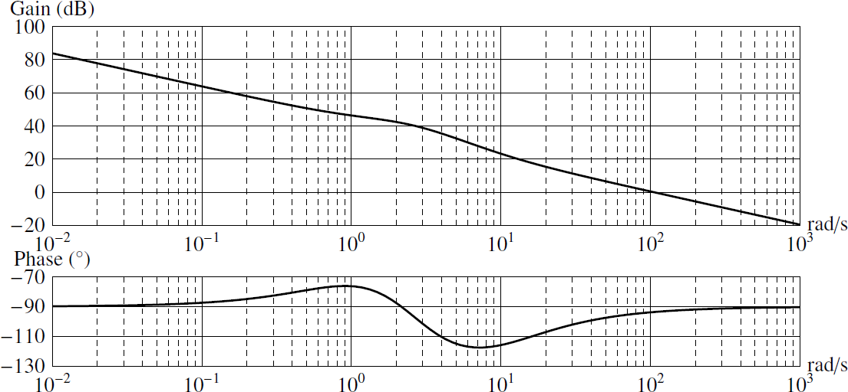

$$M_{φ}=85°$$

