Slide 2
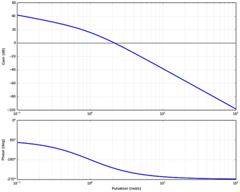


$$M_{G}=−20dB$$
$$M_{φ}=−45°$$
Instable

Slide 3
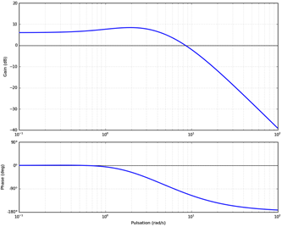


$$M_{G}=∞$$
$$M_{φ}=60°$$
Stable

Slide 4
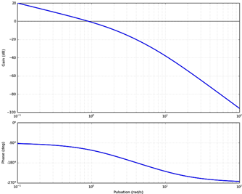


$$M_{G}=20dB$$
$$M_{φ}≃45°$$
Stable

Slide 5
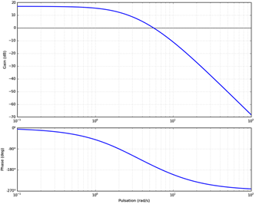


$$M_{G}=10dB$$
$$M_{φ}≃30°$$
Stable

Slide 6
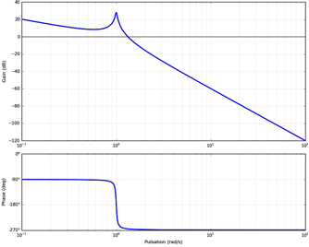


$$M_{G}=−30dB$$
$$M_{φ}≃−90°$$
Stable

