Slide 1
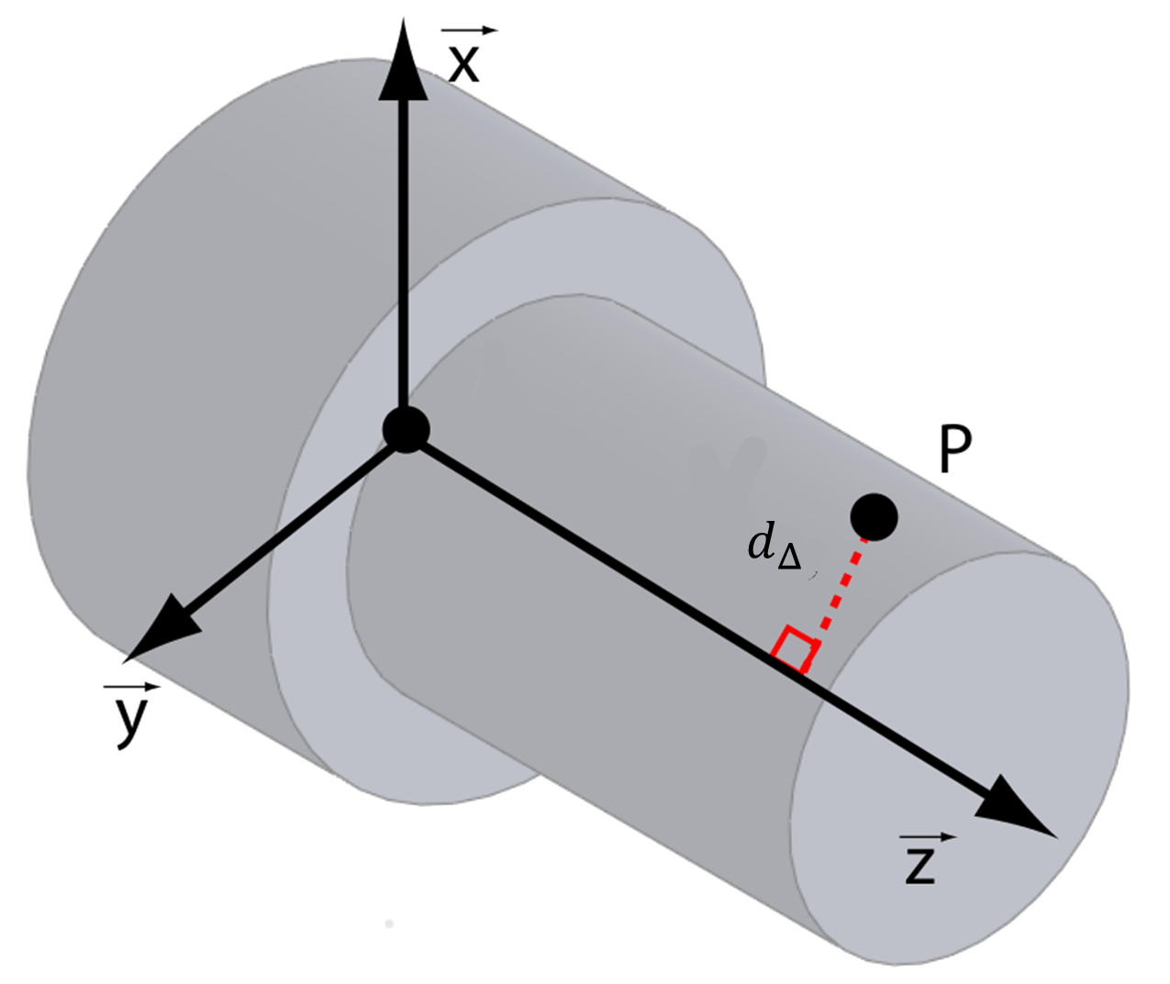


$$O$$
$$\vec{u}$$

