Slide 2










$$E\left(p\right)$$
$$\frac{1}{p}$$
$$S\left(p\right)$$
$$+$$
$$A$$
$$+$$
$$−$$
$$−$$
$$B$$
$$C$$

Slide 3


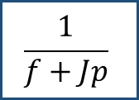
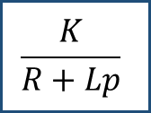

$$U\left(p\right)$$
$$\frac{K}{R+Lp}$$
$$\frac{1}{f+Jp}$$
$$Ω\left(p\right)$$
$$+$$
$$−$$
$$K$$

