Slide 1







$$E(p)$$
$$A$$
$$B$$
$$C$$
$$D$$
$$S(p)$$
+
-
$$E$$

Slide 2






$$E(p)$$
$$A$$
$$B$$
$$C$$
$$D$$
$$S(p)$$
$$E$$
FTBO = BCDE

Slide 3



$$E(p)$$
B
$$S(p)$$
$$A$$
FTBO = (1+A)B

Slide 4
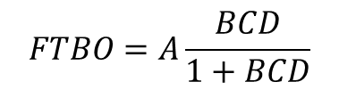
$$E(p)$$
+
-
$$S(p)$$
-
$$A$$
+
$$B$$
$$C$$
$$D$$
$$FTBO=A\frac{BCD}{1+BCD}$$

Slide 5
$$E(p)$$
+
-
$$S(p)$$
-
$$A$$
+
$$B$$
$$C$$
$$D$$

Slide 6
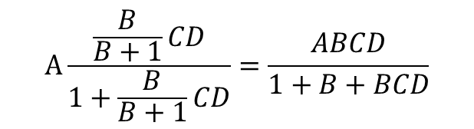



$$E(p)$$
+
-
+
$$S(p)$$
-
$$A$$
+
-
$$B$$
$$C$$
$$D$$
$$A\frac{\frac{B}{B+1}CD}{1+\frac{B}{B+1}CD}=\frac{ABCD}{1+B+BCD}$$

Slide 7



$$P(p)$$
$$D$$
$$E(p)$$
+
-
-
$$A$$
+
$$B$$
$$C$$
$$S(p)$$
$$ABC$$

Slide 8


$$P(p)$$
$$D$$
$$E(p)$$
+
-
$$A$$
-
+
$$B$$
$$C$$
$$S(p)$$
$$BC$$

Slide 9


$$P(p)$$
$$D$$
$$E(p)$$
-
$$A$$
+
+
-
$$B$$
$$C$$
$$S(p)$$
$$BC$$

Slide 10





$$E$$
$$E(p)$$
+
-
$$S(p)$$
-
$$A$$
+
$$B$$
$$C$$
$$D$$

Slide 11

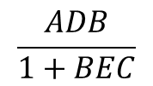
$$EC$$
$$E(p)$$
+
-
$$S(p)$$
-
$$A$$
+
$$B$$
$$C$$
$$D$$
$$\frac{ADB}{1+BEC}$$

