Slide 2
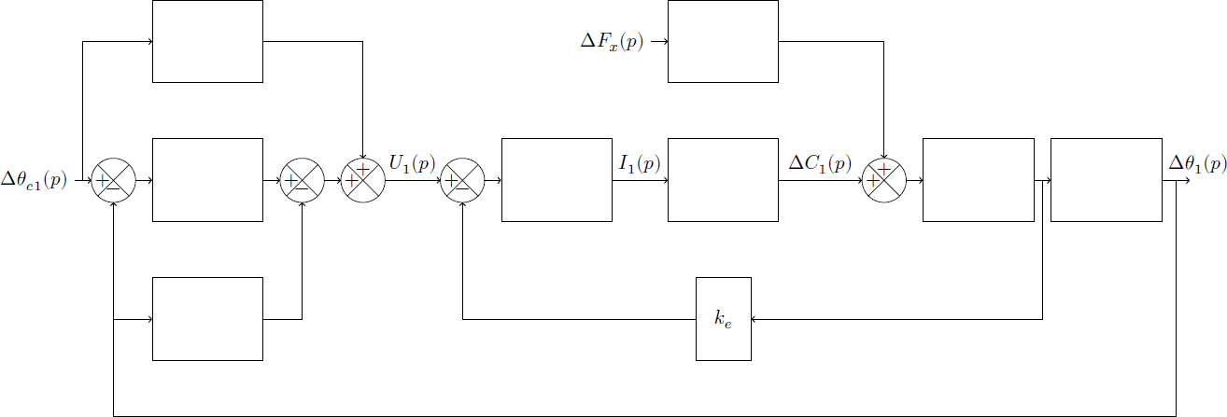

Slide 3










$$ΔF_{x}(p)$$
$$Δθ_{c1}(p)$$
$$U_{1}(p)$$
$$I_{1}(p)$$
$$ΔC_{1}(p)$$
$$Δθ_{1}(p)$$
$$+$$
$$+$$
$$+$$
$$+$$
$$+$$
$$+$$
$$+$$
$$−$$
$$−$$
$$−$$
$$k_{e}$$

Slide 4








$$A(p)$$
$$ΔF_{x}(p)$$
$$E(p)$$
$$Δθ_{c1}(p)$$
$$U_{1}(p)$$
$$I_{1}(p)$$
$$ΔC_{1}(p)$$
$$Δθ_{1}(p)$$
$$+$$
$$B(p)$$
$$+$$
$$+$$
$$+$$
$$+$$
$$D(p)$$
$$F(p)$$
$$+$$
$$+$$
$$G(p)$$
$$H(p)$$
$$−$$
$$−$$
$$−$$
$$C(p)$$
$$k_{e}$$

Slide 5








$$σ_{4}$$
$$ΔF_{x}(p)$$
$$\frac{k_{1}r_{9}^{′}}{r_{0}}h_{2}$$
$$Δθ_{c1}(p)$$
$$σ_{1}+\frac{σ_{2}}{p}$$
$$U_{1}(p)$$
$$\frac{1}{R}$$
$$I_{1}(p)$$
$$ΔC_{1}(p)$$
$$\frac{1}{Jp}$$
$$\frac{1}{p}$$
$$Δθ_{1}(p)$$
$$+$$
$$+$$
$$+$$
$$+$$
$$+$$
$$k_{t}$$
$$+$$
$$+$$
$$−$$
$$−$$
$$−$$
$$σ_{3}p$$
$$k_{e}$$

