Slide 1
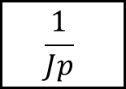
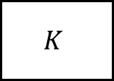


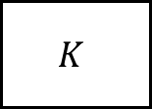
$$E(p)$$
$$K$$
$$\frac{1}{Jp}$$
$$S(p)$$
+
-
$$K$$

Slide 2
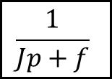
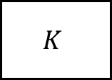
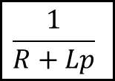
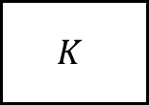

$$E(p)$$
$$\frac{1}{R+Lp}$$
$$K$$
$$\frac{1}{Jp+f}$$
$$S(p)$$
+
-
$$K$$

Slide 3
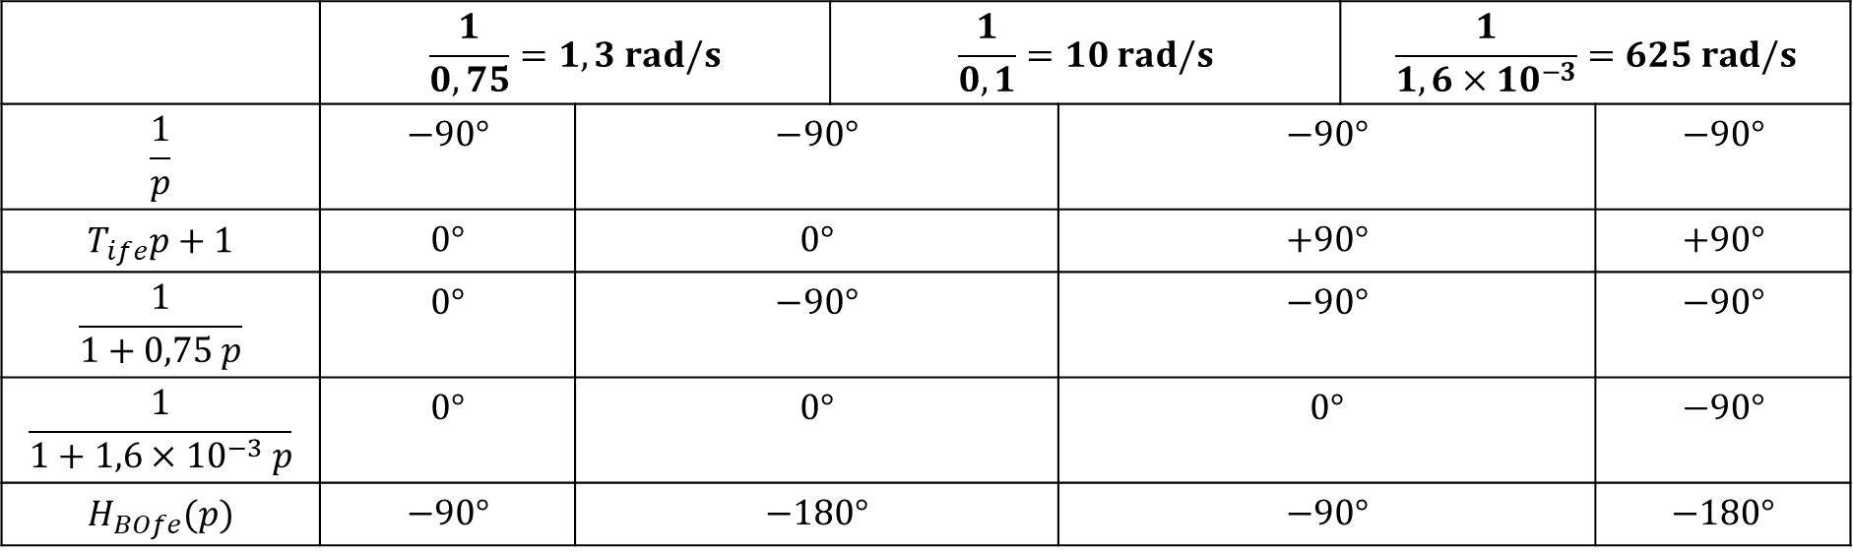
 | $$\frac{1}{0,75}=1,3 rad/s$$ |  | $$\frac{1}{0,1}=10 rad/s$$ |  | $$\frac{1}{1,6×10^{−3}}=625 rad/s$$
$$\frac{1}{p}$$ | $$−90°$$ | $$−90°$$ |  | $$−90°$$ |  | $$−90°$$
$$T_{ife}p+1$$ | $$0°$$ | $$0°$$ |  | $$+90°$$ |  | $$+90°$$
$$\frac{1}{1+0,75 p}$$ | $$0°$$ | $$−90°$$ |  | $$−90°$$ |  | $$−90°$$
$$\frac{1}{1+1,6×{10}^{−3} p}$$ | $$0°$$ | $$0°$$ |  | $$0°$$ |  | $$−90°$$
$$H_{BOfe}(p)$$ | $$−90°$$ | $$−180°$$ |  | $$−90°$$ |  | $$−180°$$

Slide 4






79_Tuyere
$$Q(p)$$
$$Σ(p)$$
$$F_{v}(p)$$
$$V(p)$$
$$X(p)$$
$$+$$
$$−$$

Slide 5





79_Tuyere
$$Q(p)$$
$$\frac{B}{V_{0}p}$$
$$F_{v}(p)$$
$$\frac{1}{M_{eq}p}$$
$$V(p)$$
$$\frac{1}{p}$$
$$X(p)$$
$$+$$
$$Σ(p)$$
$$S$$
$$−$$
$$S$$

Slide 6


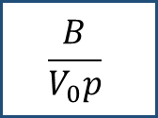



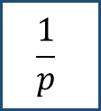


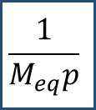


79_Tuyere
$$F_{R}\left(p\right)$$
$$K_{F}$$
$$Q\left(p\right)$$
$$\frac{B}{V_{0}p}$$
$$S\left(p\right)$$
$$F_{V}\left(p\right)$$
$$\frac{1}{M_{eq}p}$$
$$V\left(p\right)$$
$$S$$
$$−$$
$$\frac{1}{p}$$
$$X\left(p\right)$$
$$+$$
$$+$$
$$−$$
$$S$$

Slide 7



79_Tuyere
$$δ$$
$$F_{R}\left(p\right)$$
$$K_{F}$$
$$Q\left(p\right)$$
$$\frac{B}{V_{0}p}$$
$$S\left(p\right)$$
$$F_{V}\left(p\right)$$
$$\frac{1}{M_{eq}p}$$
$$V\left(p\right)$$
$$−$$
$$S$$
$$−$$
$$\frac{1}{p}$$
$$X\left(p\right)$$
$$+$$
$$+$$
$$−$$
$$S$$

Slide 8












$$F_{R}\left(p\right)$$
$$K_{F}$$
$$Q\left(p\right)$$
$$\frac{B}{V_{0}p}$$
$$S\left(p\right)$$
$$F_{V}\left(p\right)$$
$$\frac{1}{M_{eq}p}$$
$$V\left(p\right)$$
$$S$$
$$−$$
$$\frac{1}{p}$$
$$X\left(p\right)$$
$$+$$
$$+$$
$$−$$
$$S$$

Slide 9













$$ΔF_{x}(p)$$
$$E(p)$$
$$U_{1}(p)$$
$$I_{1}(p)$$
$$ΔC_{1}(p)$$
$$Δθ_{1}(p)$$
$$+$$
$$D(p)$$
$$F(p)$$
$$+$$
$$+$$
$$G(p)$$
$$H(p)$$
$$−$$
$$k_{e}$$

Slide 10




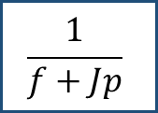








$$C_{r}\left(p\right)$$
$$U\left(p\right)$$
$$I\left(p\right)$$
$$\frac{1}{f+Jp}$$
$$Ω\left(p\right)$$
$$+$$
$$\frac{1}{R+Lp}$$
$$K$$
$$+$$
$$−$$
$$+$$
$$E\left(p\right)$$
$$K$$

Slide 11
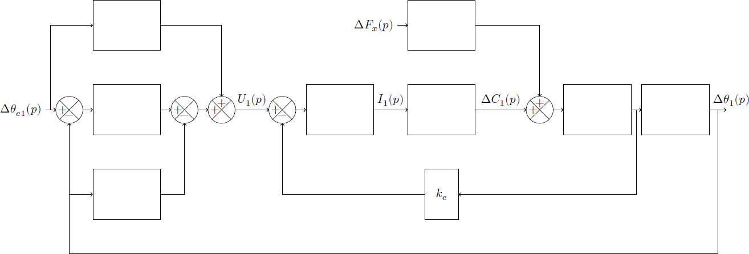
$$ΔF_{x}(p)$$
$$Δθ_{c1}(p)$$
$$U_{1}(p)$$
$$I_{1}(p)$$
$$ΔC_{1}(p)$$
$$Δθ_{1}(p)$$
$$+$$
$$+$$
$$+$$
$$+$$
$$+$$
$$+$$
$$+$$
$$−$$
$$−$$
$$−$$
$$k_{e}$$

Slide 12
$$A(p)$$
$$ΔF_{x}(p)$$
$$E(p)$$
$$Δθ_{c1}(p)$$
$$U_{1}(p)$$
$$I_{1}(p)$$
$$ΔC_{1}(p)$$
$$Δθ_{1}(p)$$
$$+$$
$$B(p)$$
$$+$$
$$+$$
$$+$$
$$+$$
$$D(p)$$
$$F(p)$$
$$+$$
$$+$$
$$G(p)$$
$$H(p)$$
$$−$$
$$−$$
$$−$$
$$C(p)$$
$$k_{e}$$

Slide 13
$$σ_{4}$$
$$ΔF_{x}(p)$$
$$\frac{k_{1}r_{9}^{′}}{r_{0}}h_{2}$$
$$Δθ_{c1}(p)$$
$$σ_{1}+\frac{σ_{2}}{p}$$
$$U_{1}(p)$$
$$\frac{1}{R}$$
$$I_{1}(p)$$
$$ΔC_{1}(p)$$
$$\frac{1}{Jp}$$
$$\frac{1}{p}$$
$$Δθ_{1}(p)$$
$$+$$
$$+$$
$$+$$
$$+$$
$$+$$
$$k_{t}$$
$$+$$
$$+$$
$$−$$
$$−$$
$$−$$
$$σ_{3}p$$
$$k_{e}$$

Slide 14






$$H_{4}\left(p\right)$$
$$E\left(p\right)$$
$$+$$
$$S\left(p\right)$$
$$+$$
$$H_{1}\left(p\right)$$
$$H_{2}\left(p\right)$$
$$+$$
$$−$$
$$H_{3}\left(p\right)$$

Slide 15






$$E\left(p\right)$$
$$E\left(p\right)$$
$$−$$
$$S\left(p\right)$$
$$+$$
$$A\left(p\right)$$
$$+$$
$$B\left(p\right)$$
$$C\left(p\right)$$
$$−$$
$$D\left(p\right)$$

Slide 16


$$E\left(p\right)$$
$$S\left(p\right)$$
$$+$$
$$H_{1}\left(p\right)$$
$$−$$
$$H_{2}\left(p\right)$$

Slide 17

$$P\left(p\right)$$
$$E\left(p\right)$$
$$+$$
$$S\left(p\right)$$
$$+$$
$$A\left(p\right)$$
$$+$$
$$B\left(p\right)$$
$$C\left(p\right)$$
$$−$$
$$D\left(p\right)$$

Slide 18

$$P\left(p\right)$$
$$E\left(p\right)$$
$$+$$
$$S\left(p\right)$$
$$+$$
$$+$$
$$A\left(p\right)$$
$$+$$
$$B\left(p\right)$$
$$C\left(p\right)$$
$$−$$
$$−$$
$$D\left(p\right)$$

Slide 19






$$E\left(p\right)$$
$$S\left(p\right)$$
$$+$$
$$A(p)$$
$$+$$
$$B(p)$$
$$D(p)$$
$$−$$
$$−$$
$$C\left(p\right)$$

Slide 20


$$E\left(p\right)$$
$$S\left(p\right)$$
$$A(p)$$
$$+$$
$$B(p)$$
$$D(p)$$
$$−$$
$$C\left(p\right)$$

Slide 21

$$F\left(p\right)$$
$$E\left(p\right)$$
$$−$$
$$S\left(p\right)$$
$$+$$
$$A\left(p\right)$$
$$+$$
$$B\left(p\right)$$
$$C\left(p\right)$$
$$−$$
$$D\left(p\right)$$

Slide 22



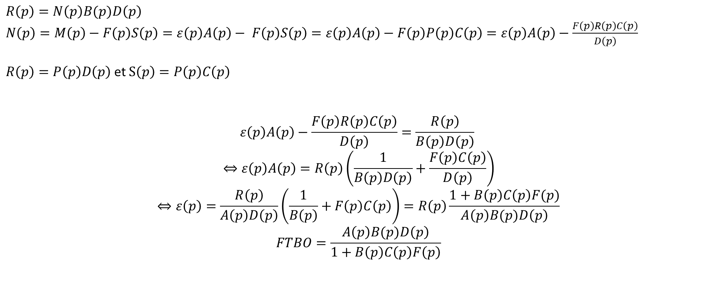


$$F\left(p\right)$$
$$ε\left(p\right)$$
$$M\left(p\right)$$
$$N\left(p\right)$$
$$P\left(p\right)$$
$$E\left(p\right)$$
$$−$$
$$S\left(p\right)$$
$$+$$
$$A\left(p\right)$$
$$+$$
$$B\left(p\right)$$
$$C\left(p\right)$$
$$−$$
$$D\left(p\right)$$
$$R\left(p\right)$$
$R\left(p\right)=N\left(p\right)B(p)D\left(p\right)$
$N\left(p\right)=M\left(p\right)−F\left(p\right)S\left(p\right)=ε\left(p\right)A\left(p\right)− F\left(p\right)S\left(p\right)=ε\left(p\right)A\left(p\right)−F\left(p\right)P\left(p\right)C\left(p\right)$ $=ε\left(p\right)A\left(p\right)−\frac{F\left(p\right)R\left(p\right)C\left(p\right)}{D\left(p\right)}$
$R\left(p\right)=P\left(p\right)D\left(p\right)$ et $S\left(p\right)=P\left(p\right)C\left(p\right)$
$$ε\left(p\right)A\left(p\right)−\frac{F\left(p\right)R\left(p\right)C\left(p\right)}{D\left(p\right)}=\frac{R\left(p\right)}{B\left(p\right)D\left(p\right)}$$
$$⇔ε\left(p\right)A\left(p\right)=R\left(p\right)\left(\frac{1}{B\left(p\right)D\left(p\right)}+\frac{F\left(p\right)C\left(p\right)}{D\left(p\right)}\right)$$
$$⇔ε\left(p\right)=\frac{R\left(p\right)}{A\left(p\right)D\left(p\right)}\left(\frac{1}{B\left(p\right)}+F\left(p\right)C\left(p\right)\right)=R\left(p\right)\frac{1+B\left(p\right)C\left(p\right)F(p)}{A\left(p\right)B(p)D\left(p\right)}$$
$$FTBO=\frac{A\left(p\right)B(p)D\left(p\right)}{1+B\left(p\right)C\left(p\right)F\left(p\right)}$$

Slide 23


$$F\left(p\right)$$
$$E\left(p\right)$$
$$S\left(p\right)$$
$$+$$
$$A\left(p\right)$$
$$−$$
$$B\left(p\right)$$
$$C\left(p\right)$$
$$−$$
$$+$$
$$D\left(p\right)$$

Slide 24

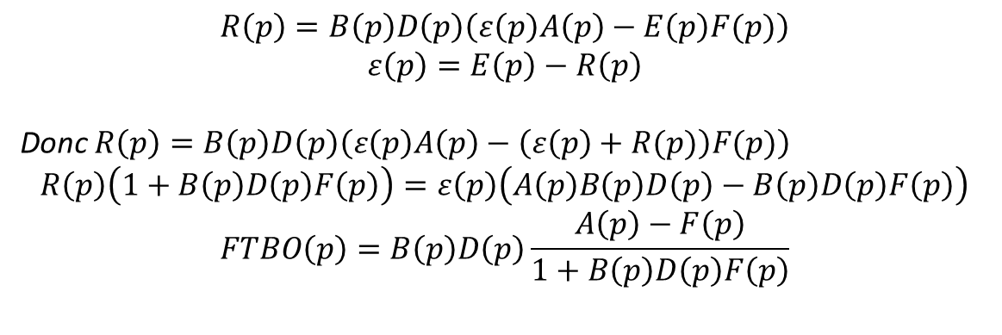

$$F\left(p\right)$$
$$E\left(p\right)$$
$$ε\left(p\right)$$
$$A\left(p\right)$$
$$−$$
$$B\left(p\right)$$
$$C\left(p\right)$$
$$S\left(p\right)$$
$$+$$
$$+$$
$$−$$
$$R\left(p\right)$$
$$D\left(p\right)$$
$$R\left(p\right)=B\left(p\right)D\left(p\right)\left(ε\left(p\right)A\left(p\right)−E\left(p\right)F(p)\right)$$
$$ε\left(p\right)=E\left(p\right)−R\left(p\right)$$
Donc $R\left(p\right)=B\left(p\right)D\left(p\right)\left(ε\left(p\right)A\left(p\right)−\left(ε\left(p\right)+R(p)\right)F(p)\right)$
$$R\left(p\right)\left(1+B\left(p\right)D\left(p\right)F\left(p\right)\right)=ε\left(p\right)\left(A\left(p\right)B\left(p\right)D\left(p\right)−B\left(p\right)D\left(p\right)F\left(p\right)\right)$$
$$FTBO\left(p\right)=B\left(p\right)D\left(p\right)\frac{A\left(p\right)−F\left(p\right)}{1+B\left(p\right)D\left(p\right)F\left(p\right)}$$

Slide 25


$$C\left(p\right)$$
$$E\left(p\right)$$
$$S\left(p\right)$$
$$+$$
$$A\left(p\right)$$
$$−$$
$$B\left(p\right)$$
$$−$$
$$+$$
$$D\left(p\right)$$

