Slide 1
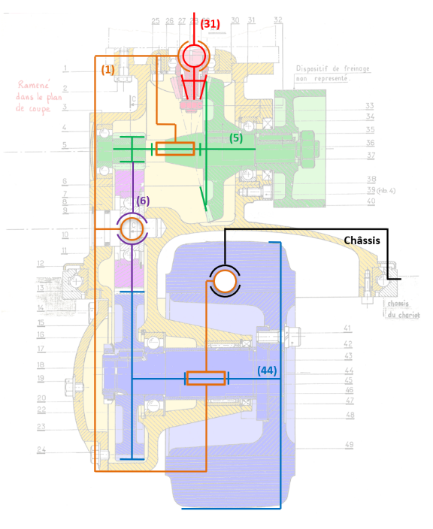


$$\vec{y_{0}}$$
$$\vec{x_{0}}$$

Slide 2








$$Z_{2}$$
2
$$B$$
$$\vec{x_{2}}$$
$$\vec{x_{0}}$$
1
3
$$\vec{z_{0}}$$
$$A$$
$$Z_{1}$$
$$Z_{0}$$
0

Slide 3
2
$$B$$
$$\vec{x_{2}}$$
$$\vec{x_{0}}$$
1
3
$$\vec{z_{0}}$$
$$A$$
0

Slide 4









$$Z_{22}$$
$$Z_{21}$$
2
$$O_{2}$$
$$\vec{x_{0}}$$
$$\vec{z_{0}}$$
$$O_{1}$$
1
3
$$O_{3}$$
$$Z_{3}$$
$$Z_{1}$$
0

Slide 5
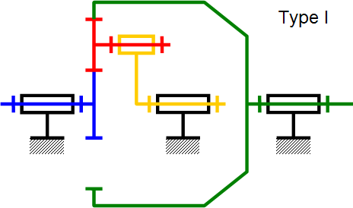


2
$$B$$
$$\vec{x_{2}}$$
1
3
$$A$$
$$\vec{x_{0}}$$
$$\vec{z_{0}}$$
0

Slide 6





$$Z_{2}$$
3
2
1
0
$$Z_{1}$$
$$\vec{x_{0}}$$
$$\vec{z_{0}}$$
$$Z_{3}$$

Slide 7



$$Z_{21}$$
$$Z_{22}$$
2
1
3
$$Z_{1}$$
0
$$Z_{4}$$
4

Slide 8


$$Z_{21}$$
2
1
$$Z_{22}$$
$$Z_{1}$$
0
$$Z_{4}$$
4

Slide 9
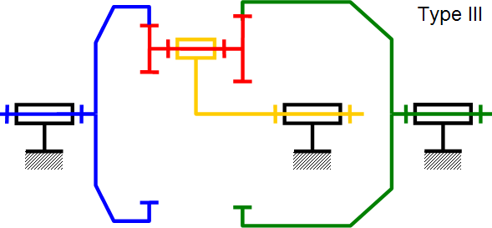


$$Z_{22}$$
$$Z_{21}$$
2
1
3
0
$$Z_{1}$$
$$Z_{4}$$
4

Slide 10


2
$$Z_{21}$$
1
$$Z_{22}$$
$$Z_{1}$$
0
$$Z_{4}$$
4

Slide 11
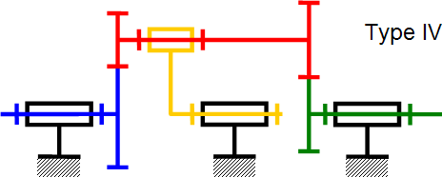


$$Z_{22}$$
$$Z_{21}$$
2
3
1
4
$$Z_{4}$$
0
$$Z_{1}$$

Slide 12
$$Z_{22}$$
$$Z_{21}$$
2
1
4
0
$$Z_{4}$$
$$Z_{1}$$

