Slide 1





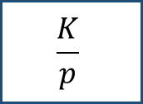

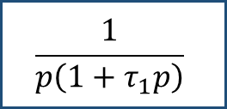



$$P\left(p\right)$$
$$E\left(p\right)$$
$$ε\left(p\right)$$
$$\frac{K}{p}$$
$$+$$
$$\frac{1}{p\left(1+τ_{1}p\right)}$$
$$S\left(p\right)$$
$$+$$
$$+$$
$$−$$
$$C$$

