Slide 2
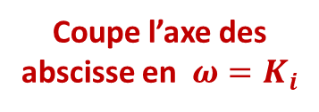
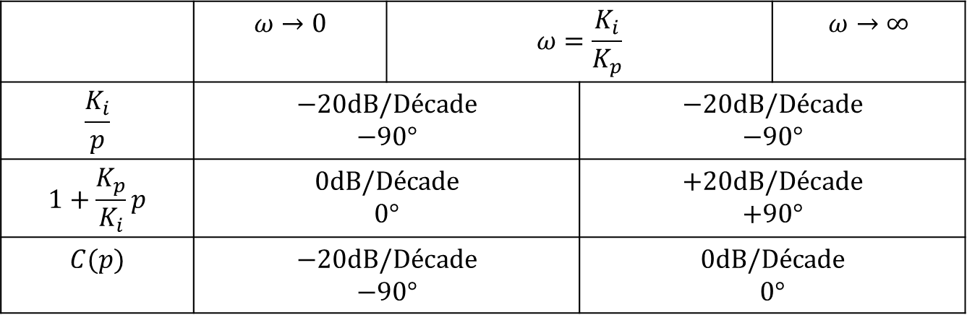
 | $$ω→0$$ | $$ω=\frac{K_{i}}{K_{p}}$$ |  | $$ω→∞$$
$$\frac{K_{i}}{p}$$ | $$−20dB/Décade$$ $$−90°$$ |  | $$−20dB/Décade$$ $$−90°$$
$$1+\frac{K_{p}}{K_{i}}p$$ | $$0dB/Décade$$ $$0°$$ |  | $$+20dB/Décade$$ $$+90°$$
$$C(p)$$ | $$−20dB/Décade$$ $$−90°$$ |  | $$0dB/Décade$$ $$0°$$
Coupe l’axe des abscisse en $ω=K_{i}$

Slide 3
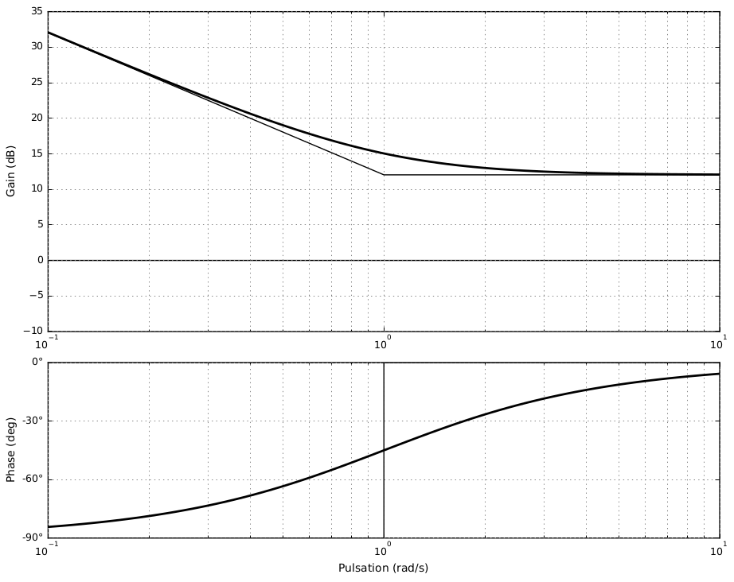




$$−20 dB/décade$$
$$0dB/décade$$
$$\frac{K_{i}}{K_{p}}$$
$$K_{i}$$

Slide 4
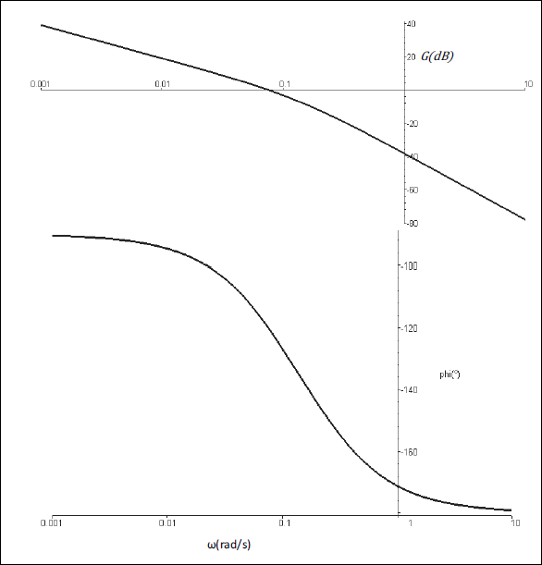
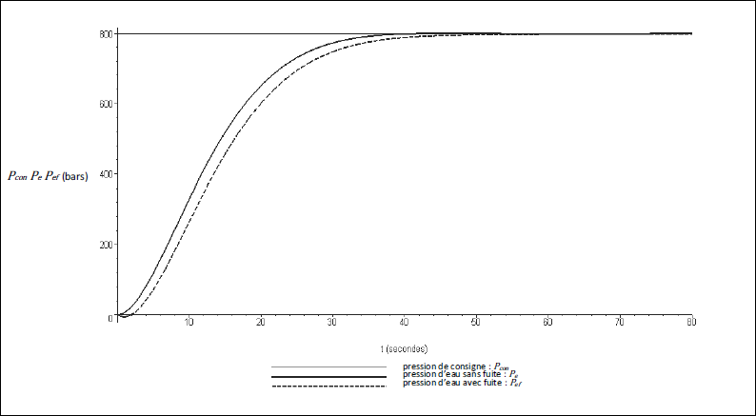



$$760$$
$$32 s$$
$$M_{φ}=60°$$

