Slide 1






Enroulement
3
$$i_{1}(t)$$
1
N
$$i_{2}(t)$$
$$v_{1}(t)$$
1
2
$$i_{3}(t)$$
$$v_{2}(t)$$
3
P
$$v_{3}(t)$$
N
2

Slide 2
Enroulement
3
$$i_{1}(t)$$
1
N
$$i_{2}(t)$$
$$v_{1}(t)$$
1
2
Rotor /
Inducteur
$$i_{3}(t)$$
$$v_{2}(t)$$
3
P
$$v_{3}(t)$$
Stator / Induit
N
2

Slide 3
2
3
$$i_{1}(t)$$
1
P
N
$$i_{2}(t)$$
$$v_{1}(t)$$
1
1
2
$$i_{3}(t)$$
$$v_{2}(t)$$
P
3
N
$$v_{3}(t)$$
N
3
2

Slide 4


$$i_{1}(t)$$
$$Z$$
1
$$i_{2}(t)$$
$$v_{1}(t)$$
2
$$Z$$
$$i_{3}(t)$$
$$v_{2}(t)$$
3
$$Z$$
$$v_{3}(t)$$
$$i_{N}=0$$
N

Slide 5





$$Ω$$
$$R_{mes}=0,4 Ω$$
$$i_{1}(t)$$
$$Z$$
1
$$i_{2}(t)$$
$$v_{1}(t)$$
2
$$Z$$
$$i_{3}(t)$$
$$v_{2}(t)$$
3
$$Z$$
$$v_{3}(t)$$
$$i_{N}=0$$
N

Slide 6



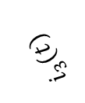



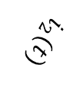

$$i_{2}(t)$$
$$Z$$
2
$$v_{2}(t)$$
$$v_{1}(t)$$
$$i_{1}(t)$$
$$Z$$
1
$$v_{3}(t)$$
$$i_{N}=0$$
N
$$i_{3}(t)$$
$$Z$$
3

Slide 9


$$t$$
$$T$$

Slide 10



$$A$$
$$αT$$
$$t$$
$$T$$

Slide 11
$$A$$
$$αT$$
$$t$$
$$T$$

Slide 12

$$A$$
$$\left\langle s\right\rangle$$
$$αT$$
$$t$$
$$T$$

Slide 13
$$A$$
$$αT$$
$$t$$
$$T$$

Slide 14

$$A$$
$$αT$$
$$t$$
$$T$$

Slide 15
$$A$$
$$αT$$
$$t$$
$$T$$

Slide 16


$$A$$
$$\left\langle s\right\rangle$$
$$αT$$
$$t$$
$$T$$

Slide 17

$$A$$

Slide 18
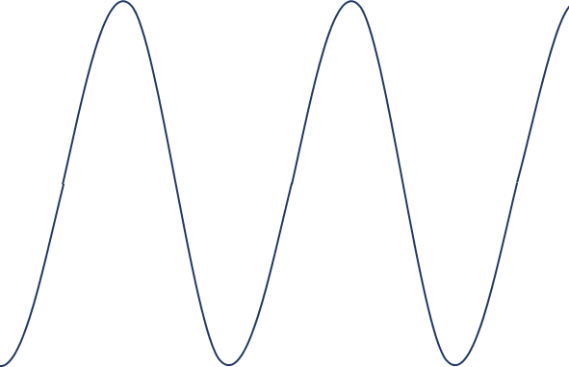


$$A$$
$$T$$
$$φ$$

Slide 23
« Terre »
Phase
Neutre

Slide 24



Im
$$\underline{I}$$
$$\underline{U_{C}}$$
$$ωt+φ$$
Re
$$ωt+φ+\frac{π}{2}$$

Slide 25




Im
$$\underline{u_{12}}(t)$$
$$\underline{v_{3}}(t)$$
$$\underline{v_{1}}(t)$$
Re
$$\underline{v_{2}}(t)$$

Slide 26




Im
$$\underline{S}$$
$$\underline{Q}$$
$$φ$$
Re
$$\underline{P}$$

Slide 27
Phase 1
230 V
400 V
400 V
Phase 2
230 V
400 V
Phase 3
230 V
Neutre

Slide 28




Couplage
étoile
Couplage
triangle
$$i_{1}(t)$$
1
$$i_{2}(t)$$
$$v_{1}(t)$$
$$u_{12}(t)$$
2
$$i_{3}(t)$$
$$v_{2}(t)$$
$$u_{23}(t)$$
$$u_{31}(t)$$
3
$$j_{1}(t)$$
$$v_{3}(t)$$
N
Tensions
simples
Tensions
composées

Slide 29
Couplage
étoile
Couplage
triangle
$$i_{1}(t)$$
$$Z$$
1
$$i_{2}(t)$$
$$v_{1}(t)$$
2
$$Z$$
$$i_{3}(t)$$
$$v_{2}(t)$$
3
$$Z$$
$$j_{1}(t)$$
$$v_{3}(t)$$
$$i_{N}=0$$
N

Slide 30















3
$$j_{31}(t)$$
$$u_{31}(t)$$
$$u_{23}(t)$$
1
$$j_{23}(t)$$
$$j_{12}(t)$$
$$u_{12}(t)$$
2
$$i_{1}(t)$$
$$Z$$
$$j_{12}(t)$$
1
$$v_{1}(t)$$
$$u_{12}(t)$$
$$i_{2}(t)$$
$$Z$$
$$j_{23}(t)$$
2
$$u_{31}(t)$$
$$u_{23}(t)$$
$$i_{3}(t)$$
$$v_{2}(t)$$
3
$$Z$$
$$j_{31}(t)$$
$$v_{3}(t)$$
N

Slide 31

Phase 1
$$v_{1}(t)$$
Phase 2
Phase 3
Neutre

Slide 32



$$i\left(t\right)$$
$$e\left(t\right)$$
$$R$$
$$u_{R}\left(t\right)$$

Slide 33


$$i\left(t\right)$$
$$e\left(t\right)$$
$$C$$
$$u_{C}\left(t\right)$$

Slide 34

$$u_{R}\left(t\right)$$
$$i\left(t\right)$$
$$R$$
$$e\left(t\right)$$
$$C$$
$$u_{C}\left(t\right)$$

Slide 35
$$u_{R}\left(t\right)$$
$$i\left(t\right)$$
$$R$$
$$\underline{E}$$
$$C$$
$$u_{C}\left(t\right)$$

Slide 36

$$−\sin\left(x\right)=\cos\left(x+\frac{π}{2}\right)$$

