Slide 1








Im
$$\underline{E}$$
$$\underline{U_{X}}$$
$$\underline{V}$$
$$\underline{v_{1}}(t)$$
$$\underline{v_{3}}(t)$$
$$φ$$
Re
$$\underline{v_{2}}(t)$$
$$\underline{U_{R}}$$

Slide 2






Enroulement
3
$$i_{1}(t)$$
1
N
$$i_{2}(t)$$
$$v_{1}(t)$$
1
2
$$i_{3}(t)$$
$$v_{2}(t)$$
3
P
$$v_{3}(t)$$
N
2

Slide 3
Enroulement
3
$$i_{1}(t)$$
1
N
$$i_{2}(t)$$
$$v_{1}(t)$$
1
2
Rotor /
Inducteur
$$i_{3}(t)$$
$$v_{2}(t)$$
3
P
$$v_{3}(t)$$
Stator / Induit
N
2

Slide 4
2
3
$$i_{1}(t)$$
1
P
N
$$i_{2}(t)$$
$$v_{1}(t)$$
1
1
2
$$i_{3}(t)$$
$$v_{2}(t)$$
P
3
N
$$v_{3}(t)$$
N
3
2

Slide 5


$$i_{1}(t)$$
$$Z$$
1
$$i_{2}(t)$$
$$v_{1}(t)$$
2
$$Z$$
$$i_{3}(t)$$
$$v_{2}(t)$$
3
$$Z$$
$$v_{3}(t)$$
$$i_{N}=0$$
N

Slide 6





$$Ω$$
$$R_{mes}=0,4 Ω$$
$$i_{1}(t)$$
$$Z$$
1
$$i_{2}(t)$$
$$v_{1}(t)$$
2
$$Z$$
$$i_{3}(t)$$
$$v_{2}(t)$$
3
$$Z$$
$$v_{3}(t)$$
$$i_{N}=0$$
N

Slide 7



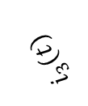



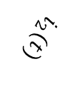

$$i_{2}(t)$$
$$Z$$
2
$$v_{2}(t)$$
$$v_{1}(t)$$
$$i_{1}(t)$$
$$Z$$
1
$$v_{3}(t)$$
$$i_{N}=0$$
N
$$i_{3}(t)$$
$$Z$$
3

Slide 10


$$t$$
$$T$$

Slide 11



$$A$$
$$αT$$
$$t$$
$$T$$

Slide 12
$$A$$
$$αT$$
$$t$$
$$T$$

Slide 13

$$A$$
$$\left\langle s\right\rangle$$
$$αT$$
$$t$$
$$T$$

Slide 14
$$A$$
$$αT$$
$$t$$
$$T$$

Slide 15

$$A$$
$$αT$$
$$t$$
$$T$$

Slide 16
$$A$$
$$αT$$
$$t$$
$$T$$

Slide 17


$$A$$
$$\left\langle s\right\rangle$$
$$αT$$
$$t$$
$$T$$

Slide 18

$$A$$

Slide 19
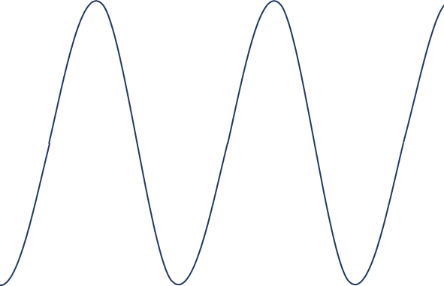


$$A$$
$$T$$
$$φ$$

Slide 24
« Terre »
Phase
Neutre

Slide 25



Im
$$\underline{I}$$
$$\underline{U_{C}}$$
$$ωt+φ$$
Re
$$ωt+φ+\frac{π}{2}$$

Slide 26




Im
$$\underline{u_{12}}(t)$$
$$\underline{v_{3}}(t)$$
$$\underline{v_{1}}(t)$$
Re
$$\underline{v_{2}}(t)$$

Slide 27




Im
$$\underline{S}$$
$$\underline{Q}$$
$$φ$$
Re
$$\underline{P}$$

Slide 28
Phase 1
230 V
400 V
400 V
Phase 2
230 V
400 V
Phase 3
230 V
Neutre

Slide 29




Couplage
étoile
Couplage
triangle
$$i_{1}(t)$$
1
$$i_{2}(t)$$
$$v_{1}(t)$$
$$u_{12}(t)$$
2
$$i_{3}(t)$$
$$v_{2}(t)$$
$$u_{23}(t)$$
$$u_{31}(t)$$
3
$$j_{1}(t)$$
$$v_{3}(t)$$
N
Tensions
simples
Tensions
composées

Slide 30
Couplage
étoile
Couplage
triangle
$$i_{1}(t)$$
$$Z$$
1
$$i_{2}(t)$$
$$v_{1}(t)$$
2
$$Z$$
$$i_{3}(t)$$
$$v_{2}(t)$$
3
$$Z$$
$$j_{1}(t)$$
$$v_{3}(t)$$
$$i_{N}=0$$
N

Slide 31















3
$$j_{31}(t)$$
$$u_{31}(t)$$
$$u_{23}(t)$$
1
$$j_{23}(t)$$
$$j_{12}(t)$$
$$u_{12}(t)$$
2
$$i_{1}(t)$$
$$Z$$
$$j_{12}(t)$$
1
$$v_{1}(t)$$
$$u_{12}(t)$$
$$i_{2}(t)$$
$$Z$$
$$j_{23}(t)$$
2
$$u_{31}(t)$$
$$u_{23}(t)$$
$$i_{3}(t)$$
$$v_{2}(t)$$
3
$$Z$$
$$j_{31}(t)$$
$$v_{3}(t)$$
N

Slide 32

Phase 1
$$v_{1}(t)$$
Phase 2
Phase 3
Neutre

Slide 33



$$i\left(t\right)$$
$$e\left(t\right)$$
$$R$$
$$u_{R}\left(t\right)$$

Slide 34


$$i\left(t\right)$$
$$e\left(t\right)$$
$$C$$
$$u_{C}\left(t\right)$$

Slide 35

$$u_{R}\left(t\right)$$
$$i\left(t\right)$$
$$R$$
$$e\left(t\right)$$
$$C$$
$$u_{C}\left(t\right)$$

Slide 36


$$\underline{U_{X}}$$
$$\underline{U_{r}}$$
$$\underline{I}$$
$$\underline{X}=jLω$$
$$r$$
$$\underline{V}$$
$$\underline{E}$$
Modèle d’un enroulement du stator (1 phase) – Induit

Slide 37

$$−\sin\left(x\right)=\cos\left(x+\frac{π}{2}\right)$$

