Slide 1
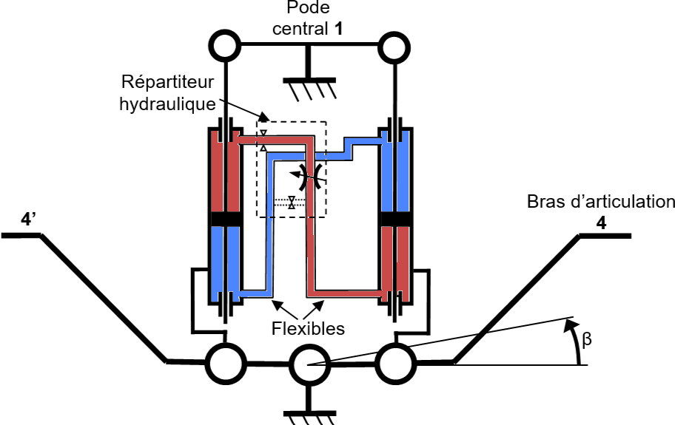

Slide 2
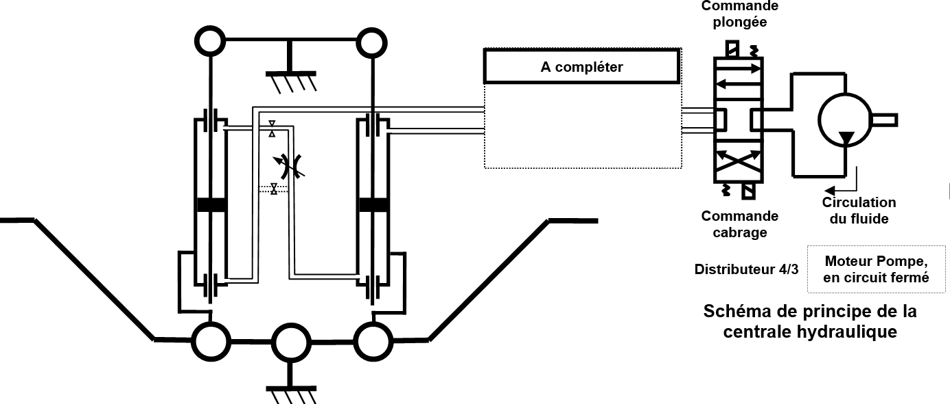

Slide 3


$$P_{1}$$
$$P_{2}$$

Slide 4
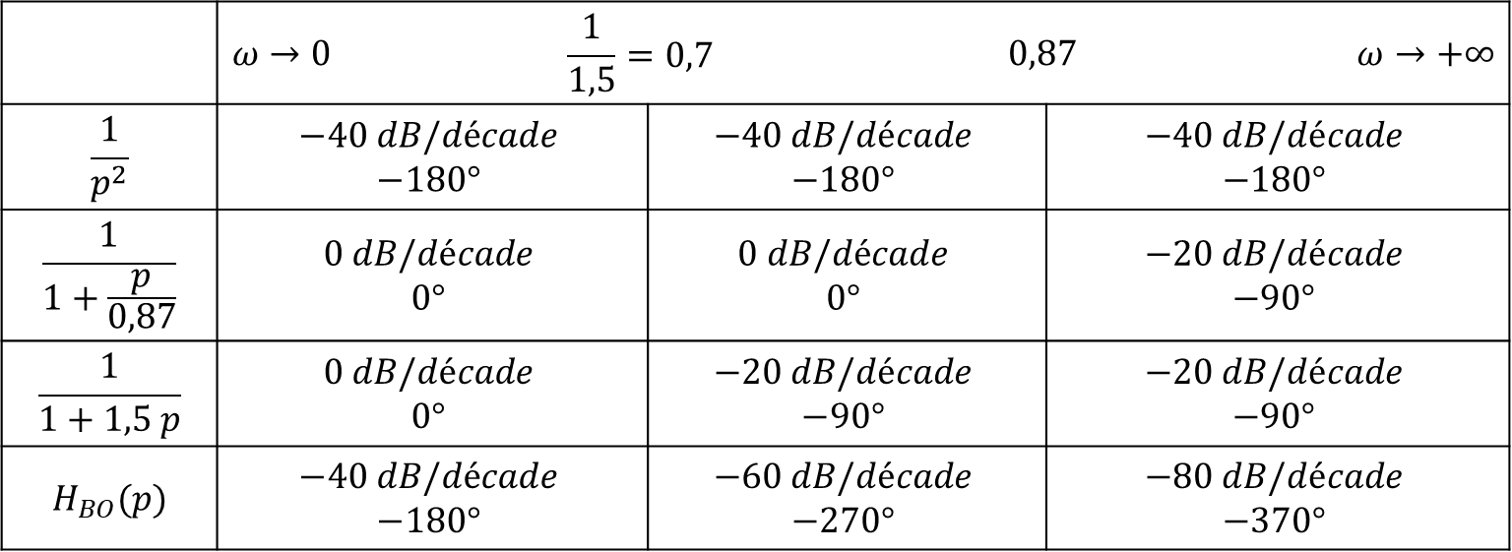
 | $$ω→0$$ | $$\frac{1}{1,5}=0,7$$ |  | $$0,87$$ |  | $$ω→+∞$$
$$\frac{1}{p^{2}}$$ | $$−40 dB/décade$$ $$−180°$$ |  | $$−40 dB/décade$$ $$−180°$$ |  | $$−40 dB/décade$$ $$−180°$$
$$\frac{1}{1+\frac{p}{0,87}}$$ | $$0 dB/décade$$ $$0°$$ |  | $$0 dB/décade$$ $$0°$$ |  | $$−20 dB/décade$$ $$−90°$$
$$\frac{1}{1+1,5 p}$$ | $$0 dB/décade$$ $$0°$$ |  | $$−20 dB/décade$$ $$−90°$$ |  | $$−20 dB/décade$$ $$−90°$$
$$H_{BO}(p)$$ | $$−40 dB/décade$$ $$−180°$$ |  | $$−60 dB/décade$$ $$−270°$$ |  | $$−80 dB/décade$$ $$−370°$$

Slide 5
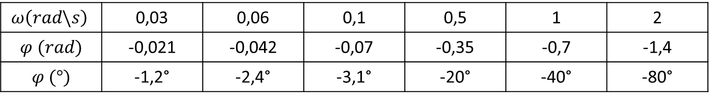
$$ω\left(rad\backslash s\right)$$ | 0,03 | 0,06 | 0,1 | 0,5 | 1 | 2
$$φ (rad)$$ | -0,021 | -0,042 | -0,07 | -0,35 | -0,7 | -1,4
$$φ (°)$$ | -1,2° | -2,4° | -3,1° | -20° | -40° | -80°

Slide 6

$$Mφ=−25°$$

