Slide 2
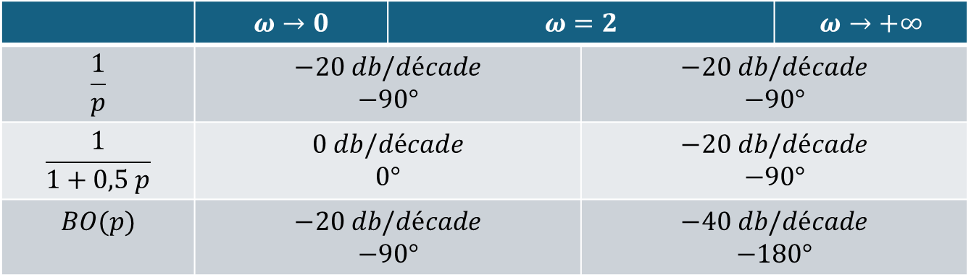
 | $$ω→0$$ | $$ω=2$$ |  | $$ω→+∞$$
$$\frac{1}{p}$$ | $$−20 db/décade$$ $$−90°$$ |  | $$−20 db/décade$$ $$−90°$$
$$\frac{1}{1+0,5 p}$$ | $$0 db/décade$$ $$0°$$ |  | $$−20 db/décade$$ $$−90°$$
$$BO(p)$$ | $$−20 db/décade$$ $$−90°$$ |  | $$−40 db/décade$$ $$−180°$$

Slide 3
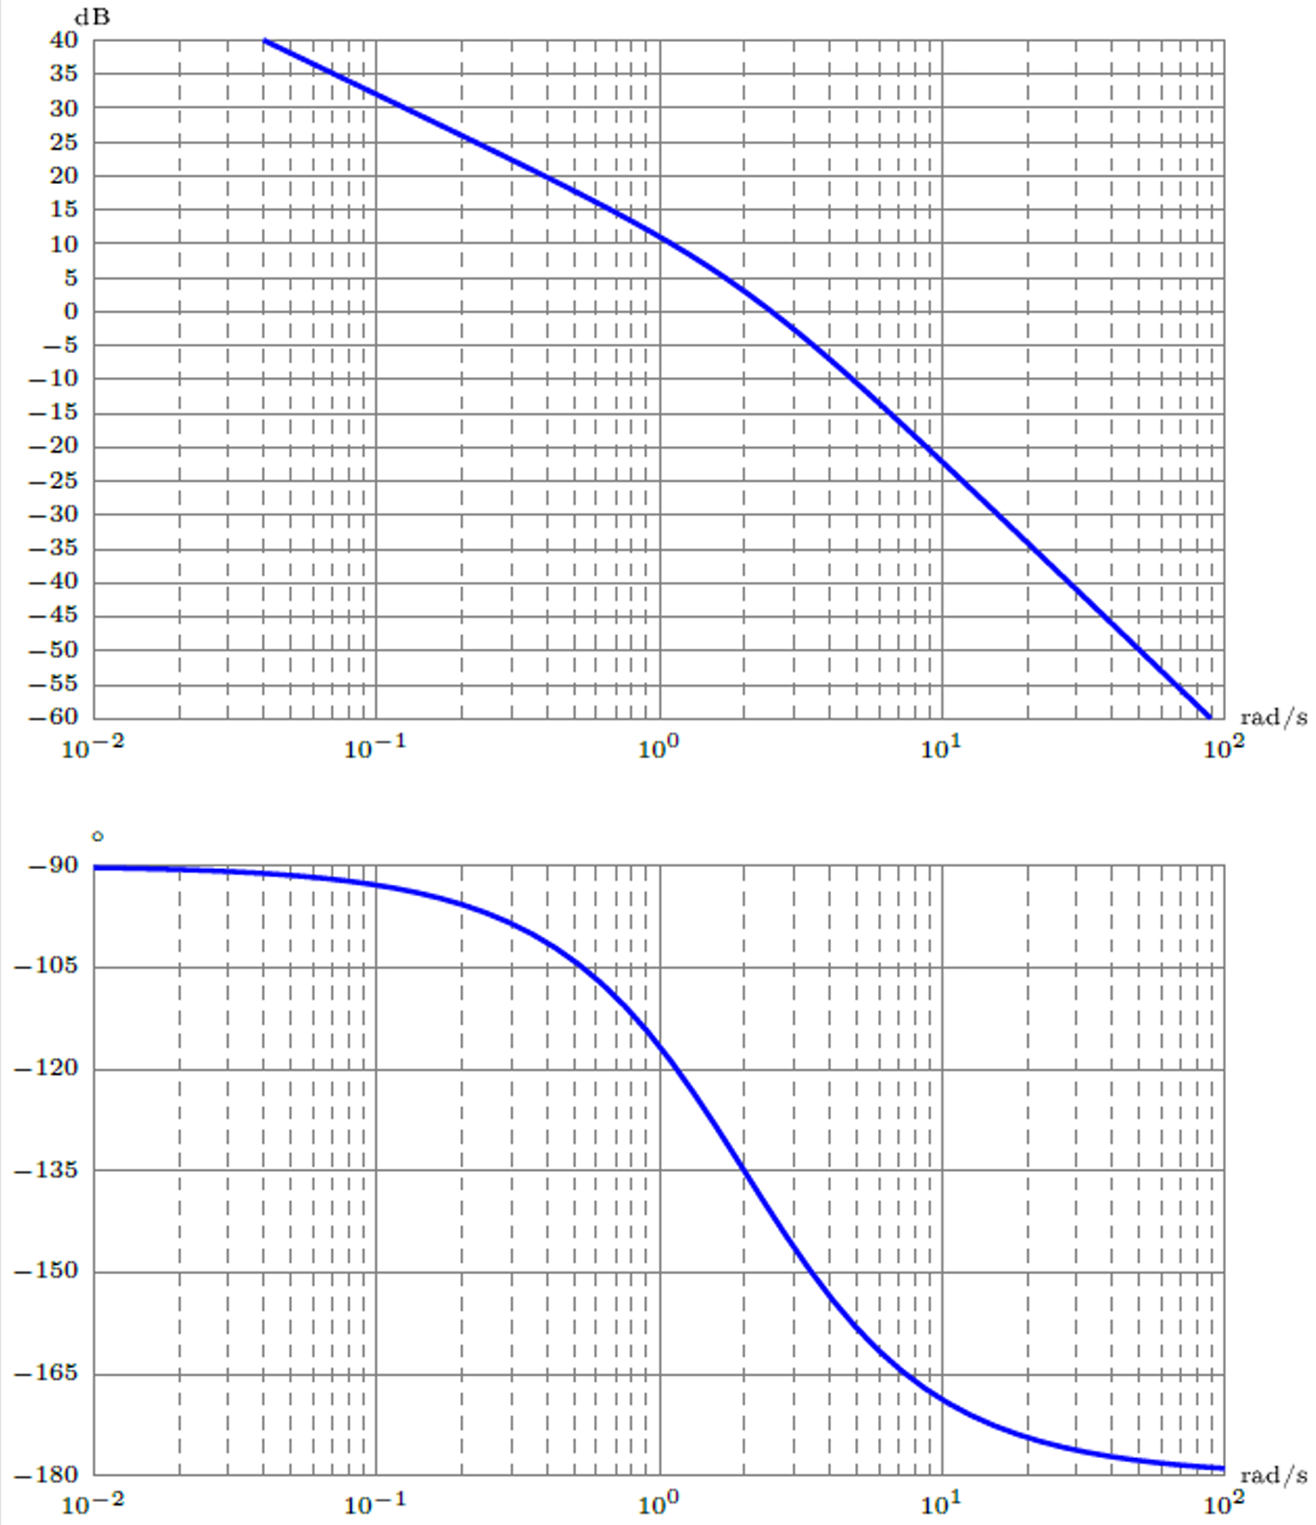




$−20$ dB/décade
$−40$ dB/décade
$−90°$
$−180°$

Slide 4
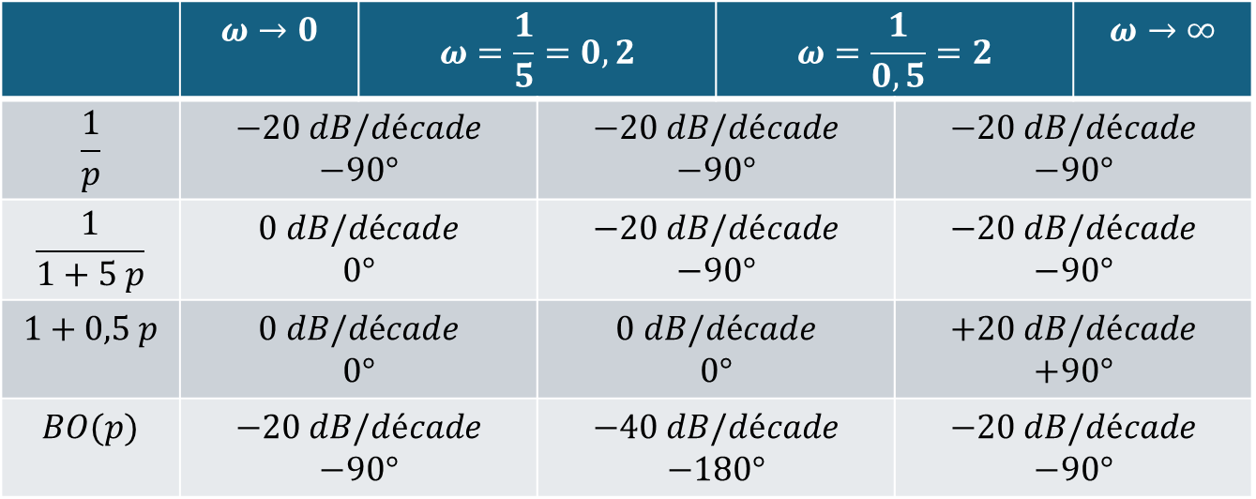
 | $$ω→0$$ | $$ω=\frac{1}{5}=0,2$$ |  | $$ω=\frac{1}{0,5}=2$$ |  | $$ω→∞$$
$$\frac{1}{p}$$ | $$−20 dB/décade$$ $$−90°$$ |  | $$−20 dB/décade$$ $$−90°$$ |  | $$−20 dB/décade$$ $$−90°$$
$$\frac{1}{1+5 p}$$ | $$0 dB/décade$$ $$0°$$ |  | $$−20 dB/décade$$ $$−90°$$ |  | $$−20 dB/décade$$ $$−90°$$
$$1+0,5 p$$ | $$0 dB/décade$$ $$0°$$ |  | $$0 dB/décade$$ $$0°$$ |  | $$+20 dB/décade$$ $$+90°$$
$$BO(p)$$ | $$−20 dB/décade$$ $$−90°$$ |  | $$−40 dB/décade$$ $$−180°$$ |  | $$−20 dB/décade$$ $$−90°$$

Slide 5
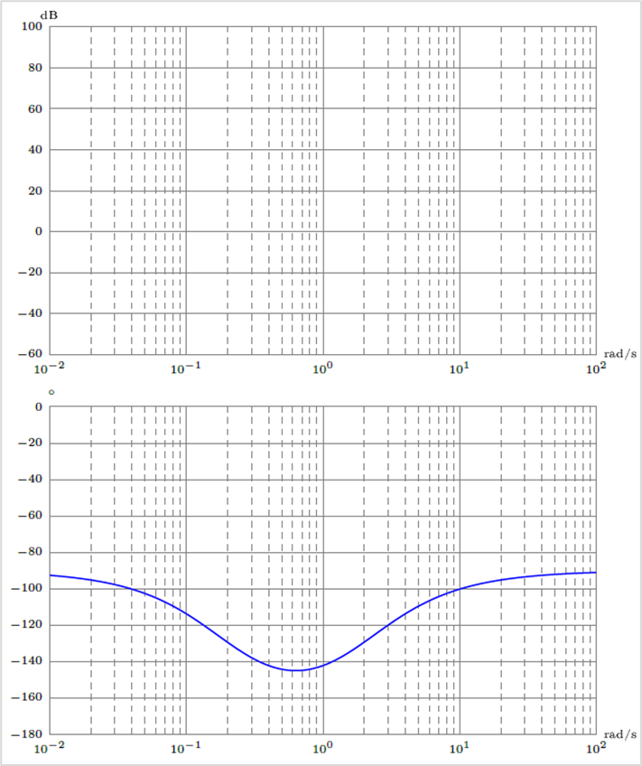

$M_{φ}=30°$

