Slide 1









0
RSG $\left(I_{1g},\vec{Z_{L}}\right)$
$$Σ$$
2_{g}
1_{g}
3_{g}
Pivot $\left(W′,\vec{y_{2}}\right)$
$$\vec{C_{m}}$$
Pivot $\left(W,\vec{y_{3}}\right)$
Pivot $\left(X,\vec{x_{L}}\right)$
Pivot $\left(X,\vec{x_{L}}\right)$
Pode 2
4’
Pode 1
4
Pode 3
Roulis
Tangage
Tangage
Roulis
$$−\vec{C_{m}}$$
2_{d}
1_{d}
3_{d}
RSG $\left(I_{1d},\vec{Z_{L}}\right)$
0

Slide 2







$\vec{Z_{L}}$
$\dot{φ}$
$\vec{X_{L}}$
$\dot{θ}$
$$V=−e\dot{φ}=R\dot{θ}$$
$\vec{X_{0}}$
$\vec{Y_{0}}$

Slide 3


0
CP $\left(I_{2},\vec{Z_{L}}\right)$
RSG $\left(I_{1},\vec{Z_{L}}\right)$
$$Σ$$
2_{g}
1_{g}
3_{g}
Pivot $\left(W′,\vec{y_{2}}\right)$
$$\vec{C_{m}}$$
Pivot $\left(W,\vec{y_{3}}\right)$
Pivot $\left(X,\vec{x_{L}}\right)$
Pivot $\left(X,\vec{x_{L}}\right)$
Pode 2
4’
Pode 1
4
Pode 3
Roulis
Tangage
Tangage
Roulis

Slide 4
0
RSG $\left(I_{1g},\vec{Z_{L}}\right)$
2_{g}
1_{g}
3_{g}
Pivot $\left(W′,\vec{y_{2}}\right)$
$$\vec{C_{m}}$$
Pivot $\left(W,\vec{y_{3}}\right)$
Pivot $\left(X,\vec{x_{L}}\right)$
Pivot $\left(X,\vec{x_{L}}\right)$
Pode 2
4’
Pode 1
4
Pode 3
Roulis
Tangage
Tangage
Roulis
$$−\vec{C_{m}}$$
2_{d}
1_{d}
3_{d}
RSG $\left(I_{1d},\vec{Z_{L}}\right)$
0

Slide 5





0
2_{g}
1_{g}
3_{g}
$$\vec{C_{m}}$$
Pivot $\left(W′,\vec{y_{2}}\right)$
$$\vec{C_{m}}$$
Pivot $\left(W,\vec{y_{3}}\right)$
Pivot $\left(X,\vec{x_{L}}\right)$
Pivot $\left(X,\vec{x_{L}}\right)$
$$\vec{C_{m}}$$
Pode 2
4’
Pode 1
4
Pode 3
Roulis
Tangage
Tangage
Roulis
$$\vec{C_{m}}$$
$$\vec{C_{m}}$$
$$\vec{C_{m}}$$
2_{d}
1_{d}
3_{d}
0

Slide 6


0
2_{g}
1_{g}
3_{g}
Pivot $\left(X,\vec{x_{L}}\right)$
Pivot $\left(X,\vec{x_{L}}\right)$
Pode 2
Pode 1
Pode 3
2_{d}
1_{d}
3_{d}
0

Slide 7
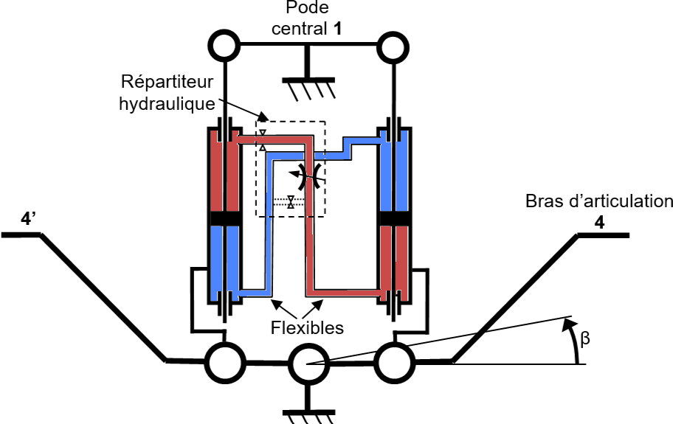

Slide 8
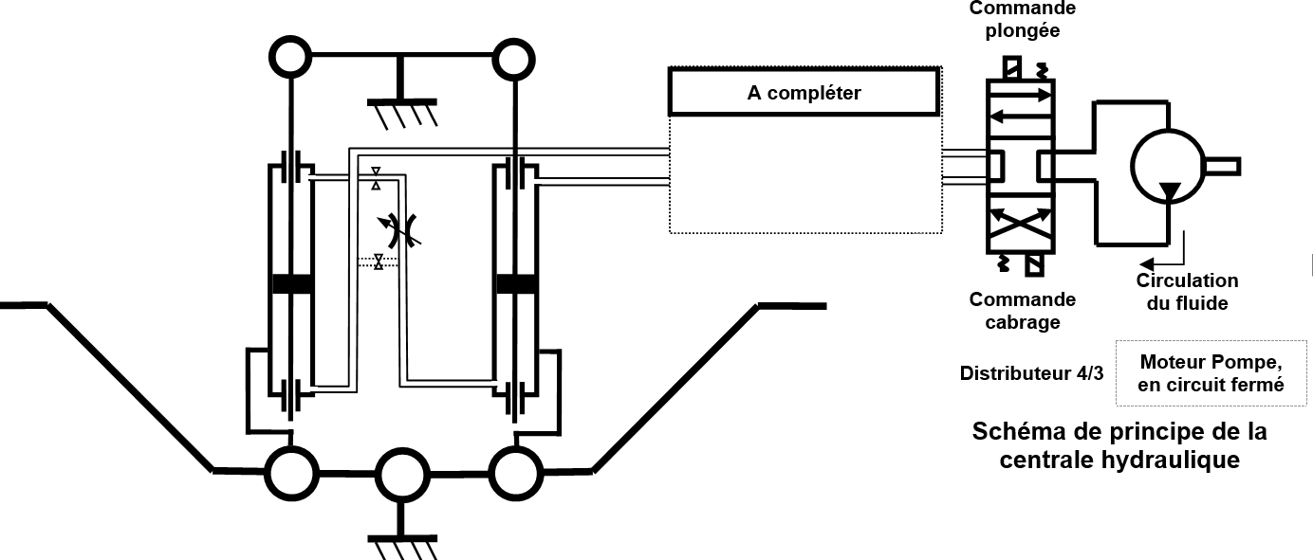

Slide 9


$$P_{1}$$
$$P_{2}$$

Slide 10
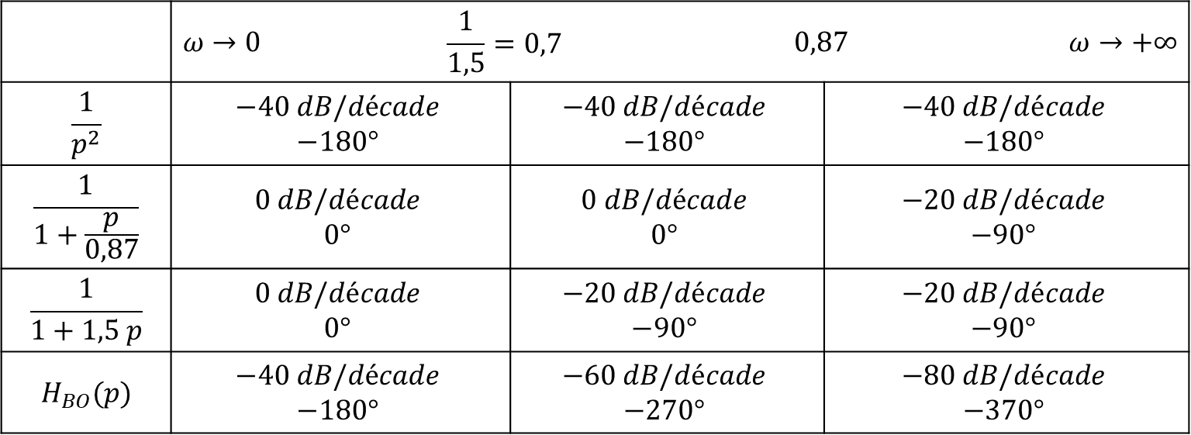
 | $$ω→0$$ | $$\frac{1}{1,5}=0,7$$ |  | $$0,87$$ |  | $$ω→+∞$$
$$\frac{1}{p^{2}}$$ | $$−40 dB/décade$$ $$−180°$$ |  | $$−40 dB/décade$$ $$−180°$$ |  | $$−40 dB/décade$$ $$−180°$$
$$\frac{1}{1+\frac{p}{0,87}}$$ | $$0 dB/décade$$ $$0°$$ |  | $$0 dB/décade$$ $$0°$$ |  | $$−20 dB/décade$$ $$−90°$$
$$\frac{1}{1+1,5 p}$$ | $$0 dB/décade$$ $$0°$$ |  | $$−20 dB/décade$$ $$−90°$$ |  | $$−20 dB/décade$$ $$−90°$$
$$H_{BO}(p)$$ | $$−40 dB/décade$$ $$−180°$$ |  | $$−60 dB/décade$$ $$−270°$$ |  | $$−80 dB/décade$$ $$−370°$$

Slide 11
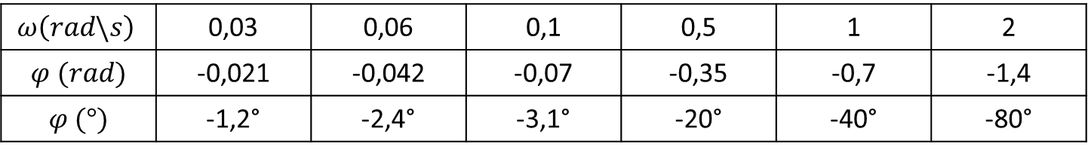
$$ω\left(rad\backslash s\right)$$ | 0,03 | 0,06 | 0,1 | 0,5 | 1 | 2
$$φ (rad)$$ | -0,021 | -0,042 | -0,07 | -0,35 | -0,7 | -1,4
$$φ (°)$$ | -1,2° | -2,4° | -3,1° | -20° | -40° | -80°

Slide 12

$$Mφ=−25°$$

Slide 13



$$10dB$$
$$65°$$
$$45°$$

