Slide 1



$$Ω_{m}(p)$$
$$θ_{c}(p)$$
$$θ_{m}(p)$$
+
-

Slide 2
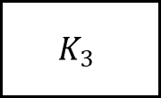
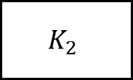
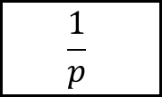
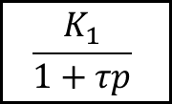
$$Ω_{m}(p)$$
$$θ_{c}(p)$$
$$K_{2}$$
$$K_{3}$$
$$\frac{K_{1}}{1+τp}$$
$$\frac{1}{p}$$
$$θ_{m}(p)$$
+
-

Slide 3
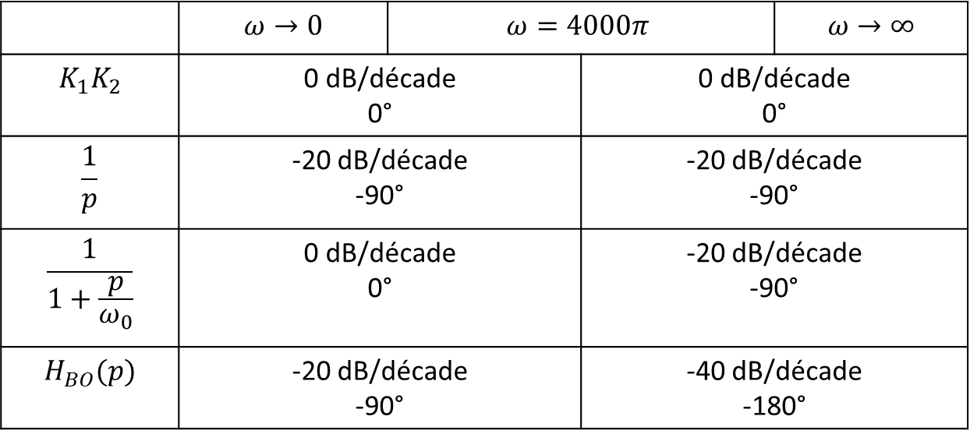
 | $$ω→0$$ | $$ω=4000π$$ |  | $$ω→∞$$
$$K_{1}K_{2}$$ | 0 dB/décade 0° |  | 0 dB/décade 0°
$$\frac{1}{p}$$ | -20 dB/décade -90° |  | -20 dB/décade -90°
$$\frac{1}{1+\frac{p}{ω_{0}}}$$ | 0 dB/décade 0° |  | -20 dB/décade -90°
$$H_{BO}(p)$$ | -20 dB/décade -90° |  | -40 dB/décade -180°

