Slide 1








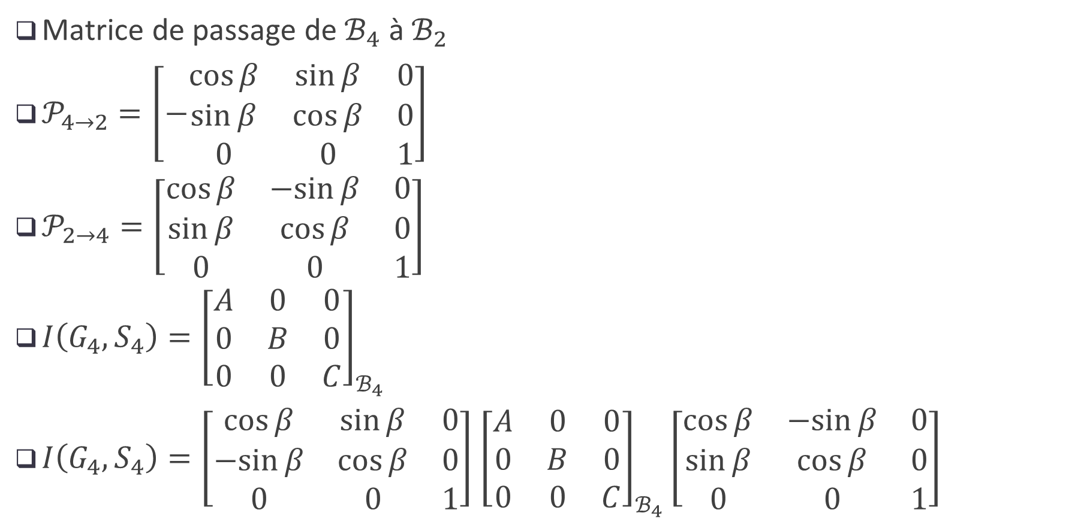











$$\vec{Z_{1}}$$
$$E_{4}$$
$$C_{4}$$
$$\vec{Z}$$
$$\vec{X_{2}}$$
Matrice de passage de $ℬ_{4}$ à $ℬ_{2}$
$𝒫_{4→2}=\left[−\begin{matrix}\cos{β} & \sin{β} & 0 \\ \sin{β} & \cos{β} & 0 \\ 0 & 0 & 1\end{matrix}\right]$
$𝒫_{2→4}=\left[\begin{matrix}\cos{β} & −sin{β} & 0 \\ \sin{β} & \cos{β} & 0 \\ 0 & 0 & 1\end{matrix}\right]$
$I\left(G_{4},S_{4}\right)={\left[\begin{matrix}A & 0 & 0 \\ 0 & B & 0 \\ 0 & 0 & C\end{matrix}\right]}_{ℬ_{4}}$
$I\left(G_{4},S_{4}\right)=\left[\begin{matrix}\cos{β} & \sin{β} & 0 \\ −sin{β} & \cos{β} & 0 \\ 0 & 0 & 1\end{matrix}\right]$ ${\left[\begin{matrix}A & 0 & 0 \\ 0 & B & 0 \\ 0 & 0 & C\end{matrix}\right]}_{ℬ_{4}}\left[\begin{matrix}\cos{β} & −sin{β} & 0 \\ \sin{β} & \cos{β} & 0 \\ 0 & 0 & 1\end{matrix}\right]$
$$\vec{Y}$$
$$G_{4}$$
$$\vec{Y_{1}}$$
$$\vec{X_{1}}$$
$$S_{0}$$
$$E_{2}$$
$$C_{2}$$
$$S_{1}$$
$$\vec{X}=\vec{X_{1}}$$
$$G_{2}$$
$$\vec{Y_{2}}$$
$$\vec{Y_{1}}$$
$$β_{2}$$
$$\vec{X_{2}}$$
$$\vec{X_{1}}$$

Slide 2
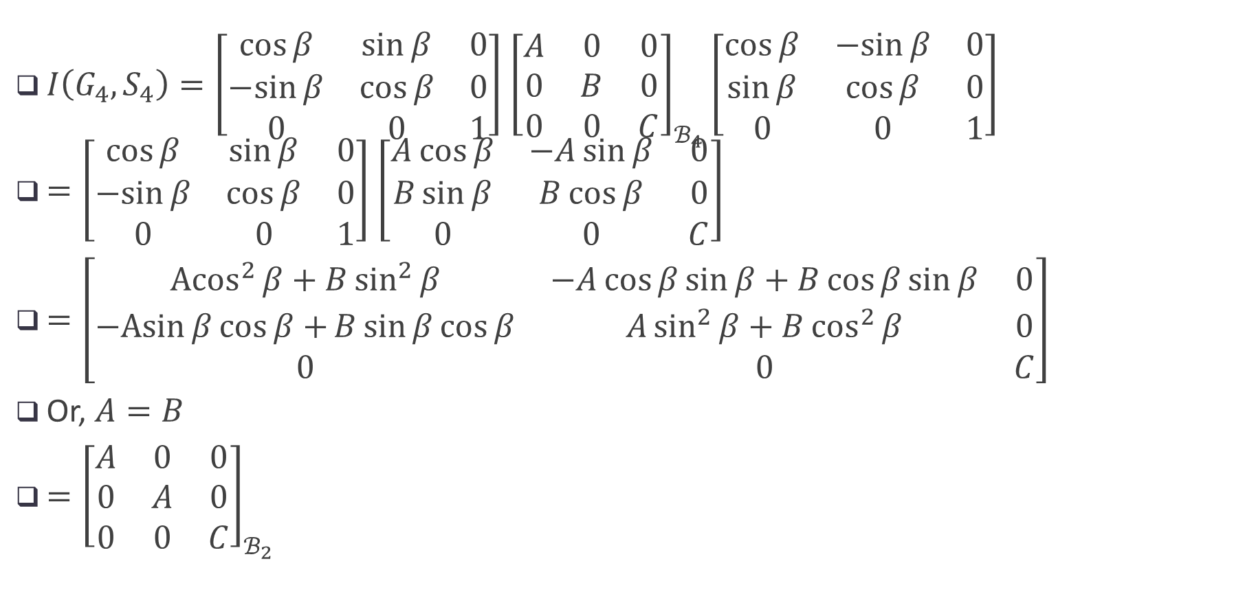
$I\left(G_{4},S_{4}\right)=\left[\begin{matrix}\cos{β} & \sin{β} & 0 \\ −sin{β} & \cos{β} & 0 \\ 0 & 0 & 1\end{matrix}\right]$ ${\left[\begin{matrix}A & 0 & 0 \\ 0 & B & 0 \\ 0 & 0 & C\end{matrix}\right]}_{ℬ_{4}}\left[\begin{matrix}\cos{β} & −sin{β} & 0 \\ \sin{β} & \cos{β} & 0 \\ 0 & 0 & 1\end{matrix}\right]$
$=\left[\begin{matrix}\cos{β} & \sin{β} & 0 \\ −sin{β} & \cos{β} & 0 \\ 0 & 0 & 1\end{matrix}\right]$ ${\left[\begin{matrix}A\cos{β} & −A\sin{β} & 0 \\ B\sin{β} & B\cos{β} & 0 \\ 0 & 0 & C\end{matrix}\right]}_{}$
$=\left[\begin{matrix}{Acos}^{2}{β}+B\sin^{2}{β} & −A\cos{β}\sin{β}+B\cos{β\sin{β}} & 0 \\ −Asin{β}\cos{β+}B\sin{β}\cos{β} & A\sin^{2}{β}+B\cos^{2}{β} & 0 \\ 0 & 0 & C\end{matrix}\right]$
Or, $A=B$
$={\left[\begin{matrix}A & 0 & 0 \\ 0 & A & 0 \\ 0 & 0 & C\end{matrix}\right]}_{ℬ_{2}}$
$$\vec{Y_{2}}$$
$$\vec{Y_{1}}$$
$$β_{2}$$
$$\vec{X_{2}}$$
$$\vec{X_{1}}$$

