Slide 1
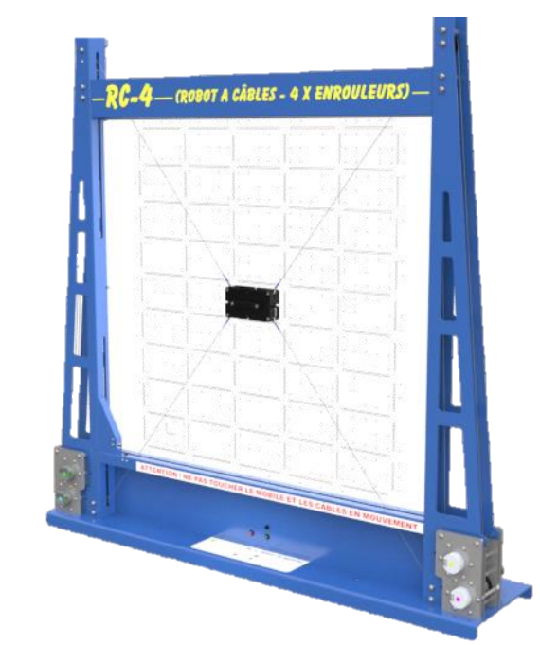
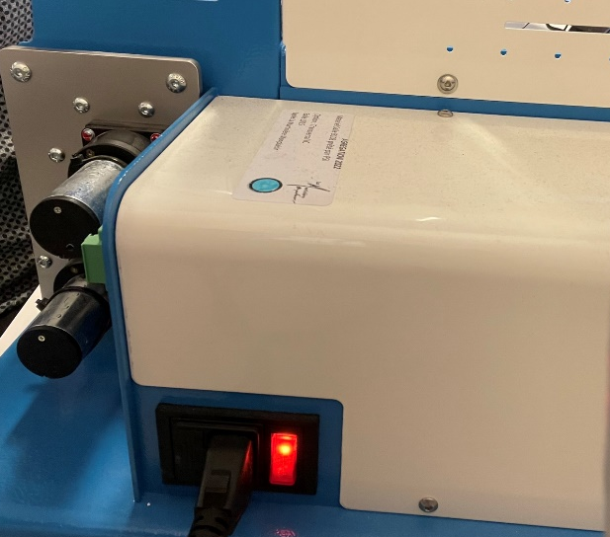

Slide 2
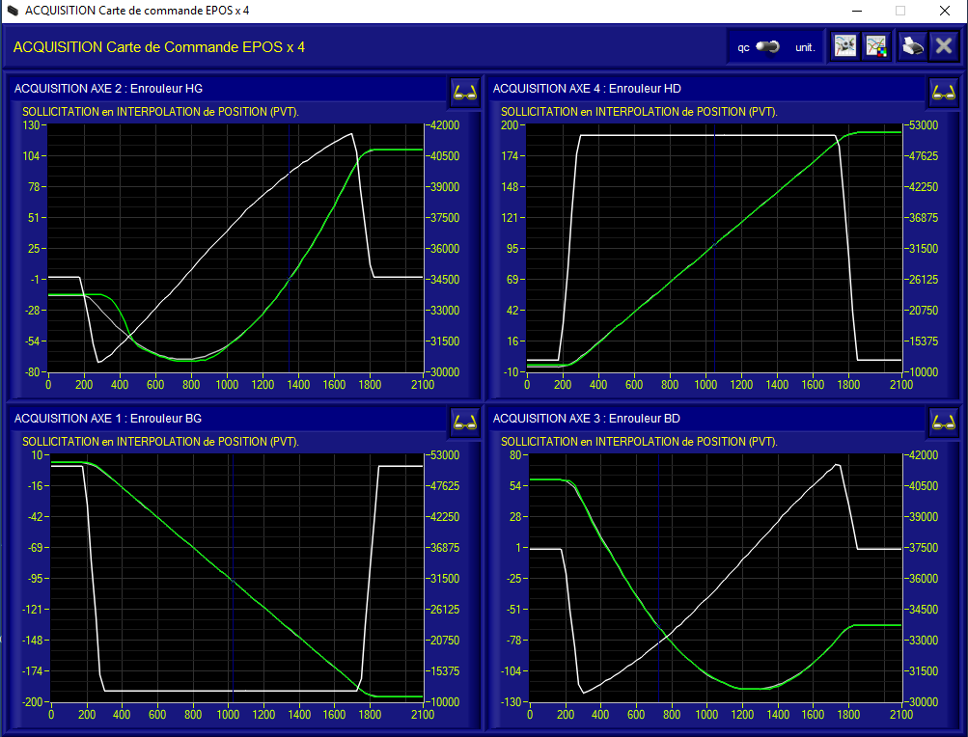
HG
HD
BG
BD

Slide 3
HG

Slide 4
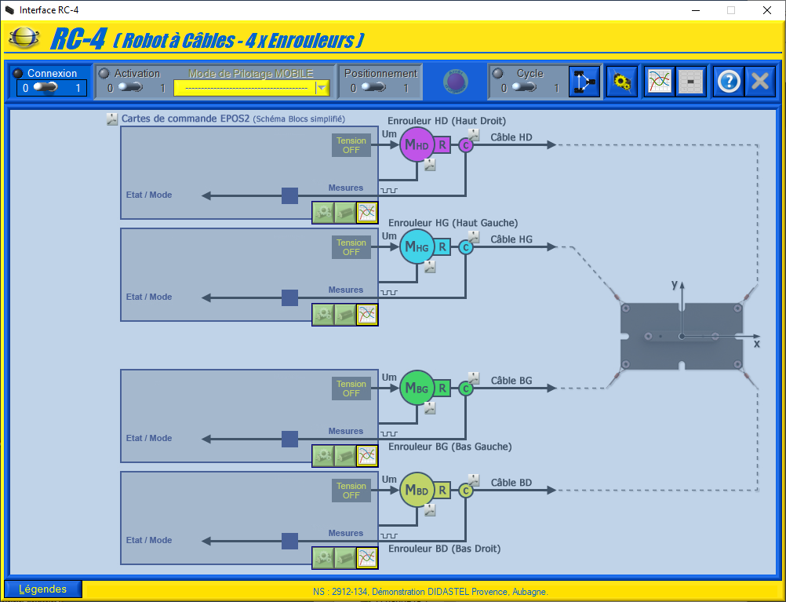
1
2

Slide 5
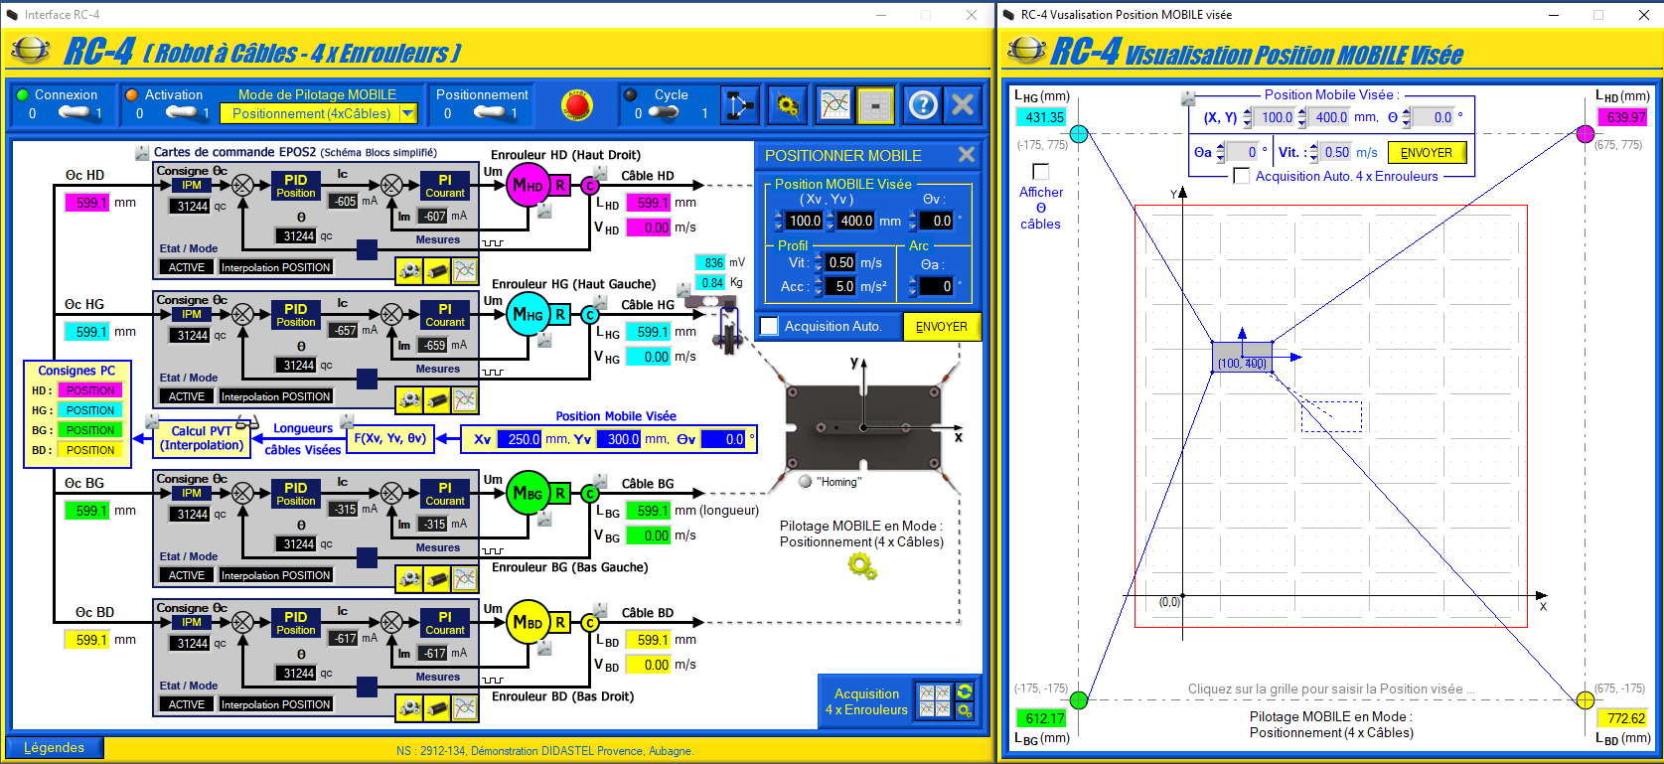
4
5
6
7

Slide 7








$$C_{HD}$$
$$B_{HD}$$
$$\vec{y}$$
$$\vec{u_{HD}}$$
$$A_{HD}$$
$$M$$
$$O$$
$$\vec{x}$$

Slide 8












$$\vec{y_{m}}$$
$$\vec{y}$$
$$\vec{v_{HD}}$$
$$\vec{y}$$
$$\vec{x_{M}}$$
$$\vec{u_{HD}}$$
$$θ$$
$$\vec{x}$$
$$φ_{HD}$$
$$\vec{x}$$
$$\vec{z}$$
$$\vec{z}$$

Slide 9
Modèle inverse

Slide 10
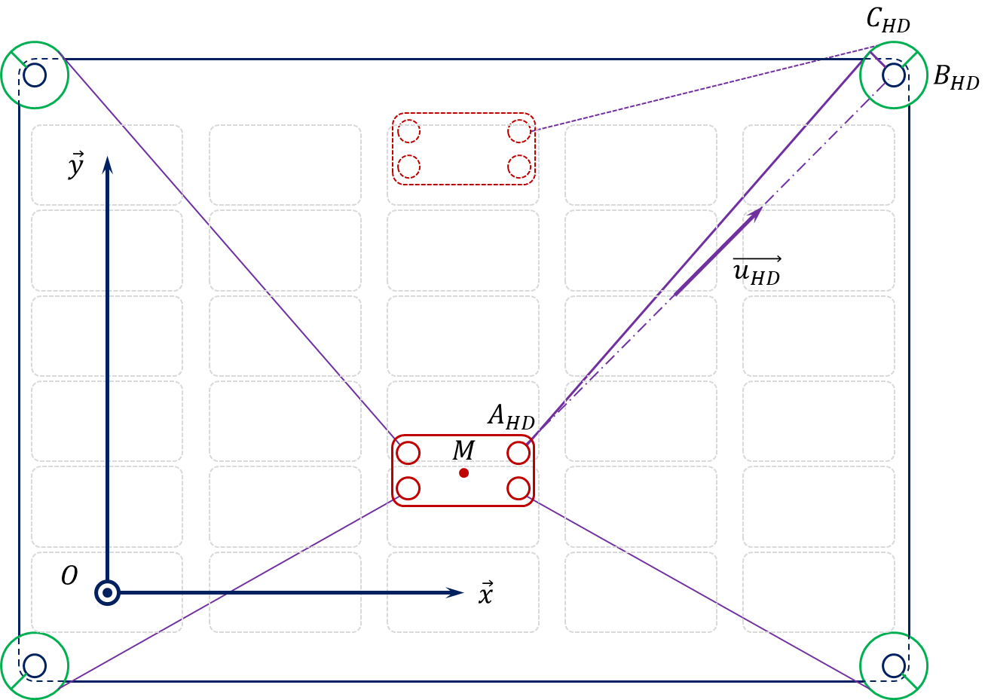
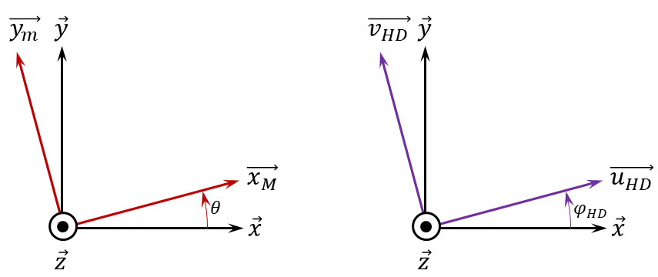
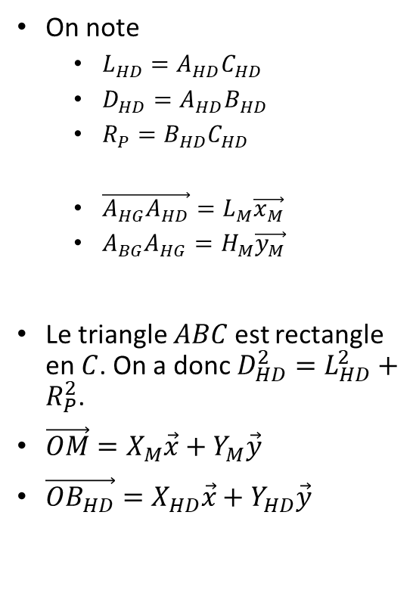
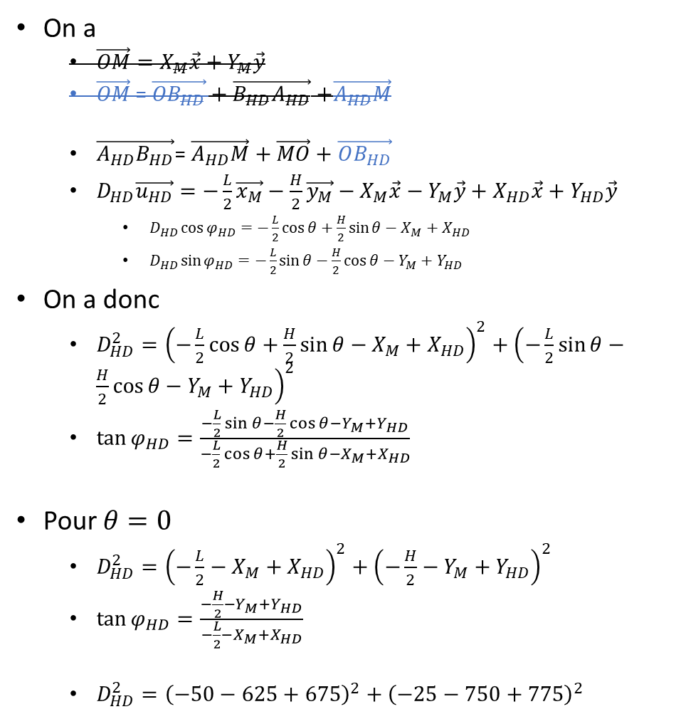
On note
$L_{HD}=A_{HD}C_{HD}$
$D_{HD}=A_{HD}B_{HD}$
$R_{P}=B_{HD}C_{HD}$
$\vec{A_{HG}A_{HD}}=L_{M}\vec{x_{M}}$
$A_{BG}A_{HG}=H_{M}\vec{y_{M}}$
Le triangle $ABC$ est rectangle en $C$. On a donc $D_{HD}^{2}=L_{HD}^{2}+R_{P}^{2}$.
$\vec{OM}=X_{M}\vec{x}+Y_{M}\vec{y}$
$\vec{OB_{HD}}=X_{HD}\vec{x}+Y_{HD}\vec{y}$
On a
$\vec{OM}$ = $\vec{OB_{HD}}+\vec{{B_{HD}A}_{HD}}$ $+\vec{A_{HD}M}$
$\vec{{A_{HD}B}_{HD}}$= $\vec{A_{HD}M}+\vec{MO}+\vec{OB_{HD}}$
$D_{HD}\vec{u_{HD}}=−\frac{L}{2}\vec{x_{M}}−\frac{H}{2}\vec{y_{M}}−X_{M}\vec{x}−Y_{M}\vec{y}+X_{HD}\vec{x}+Y_{HD}\vec{y}$
$D_{HD}\cos{φ_{HD}}=−\frac{L}{2}\cos{θ}+\frac{H}{2}\sin{θ}−X_{M}+X_{HD}$
$D_{HD}\sin{φ_{HD}}=−\frac{L}{2}\sin{θ}−\frac{H}{2}\cos{θ}−Y_{M}+Y_{HD}$
On a donc
$D_{HD}^{2}={\left(−\frac{L}{2}\cos{θ}+\frac{H}{2}\sin{θ}−X_{M}+X_{HD}\right)}^{2}+{\left(−\frac{L}{2}\sin{θ}−\frac{H}{2}\cos{θ}−Y_{M}+Y_{HD}\right)}^{2}$
$\tan{φ_{HD}}=\frac{−\frac{L}{2}\sin{θ}−\frac{H}{2}\cos{θ}−Y_{M}+Y_{HD}}{−\frac{L}{2}\cos{θ}+\frac{H}{2}\sin{θ}−X_{M}+X_{HD}}$
Pour $θ=0$
$D_{HD}^{2}={\left(−\frac{L}{2}−X_{M}+X_{HD}\right)}^{2}+{\left(−\frac{H}{2}−Y_{M}+Y_{HD}\right)}^{2}$
$\tan{φ_{HD}}=\frac{−\frac{H}{2}−Y_{M}+Y_{HD}}{−\frac{L}{2}−X_{M}+X_{HD}}$
$D_{HD}^{2}={\left(−50−625+675\right)}^{2}+{\left(−25−750+775\right)}^{2}$

Slide 11
Modèle direct

Slide 12
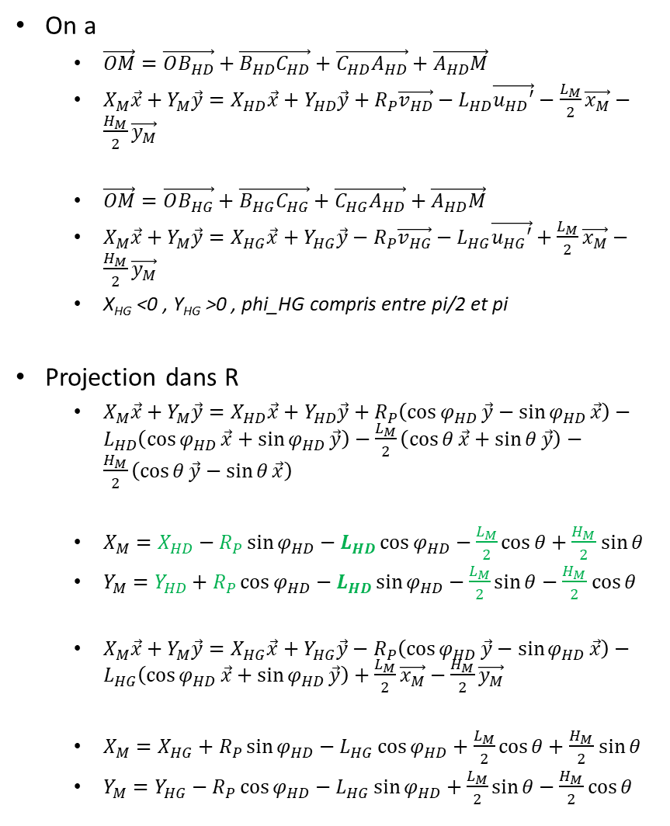
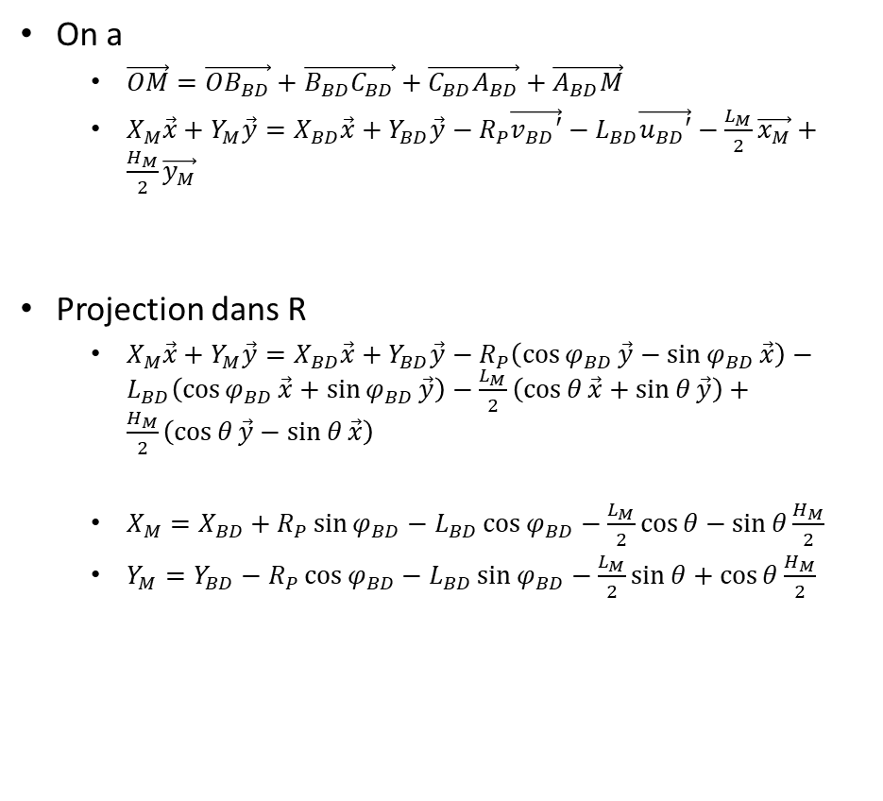
On a
$\vec{OM}=\vec{OB_{HD}}+\vec{B_{HD}C_{HD}}+\vec{C_{HD}A_{HD}}+\vec{A_{HD}M}$
$X_{M}\vec{x}+Y_{M}\vec{y}=X_{HD}\vec{x}+Y_{HD}\vec{y}+R_{P}\vec{v_{HD}}−L_{HD}\vec{u_{HD}′}−\frac{L_{M}}{2}\vec{x_{M}}−\frac{H_{M}}{2}\vec{y_{M}}$
$\vec{OM}=\vec{OB_{HG}}+\vec{B_{HG}C_{HG}}+\vec{C_{HG}A_{HD}}+\vec{A_{HD}M}$
$X_{M}\vec{x}+Y_{M}\vec{y}=X_{HG}\vec{x}+Y_{HG}\vec{y}−R_{P}\vec{v_{HG}}−L_{HG}\vec{u_{HG}′}+\frac{L_{M}}{2}\vec{x_{M}}−\frac{H_{M}}{2}\vec{y_{M}}$
X_{HG} <0 , Y_{HG} >0 , phi_HG compris entre pi/2 et pi
Projection dans R
$X_{M}\vec{x}+Y_{M}\vec{y}=X_{HD}\vec{x}+Y_{HD}\vec{y}+R_{P}\left(\cos{φ_{HD}}\vec{y}−\sin{φ_{HD}}\vec{x}\right)−L_{HD}\left(\cos{φ_{HD}}\vec{x}+\sin{φ_{HD}}\vec{y}\right)−\frac{L_{M}}{2}\left(\cos{θ}\vec{x}+\sin{θ}\vec{y}\right)−\frac{H_{M}}{2}\left(\cos{θ}\vec{y}−\sin{θ}\vec{x}\right)$
$X_{M}=X_{HD}−R_{P}\sin{φ_{HD}}−L_{HD}\cos{φ_{HD}}−\frac{L_{M}}{2}\cos{θ}+\frac{H_{M}}{2}$ $\sin{θ}$
$Y_{M}=Y_{HD}+R_{P}\cos{φ_{HD}}−L_{HD}\sin{φ_{HD}}−\frac{L_{M}}{2}\sin{θ}−\frac{H_{M}}{2}$ $\cos{θ}$
$X_{M}\vec{x}+Y_{M}\vec{y}=X_{HG}\vec{x}+Y_{HG}\vec{y}−R_{P}\left(\cos{φ_{HD}}\vec{y}−\sin{φ_{HD}}\vec{x}\right)−L_{HG}\left(\cos{φ_{HD}}\vec{x}+\sin{φ_{HD}}\vec{y}\right)+\frac{L_{M}}{2}\vec{x_{M}}−\frac{H_{M}}{2}\vec{y_{M}}$
$X_{M}=X_{HG}+R_{P}\sin{φ_{HD}}−L_{HG}\cos{φ_{HD}}+\frac{L_{M}}{2}\cos{θ}+\frac{H_{M}}{2}$ $\sin{θ}$
$Y_{M}=Y_{HG}−R_{P}\cos{φ_{HD}}−L_{HG}\sin{φ_{HD}}+\frac{L_{M}}{2}\sin{θ}−\frac{H_{M}}{2}\cos{θ}$
On a
$\vec{OM}=\vec{OB_{BD}}+\vec{B_{BD}C_{BD}}+\vec{C_{BD}A_{BD}}+\vec{A_{BD}M}$
$X_{M}\vec{x}+Y_{M}\vec{y}=X_{BD}\vec{x}+Y_{BD}\vec{y}−R_{P}\vec{v_{BD}′}−L_{BD}\vec{u_{BD}′}−\frac{L_{M}}{2}\vec{x_{M}}+\frac{H_{M}}{2}\vec{y_{M}}$
Projection dans R
$X_{M}\vec{x}+Y_{M}\vec{y}=X_{BD}\vec{x}+Y_{BD}\vec{y}−R_{P}\left(\cos{φ_{BD}}\vec{y}−\sin{φ_{BD}}\vec{x}\right)−L_{BD}\left(\cos{φ_{BD}}\vec{x}+\sin{φ_{BD}}\vec{y}\right)−\frac{L_{M}}{2}\left(\cos{θ}\vec{x}+\sin{θ}\vec{y}\right)+\frac{H_{M}}{2}\left(\cos{θ}\vec{y}−\sin{θ}\vec{x}\right)$
$X_{M}=X_{BD}+R_{P}\sin{φ_{BD}}−L_{BD}\cos{φ_{BD}}−\frac{L_{M}}{2}\cos{θ}−\sin{θ}\frac{H_{M}}{2}$
$Y_{M}=Y_{BD}−R_{P}\cos{φ_{BD}}−L_{BD}\sin{φ_{BD}}−\frac{L_{M}}{2}\sin{θ}+\cos{θ}\frac{H_{M}}{2}$

Slide 13



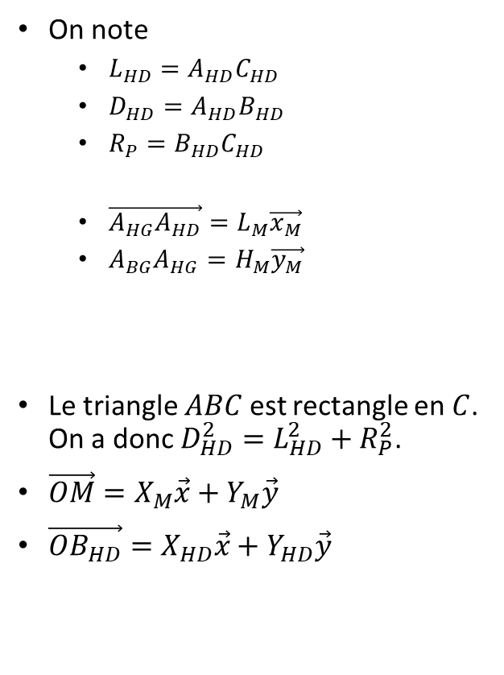










$$\vec{y}$$
$$φ$$
$$\vec{u_{HD}′}$$
$$\vec{v_{HD}′}$$
$$C_{HD}$$
$$π−φ$$
$$\vec{u_{HD}′}$$
$$\vec{x}$$
$$O$$
$$B_{HD}$$
On note
$L_{HD}=A_{HD}C_{HD}$
$D_{HD}=A_{HD}B_{HD}$
$R_{P}=B_{HD}C_{HD}$
$\vec{A_{HG}A_{HD}}=L_{M}\vec{x_{M}}$
$A_{BG}A_{HG}=H_{M}\vec{y_{M}}$
Le triangle $ABC$ est rectangle en $C$. On a donc $D_{HD}^{2}=L_{HD}^{2}+R_{P}^{2}$.
$\vec{OM}=X_{M}\vec{x}+Y_{M}\vec{y}$
$\vec{OB_{HD}}=X_{HD}\vec{x}+Y_{HD}\vec{y}$
$$\vec{v_{HD}′}$$
$$\vec{y}$$
$$A_{HD}$$
$$M$$
$$\vec{u_{HD}′}$$
$$O$$
$$\vec{v_{HD}′}$$
$$\vec{x}$$
$$\vec{u_{HD}′}$$
$$\vec{v_{HD}′}$$

Slide 14


$$\vec{y}$$
$$φ$$
$$\vec{u_{HG}}$$
$$π−φ$$
$$C_{HD}$$
$$π−φ$$
$$\vec{x}$$
$$O$$
$$B_{HD}$$
On note
$L_{HD}=A_{HD}C_{HD}$
$D_{HD}=A_{HD}B_{HD}$
$R_{P}=B_{HD}C_{HD}$
$\vec{A_{HG}A_{HD}}=L_{M}\vec{x_{M}}$
$A_{BG}A_{HG}=H_{M}\vec{y_{M}}$
Le triangle $ABC$ est rectangle en $C$. On a donc $D_{HD}^{2}=L_{HD}^{2}+R_{P}^{2}$.
$\vec{OM}=X_{M}\vec{x}+Y_{M}\vec{y}$
$\vec{OB_{HD}}=X_{HD}\vec{x}+Y_{HD}\vec{y}$
$$\vec{y}$$
$$\vec{u_{HD}}$$
$$A_{HD}$$
$$M$$
$$O$$
$$\vec{x}$$

Slide 15
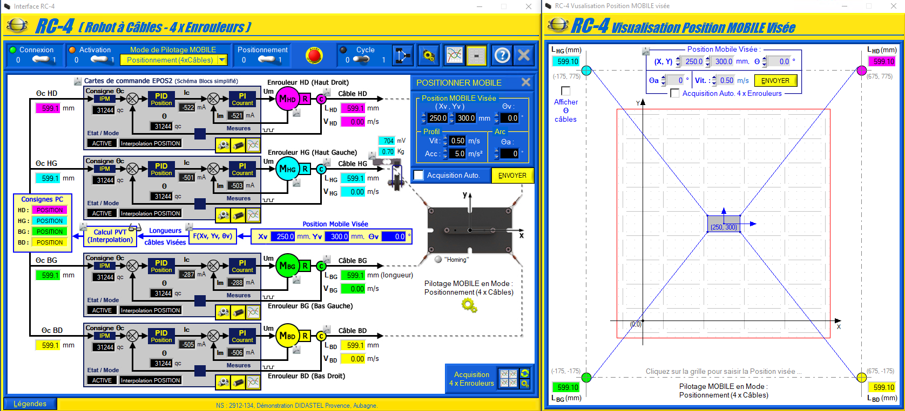

Slide 16
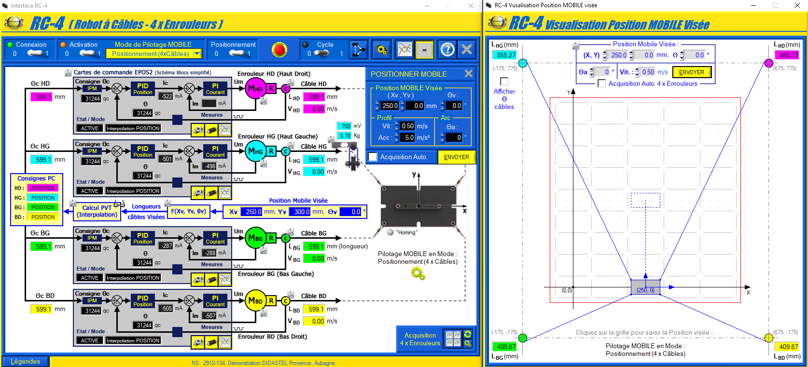
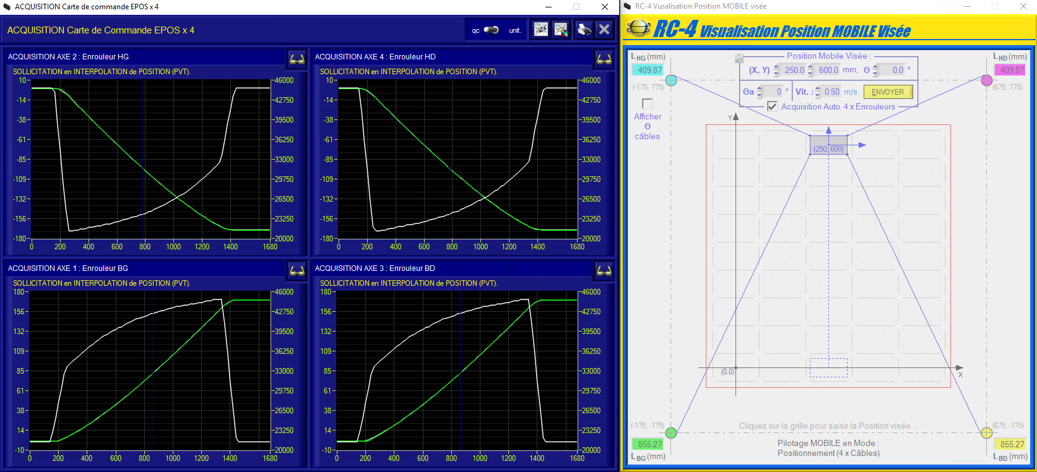
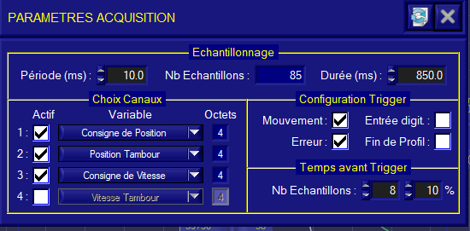

Slide 18
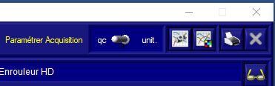
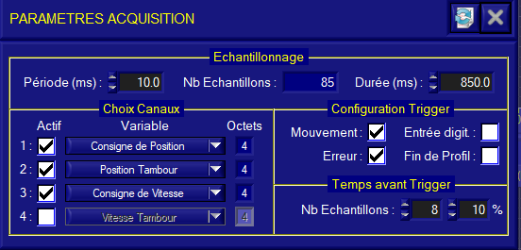
1
3
2

