Slide 1













$$R$$
$$i(t)$$
$$c_{m}\left(t\right),ω_{m}(t)$$
$$u(t)$$
$$e(t)$$
$$M$$
$$J$$
$$L$$
$$E(p)$$
$$S(p)$$
$$F(p)$$
$$G(p)$$
$$K(p)$$

Slide 2
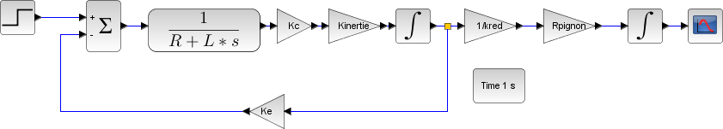
Moteur à courant continu et inertie de la masse ramenée sur l’arbre moteur

Slide 3









$$E(p)$$
$$S\left(p\right)=H\left(p\right)⋅E(p)$$
$$E(p)$$
$$S\left(p\right)=H\left(p\right)⋅E(p)$$
$$H(p)$$
$$H(p)$$
$$Z\left(p\right)=E(p)$$
$$\frac{1}{H\left(p\right)}$$
$$Z\left(p\right)=E(p)$$

Slide 4
$$E(p)$$
$$S\left(p\right)=H\left(p\right)⋅E(p)$$
$$E(p)$$
$$S\left(p\right)=H\left(p\right)⋅E(p)$$
$$H(p)$$
$$H(p)$$
$$Z\left(p\right)=E(p)$$
$$\frac{1}{H\left(p\right)}$$
$$Z\left(p\right)=E(p)$$

Slide 5







$$E_{1}(p)$$
$$H(p)$$
$$S\left(p\right)=H\left(p\right)⋅E_{1}\left(p\right)−E_{2}(p)$$
$$E_{1}(p)$$
$$H(p)$$
$$S\left(p\right)=H\left(p\right)⋅E_{1}\left(p\right)+E_{2}(p)$$
+
+
-
-
$$E_{2}(p)$$
$$E_{2}(p)$$
$$\frac{1}{H(p)}$$

Slide 6




$$E_{1}(p)$$
$$H(p)$$
$$S\left(p\right)=H\left(p\right)⋅\left(E_{1}\left(p\right)−E_{2}(p)\right)$$
$$E_{1}(p)$$
$$H(p)$$
$$S\left(p\right)=H\left(p\right)⋅\left(E_{1}\left(p\right)−E_{2}(p)\right)$$
+
+
-
-
$$E_{2}(p)$$
$$E_{2}(p)$$
$$H(p)$$

Slide 7





Chaîne directe
$$E(p)$$
$$ε(p)$$
$$K$$
$$G(p)$$
$$S(p)$$
+
-
$$F(p)$$
Chaîne de retour

Slide 8
$$E(p)$$
$$ε(p)$$
$$K$$
$$G(p)$$
$$S(p)$$
+
-
$$F(p)$$
Coupure

Slide 9









$$C_{r}(p)$$
$$U(p)$$
$$\frac{1}{Lp+R}$$
$$I(p)$$
$$K_{C}$$
$$C_{m}(p)$$
-
$$\frac{1}{Jp}$$
$$Ω_{m}(p)$$
+
+
-
$$E(p)$$
$$K_{E}$$

Slide 10


$$U(p)$$
$$\frac{1}{R}$$
$$I(p)$$
$$K_{C}$$
$$C_{m}(p)$$
$$\frac{1}{Jp}$$
$$Ω_{m}(p)$$
+
-
$$E(p)$$
$$K_{E}$$

Slide 11
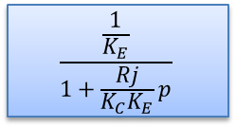




$$U(p)$$
$$\frac{\frac{1}{K_{E}}}{1+\frac{Rj}{K_{C}K_{E}}p}$$
$$Ω_{m}(p)$$
$$1$$
+
-
$$1$$

Slide 12





$$f_{v}$$
$$C_{r}(p)$$
$$U(p)$$
$$\frac{1}{Lp+R}$$
$$I(p)$$
$$K_{C}$$
$$C_{m}(p)$$
-
$$\frac{1}{Jp}$$
$$Ω_{m}(p)$$
+
+
-
$$E(p)$$
$$K_{E}$$

Slide 13


$$U(p)$$
$$\frac{1}{Lp+R}$$
$$I(p)$$
$$K_{C}$$
$$C_{m}(p)$$
$$\frac{1}{Jp}$$
$$Ω_{m}(p)$$
+
-
$$E(p)$$
$$K_{E}$$

