Slide 1
True Blue
True Red
10
16
9
13
15
18
19
25
23
24
12
8
21
30
29
22
11
7
27
26
31
6
4
32
5
14
28
2
34
1
33
3
17
20
False Red
False Blue

Slide 2
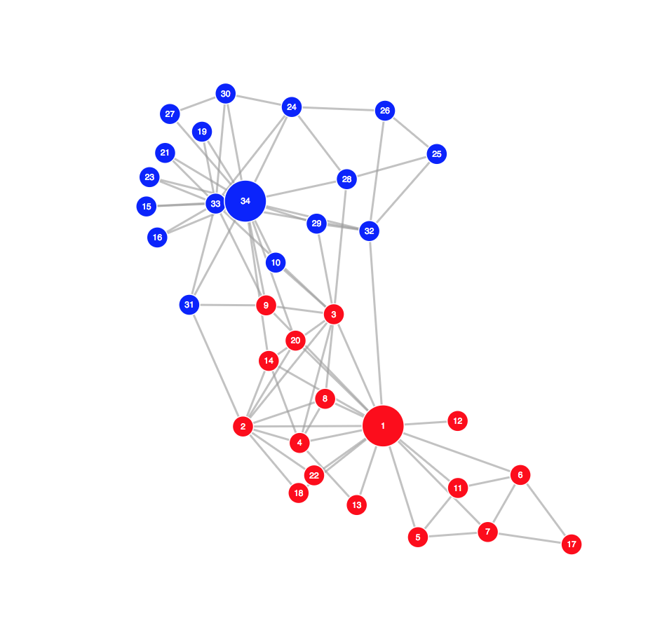
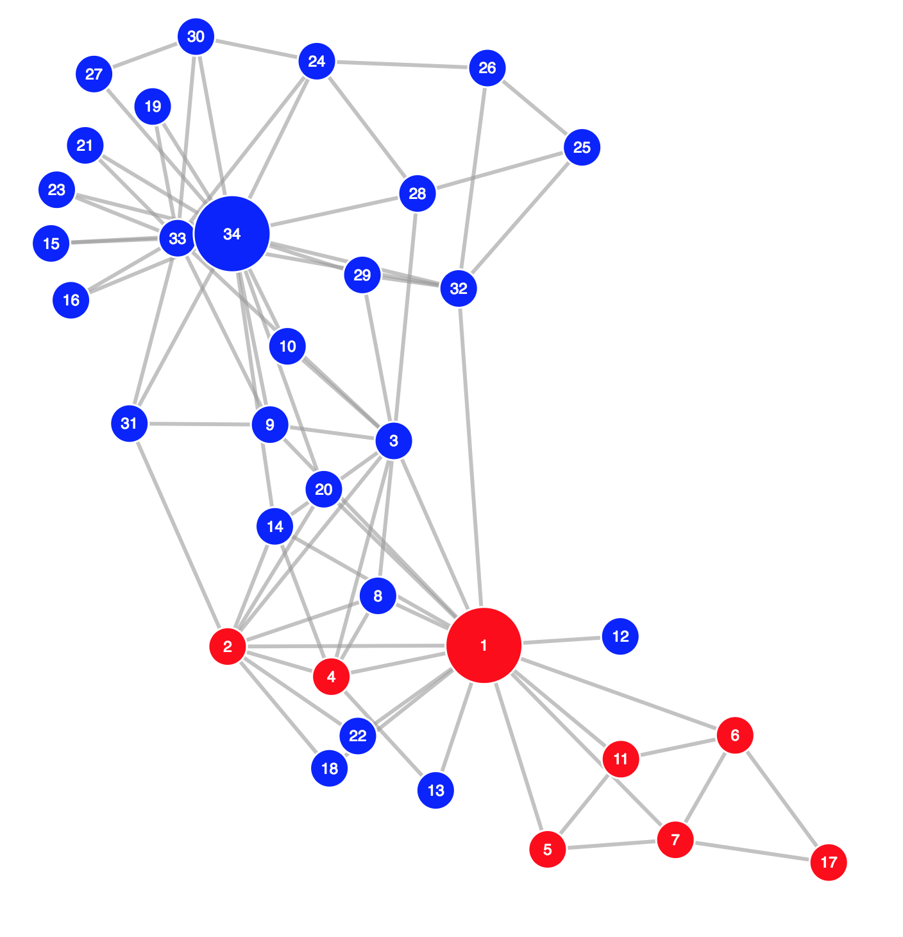
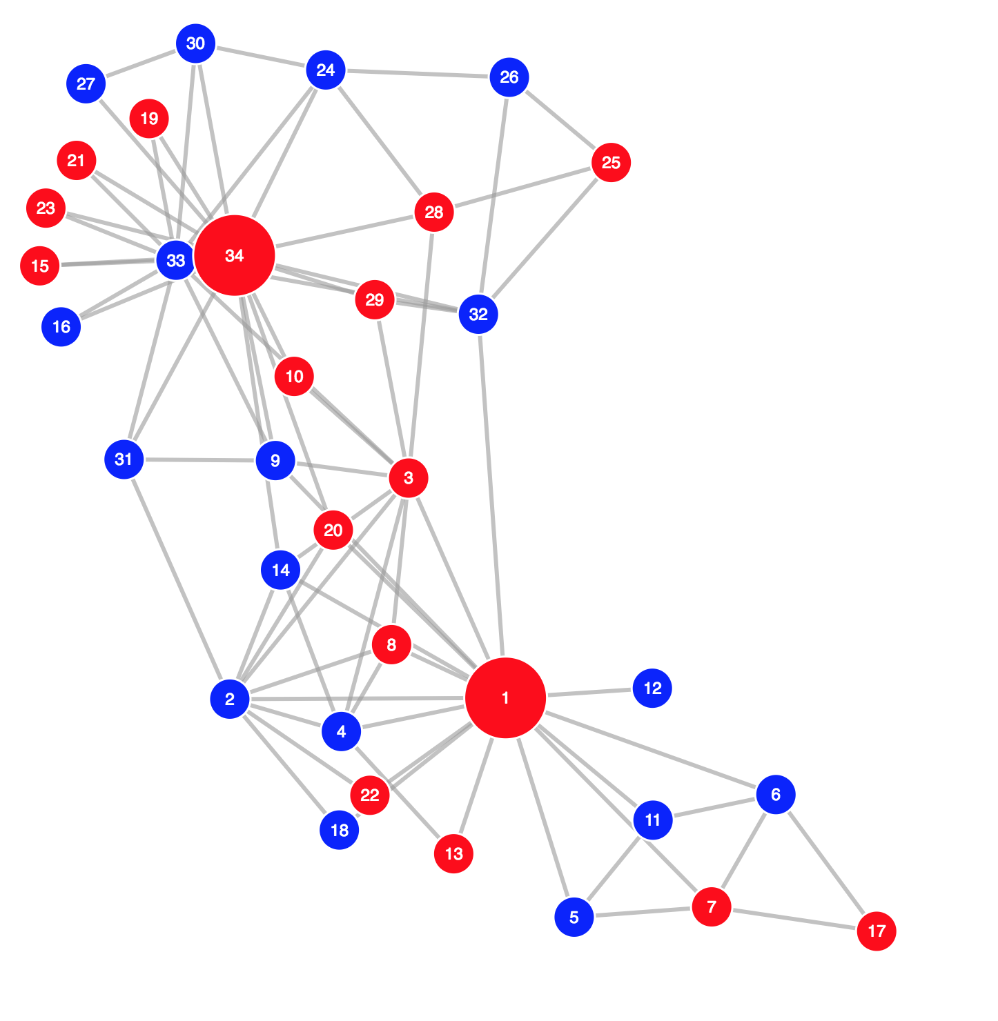
Ground Truth
Spectral Clustering - Scikit

