Slide 1
True Blue
True Red
10
16
9
13
15
18
19
25
23
24
12
8
21
30
29
22
11
7
27
26
31
6
4
32
5
14
28
2
34
1
33
3
17
20
False Red
False Blue

Slide 2
True Blue
True Red
24
23
29
1
4
18
10
16
30
13
12
19
25
8
15
9
11
21
7
27
26
3
14
32
28
5
22
33
17
34
20
False Red
False Blue
6
2
31

Slide 3
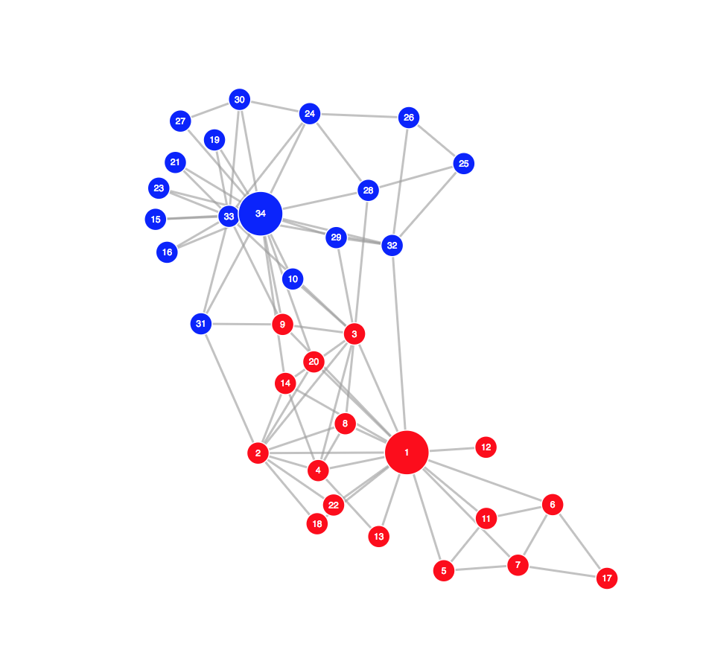
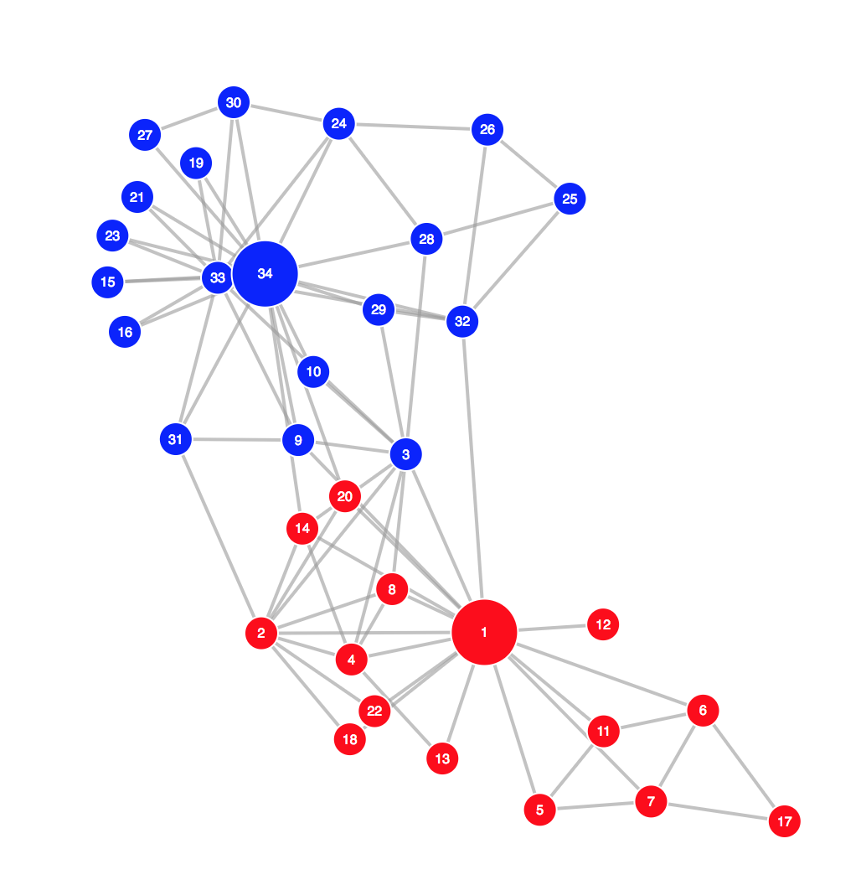
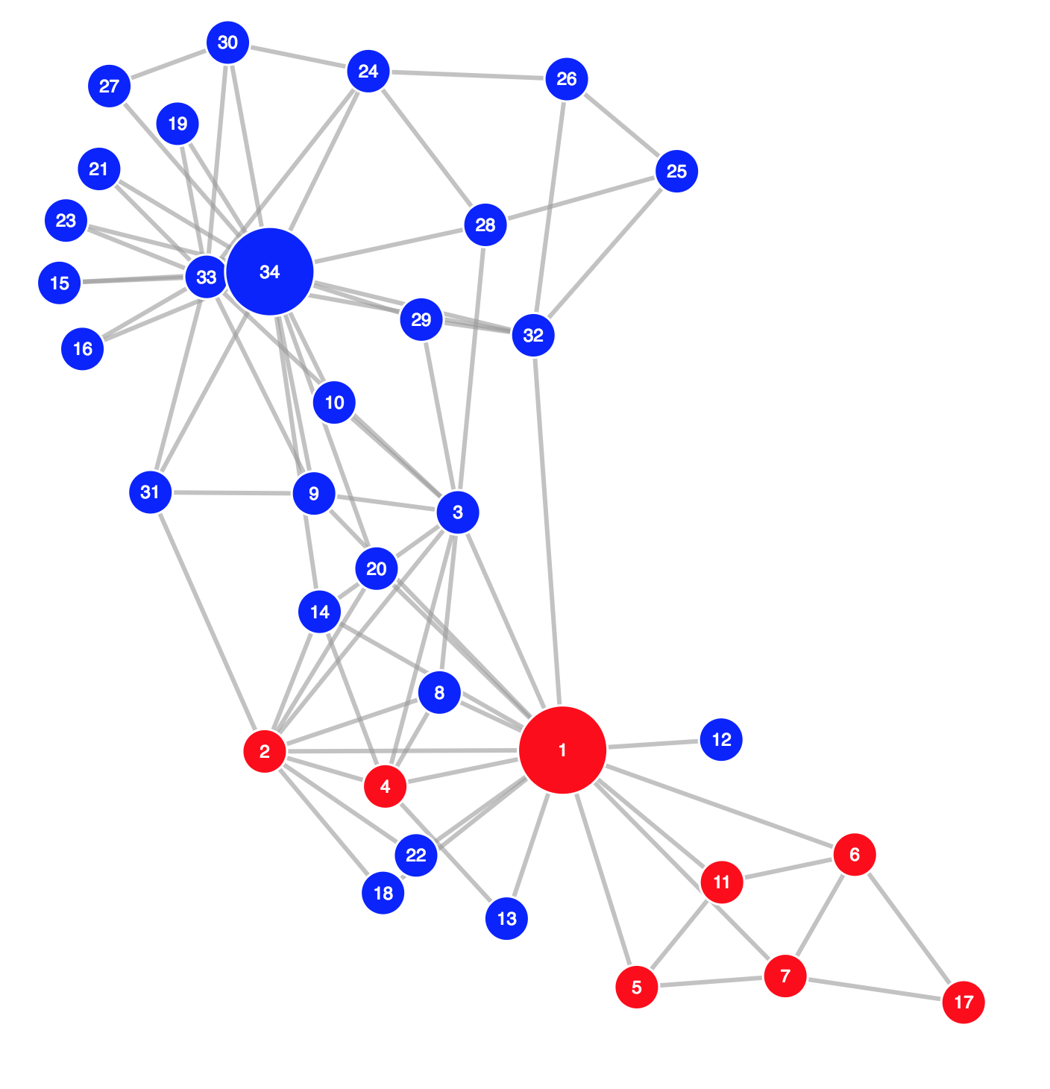
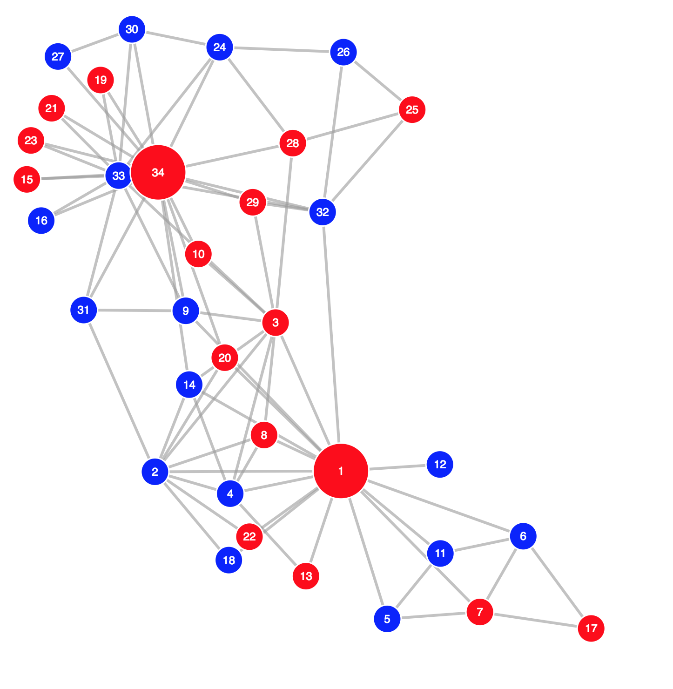
Ground Truth
Spectral Clustering

