Slide 1
Chapter 10
Projectile & Satellite Motion

Slide 2
This lecture will help you understand:
Projectile Motion
Fast-Moving Projectiles – Satellites
Circular Satellite Orbits
Elliptical Orbits
Kepler’s Laws of Planetary Motion

Slide 3
Projectile Motion
Without gravity, a tossed object follows a straight-line path.
With gravity, the same object tossed at an angle follows a curved path.
Projectile:
Any object that moves through the air or space under the influence of gravity, continuing in motion by its own inertia.

Slide 4
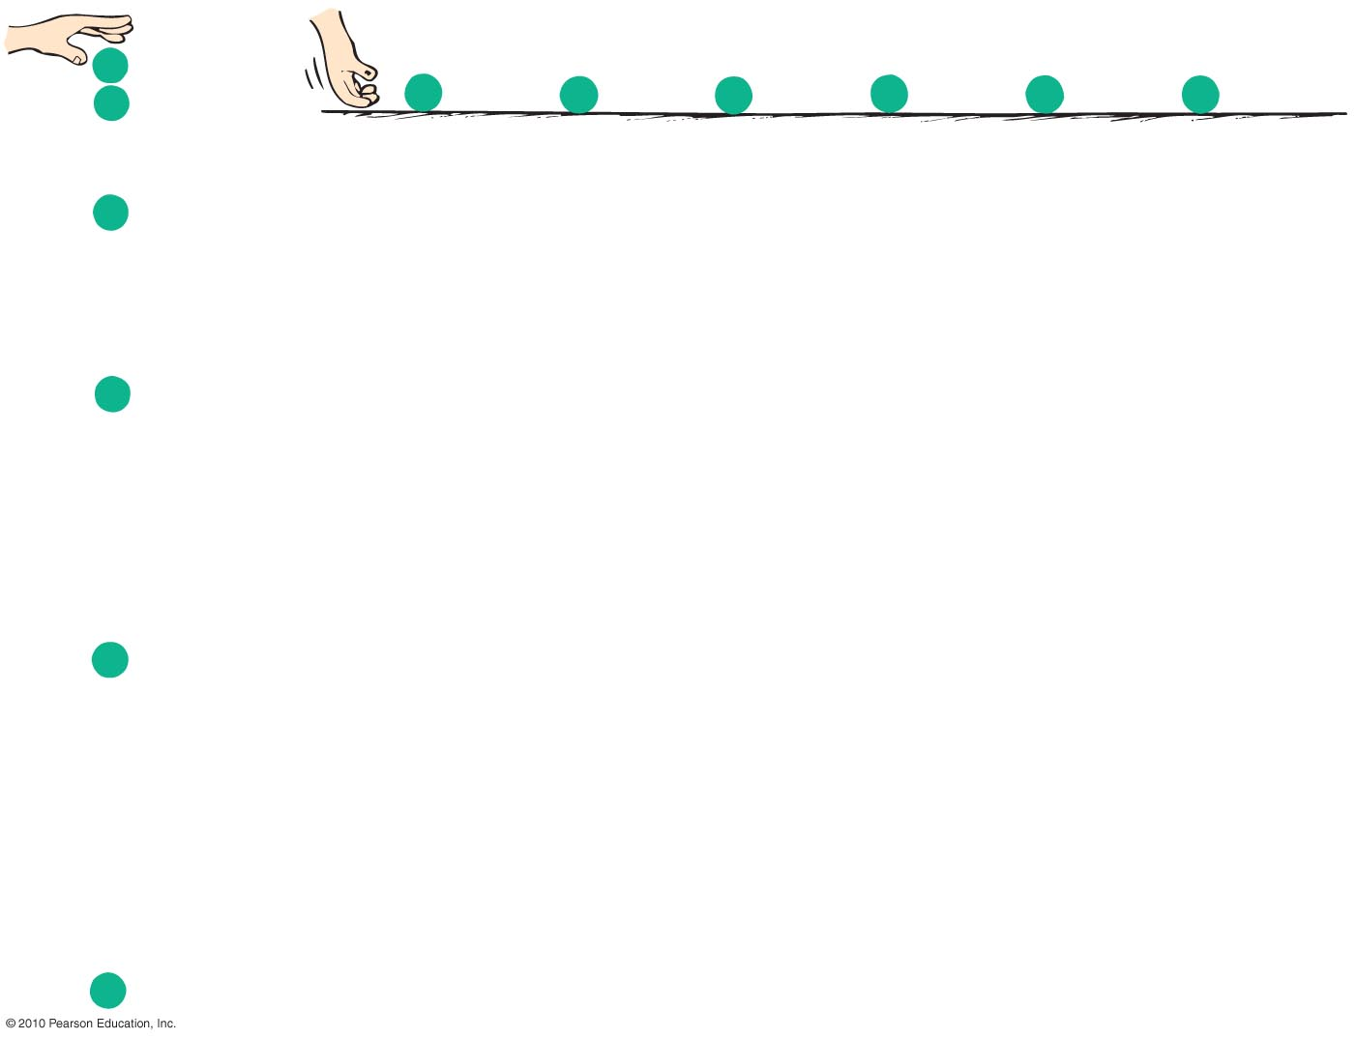
Projectile Motion
Projectile motion is a combination of
a horizontal component, and
a vertical component.

Slide 5
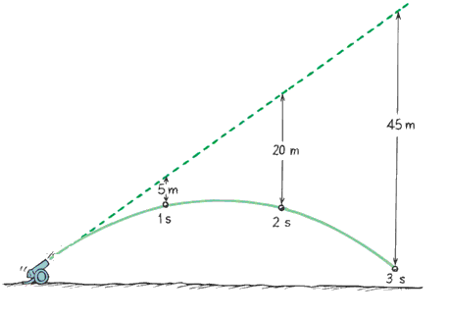
Projectile Motion
Projectiles launched horizontally
Important points:
Horizontal component of velocity doesn’t change (when air drag is negligible).
Ball travels the same horizontal
distance in equal times (no
component of gravitational
force acting horizontally).
Remains constant.

Slide 6
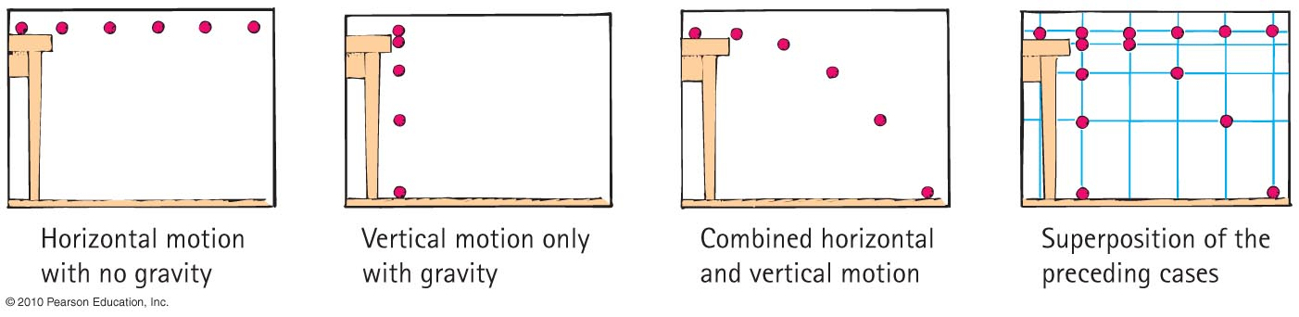
Projectile Motion
Vertical positions become farther apart with time.
  Gravity acts downward, so ball accelerates downward.
Curvature of path is the combination of horizontal and vertical components of motion.

Slide 7
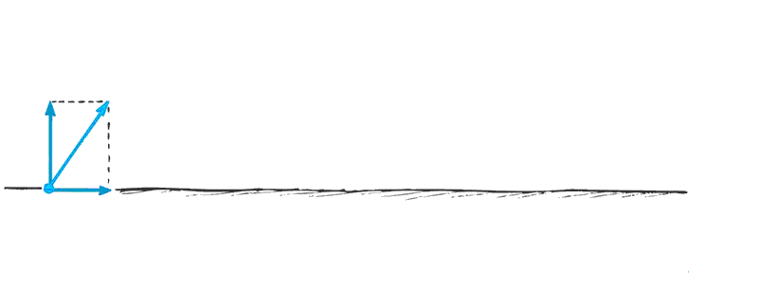
Projectile Motion
Parabola:
Curved path of a projectile that undergoes acceleration only in the vertical direction, while moving horizontally at a constant speed

Slide 8
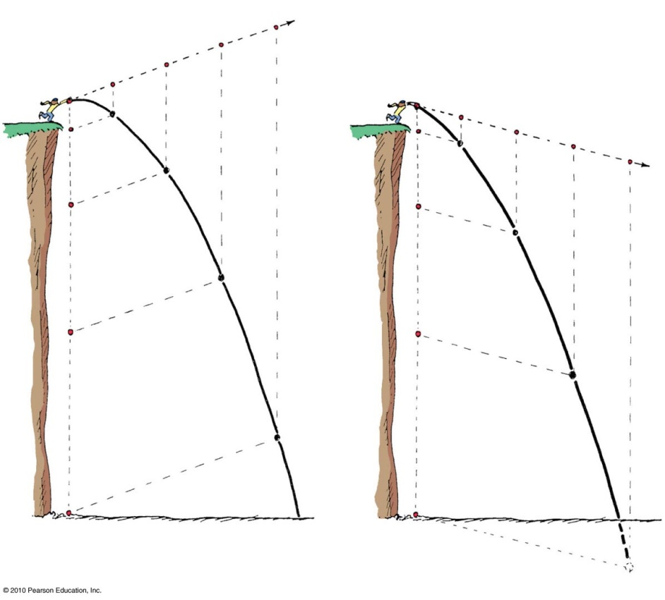
Projectile Motion
Projectiles launched at an angle:
Paths of stone thrown at an angle upward and downward
  Vertical and horizontal components are independent of each other.

Slide 9
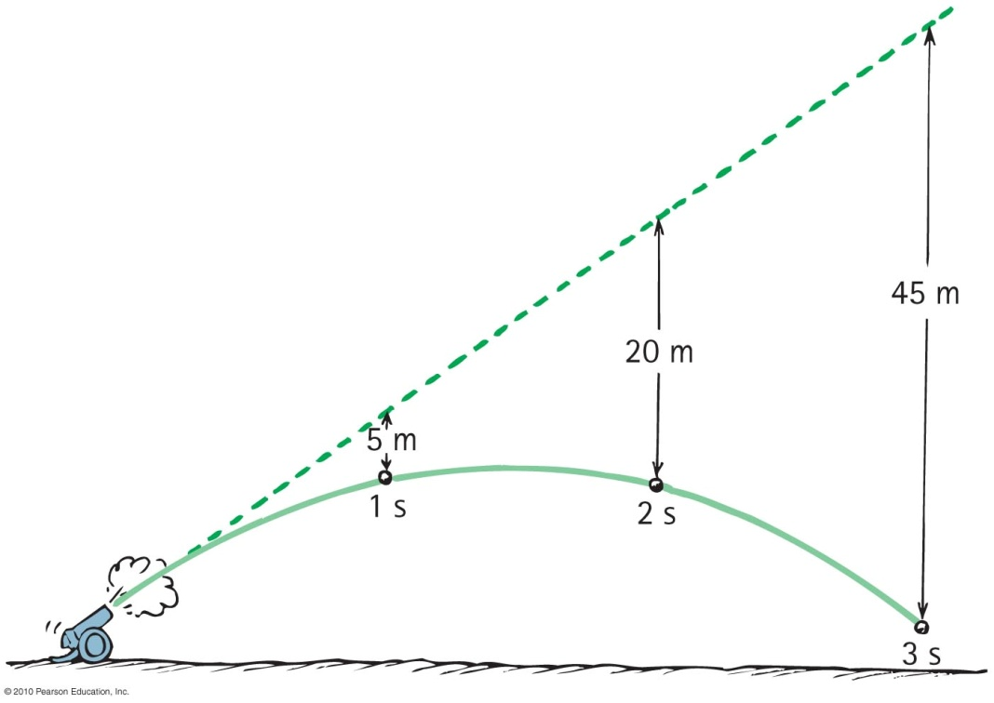
Projectile Motion
Paths of a cannonball shot at an upward angle
  Vertical distance that a stone falls is the same vertical distance it would have fallen if it had been dropped from rest and been falling for the same amount of time (5t²).

Slide 10
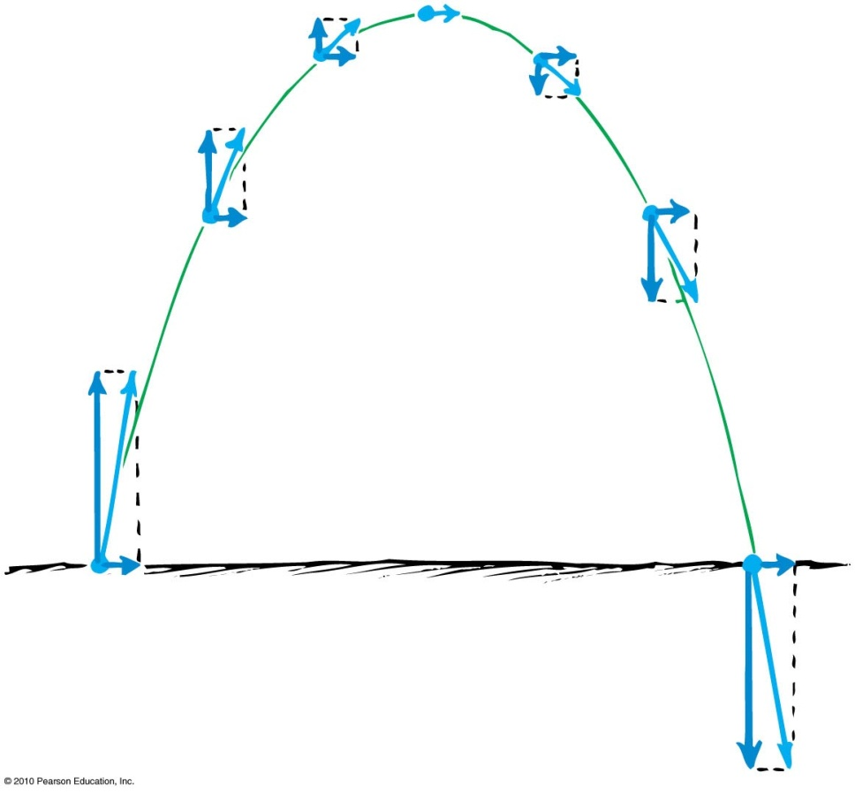
Projectile Motion
Paths of projectile following a parabolic trajectory
  Horizontal component along trajectory remains unchanged.
  Only vertical component changes.
  Velocity at any point is computed with the Pythagorean theorem (diagonal of rectangle).

Slide 11
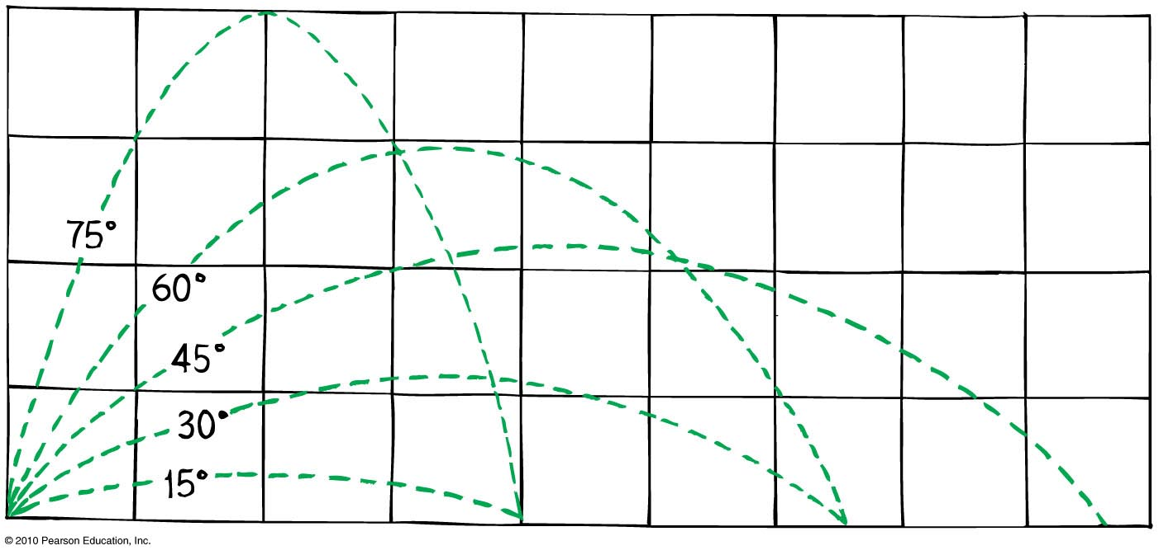
Projectile Motion
Different horizontal distances
  Same range is obtained from two different launching angles when the angles add up to 90°.
    Object thrown at an angle of 60° has the same range as if it were thrown at an angle of 30°.

Slide 12
Projectile Motion
Different horizontal distances
- Maximum range occurs for ideal launch at 45°.
  With air resistance, the maximum range occurs for a baseball batted at less than 45° above the horizontal (~ 25 -34 degrees)

Slide 13
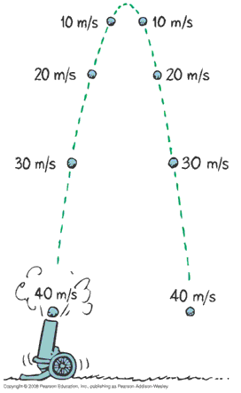
Projectile Motion
Without air resistance, the time for a projectile to reach maximum height is the same as the time for it to return to its initial level.

Slide 14
The velocity of a typical projectile can be represented by horizontal and vertical components. Assuming negligible air resistance, the horizontal component of velocity along the path of the projectile
A. increases.
decreases.
remains the same.
Not enough information.
Notes:
C. remains the same.

Slide 15
The velocity of a typical projectile can be represented by horizontal and vertical components. Assuming negligible air resistance, the horizontal component of velocity along the path of the projectile
A. increases.
decreases.
remains the same.
Not enough information.
Explanation:
Since there is no force horizontally, no horizontal acceleration occurs.
Notes:
C. remains the same.

Slide 16
When no air resistance acts on a fast-moving baseball, its acceleration is
A. downward, g.
a combination of constant horizontal motion and accelerated downward motion.
opposite to the force of gravity.
centripetal.
Notes:
A. downward, g.

Slide 17
When no air resistance acts on a fast-moving baseball, its acceleration is
A. downward, g.
a combination of constant horizontal motion and accelerated downward motion.
opposite to the force of gravity.
centripetal.
Notes:
A. downward, g.

Slide 18
Neglecting air drag, a ball tossed at an angle of 30° with the horizontal will go as far downrange as one that is tossed at the same speed at an angle of
A. 45°.
60°.
75°.
None of the above.
Notes:
B. 60°.

Slide 19
Neglecting air drag, a ball tossed at an angle of 30° with the horizontal will go as far downrange as one that is tossed at the same speed at an angle of
A. 45°.
60°.
75°.
None of the above.
Explanation:
Same initial-speed projectiles have the same range when their launching angles add up to 90°. Why this is true involves a bit of trigonometry—which, in the interest of time, we’ll not pursue here.
Notes:
B. 60°.

Slide 20
Fast-Moving Projectiles: Satellites
Satellite motion is an example of a high-speed projectile.
A satellite is simply a projectile that falls around Earth rather than into it.
  Sufficient tangential velocity needed for orbit.
  With no resistance to reduce speed, a satellite goes around Earth indefinitely.

Slide 21
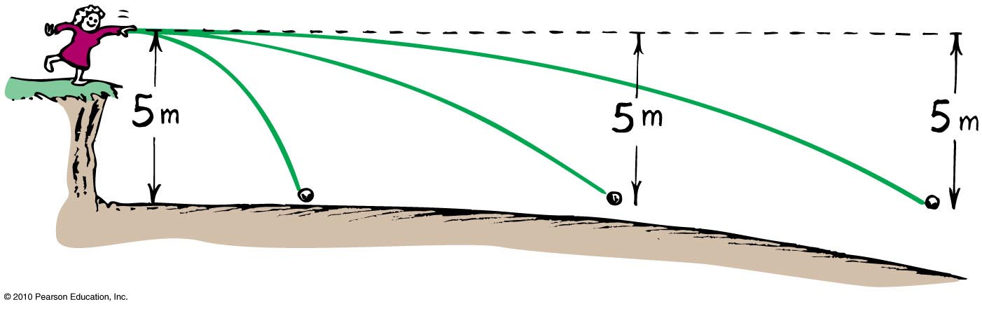
As the ball leaves the girl’s hand, 1 second later it will have fallen
A. 10 meters.
5 meters below the dashed line.
less than 5 meters below the straight-line path.
None of the above.
Notes:
B. 5 meters below the dashed line.

Slide 22
As the ball leaves the girl’s hand, 1 second later it will have fallen
A. 10 meters.
5 meters below the dashed line.
less than 5 meters below the straight-line path.
None of the above.
Comment:
Whatever the speed, the ball will fall a vertical distance of 5 meters below the dashed line. ( d = 5t² )
Notes:
B. 5 meters below the dashed line.

Slide 23
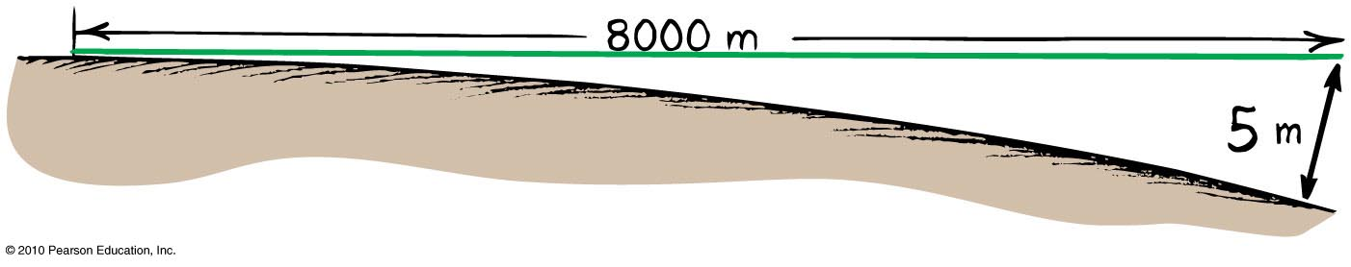
Circular Satellite Orbits
Curvature of Earth
Earth surface drops a vertical distance of 5 meters for every 8000 meters tangent to the surface

Slide 24
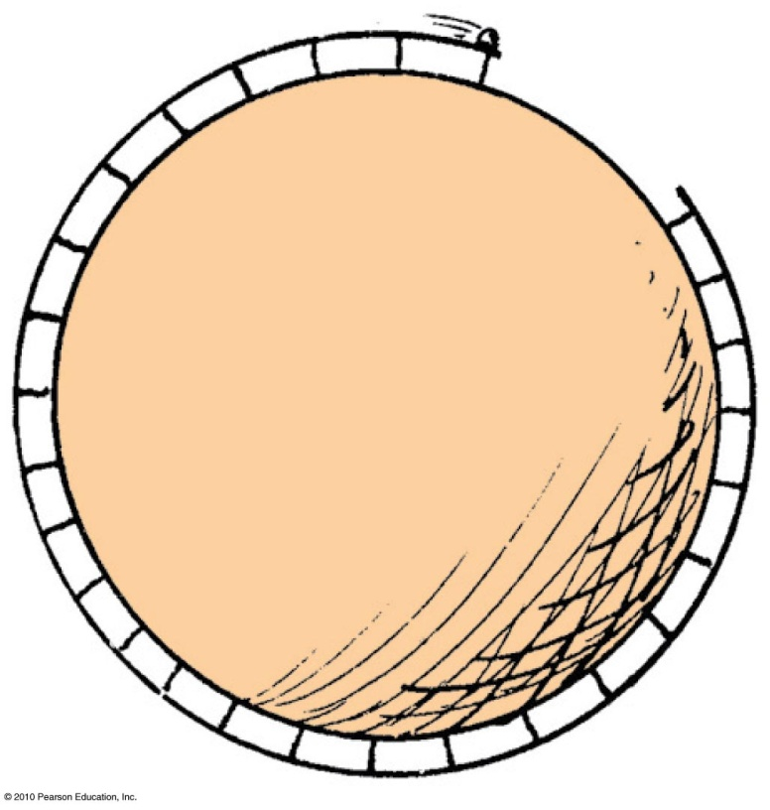
Circular Satellite Orbits
What speed will allow the ball to clear the gap?
8 km/s. If you could throw a ball with 8 km/s speed, it would be in circular orbit.

Slide 25
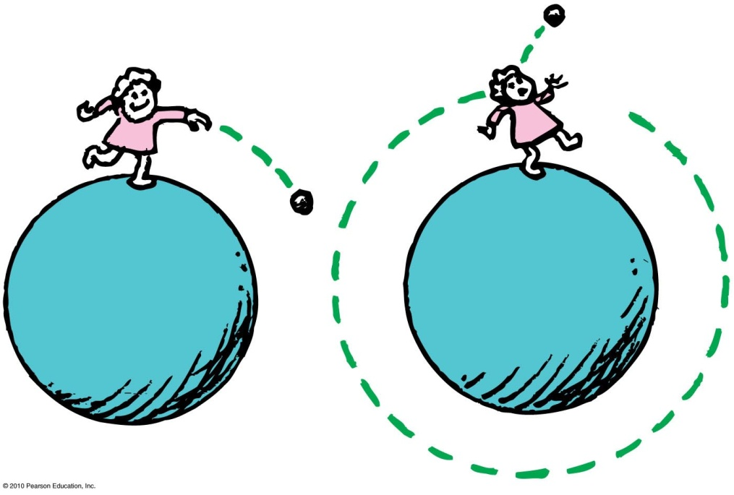
Circular Satellite Orbits
Satellite in circular orbit
Speed
  must be great enough to ensure that its falling distance matches Earth’s curvature.
  is constant : only direction changes.
  is unchanged by gravity.

Slide 26
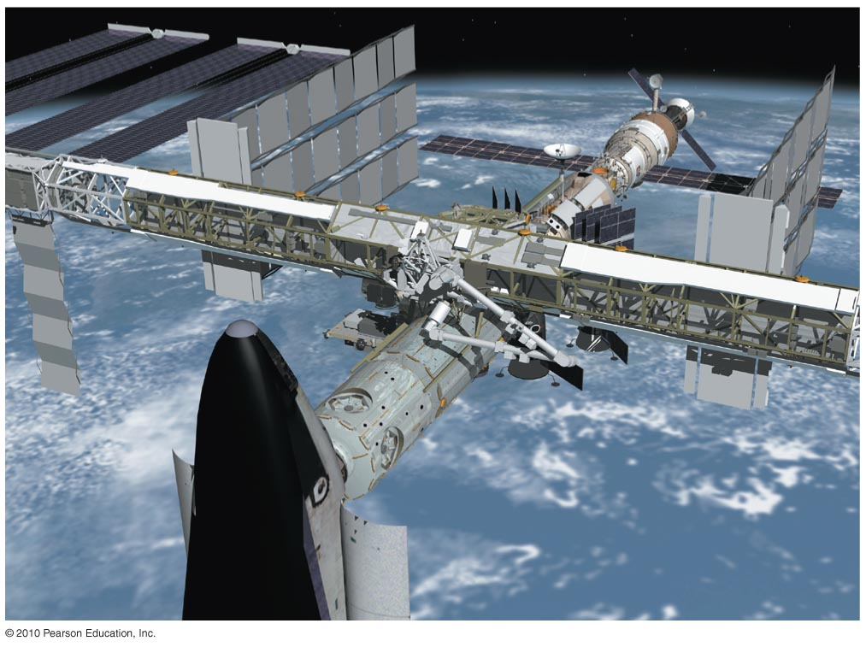
Circular Satellite Orbits
Positioning:
  beyond Earth’s atmosphere, where air resistance is almost totally absent.
  Example: Space shuttles are launched to altitudes of 150 kilometers or more, to be above air drag
  (But even the ISS, as shown experiences some air drag, which is compensated for with periodic upward boosts.)

Slide 27
Circular Satellite Orbits
Motion
  moves in a direction perpendicular to the force of gravity acting on it
Period for complete orbit about Earth
    for satellites close to Earth—about 90 minutes
    for satellites at higher altitudes—longer periods

Slide 28
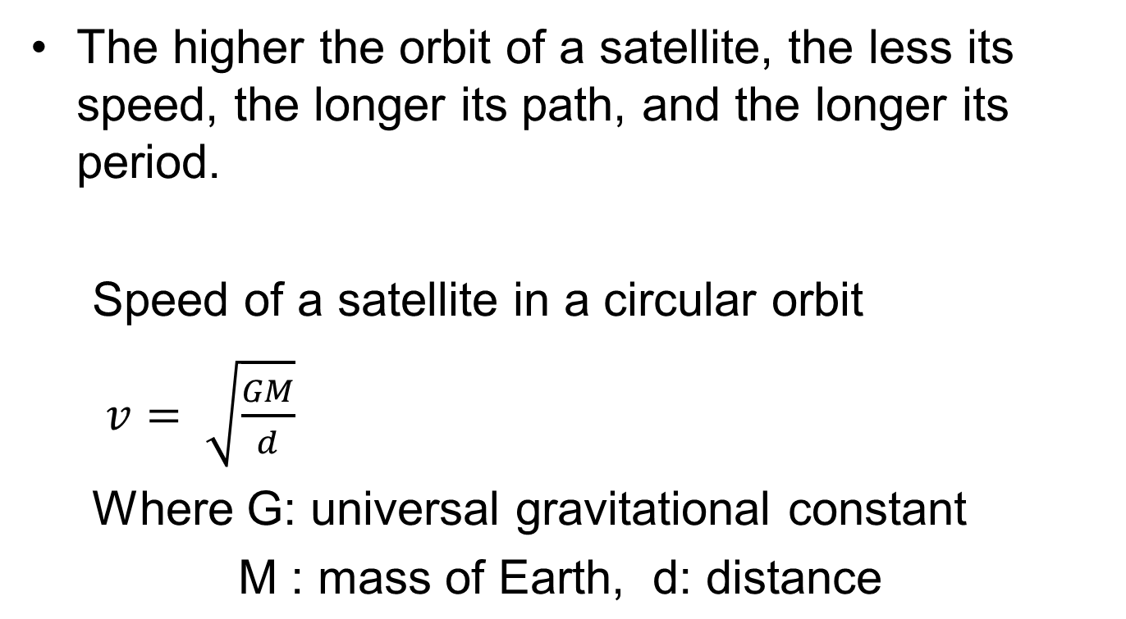
Circular Satellite Orbits

Slide 29
When you toss a projectile sideways, it curves as it falls. It will be an Earth satellite if the curve it makes
A. matches the curved surface of Earth.
results in a straight line.
spirals out indefinitely.
None of the above.
Notes:
A. matches the curved surface of Planet Earth.

Slide 30
When you toss a projectile sideways, it curves as it falls. It will be an Earth satellite if the curve it makes
A. matches the curved surface of Earth.
results in a straight line.
spirals out indefinitely.
None of the above.
Explanation:
For an 8-km tangent, Earth curves downward 5 m. Therefore, a projectile traveling horizontally at 8 km/s will fall 5 m in that time, and follow the curve of Earth.
Notes:
A. matches the curved surface of Planet Earth.

Slide 31
When a satellite travels at a constant speed, the shape of its path is
A. a circle.
an ellipse.
an oval that is almost elliptical.
a circle with a square corner, as seen throughout your book.
Notes:
A. a circle.

Slide 32
When a satellite travels at a constant speed, the shape of its path is
A. a circle.
an ellipse.
an oval that is almost elliptical.
a circle with a square corner, as seen throughout your book.
Notes:
A. a circle.

Slide 33
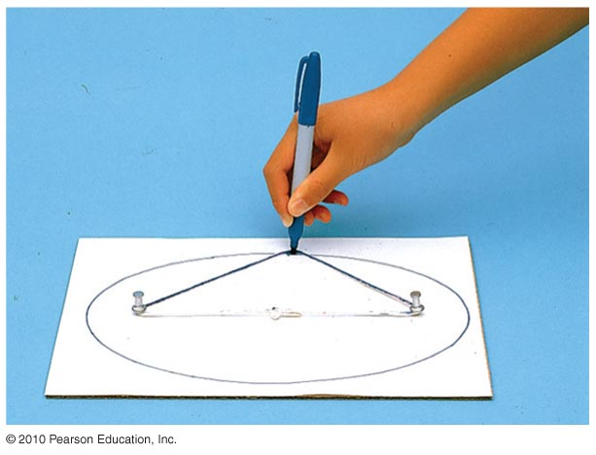
Elliptical Orbits
A projectile just above the atmosphere will follow an elliptical path if given a horizontal speed greater than 8 km/s.
Ellipse
  specific curve, an oval path
    Example: A circle is a special case of an ellipse when its two foci coincide.

Slide 34
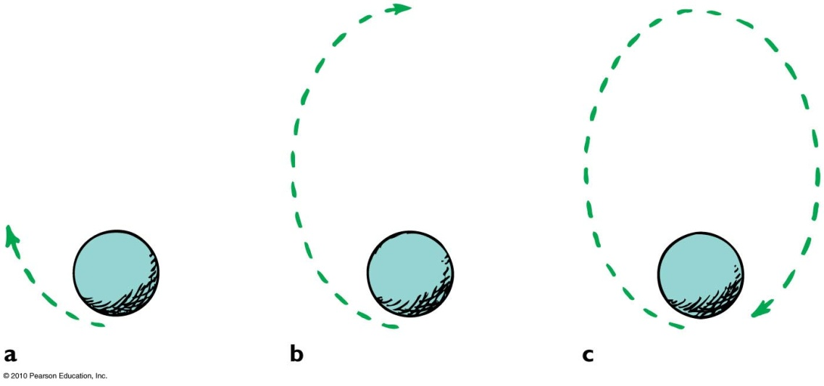
Elliptical Orbits
Elliptical orbit
Speed of satellite varies.
  Initially, if speed is greater than needed for circular orbit, satellite overshoots a circular path and moves away from Earth.
  Satellite loses speed and then regains it as it falls back toward Earth.
  It rejoins its original path with the same speed it had initially.
  Procedure is repeated.

Slide 35
The speed of a satellite in an elliptical orbit
A. varies.
remains constant.
acts at right angles to its motion.
All of the above.
Notes:
A. varies.

Slide 36
The speed of a satellite in an elliptical orbit
A. varies.
remains constant.
acts at right angles to its motion.
All of the above.
Comment : A satellite in an elliptical orbit half the time recedes from Earth and loses speed and half the time approaches Earth and gains speed.
Notes:
A. varies.

Slide 37
Kepler’s Laws of Planetary Motion
Kepler was assistant to the famous astronomer Brahe, who directed the world’s first observatory.
He used data his mentor Brahe had collected on planetary motion to figure out the motion of planets.
He found that the motion of planets was not circular; rather, it was elliptical.

Slide 38
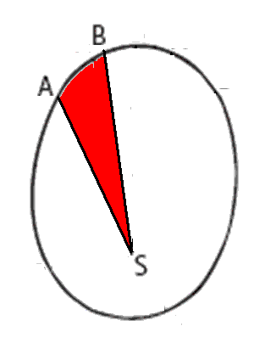
Kepler’s Laws of Planetary Motion
1st Law: The path of each planet around the Sun is an ellipse with the Sun at one focus.
2nd Law: The line from the Sun to any planet sweeps out equal areas of space in equal time intervals.
3rd Law: The square of the orbital period of a planet is directly proportional to the cube of the average distance of the planet from the Sun (for all planets).

Slide 39
Energy Conservation and Satellite Motion
Recall the following:
Object in motion possesses KE due to its motion.
Object above Earth’s surface possesses PE by virtue of its position.
Satellite in orbit possesses KE and PE.
  Sum of KE and PE is constant at all points in the orbit.

Slide 40
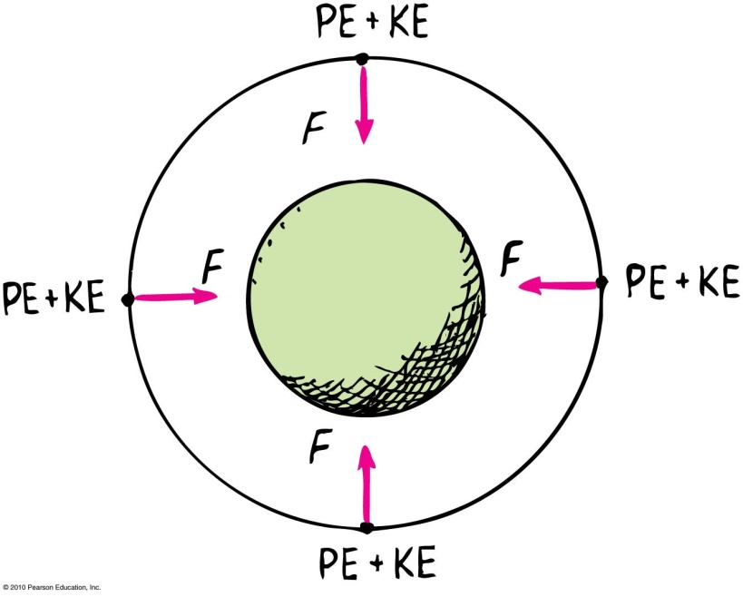
Energy Conservation and Satellite Motion
PE, KE, and speed in circular orbit:
  Unchanged.
  distance between the satellite and center of the attracting body does not change—PE is the same everywhere.
  no component of force acts along the direction of motion—no change in speed and KE.

Slide 41
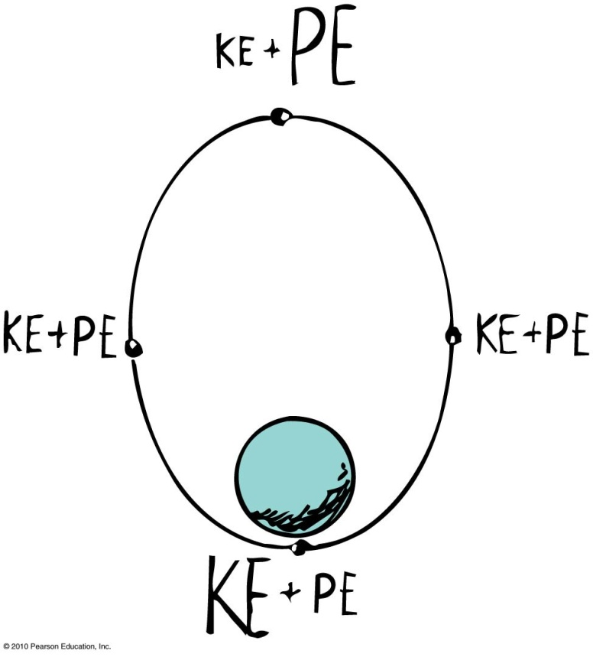
Energy Conservation and Satellite Motion
Elliptical Orbit Varies.
  PE is greatest when the satellite is farthest away (apogee).
  PE is least when the satellite is closest (perigee).
  KE is least when PE is the most and vice versa.
  At every point in the orbit, sum of KE and PE is the same.

Slide 42
Chapter 10 Problems
2. You're in an airplane that flies horizontally with speed 1000 km/h (280 m/s) when an engine falls off. Neglecting air resistance, assume it takes 30 s for the engine to hit the ground.
Show that the airplane is 4.5 km high. Show that the horizontal distance that the aircraft engine falls is 8400 m.

Slide 43
Chapter 10 Problems
2. You're in an airplane that flies horizontally with speed 1000 km/h (280 m/s) when an engine falls off. Neglecting air resistance, assume it takes 30 s for the engine to hit the ground.
Show that the airplane is 4.5 km high. Show that the horizontal distance that the aircraft engine falls is 8400 m.
H = ½ gt² = 5 m/s² (30 s)² = 5 x 900 m = 4500m =
H = 4.5Km
b. If the airplane somehow continues to fly as if nothing had happened, where is the engine relative to the airplane at the moment the engine hits the ground? Assume there is no air resistance.

Slide 44
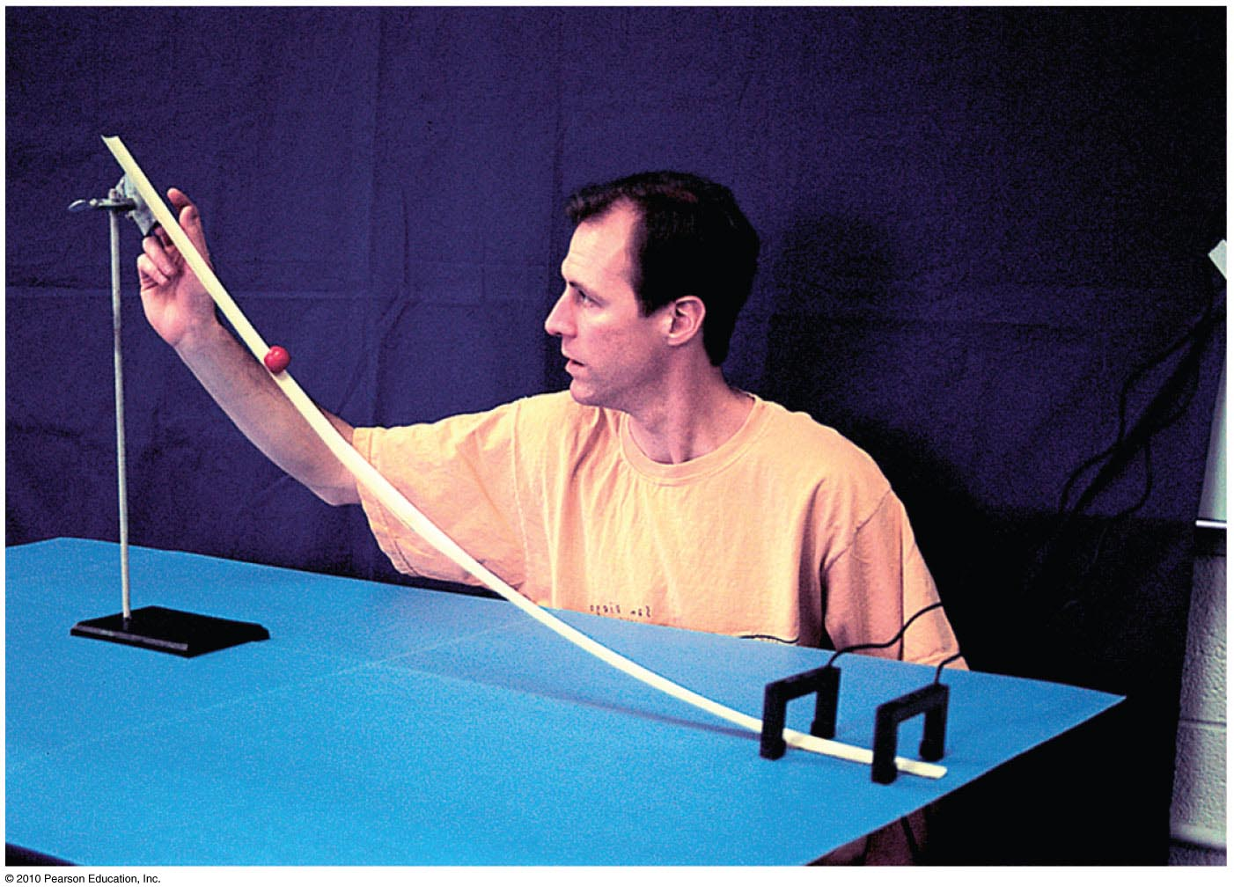
Chapter 10 Problems
4. Students in Chuck Stone's lab (see figure) measure the speed of a steel ball to be 8.0 m/s when launched horizon­ tally from a 1.0 m high tabletop. Their objective is to place a 20 cm tall coffee can on the floor to catch the ball. Show that they score a bull's-eye when the can is placed 3.2 m from the base of the table.

Slide 45
Chapter 10 Problems
4. Students in Chuck Stone's lab (see figure) measure the speed of a steel ball to be 8.0 m/s when launched horizon­ tally from a 1.0 m high tabletop. Their objective is to place a 20 cm tall coffee can on the floor to catch the ball. Show that they score a bull's-eye when the can is placed 3.2 m from the base of the table.
t = (2h/g)^{1/2} = (2·(1.0 -0.2 )m/10m/s²)^{1/2} = (0.16)^{1/2} = 0.4 s
d = v·t = 8.0 m/s·0.4s = 3.2m

Slide 46
Homework
Read Chapter 10 in Detail.
Do Ranking #3
Do Exercises 2, 3, 7, 8, 12
Do Problems 2, 5
Homework due: June 25

