Slide 1
Introduction and
Chapter 1 : About Science

Slide 2
Chapter 1: About Science
• Scientific Measurements
• Mathematics—The Language of Science
• Scientific Methods
• The Scientific Attitude
• Science and Technology
• Physics - The Basic Science

Slide 3
What is Science?
Science is the body of knowledge that describes the order within nature, and the causes of that order.
Began long time ago, when people noticed regularities and relationships in nature.
weather patterns , beginning of rainy season
Star patterns in the night sky

Slide 4
Scientific Measurements
Measurement is foundation of the scientific method.
If its not measurable it isn't science.
How much you know about something is often related to how well you can measure it.
Making careful quantitative measurements are important.
The measurement accuracy is also fundamental to the to the scientific method.

Slide 5
Scientific Measurements
Measurements represent some physical quantity. For example, 9.4 seconds represents a time. The quantity has a number (9.4) and a unit (seconds).
The number tells you the amount and the unit tells you the thing that you are talking about. Both the number and the unit are required to specify a measured quantity.
Leaving either out makes your answer wrong!!!

Slide 6
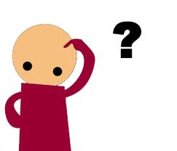
Scientific Measurements
In 3rd century, scientists made fairly accurate measurements of the size of earth, moon and sun, as well as distances between them.
How did they do that without computers and calculators?
Trigonometry !!!

Slide 7
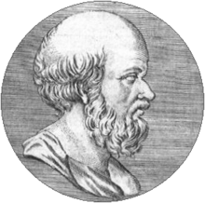
How did Eratosthenes measure the
size of earth?
First measured by Eratosthenes about 235 BC.
He learned: the Sun is highest in the sky at noon
On June 22, and it is directly overhead the city
Syene.
http://en.wikipedia.org/wiki/Eratosthenes

Slide 8
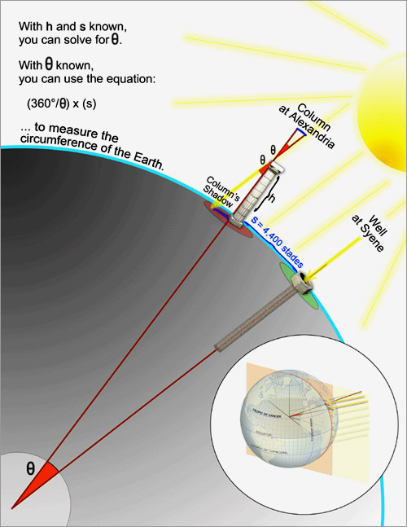
7.2/360 =1/50
Circumference of the earth is 50 times the distance from Alexandria to Syene.
Distance from Alexandria to Syene = 800 km
Circumference of the earth
= 50 x 800 km
= 40,000 km
How accurate do you think
the angle and distance measurements were?
http://www.wired.com/science/discoveries/news/2008/06/dayintech_0619#

Slide 9
How accurate do you think the angle and distance measurements were?
An uncertainty of 0.1 degree would be an accuracy of 0.1/7.2 or about 14%.
The circumference is 40,075 km at the equator and 40,008 km around the poles.
So, the accuracy is 0.02% to 0.2% !!!

Slide 10
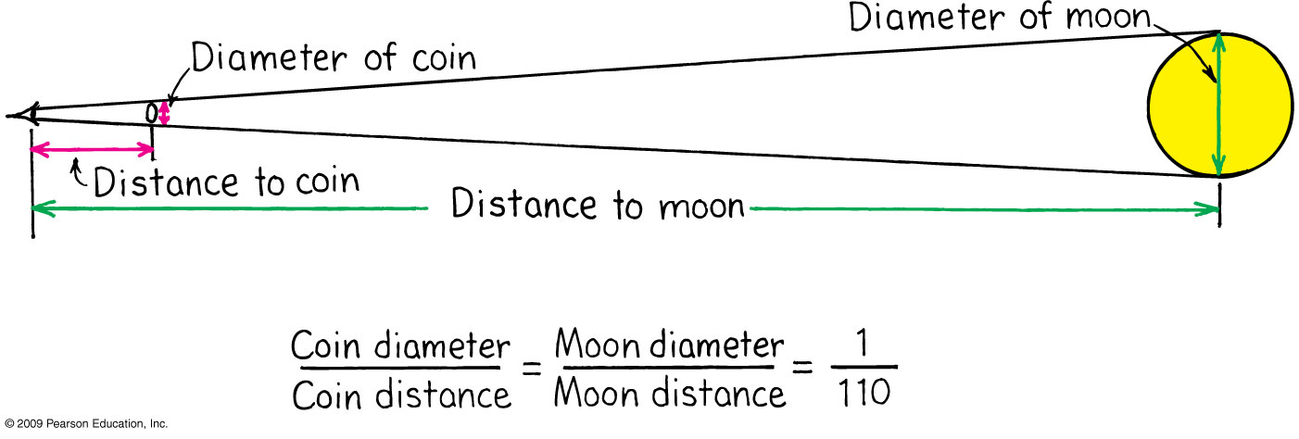
Distance to the Moon
With Aristarchus’s measurement of the Moon’s
diameter (see page 3), we can calculate the
distance to the Moon.

Slide 11
Mathematics
Mathematics is the language of science.
When ideas are expressed in mathematical
terms, they are unambiguous.
Provide compact expressions of relationships
between concepts.

Slide 12
Scientific Methods
1) Recognize a question or a puzzle (ex: unexplained fact)
2) Make an educated guess – Hypothesis.
3) Predict consequences of the hypothesis.
4) Perform experiment(s), measurements and calculations to test the hypothesis.
5) Formulate the simplest rule that organizes hypothesis, prediction, and results.

Slide 13
The Scientific Attitude
The scientific attitude is one of inquiry, integrity
And humility,- i.e., a willingness to admit error.
If evidence contradicts a hypothesis, a law or a
principle, then it must be changed or abandoned.

Slide 14
The Scientific Attitude
The Greek philosopher Aristotle claimed that
an object falls at a speed proportional to its
weight. Nearly 2000 years this idea was
accepted until Galileo showed that heavy &
light objects dropped from the Leaning Tower
of Pisa fell at nearly equal speeds.
Scientists must accept their experimental findings
even when they would like them to be different.

Slide 15
Scientific Theory
In everyday speech, a theory is no different from
a hypothesis – a supposition that has not been
verified. This is inaccurate !!!
A scientific theory
* Is a general rule that organizes facts, hypothesis, measurements or and observations.
* Evolves or undergoes change.
* Must be changed when proven incomplete or wrong.

Slide 16
Facts
Agreed upon observations by competent observers.
Measurements that are repeatable.
May be revised by further detailed observations or data (measurements) with different equipment or under different conditions.

Slide 17
Scientific Hypothesis
If there is no test for its possible wrongness,
then the hypothesis is NOT scientific.
Predicts facts and in the ideal case predicts other observations that can be measured.
Falsifiable or can be disproved (proven is not enough)

Slide 18
Consider Charles Darwin’s hypothesis that life forms from simpler to more complex forms.
Is this a scientific hypothesis?

Slide 19
- Consider Charles Darwin’s hypothesis that life forms from simpler to more complex forms.
Is this a scientific hypothesis?
YES. Because this could be proved wrong if paleontologists discovered that more complex forms of life appeared before simpler forms of life.
Less complex life forms are found to precede their more complex forms which support the claim.

Slide 20
Consider the hypothesis:
“Intelligent life exists on other planets somewhere in the universe”
Is this a scientific hypothesis?

Slide 21
Intelligent life exists on other planets somewhere in the universe”
Is this a scientific hypothesis?
NO.
Though it can be proven correct by a single finding of intelligent life elsewhere in the universe, there is no way to prove it wrong, if no intelligent life is ever found.
If we searched the far away in the universe of many years & found no life, it would not prove that it doesn’t exist ‘around the next corner’.

Slide 22
Check Point
Which of these is a scientific hypothesis?
Atoms are the smallest particles of matter that exist.
Space is permeated with an essence that is undetectable.
Albert Einstein was the greatest physicist of the 20th century.

Slide 23
Check Point
Which of these is a scientific hypothesis?
Atoms are the smallest particles of matter that exist.
Space is permeated with an essence that is undetectable.
Albert Einstein was the greatest physicist of the 20th century.
Only a is scientific because there is a test for falseness. The statement is not
only capable of being wrong, but in fact has been proved wrong.

Slide 24
Scientific Theory
General rule that organizes facts, hypothesis, measurements or and observations.
Evolve or undergo change.
Must be changed when proven incomplete or wrong.
Principle or Law
Theory that has been proven useful through many measurements or observation.
Useful for a large number of conditions, predictions or observations

Slide 25
Science and Technology
Science is concerned with gathering knowledge and organizing it.
Technology is applied science, used by engineers and technologists for practical purposes.

Slide 26
Physics - The Basic Science
Science -> life sciences & physical sciences
Life sciences: biology, zoology, botany
Physical sciences: geology, astronomy, chemistry, physics
Physics is the basic science. It is about the nature of basic things such as motion, forces, energy, matter, heat, sound, light & the structure of atoms.
An understanding of science begins with an understanding of physics.

Slide 27
Homework
Read Chapter 1 in detail
Do Exercises: 3, 9 (explain your answer)
Read Chapter 2
Homework due: May 21

