Slide 1
Chapter 1- Exercises

Slide 2
Science is an organized body of knowledge about nature and also a
a. guide to improving human behavior.
b. recipe for avoiding conflicts.
c. process for finding connections in nature.
d. handbook for establishing truth.

Slide 3
Science is an organized body of knowledge about nature and also a
a. guide to improving human behavior.
b. recipe for avoiding conflicts.
c. process for finding connections in nature.
d. handbook for establishing truth.

Slide 4
The sizes of both the Moon and the Sun are the same in the sky, which indicates that
a. both have the same diameters.
b. both are at about the same distance from Earth.
c. the smaller Moon is closer to Earth than the Sun.
d. both the Moon and the Sun circle Earth.

Slide 5
The sizes of both the Moon and the Sun are the same in the sky, which indicates that
a. both have the same diameters.
b. both are at about the same distance from Earth.
c. the smaller Moon is closer to Earth than the Sun.
d. both the Moon and the Sun circle Earth.

Slide 6
In science, the idea of prediction is
a. part of the scientific method.
b. not as useful as when gambling or testing your luck.
c. now outmoded.
d. contradictory to making scientific hypotheses.

Slide 7
In science, the idea of prediction is
a. part of the scientific method.
b. not as useful as when gambling or testing your luck.
c. now outmoded.
d. contradictory to making scientific hypotheses.

Slide 8
A person who says, “that’s only a theory” likely doesn’t know that a scientific theory is a
a. guess that involves many facts.
b. hypothesis of sorts.
c. vast synthesis of well-tested hypotheses and facts.
d. guess that may or may not be factual.

Slide 9
A person who says, “that’s only a theory” likely doesn’t know that a scientific theory is a
a. guess that involves many facts.
b. hypothesis of sorts.
c. vast synthesis of well-tested hypotheses and facts.
d. guess that may or may not be factual.

Slide 10
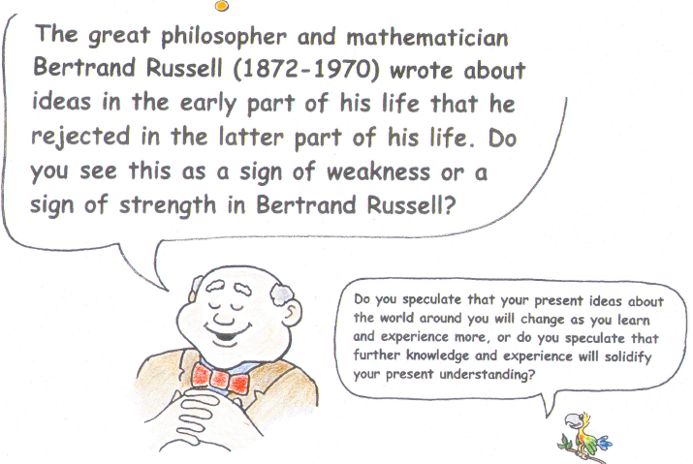

Slide 11
Which of these is a scientific hypothesis (that could be proved wrong)?
a. Atoms in proper proportions make us feel good.
b. Atoms are in all the stars in the universe.
c. An atom is the smallest bit of matter in a material.
d. Distant galaxies have atoms not found on Earth.
Notes:
Answer: C

Slide 12
Which of these is a scientific hypothesis (that could be proved wrong)?
a. Atoms in proper proportions make us feel good.
b. Atoms are in all the stars in the universe.
c. An atom is the smallest bit of matter in a material.
d. Distant galaxies have atoms not found on Earth.
Explanation: Statement c has, in fact, been proved wrong. Protons and electrons, for example, are smaller than atoms.
Notes:
Answer: C

Slide 13
The easiest way for you to measure the distance between the Earth and the moon is to place in your line of sight to the moon a
A) magnifying glass.
B) coin.
C) telescope.
D) meter stick.

Slide 14
The easiest way for you to measure the distance between the Earth and the moon is to place in your line of sight to the moon a
A) magnifying glass.
B) coin.
C) telescope.
D) meter stick.

Slide 15
In science, an educated guess is a
A) hypothesis.
B) theory.
C) both of these

Slide 16
In science, an educated guess is a
A) hypothesis.
B) theory.
C) both of these.

Slide 17
In science, a theory is
A) an educated guess.
B) less than a fact.
C) a synthesis of a large body of well-tested knowledge.
D) unchangeable.

Slide 18
In science, a theory is
A) an educated guess.
B) less than a fact.
C) a synthesis of a large body of well-tested knowledge.
D) unchangeable.

Slide 19
Which of the following is a scientific statement?
A) The moon is made of green cheese.
B) There are things we will never know about.
C) Matter is filled with undetectable particles.
D) There are parts of the universe that will never be found by man.

Slide 20
Which of the following is a scientific statement?
A) The moon is made of green cheese.
B) There are things we will never know about.
C) Matter is filled with undetectable particles.
D) There are parts of the universe that will never be found by man.

Slide 21
A scientific hypothesis may turn out to be right or it may turn out to be wrong. If it is a valid hypothesis, there must be a test for proving it
A) right.
B) wrong.

Slide 22
A scientific hypothesis may turn out to be right or it may turn out to be wrong. If it is a valid hypothesis, there must be a test for proving it
A) right.
B) wrong.

Slide 23
A truly educated person is knowledgeable about
A) science.
B) the arts.
C) religion.
D) all of these

Slide 24
A truly educated person is knowledgeable about
A) science.
B) the arts.
C) religion.
D) all of these.

Slide 25
Science and technology are
A) really one and the same.
B) responsible for all the good in the world.
C) responsible for all the bad in the world.
D) fundamentally different from each other.

Slide 26
Science and technology are
A) really one and the same.
B) responsible for all the good in the world.
C) responsible for all the bad in the world.
D) fundamentally different from each other.

