Slide 1
Chapter 2
Newton's First Law of Motion - Inertia

Slide 2
Objectives:
1) Aristotle’s Ideas of Motion
2) Galileo’s Concept of Inertia
3) Newton’s First Law of Motion
4) Net Force
5) The Equilibrium Rule
6) Support Force ,Normal Force
7) Equilibrium of Moving Things
8) The Moving Earth

Slide 3
Aristotle’s Ideas of Motion
Aristotle’s classification of motion:
2 main classes
Natural motion
  Every object in the universe has a proper place determined by a combination of four elements: earth, water, air, and fire.
  Any object not in its proper place will strive to get there.
  Examples:
    Stones fall.
    Puffs of smoke rise.
Natural motion
Violent motion
© 2010 Pearson Education Inc.

Slide 4
Aristotle’s Ideas of Motion
Natural motion (continued)
  Straight up or straight down for all things on Earth.
  Beyond Earth, motion is circular.
  Example: The Sun and Moon continually circle Earth.
Violent motion
  Produced by external pushes or pulls on objects.
  Example: Wind imposes motion on ships.
© 2010 Pearson Education Inc.

Slide 5
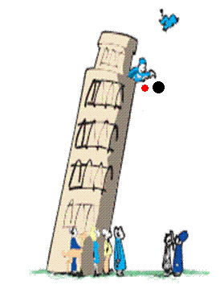
Galileo’s Concept of Inertia
Galileo demolished Aristotle’s assertions in the early 1500s.
Galileo’s discovery:
  Objects of different weight fall to the ground at the same time in the absence of air resistance.
  A moving object needs no force to keep it moving in the absence of friction.
© 2010 Pearson Education Inc.

Slide 6
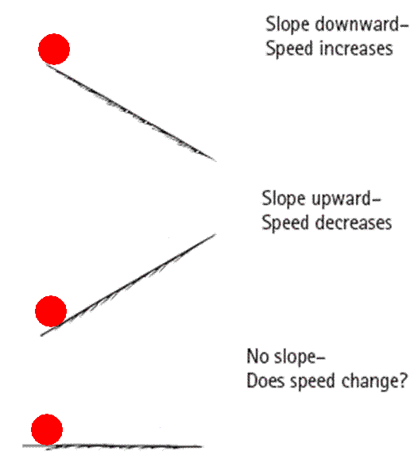
Aristotle did not consider motion in a vacuum. --> Therefore, an object needs a pull or push to keep moving.
Galileo denied this principle
and stated that if there is no
interference with a moving object,
it will keep moving in a straight
line forever; no push, pull and any kind
of force is necessary.
In the absence of retarding forces,
the object has a tendency to
move forever without slowing down.
The property of an object to resist
changes in motion: Inertia
Galileo's experiment
© 2010 Pearson Education Inc.

Slide 7
Galileo’s Concept of Inertia
Inertia
is a property of matter to resist changes in motion.
depends on the amount of matter in an object (its mass).
© 2010 Pearson Education Inc.

Slide 8
The use of inclined planes for Galileo’s experiments helped him to
eliminate the acceleration of free fall.
discover the concept of energy.
discover the property called inertia.
discover the concept of momentum.
© 2010 Pearson Education Inc.

Slide 9
The use of inclined planes for Galileo’s experiments helped him to
eliminate the acceleration of free fall.
discover the concept of energy.
discover the property called inertia.
discover the concept of momentum.
Comment:
Note that inertia is a property of matter, not a reason for the behavior of matter.
© 2010 Pearson Education Inc.

Slide 10
Newton’s First Law of Motion
Every object continues in a state of rest or of uniform speed in a straight line unless acted on by a nonzero net force.
Objects won’t move or change motion without a net force being applied
© 2010 Pearson Education Inc.

Slide 11
Net Force
Vector quantity
a quantity whose description requires both magnitude (how much) and direction (which way)
can be represented by arrows drawn to scale, called vectors
  length of arrow represents magnitude and arrowhead shows direction
  Examples: force, velocity, acceleration
© 2010 Pearson Education Inc.

Slide 12
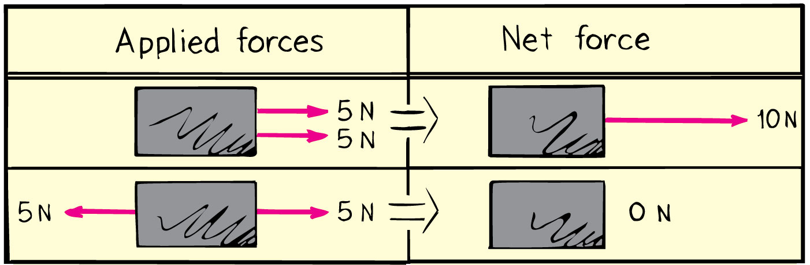
Net Force
Net force is the combination of all forces that change an object’s state of motion.
Example: If you pull on a box with 10 N and a friend pulls oppositely with 5 N, the net force is 5 N in the direction you are pulling.
© 2010 Pearson Education Inc.

Slide 13
A cart is pushed to the right with a force of 15 N while being pulled to the left with a force of 20 N. The net force on the cart is
5 N to the left.
5 N to the right.
25 N to the left.
25 N to the right.
© 2010 Pearson Education Inc.

Slide 14
A cart is pushed to the right with a force of 15 N while being pulled to the left with a force of 20 N. The net force on the cart is
5 N to the left.
5 N to the right.
25 N to the left.
25 N to the right.
Two forces are in opposite directions, so they subtract.
The direction is determined by the direction of the larger force.
© 2010 Pearson Education Inc.

Slide 15
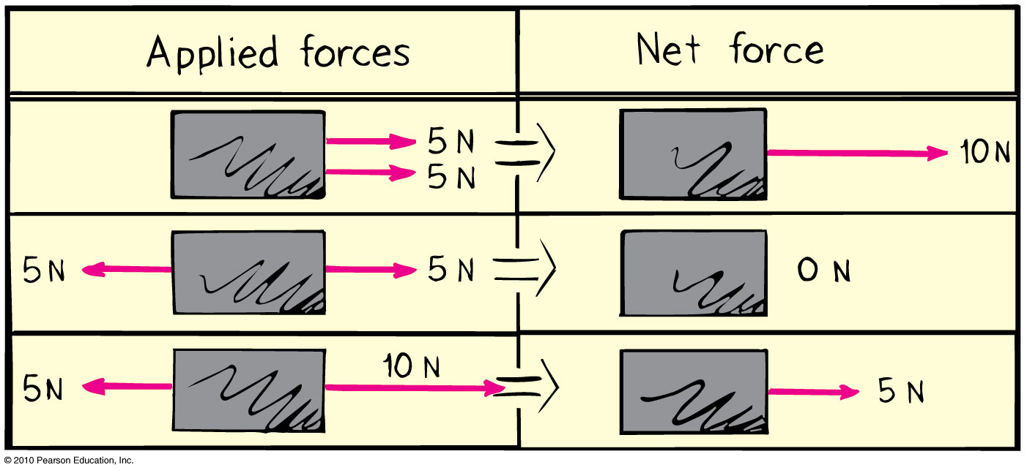
What is the net force acting on the box?
15 N to the left
15 N to the right
5 N to the left
5 N to the right
?
© 2010 Pearson Education Inc.

Slide 16
What is the net force acting on the box?
15 N to the left
15 N to the right
5 N to the left
5 N to the right
© 2010 Pearson Education Inc.

Slide 17
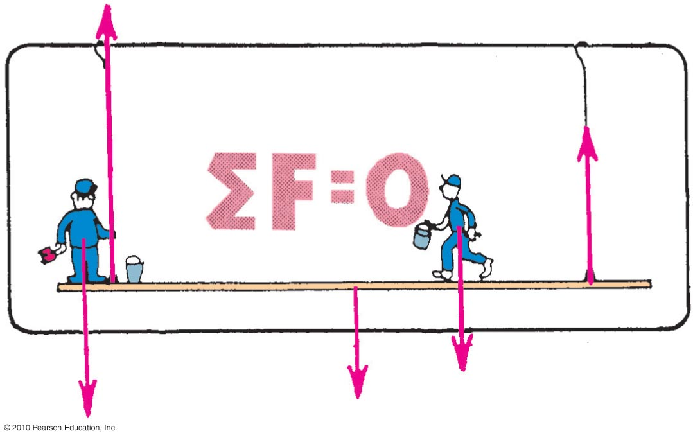
The Equilibrium Rule
The vector sum of forces acting on a non-accelerating object equals zero.
In equation form: ΣF = 0.
© 2010 Pearson Education Inc.

Slide 18
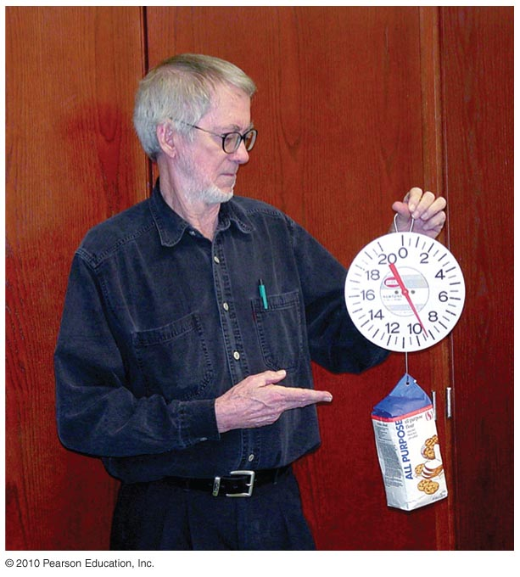
The Equilibrium Rule : Example
A string holding up a bag of flour
Two forces act on the bag of flour:
  Tension force acts upward.
  Weight acts downward.
Both are equal in magnitude and opposite in direction.
  When added, they cancel to zero.
  So, the bag of flour remains at rest.
© 2010 Pearson Education Inc.

Slide 19
The equilibrium rule, ΣF = 0, applies to
vector quantities.
scalar quantities.
Both of the above.
None of the above.
© 2010 Pearson Education Inc.

Slide 20
The equilibrium rule, ΣF = 0, applies to
vector quantities.
scalar quantities.
Both of the above.
None of the above.
Explanation:
Vector addition accounts for + and – quantities.
So, two vectors in opposite direction can add to zero.
© 2010 Pearson Education Inc.

Slide 21
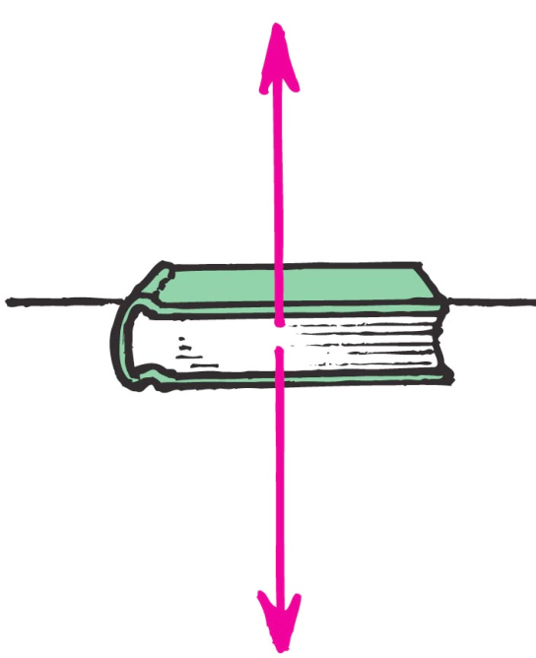
Support Force
Support force is an upward force on an object that is opposite to the force of gravity.
Example: A book on a table compresses
Atoms in the table, and the compressed
atoms produce the support force.
Normal force: component of
support force perpendicular to the
supporting surface.
© 2010 Pearson Education Inc.

Slide 22
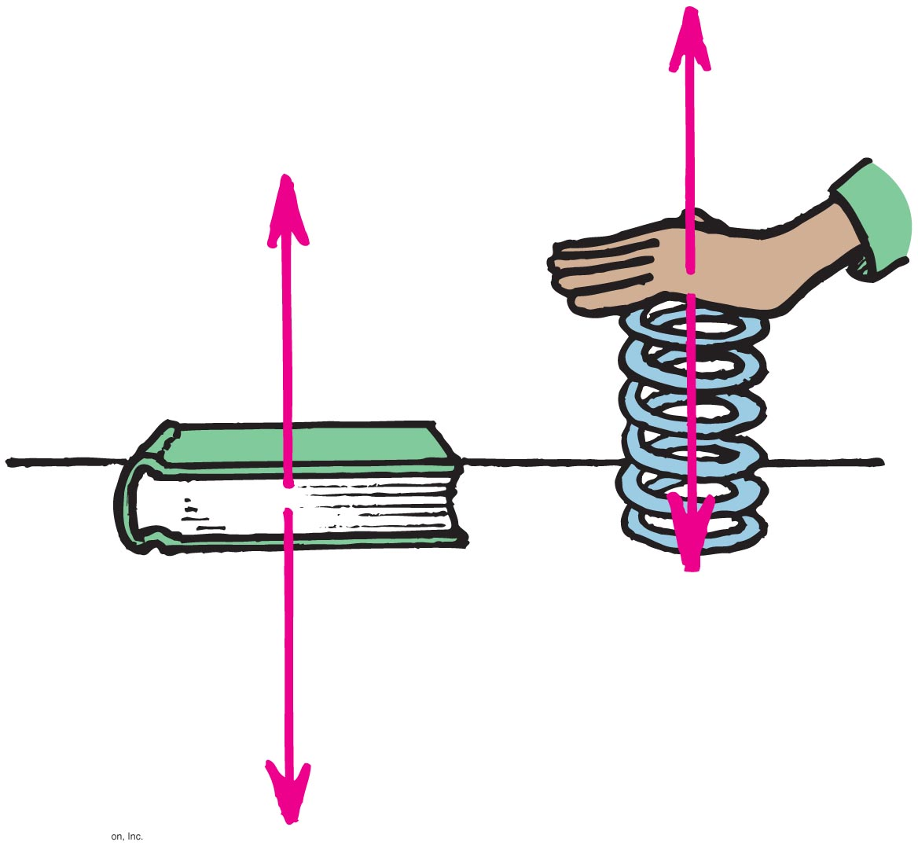
Understanding Support Force
When you push down on a spring, the spring pushes back up on you.
Similarly, when a book pushes down on a table, the table pushes back up on the book.
© 2010 Pearson Education Inc.

Slide 23
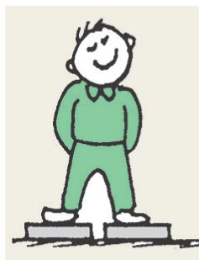
When you stand on two bathroom scales with one foot on each scale and with your weight evenly distributed, each scale will read
your weight.
half your weight.
zero.
more than your weight.
© 2010 Pearson Education Inc.

Slide 24
When you stand on two bathroom scales with one foot on each scale and with your weight evenly distributed, each scale will read
your weight.
half your weight.
zero.
more than your weight.
Explanation:
You are at rest, so ΣF=0.
Forces from both scales add to cancel your weight.
Force from each scale is one-half your weight
© 2010 Pearson Education Inc.

Slide 25
Equilibrium of Moving Things
Equilibrium: a state of no change with no net force acting.
  Static equilibrium
  Example: hockey puck at rest on slippery ice
  Dynamic equilibrium
  Example: hockey puck sliding at constant speed on slippery ice
© 2010 Pearson Education Inc.

Slide 26
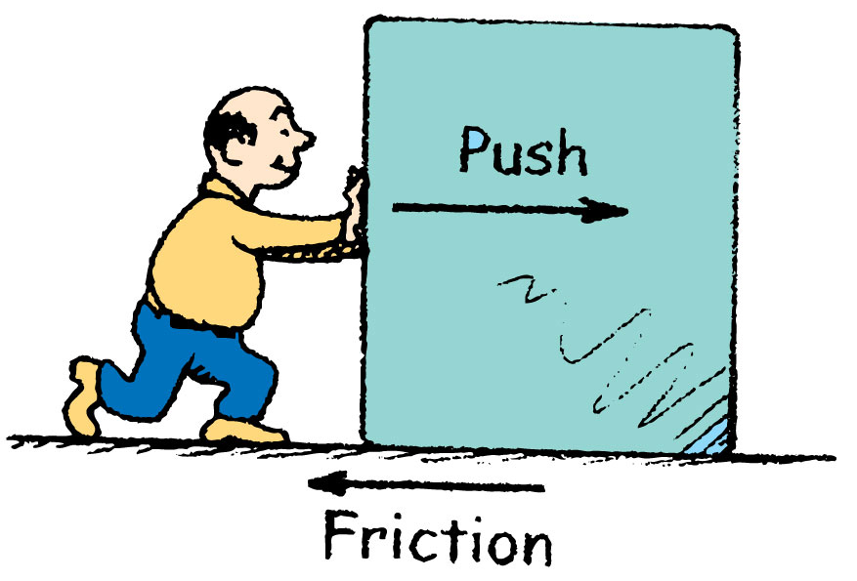
Equilibrium of Moving Things
Equilibrium test: whether something undergoes changes in motion.
  Example: A crate at rest is in static equilibrium.
  Example: When pushed at a steady speed, it is in dynamic equilibrium.
© 2010 Pearson Education Inc.

Slide 27
A bowling ball is in equilibrium when it
is at rest.
moves steadily in a straight-line path.
Both of the above.
None of the above.
© 2010 Pearson Education Inc.

Slide 28
A bowling ball is in equilibrium when it
is at rest.
moves steadily in a straight-line path.
Both of the above.
None of the above.
Explanation:
Equilibrium means no change in motion, so there are two options:
If at rest, it continues at rest.
If in motion, it continues at a steady rate in a straight line.
© 2010 Pearson Education Inc.

Slide 29
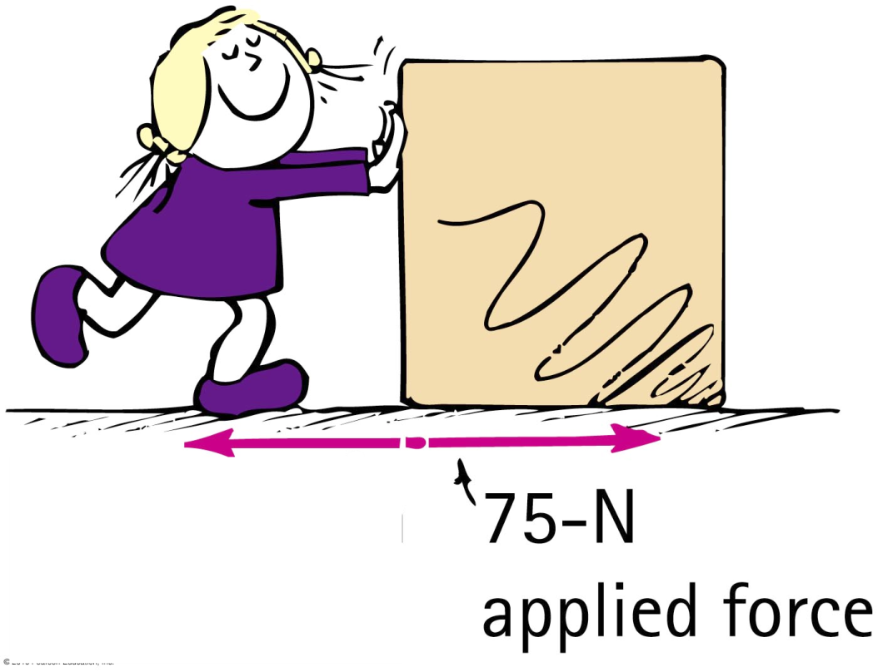
You are pushing a crate at a steady speed in a straight line. If the friction force is 75 N, how much force must you apply?
more than 75 N
less than 75 N
equal to 75 N
not enough information
© 2010 Pearson Education Inc.

Slide 30
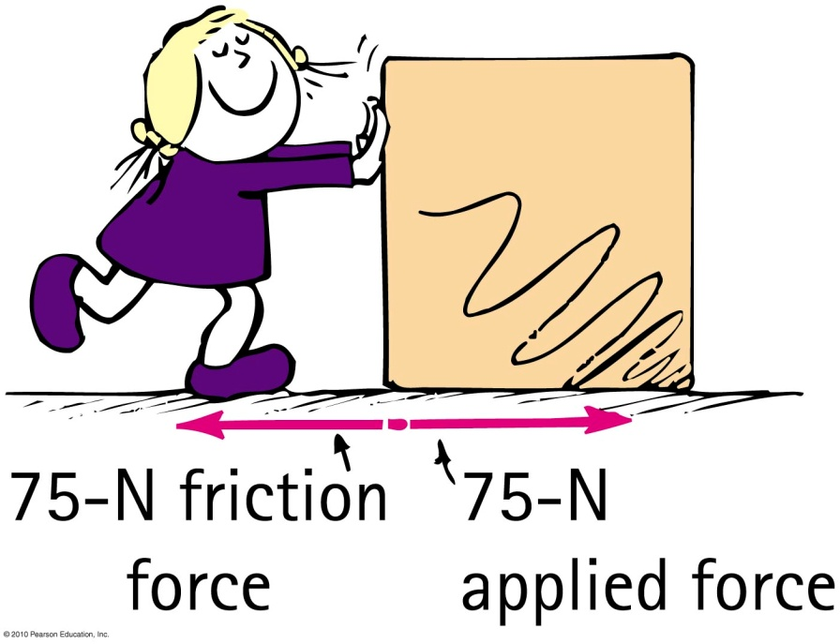
You are pushing a crate at a steady speed in a straight line. If the friction force is 75 N, how much force must you apply?
A. more than 75 N
B. less than 75 N
C. equal to 75 N
D. not enough information
Explanation:
The crate is in dynamic equilibrium, so, ΣF = 0.
Your applied force balances the force of friction.
© 2010 Pearson Education Inc.

Slide 31
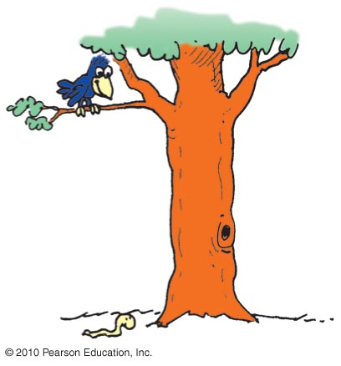
The Moving Earth
Copernicus proposed that Earth was moving.
This idea was refuted by people.
Example: If Earth moved, how can a bird swoop from a branch to catch a worm?
Solution: As it swoops, due to inertia, it continues to go sideways at the speed of Earth along with the tree, worm, etc.
© 2010 Pearson Education Inc.

Slide 32
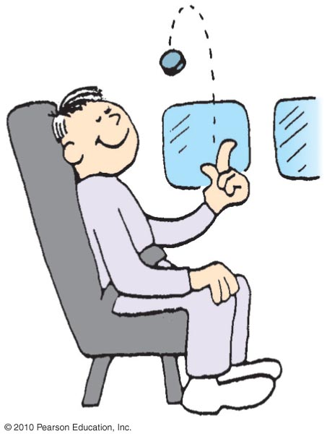
You are riding in a van at a steady speed and toss a coin up. Where will the coin land?
behind you
ahead of you
back in your hand
There is not enough information.
© 2010 Pearson Education Inc.

Slide 33
You are riding in a van at a steady speed and toss a coin up. Where will the coin land?
behind you
ahead of you
back in your hand
There is not enough information.
Explanation:
The coin has inertia. It continues sideways with the van and your hand and lands back in your hand.
© 2010 Pearson Education Inc.

Slide 34
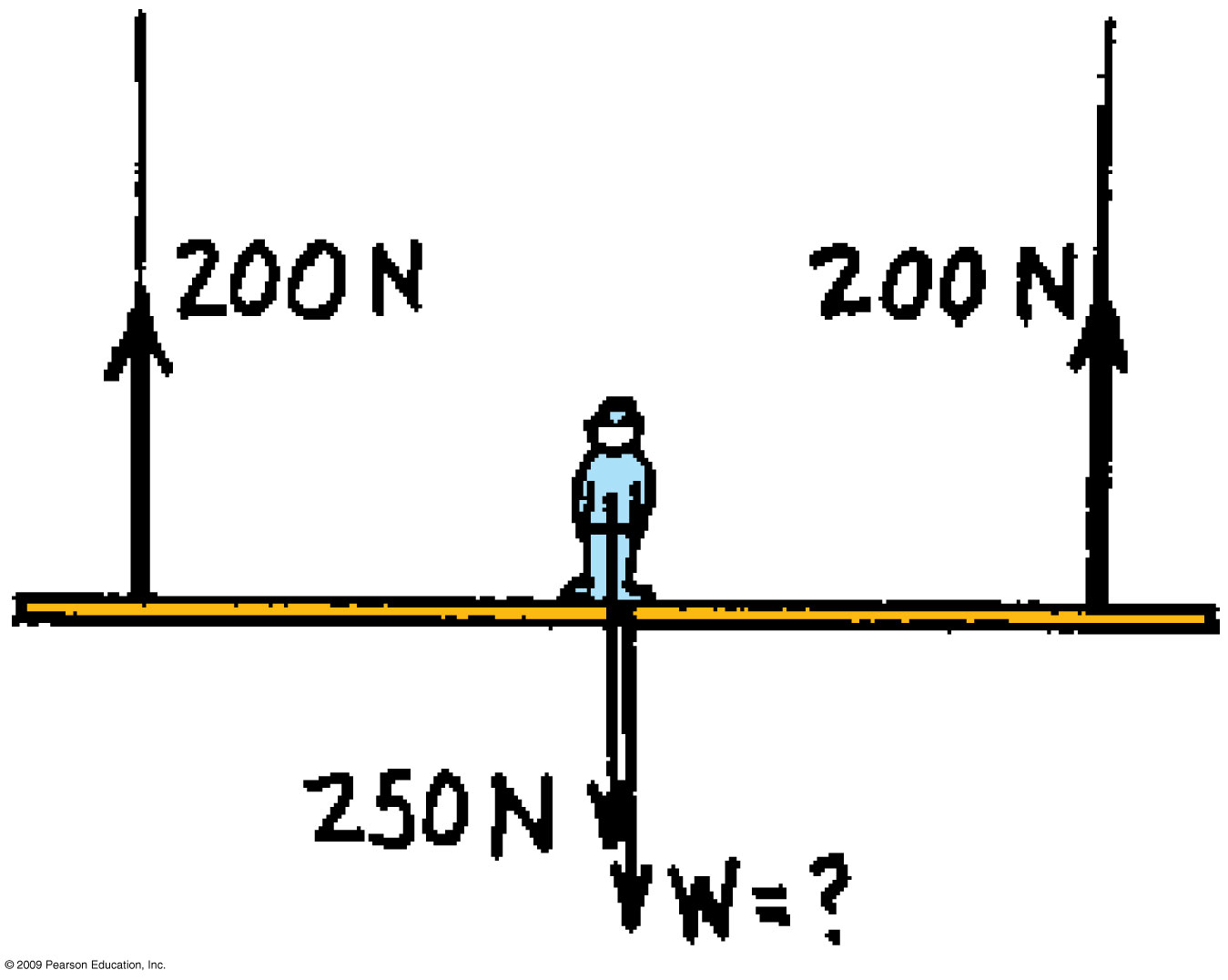
© 2010 Pearson Education Inc.

Slide 35
250 + W = 200 + 200
W = 400 – 250 = 150
=150

Slide 36
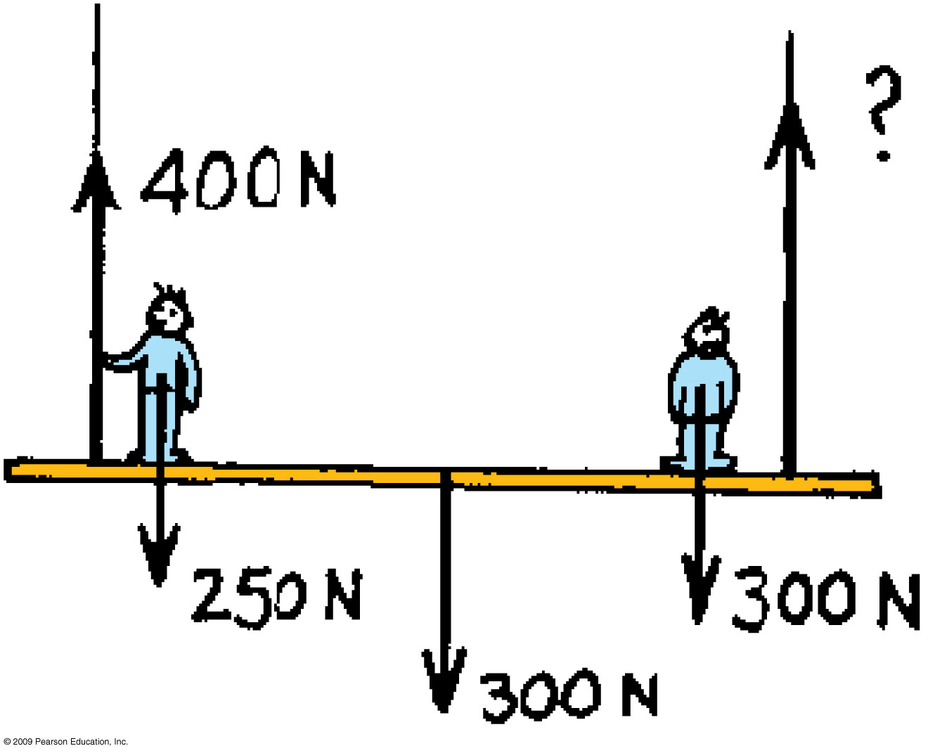
© 2010 Pearson Education Inc.

Slide 37
400 + ? = 250 + 300 + 300
? = 850 – 400 = 450 N
© 2010 Pearson Education Inc.

Slide 38
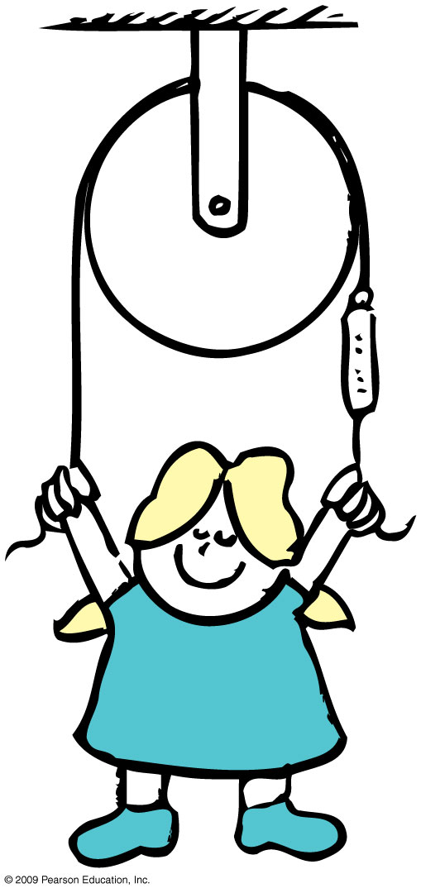
If the girl’s weight is W, what is the reading on the scale?
© 2010 Pearson Education Inc.

Slide 39
= W / 2
© 2010 Pearson Education Inc.

Slide 40
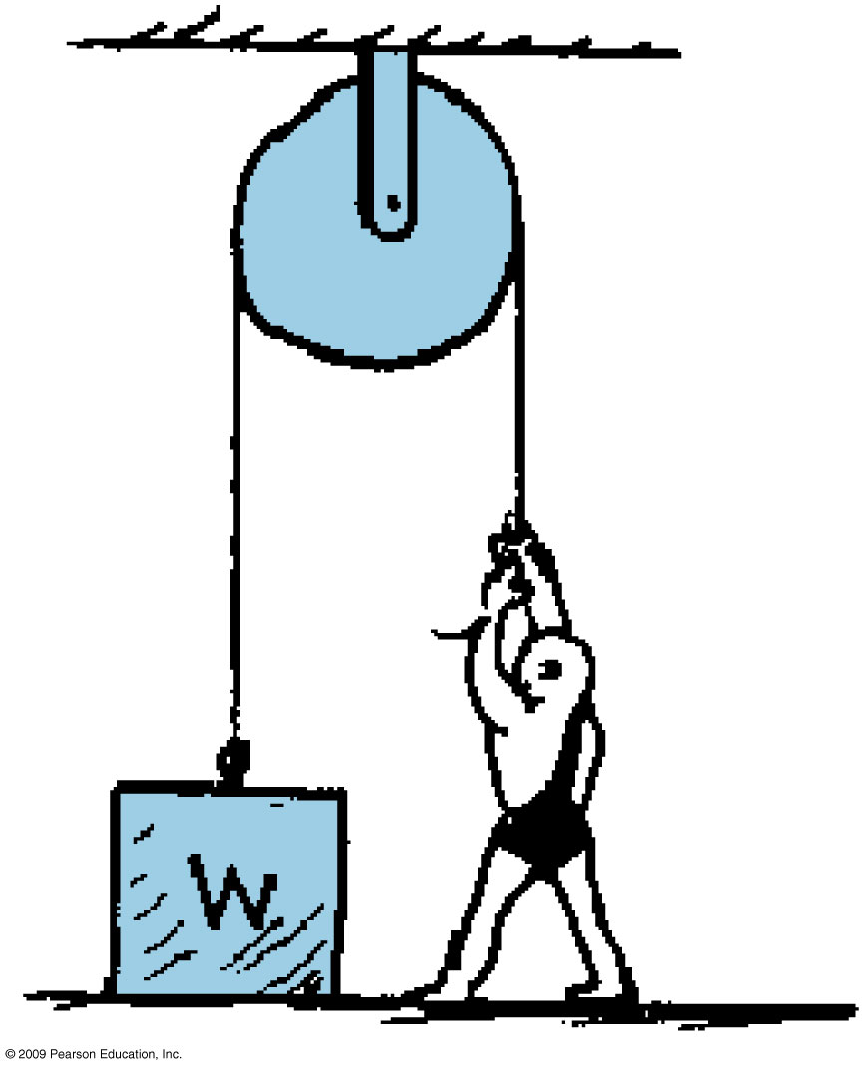
What must the man weigh in order to lift the weight?
© 2010 Pearson Education Inc.

Slide 41
What must the man weigh in order to lift the weight?
Wm > W
© 2010 Pearson Education Inc.

Slide 42
Homework
Read Chapter 2 in Detail.
Do Ranking # 2
Do Exercises 28, 32,40
Do Problem 2
Homework due: May 23

