Slide 1
Chapter 5
NEWTON’S THIRD LAW OF MOTION

Slide 2
From previous weeks …
Newton’s 1st Law of Motion (Law of Inertia)
- Every object continues in a state of rest or of uniform speed in a straight line unless acted on by a nonzero net force.
Newton’s 2nd Law of Motion
- The acceleration of an object is directly proportional to the net force acting on the object, is in the direction of the net force, and is inversely proportional to the mass of the object. F = ma

Slide 3
Objectives- Chapter 5
Forces and Interactions
Newton’s Third Law of Motion
Summary of Newton’s Laws
Vectors

Slide 4
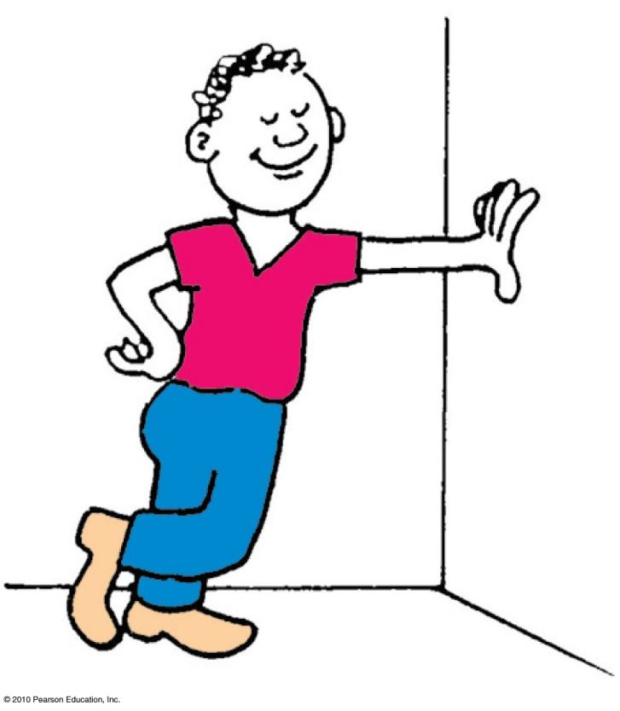
Forces and Interactions
Interaction
is between one thing and another.
requires a pair of forces acting on two objects.
Example: interaction of hand and wall pushing on each other
Force pair—you push on wall; wall pushes on you.
Forces occur in pairs.

Slide 5
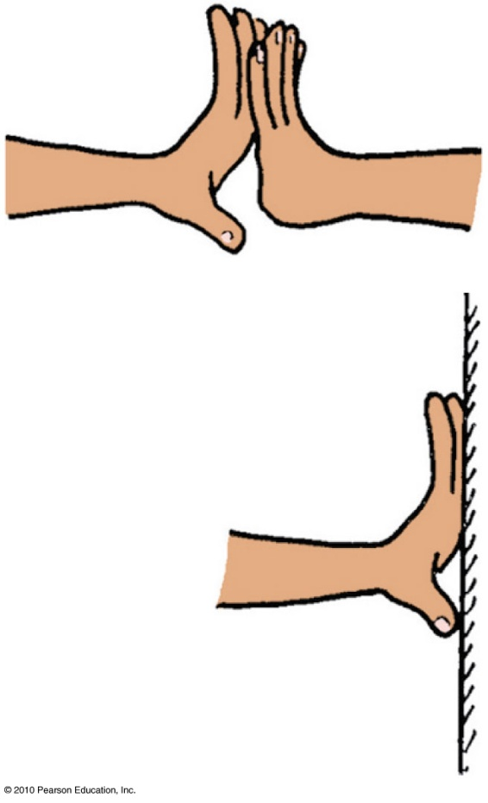
Force Pairs
Every force is a part of an interaction between two objects.
Forces come in pairs.
These forces are equal in magnitude
( have the same strength) and opposite in direction.
An interaction requires a pair of forces acting in two separate objects.

Slide 6
Newton’s Third Law of Motion
Whenever one object exerts a force on a second object, the second object exerts an equal and opposite force on the first.

Slide 7
A soccer player kicks a ball with 1500 N of force. The ball exerts a reaction force against the player’s foot of
A. somewhat less than 1500 N.
1500 N.
somewhat more than 1500 N.
None of the above.
Notes:
B. 1500 N.

Slide 8
A soccer player kicks a ball with 1500 N of force. The ball exerts a reaction force against the player’s foot of
A. somewhat less than 1500 N.
1500 N.
somewhat more than 1500 N.
None of the above.
Notes:
B. 1500 N.

Slide 9
Newton’s Third Law of Motion
Action and reaction forces
one force is called the action force; the other force is called the reaction force.
are co-pairs of a single interaction.
neither force exists without the other.
are equal in strength and opposite in direction.
always act on different objects.

Slide 10
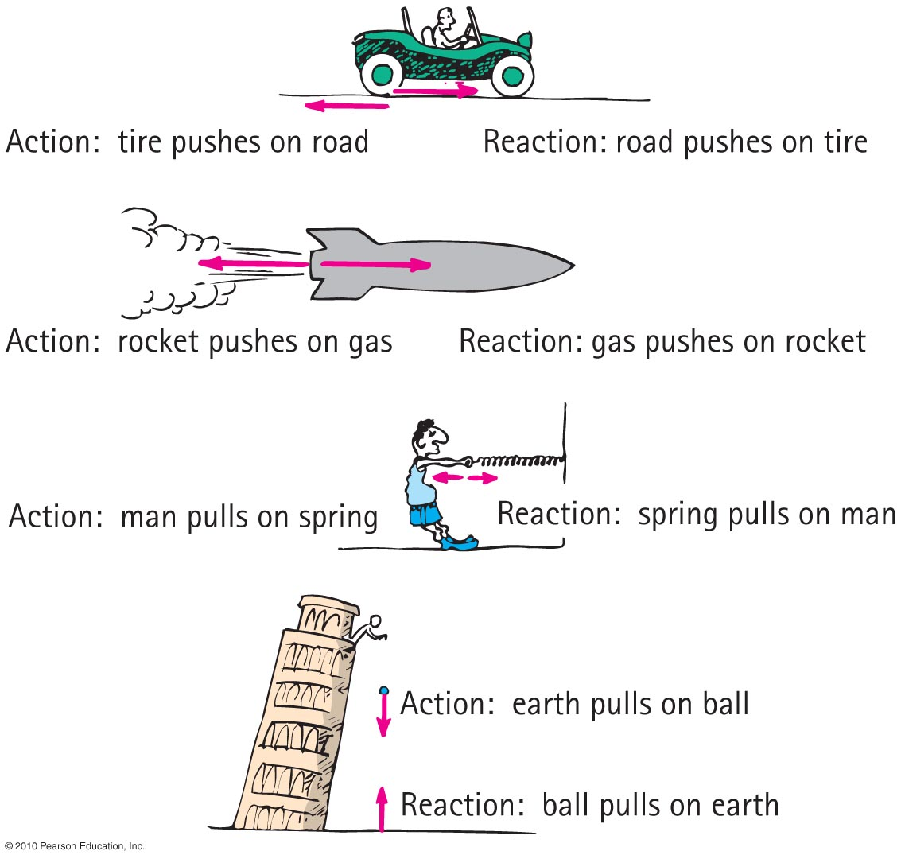
Newton’s Third Law of Motion
Reexpression of Newton’s third law: To every action there is always an opposed equal reaction.
Example: Tires of car push back against the road while the road pushes the tires forward.

Slide 11
Newton’s Third Law of Motion
Simple rule to identify action and reaction
Identify the interaction—one thing interacts with another
  Action: Object A exerts a force on object B.
  Reaction: Object B exerts a force on object A.
  Example: Action—rocket (object A) exerts force on gas (object B).
  Reaction—gas (object B) exerts force on rocket (object A).

Slide 12
When you step off a curb, Earth pulls you downward. The reaction to this force is
A. a slight air resistance.
nonexistent in this case.
you pulling Earth upward.
None of the above.
Notes:
C. you pulling Earth upward.

Slide 13
When you step off a curb, Earth pulls you downward. The reaction to this force is
A. a slight air resistance.
nonexistent in this case.
you pulling Earth upward.
None of the above.
Notes:
C. you pulling Earth upward.

Slide 14
When you step off a curb, Earth pulls you downward and you pull the force upward. Why do you not sense Earth moving upward toward you?
A. Earth is fixed, so it cannot move.
Earth can move, but other objects on it prevent it from moving.
It moves, but a very small amount that you cannot see.
None of the above.
Notes:
C. you pulling Earth upward.

Slide 15
When you step off a curb, Earth pulls you downward and you pull the force upward. Why do you not sense Earth moving upward toward you?
A. Earth is fixed, so it cannot move.
Earth can move, but other objects on it prevent it from moving.
It moves, but a very small amount that you cannot see.
None of the above.
Explanation:
You exert a force on Earth that is equal to the force it exerts on you. But you move more than the Earth does, because its mass is so great compared to your mass that it moves very little and you do not notice it.
Notes:
C. you pulling Earth upward.

Slide 16
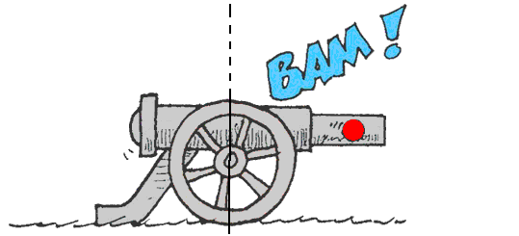
When a cannon is fired, the accelerations of the cannon and cannonball are different because the
A. forces don’t occur at the same time.
forces, although theoretically the same, in practice are not.
masses are different.
ratios of force to mass are the same.

Slide 17
When a cannon is fired, the accelerations of the cannon and cannonball are different because the
A. forces don’t occur at the same time.
forces, although theoretically the same, in practice are not.
masses are different.
ratios of force to mass are the same.

Slide 18
Action and Reaction on Different Masses
Cannonball:
Cannon:
The same force exerted on a small mass produces a large acceleration.
The same force exerted on a large mass produces a small acceleration.
F
= a
m
F
= a
m

Slide 19
Consider a high-speed bus colliding head-on with an innocent bug. The force of impact splatters the unfortunate bug over the windshield.
Which is greater, the force on the bug or the force on the bus?
A. Bug
Bus
Both are the same.
Cannot say

Slide 20
Consider a high-speed bus colliding head-on with an innocent bug. The force of impact splatters the unfortunate bug over the windshield.
Which is greater, the force on the bug or the force on the bus?
A. Bug
Bus
Both are the same.
Cannot say

Slide 21
Two people of equal mass on slippery ice push off from each other. Will both move at the same speed in opposite directions?
A. Yes
Yes, but only if both push equally
No
No, unless acceleration occurs
Notes:
A. Yes.

Slide 22
Two people of equal mass on slippery ice push off from each other. Will both move at the same speed in opposite directions?
A. Yes
Yes, but only if both push equally
No
No, unless acceleration occurs
Explanation:
However they push, the result is equal-magnitude forces on equal masses, which produces equal accelerations; therefore, there are equal changes in speed.

Slide 23
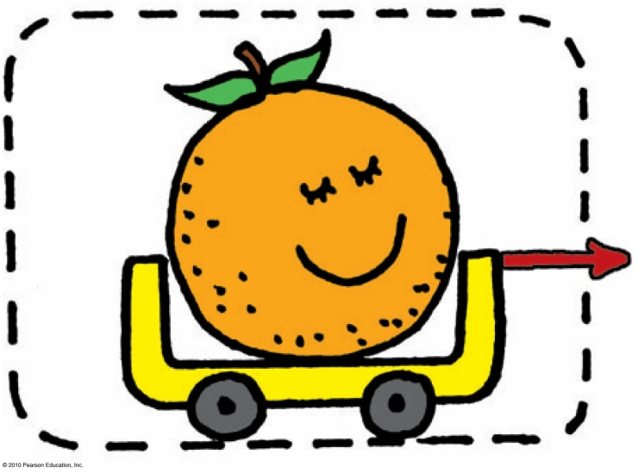
Newton’s Third Law of Motion
Defining Your System
Consider a single enclosed orange.
  Applied external force causes the orange to accelerate in accord with Newton’s second law.
  Action and reaction pair of forces is not shown.

Slide 24
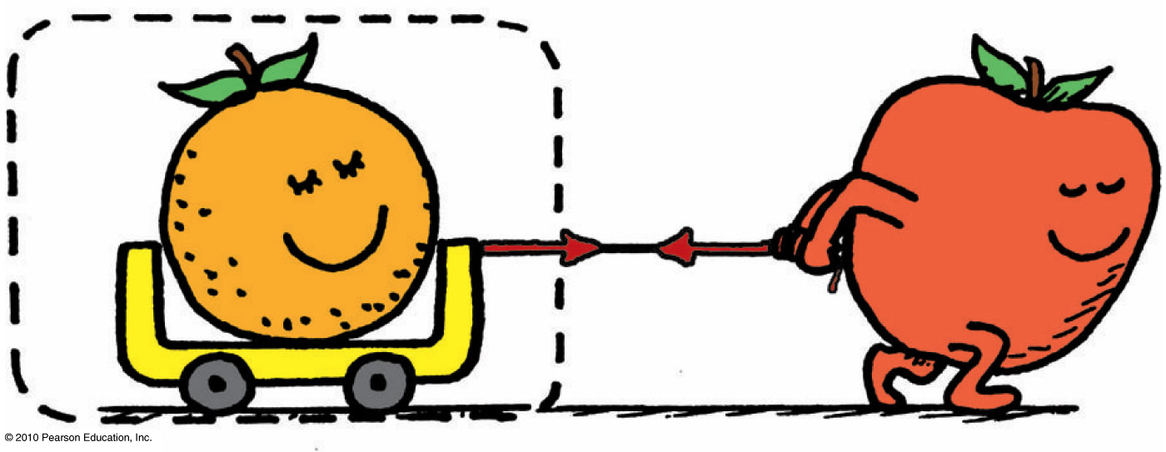
Newton’s Third Law of Motion
Consider the orange and the apple pulling on it.
  Action and reaction do not cancel (because they act on different things).
  External force by apple accelerates the orange.

Slide 25
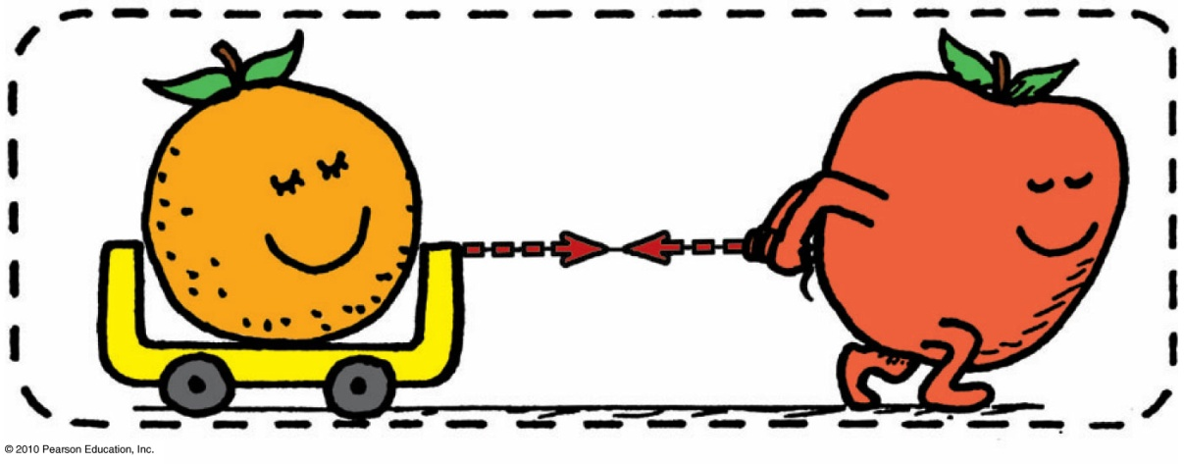
Newton’s Third Law of Motion
Consider a system comprised of both the orange and the apple
  The apple is no longer external to the system.
  Force pair is internal to system, which doesn’t cause acceleration.
  Action and reaction within the system cancel.
  With no external forces, there is no acceleration of system.

Slide 26
Newton’s Third Law of Motion
Consider the same system, but with external force of friction on it.
  Same internal action and reaction forces (between the orange and apple) cancel.
  A second pair of action-reaction forces (between the apple’s feet and the floor) exists.

Slide 27
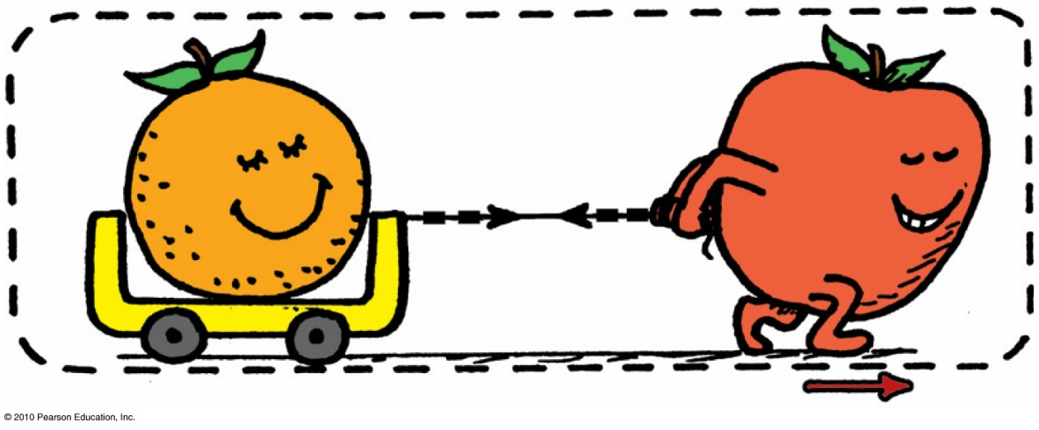
Newton’s Third Law of Motion
  One of these acts by the system (apple on the floor) and the other acts on the system (floor on the apple).
  External frictional force of floor pushes on the system, which accelerates.
  Second pair of action and reaction forces do not cancel.

Slide 28
When lift equals the weight of a helicopter, the helicopter
A. climbs down.
climbs up.
hovers in midair.
None of the above.

Slide 29
When lift equals the weight of a helicopter, the helicopter
A. climbs down.
climbs up.
hovers in midair.
None of the above.

Slide 30
When lift is greater, the helicopter
A. climbs down.
climbs up.
hovers in midair.
None of the above.

Slide 31
When lift is greater, the helicopter
A. climbs down.
climbs up.
hovers in midair.
None of the above.

Slide 32
A bird flies by
A. flapping its wings.
pushing air down so that the air pushes it upward.
hovering in midair.
inhaling and exhaling air.

Slide 33
A birds flies by
A. flapping its wings.
pushing air down so that the air pushes it upward.
hovering in midair.
inhaling and exhaling air.

Slide 34
Compared with a lightweight glider, a heavier glider would have to push air
A. downward with greater force.
downward with the same force.
downward with less force.
None of the above.

Slide 35
Compared with a lightweight glider, a heavier glider would have to push air
A. downward with greater force.
downward with the same force.
downward with less force.
None of the above.
Explanation:
The force on the air deflected downward must equal the weight of the glider.

Slide 36
Summary of Newton’s Three Laws of Motion
Newton’s first law of motion (the law of inertia)
  An object at rest tends to remain at rest; an object in motion tends to remain in motion at constant speed along a straight-line path.
Newton’s second law of motion (the law of acceleration)
  When a net force acts on an object, the object will accelerate. The acceleration is directly proportional to the net force and inversely proportional to the mass.
Newton’s third law of motion (the law of action and reaction)
  Whenever one object exerts a force on a second object, the second object exerts an equal and opposite force on the first.

Slide 37
Vectors
Vector quantity
has magnitude and direction.
is represented by an arrow.
Example: velocity, force, acceleration
Scalar quantity
has magnitude.
Example: mass, volume, speed

Slide 38
Vectors
Resultant
The sum of two or more vectors
  For vectors in the same direction, add arithmetically.
  For vectors in opposite directions, subtract arithmetically.
  Two vectors that don’t act in the same or opposite direction:
    use parallelogram rule.
  Two vectors at right angles to each other
    use Pythagorean Theorem: R² = V² + H².

Slide 39
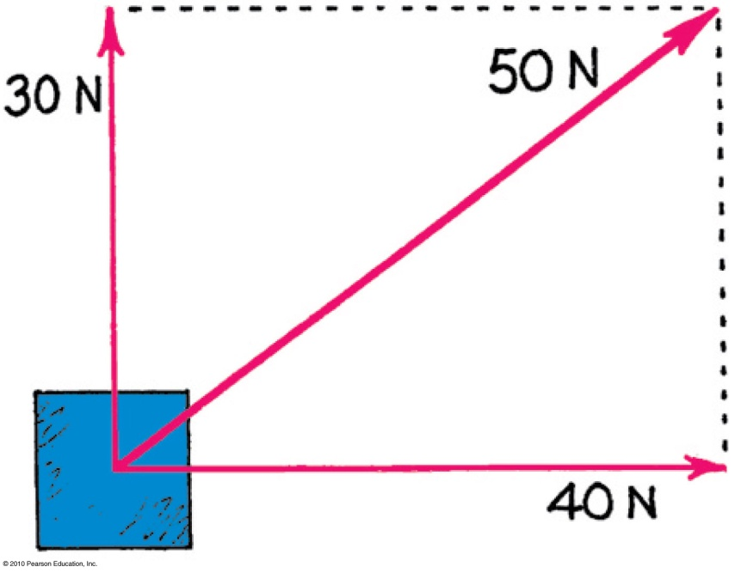
Referring to the figure, which of the following are true statements?
A. 50 N is the resultant of the 30- and 40-N vectors.
The 30-N vector can be considered a component of the 50-N vector.
The 40-N vector can be considered a component of the 50-N vector.
All of the above are correct.
Notes:
D. All of the above are correct.

Slide 40
Referring to the figure, which of the following are true statements?
A. 50 N is the resultant of the 30- and the 40-N vectors.
The 30-N vector can be considered a component of the 50-N vector.
The 40-N vector can be considered a component of the 50-N vector.
All of the above are correct.
Notes:
D. All of the above are correct.

Slide 41
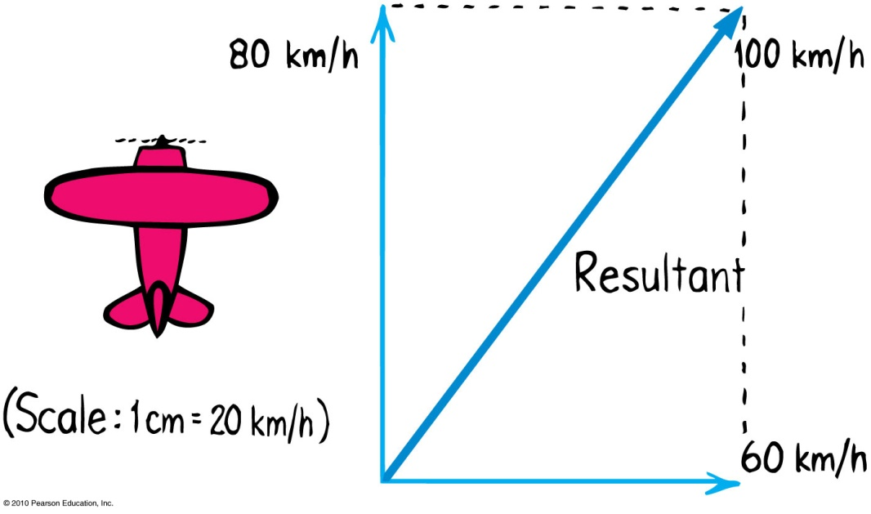
Referring to the figure, which of the following are true statements?
A. 100 km/h is the resultant of the 80- and 60-km/h vectors.
The 80-km/h vector can be considered a component of the 100-km/h vector.
C. The 60-km/h vector can be considered a component of the 100-km/h vector.
All of the above are correct.
Notes:
D. All of the above are correct.

Slide 42
Referring to the figure, which of the following are true statements?
A. 100 km/h is the resultant of the 80- and 60-km/h vectors.
The 80-km/h vector can be considered a component of the 100-km/h vector.
C. The 60-km/h vector can be considered a component of the 100-km/h vector.
All of the above are correct.
Notes:
D. All of the above are correct.

Slide 43
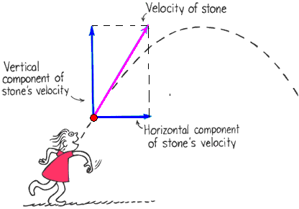
Vectors
Vector components
Vertical and horizontal components of a vector are perpendicular to each other.
Determined by resolution.

Slide 44
You run horizontally at 4 m/s in a vertically falling rain that falls at 4 m/s. Relative to you, the raindrops are falling at an angle of
A. 0°.
45°.
53°.
90°.
Notes:
B. 45°.

Slide 45
You run horizontally at 4 m/s in a vertically falling rain that falls at 4 m/s. Relative to you, the raindrops are falling at an angle of
A. 0°.
45°.
53°.
90°.
Explanation:
The horizontal 4 m/s and vertical 4 m/s combine by the parallelogram rule to produce a resultant of 5.6 m/s at 45°.
Notes:
B. 45°.

Slide 46
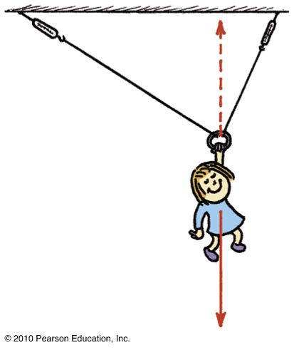
Vectors
Nellie Newton hangs from a rope as shown.
Which side has the greater tension?
There are three forces acting on Nellie:
  her weight,
  a tension in the left-hand side of the rope,
  and a tension in the right-hand side of the rope.

Slide 47
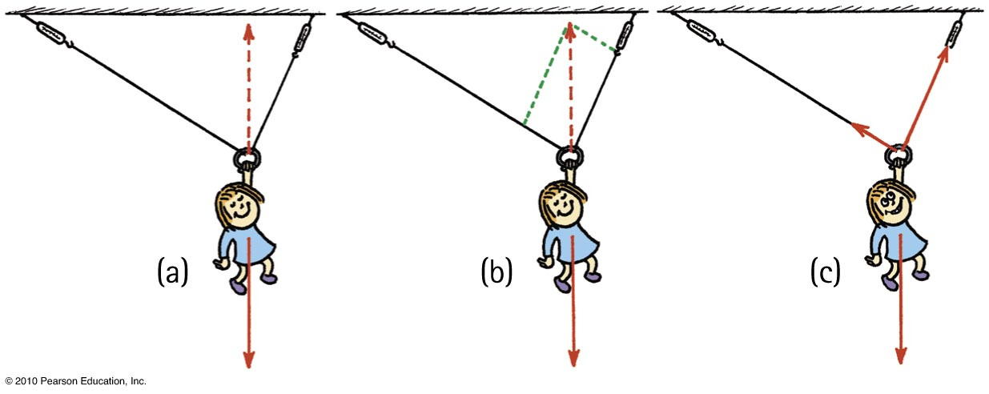
Vectors
Because of the different angles, different rope tensions will occur in each side.
Nellie hangs in equilibrium, so her weight is supported by two rope tensions, adding vectorially to be equal and opposite to her weight.
The parallelogram rule shows that the tension in the right-hand rope is greater than the tension in the left-hand rope.

Slide 48
Chapter 5 Problems
2. If you stand next to a wall on a frictionless skateboard and push the wall with a force of 40 N, how hard does the wall push on you?
The wall must exert an equal and opposite force or 40N
If your mass is 80 kg, show that your acceleration is 0.5 m/s .
a = F/m = 40 N / 80 kg = 40 kg m/s² / 80 kg = 0.5 m/s².

Slide 49
Homework
Read Chapter 5 in Detail.
Do Exercises 13, 16, 24, 44
Do Problem 2.
Homework due: Jun 04

