Slide 1
Chapter 6
MOMENTUM

Slide 2
Outline
Momentum
Impulse
Bouncing
Conservation of Momentum
Collisions
More Complicated Collisions

Slide 3
Momentum
Momentum is a property of moving things.
It means inertia in motion
more specifically, mass of an object multiplied by its velocity.
in equation form:
  Momentum = mass × velocity
  P = m v
  Momentum is a vector.

Slide 4
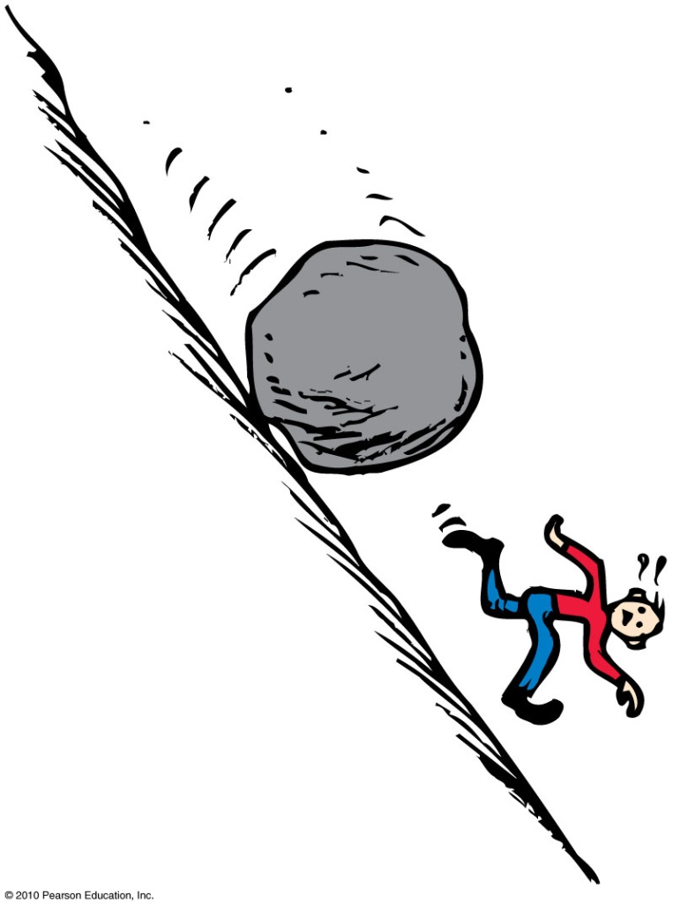
Momentum
P = m v
Example:
  A moving boulder has more momentum than a stone rolling at the same speed.
  A fast boulder has more momentum than a slow boulder.
  A boulder at rest has no momentum.

Slide 5
A moving object has
A. momentum.
energy.
speed.
All of the above.
Notes:
D. all of the above.

Slide 6
A moving object has
A. momentum.
energy.
speed.
All of the above.
Comment:
We will see in the next chapter that energy in motion is called kinetic energy.
Notes:
D. all of the above.

Slide 7
When the speed of an object is doubled, its momentum
A. remains unchanged in accord with the conservation of momentum.
doubles.
quadruples.
decreases.
Notes:
B. doubles.

Slide 8
When the speed of an object is doubled, its momentum
A. remains unchanged in accord with the conservation of momentum.
doubles.
quadruples.
decreases.
P = mv
Notes:
B. doubles.

Slide 9
When momentum of an object changes, either mass or velocity or both change.
It mass doesn't change, then velocity must change to have a change in momentum.
When the velocity changes, an acceleration occurs.
Because acceleration = force / mass , that means there must be a force to produce acceleration.
Higher the force, higher the acceleration , higher the change in velocity, and as a result, higher the change in momentum.
F = ma = m(Δv/t) = ΔP/t
ΔP = Ft

Slide 10
In addition to force, the time that the force acts on an object is also important.
When you apply a force for a certain period of time, the change in momentum occurs.
If you apply the same force for a longer period of time, the change in momentum is greater.
Both force and the time interval are important in changing momentum.

Slide 11
Impulse
Product of force and time (force × time)
In equation form: Impulse = Ft
Not something an object has
Impulse is what an object provide or what it can experience when it interacts with another object.

Slide 12
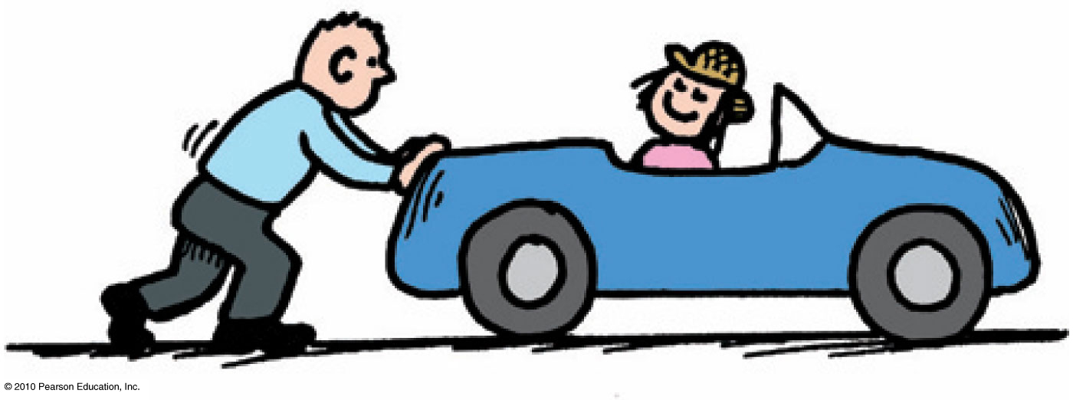
Impulse = Change in Momentum
The greater the impulse exerted on something, the greater the change in momentum.
  In equation form: Ft = Δ(mv)

Slide 13
Impulse
Examples:
Impulse = Ft
  Ft = Δ(mv)
  A brief force applied over a short time interval produces a smaller change in momentum than the same force applied over a longer time interval.
or
  If you push with the same force for twice the time, you impart twice the impulse and produce twice the change in momentum.

Slide 14
When the force that produces an impulse acts for twice as much time, the impulse is
Impulse = Ft
A. not changed.
doubled.
quadrupled.
halved.
Notes:
B. increased by twice.

Slide 15
When the force that produces an impulse acts for twice as much time, the impulse is
Impulse = Ft
A. not changed.
doubled.
quadrupled.
halved.
Notes:
B. increased by twice.

Slide 16
Impulse = Change in Momentum
  I = Ft = Δ(mv)
  What happens when we
  Increase momentum?
  Decrease momentum over a long time?
  Decrease momentum over a short time?

Slide 17
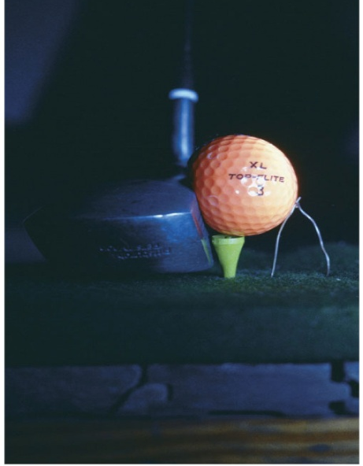
Impulse = Change in Momentum
I = Ft = Δ(mv)
  Case 1: increasing momentum
To increase the momentum
  Apply the greatest force for as long as possible and extend the time of contact.
  Force can vary throughout the duration of contact.
  Examples:
    Golfer swings a club and
    follows through.
    Baseball player hits a ball and
    follows through.

Slide 18
Impulse = Change in Momentum
I = Ft = Δ(mv)
Case 2: decreasing momentum over a long time
  extend the time during which momentum is reduced.
  Example: If you were in a car that was out of control and you had to choose between hitting a concrete wall or a haystack, what would you choose?

Slide 19
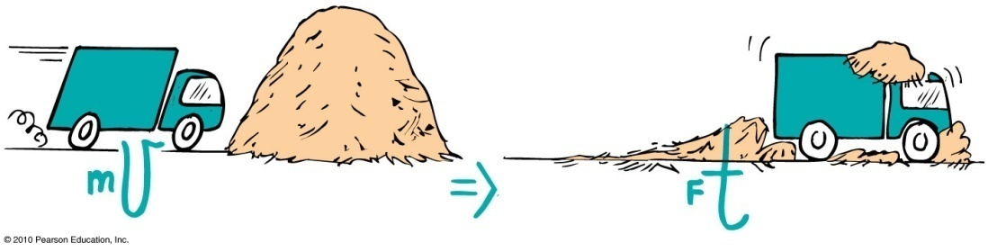
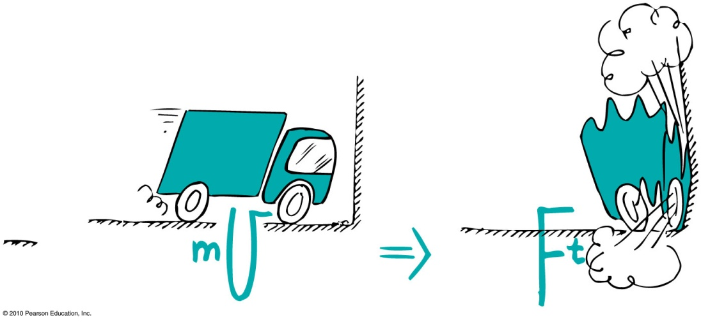
Impulse = Change in Momentum
  When a car is out of control, it is better to hit a haystack than a concrete wall.
Physics reason: Same impulse either way, but extension of hitting time reduces the force.

Slide 20
A fast-moving car hitting a haystack or a cement wall produces vastly different results.
1. Do both experience the same change in momentum?
2. Do both experience the same impulse?
3. Do both experience the same force?
A. Yes for all three
Yes for 1 and 2
No for all three
No for 1 and 2
I = Ft = Δ(mv)
Notes:
B. Yes for 1 and 2.

Slide 21
A fast-moving car hitting a haystack or hitting a cement wall produces vastly different results.
1. Do both experience the same change in momentum?
2. Do both experience the same impulse?
3. Do both experience the same force?
I = Ft = Δ(mv)
A. Yes for all three
Yes for 1 and 2
No for all three
No for 1 and 2
Explanation:
Although stopping the momentum is the same whether done slowly or quickly, the force is vastly different. Be sure to distinguish among momentum, impulse, and force.
Notes:
B. Yes for 1 and 2.

Slide 22
When a dish falls, will the change in momentum be less if it lands on a carpet than if it lands on a hard floor? (Careful!)
I = Ft = Δ(mv)
A. No, both are the same.
Yes, less if it lands on the carpet.
No, less if it lands on a hard floor.
No, more if it lands on a hard floor.
Notes:
A. No, both are the same.

Slide 23
When a dish falls, will the change in momentum be less if it lands on a carpet than if it lands on a hard floor? (Careful!)
A. No, both are the same.
Yes, less if it lands on the carpet.
No, less if it lands on a hard floor.
No, more if it lands on a hard floor.
Explanation:
The momentum becomes zero in both cases, so both change by the same amount. Although the momentum change and impulse are the same, the force is less when the time of momentum change is extended. Be careful to distinguish among force, impulse, and momentum.
I = Ft = Δ(mv)
Notes:
A. No, both are the same.

Slide 24
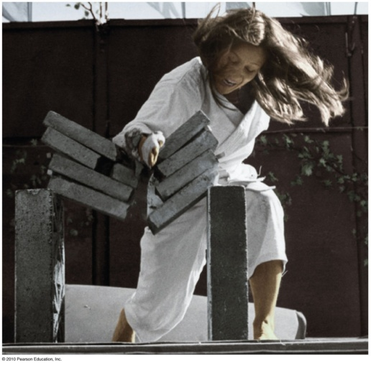
Impulse = Change in Momentum
I = Ft = Δ(mv)
Case 3: decreasing momentum over a short time
  short time interval produces large force.
  Example: Karate expert splits a
  stack of bricks by bringing her arm and hand swiftly against
  the bricks with considerable
  momentum. Time of contact is
  brief and force of impact is huge.

Slide 25
Bouncing
Impulses are generally greater when objects bounce.
Example:
  Catching a falling flower pot from a shelf with your hands. You provide the impulse to reduce its momentum to zero. If you throw the flower pot up again, you provide an additional impulse. This “double impulse” occurs when something bounces.
I = Ft = Δ(mv)

Slide 26
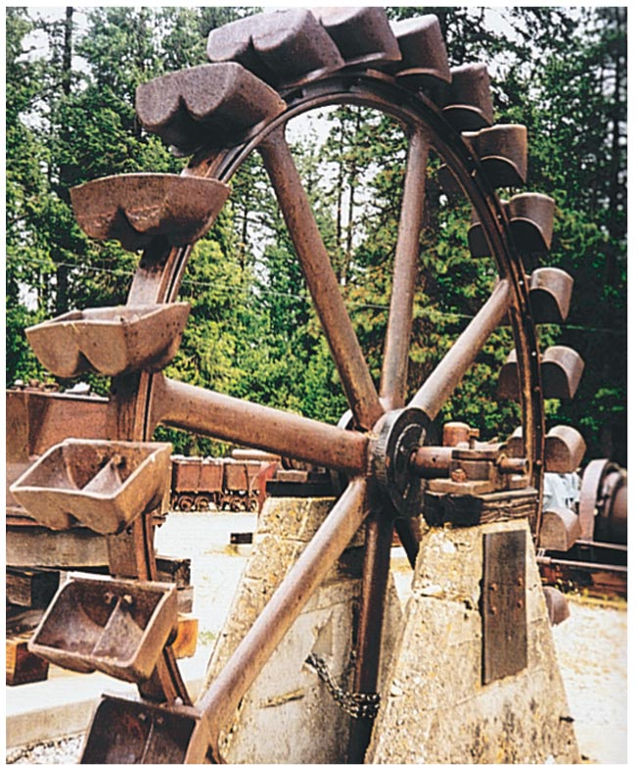
Bouncing
Pelton wheel designed to “bounce” water when it makes a U-turn on impact with the curved paddle
Gets energy from the momentum of moving water. When water bounces from curved paddles, it increases the impulse on the wheel.

Slide 27
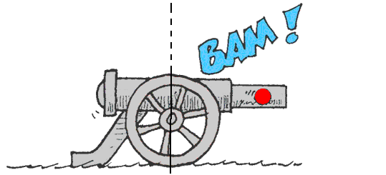
Conservation of Momentum
Law of conservation of momentum:
  In the absence of an external force, the momentum of a system remains unchanged.

Slide 28
Conservation of Momentum
Examples:
    When a cannon is fired, the force on the cannonball inside the cannon barrel is equal and opposite to the force of the cannonball on the cannon.
    The cannonball gains momentum, while the cannon gains an equal amount of momentum in the opposite direction—the cannon recoils.
  When no external force is present, no external impulse is present, and no change in momentum is possible.

Slide 29
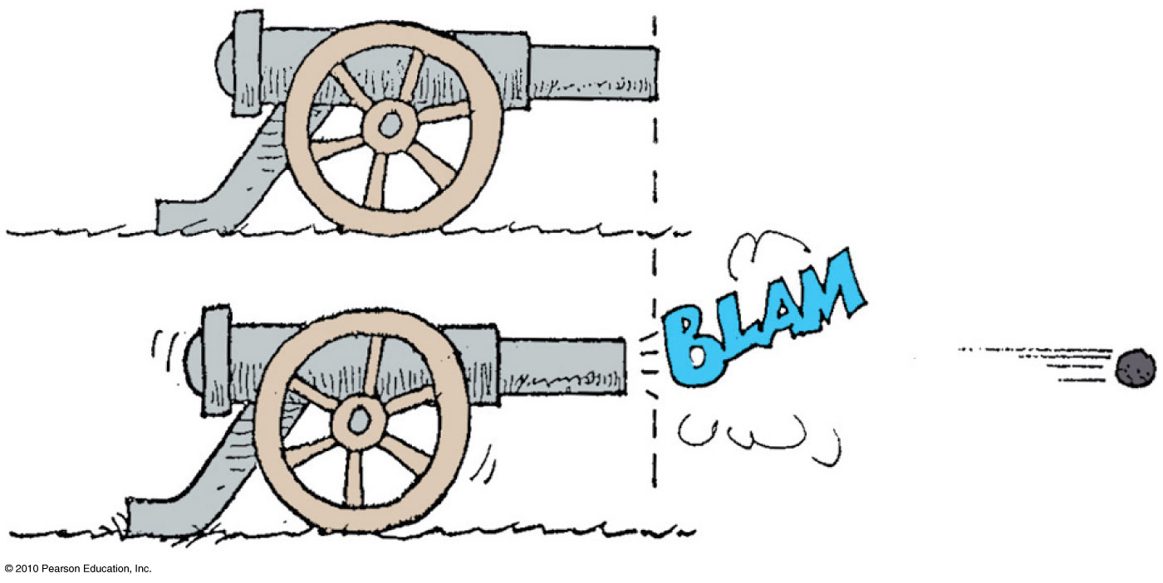
Momentum of the system before firing = 0
Force on cannon = force on cannonball (Newton’s 3rd Law)
Time is the same. Therefore, impulse or change in momentum is the same.
Momentum of the cannonball = momentum of the cannon in opposite direction
Momentum of the system after firing = 0
Momentum is conserved !!!

Slide 30
Collisions
For all collisions in the absence of external forces,
  net momentum before collision equals net momentum after collision.
  in equation form:
(net mv)_{before} = (net mv)_{after}
In the absence of external forces, for all collisions momentum is conserved.

Slide 31
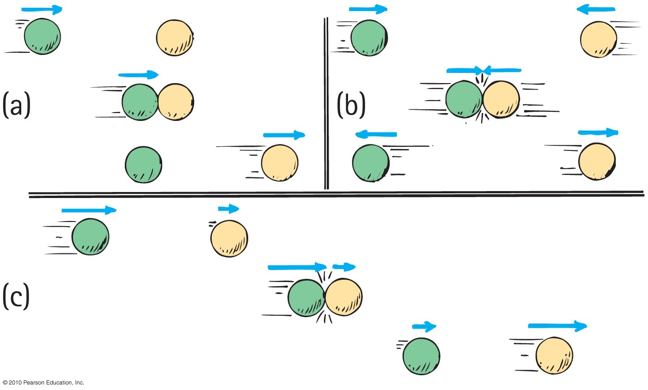
Collisions
Elastic collision
  occurs when colliding objects rebound without lasting deformation or any generation of heat.

Slide 32
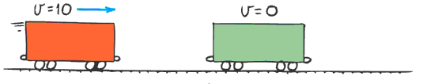
Collisions
Inelastic collision
  occurs when colliding objects result in deformation and/or the generation of heat.

Slide 33
Collisions
Example of elastic collision:
single car moving at 10 m/s collides with another car of the same mass, m, at rest
From the conservation of momentum,
(net mv)_{before} = (net mv)_{after}
(m × 10)_{before} = (2m × V)_{after}
V = 5 m/s

Slide 34
Freight car A is moving toward identical freight car B that is at rest. When they collide, both freight cars couple together. Compared with the initial speed of freight car A, the speed of the coupled freight cars is
A. the same.
half.
twice.
None of the above.
Notes:
B. half.

Slide 35
Freight car A is moving toward identical freight car B that is at rest. When they collide, both freight cars couple together. Compared with the initial speed of freight car A, the speed of the coupled freight cars is
A. the same.
half.
twice.
None of the above.
Explanation:
After the collision, the mass of the moving freight cars has doubled. Can you see that their speed is half the initial velocity of freight car A?
Notes:
B. half.

Slide 36
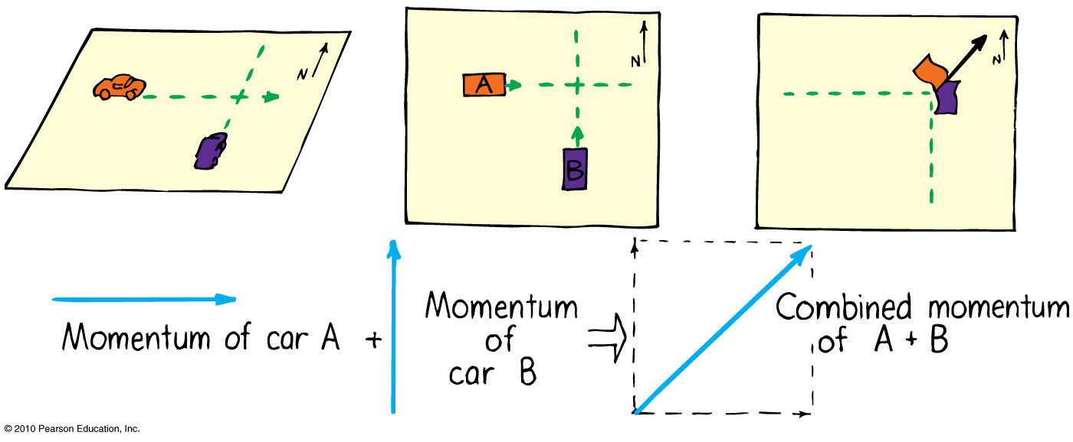
More Complicated Collisions
Sometimes the colliding objects are not moving in the same straight line.
In this case you create a parallelogram of the vectors describing each initial momentum to find the combined momentum.
Example: collision of two cars at a corner

Slide 37
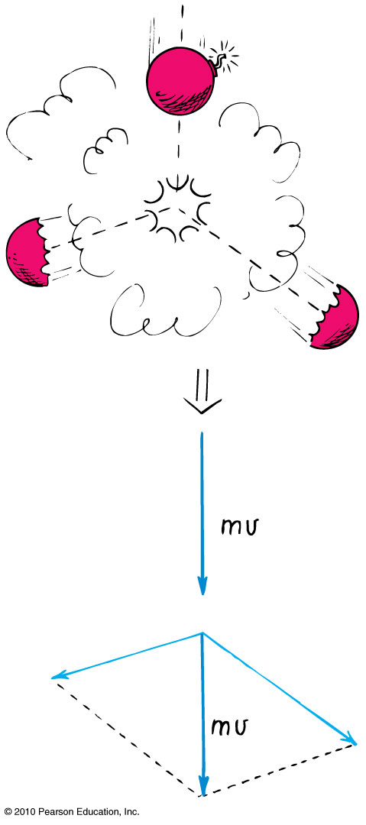
More Complicated Collisions
Another example:
A firecracker exploding; the total momentum of the pieces after the explosion can be added vectorially to get the initial momentum of the firecracker before it exploded.

Slide 38
Chapter 6 Problems
2. Joanne drives her car with a mass of 1000 kg at a speed of 20 m/s. Show that to bring her car to a halt in 10 s road friction must exert a force of 2000 N on the car.
I = F t = Δ(mv)

Slide 39
Chapter 6 Problems
2. Joanne drives her car with a mass of 1000 kg at a speed of 20 m/s. Show that to bring her car to a halt in 10 s road friction must exert a force of 2000 N on the car.
Since F t = Δmv, then F = Δmv/t = (1000 kg)( 20 m/s) /10s
F = 2000 kg m /s²

Slide 40
Chapter 6 Problems
4. Judy (mass 40 kg), standing on slippery ice, catches her leaping dog (mass 15 kg) moving horizontally at 3.0 m/s. Show that the speed of Judy and her dog after the catch is 0.8 m/s.
Hint: momentum is conserved.

Slide 41
Chapter 6 Problems
4. Judy (mass 40 kg), standing on slippery ice, catches her leaping dog (mass 15 kg) moving horizontally at 3.0 m/s. Show that the speed of Judy and her dog after the catch is 0.8 m/s.
momentum before = momentum after
m_{Judy} v_{Judy} + m_{dog} v_{dog} = (m_{Judy} + m_{dog} ) v_{after}
v_{after} = m_{dog} v_{dog} / (m_{Judy} + m_{dog} ) =
v_{after} = 15 kg 3.0 m/s / (40 kg + 15 kg)
v_{after} = 45 kg m/s / 55 kg = 0.8 m/s

Slide 42
Chapter 6 Problems
6 A railroad diesel engine weighs four times as much as a freight car. If the diesel engine coasts at 5 km/h into a
freight car that is initially at rest show that the speed of the coupled cars is 4 km/h.

Slide 43
Homework
Read Chapter 6 in Detail.
Do Ranking 4
Do Exercises 21, 48
Do Problems 8, 10
Homework due: June 06

