Slide 1
Chapter 7
ENERGY

Slide 2
In this lecture you will learn about:
Work
Power
Mechanical Energy : Potential and Kinetic
Work-Energy Theorem
Conservation of Energy
Machines
Efficiency

Slide 3
Work
An object’s motion depends both on force and on how long the force acts.
When ‘how long’ = time;
Impulse = force x time
When ‘how long’ = distance
Work = force x distance

Slide 4
Work
Work
involves force and distance.
is force × distance.
in equation form: W = Fd.
Two things occur whenever work is done:
application of force
movement of something by that force

Slide 5
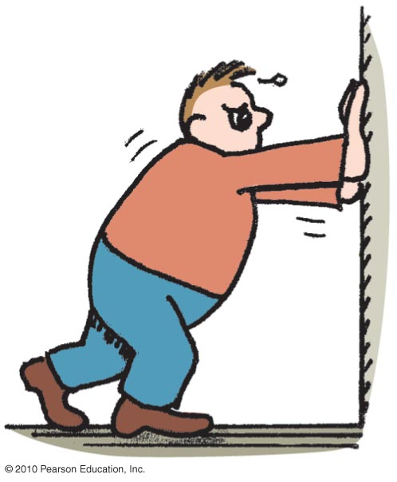
If you push against a stationary brick wall for several minutes, you do no work
A. on the wall.
at all.
Both of the above.
None of the above.
Notes:
A. on the wall.

Slide 6
If you push against a stationary brick wall for several minutes, you do no work
A. on the wall.
at all.
Both of the above.
None of the above.
Explanation:
You may do work on your muscles, but not on the wall.
Notes:
A. on the wall.

Slide 7
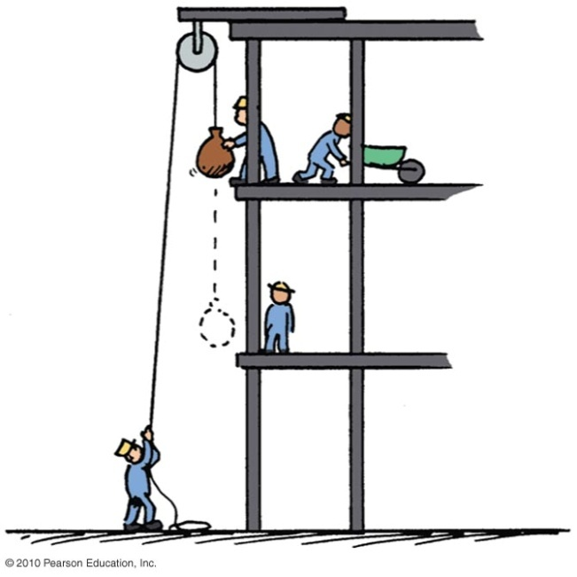
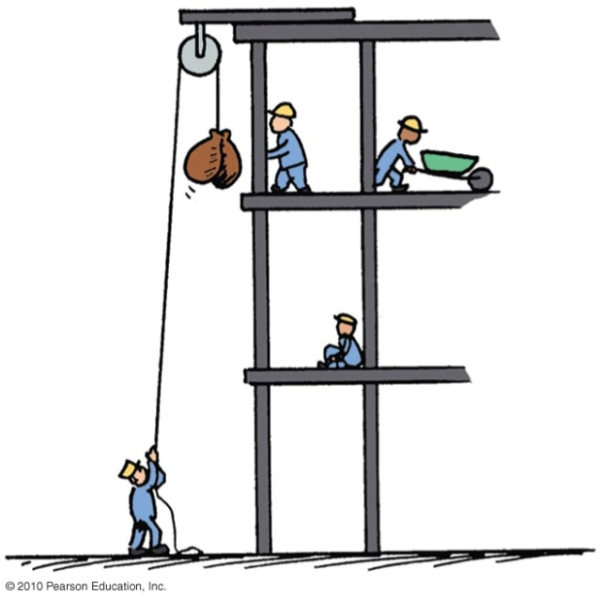
Work
Examples:
Twice as much work is done in lifting 2 loads 1 story high versus lifting 1 load the same vertical distance.
  Reason: force needed to lift twice the load is twice as much.
Twice as much work is done in lifting a load 2 stories instead of 1 story.
  Reason: distance is twice as great.

Slide 8
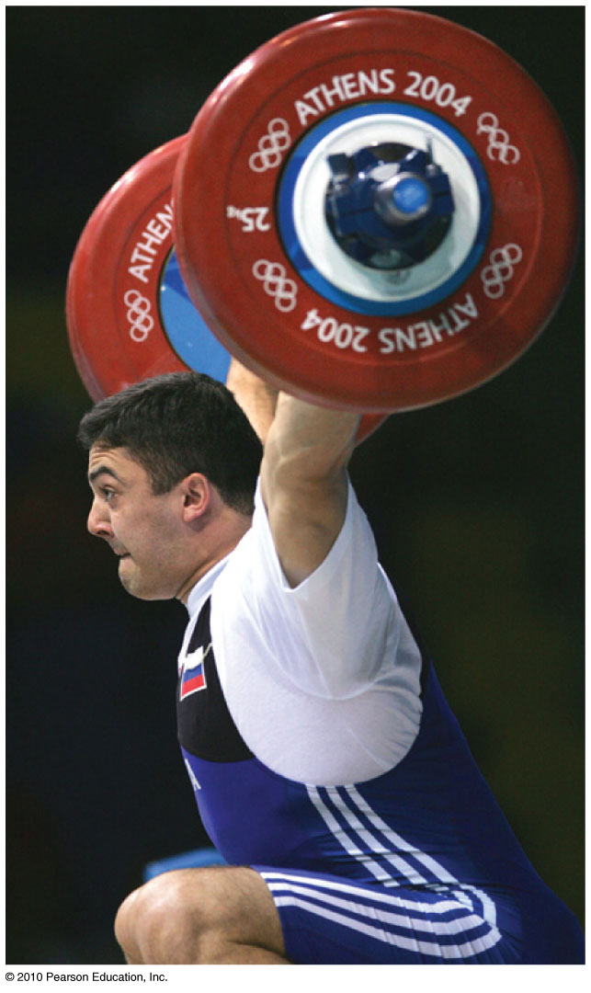
Work
Example:
  a weightlifter raising a barbell from the floor does work on the barbell.
Unit of work:
newton-meter (Nm)
or joule (J)
You do work on something when you force it to move against the influence of an opposing force.

Slide 9
Work is done in lifting a barbell. How much work is done in lifting a barbell that is twice as heavy the same distance?
A. Twice as much
Half as much
The same
Depends on the speed of the lift
Notes:
A. Twice as much.

Slide 10
Work is done in lifting a barbell. How much work is done in lifting a barbell that is twice as heavy the same distance?
A. Twice as much
Half as much
The same
Depends on the speed of the lift
Explanation:
This is in accord with work = force × distance. Twice the force for the same distance means twice the work done on the barbell.
Notes:
A. Twice as much.

Slide 11
You do work when pushing a cart with a constant force. If you push the cart twice as far, then the work you do is
A. less than twice as much.
twice as much.
more than twice as much.
zero.
Notes:
B. twice as much.

Slide 12
You do work when pushing a cart with a constant force. If you push the cart twice as far, then the work you do is
A. less than twice as much.
twice as much.
more than twice as much.
zero.
Notes:
B. twice as much.

Slide 13
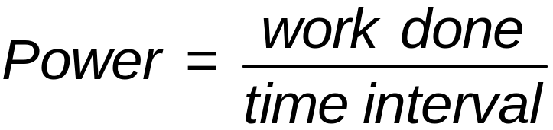
Power
Power:
Measure of how fast work is done
In equation form:

Slide 14
Power
Example:
  A worker uses more power running up the stairs than climbing the same stairs slowly.
  A high power engine does work rapidly. A more powerful engine can get a car up to a given speed in less time than a less powerful engine can.

Slide 15
Power
Unit of power
joule per second, called the watt, after James Watt, developer of the steam engine
  1 joule/second = 1 watt
  1 kilowatt = 1000 watts

Slide 16
A job can be done slowly or quickly. Both may require the same amount of work, but different amounts of
A. energy.
momentum.
power.
impulse.
Notes:
C. power.

Slide 17
A job can be done slowly or quickly. Both may require the same amount of work, but different amounts of
A. energy.
momentum.
power.
impulse.
Comment:
Power is the rate at which work is done.
Notes:
C. power.

Slide 18
Energy
Property of a system that enables it to do work.
Examples: mechanical energy, thermal energy, chemical energy, electrical energy.

Slide 19
Mechanical Energy
Mechanical energy is due to position or to motion, or both.
There are two forms of mechanical energy:
Potential energy
Kinetic energy

Slide 20
Potential Energy
Stored energy held in readiness with a potential for doing work.
Example:
  A stretched bow has stored energy that can do work on an arrow.
  A stretched rubber band of a slingshot has stored energy and is capable of doing work.

Slide 21
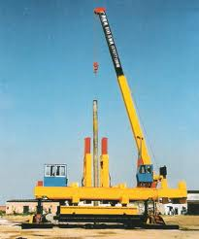
Potential Energy—Gravitational
Potential energy due to elevated position
Example:
  water in an elevated reservoir
  raised ram of a pile driver
http://li-jack.com/pile_driver

Slide 22
Potential Energy—Gravitational
Equal to the work done (force required to move it upward × the vertical distance moved against gravity) in lifting it.
In equation form:
  Potential energy
  = mass × acceleration due to gravity × height
  = mgh

Slide 23
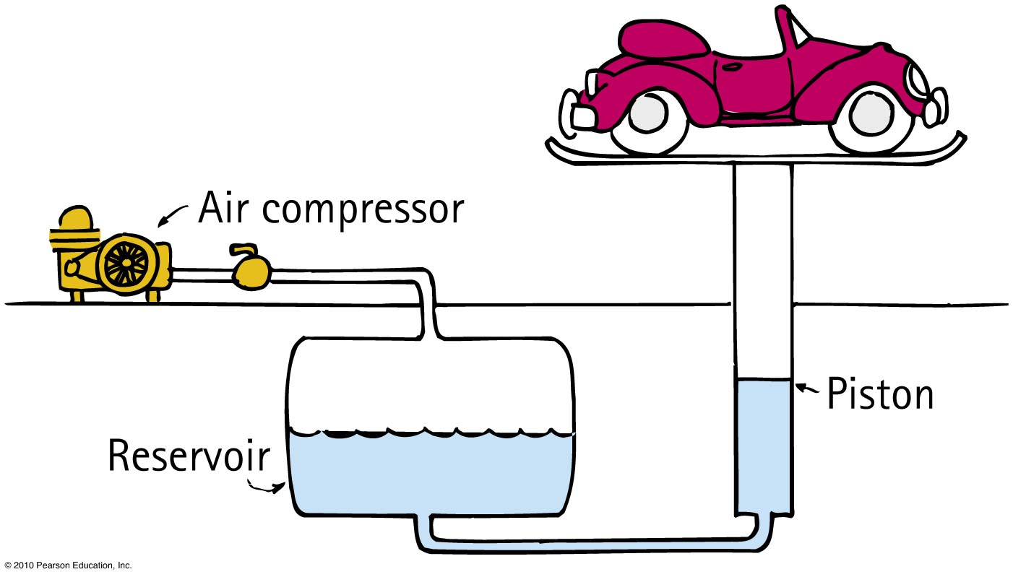
Does a car hoisted for repairs in a service station have increased potential energy relative to the floor?
A. Yes
No
Sometimes
Not enough information
Notes:
A. Yes.

Slide 24
Does a car hoisted for repairs in a service station have increased potential energy relative to the floor?
A. Yes
No
Sometimes
Not enough information
Comment:
If the car were twice as heavy, its increase in potential energy would be twice as great.
Notes:
A. Yes.

Slide 25
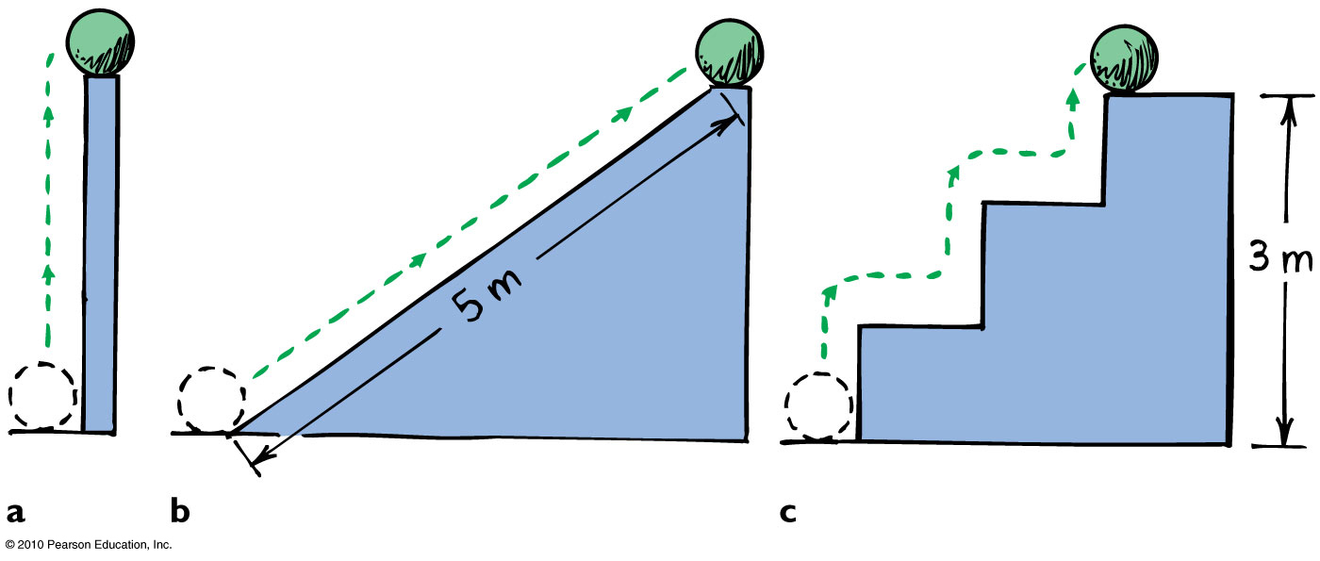
Potential Energy
Example: Potential energy of 10-N ball is the same in all 3 cases because work done in elevating it is the same.

Slide 26
Kinetic Energy
Energy of motion
Depends on the mass of the object and square of its speed
Include the proportional constant 1/2 and
  kinetic energy = 1/2 × mass × speed × speed
If object speed is doubled ⇒ kinetic energy is quadrupled.

Slide 27
Must a car with momentum have kinetic energy?
A. Yes, due to motion alone
Yes, when motion is nonaccelerated
Yes, because speed is a scalar and velocity is a vector quantity
No
Notes:
A. Yes, due to motion alone.

Slide 28
Must a car with momentum have kinetic energy?
A. Yes, due to motion alone
Yes, when momentum is nonaccelerated
Yes, because speed is a scalar and velocity is a vector quantity
No
Explanation:
Acceleration, speed being a scalar, and velocity being a vector quantity are irrelevant. Any moving object has both momentum and kinetic energy.
Notes:
A. Yes, due to motion alone.

Slide 29
Kinetic Energy
If an object is moving, then it is capable of doing work. It has energy of motion (K.E.)
When you throw a ball, you do work on it to give it speed as it leaves your hand.
The moving ball can then hit something and push it, doing work on the second object.
Kinetic Energy → Work

Slide 30
Kinetic Energy
Kinetic energy of a moving object is equal to
the work required to bring it from rest to that speed, or
the work the object can do while being brought to rest.
Kinetic Energy = Work = Net Force x Distance
F d = ½ mv²

Slide 31
Work-Energy Theorem
Gain or reduction of energy is the result of work.
In other words, work = change in kinetic energy (here, the work is net work, the work based on the net force.
In equation form: W = ΔKE
Doubling speed of an object requires 4 times the work.

Slide 32
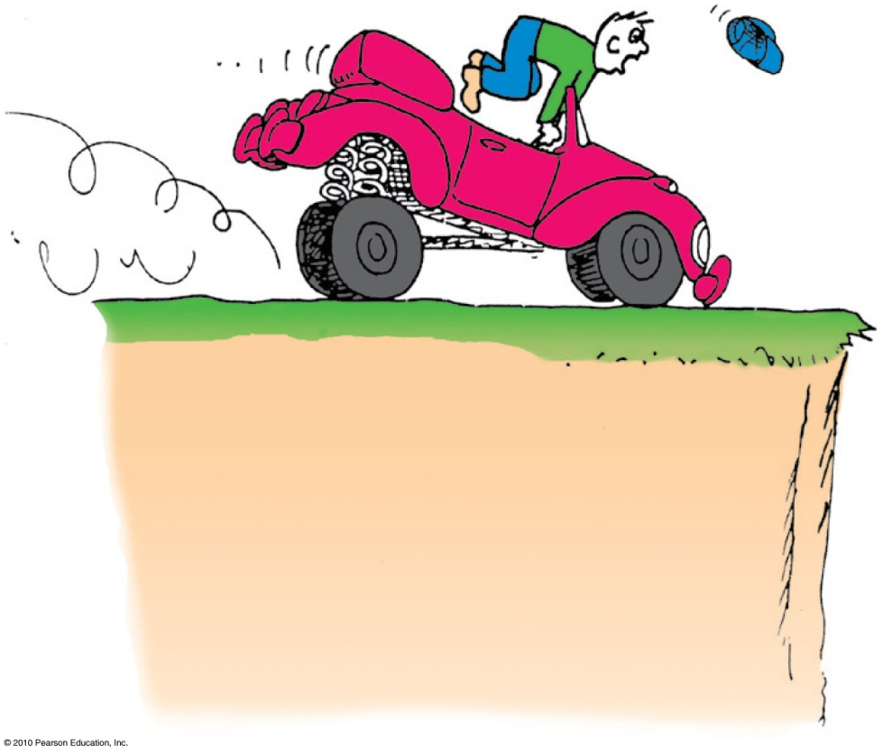
Work-Energy Theorem
Applies to decreasing speed:
  reducing the speed of an object or bringing it to a halt.
  Example: Applying the brakes to slow a moving car, work is done on it.
  (the friction force supplied by the brakes × distance).

Slide 33
Consider a problem that asks for the distance of a fast-moving crate sliding across a factory floor and then coming to a stop. The most useful equation for solving this problem is
A. F = ma.
B. Ft = Δmv.
C. KE = ¹/₂mv².
D. Fd = Δ¹/₂mv².

Slide 34
Consider a problem that asks for the distance of a fast-moving crate sliding across a factory floor and then coming to a stop. The most useful equation for solving this problem is
A. F = ma.
B. Ft = Δmv
C. KE = ¹/₂mv².
D. Fd = Δ¹/₂mv².
Notes:
D. Fd = Δ¹/₂mv².

Slide 35
The work done in bringing a moving car to a stop is the force of tire friction × stopping distance. If the initial speed of the car is doubled, the stopping distance is
A. actually less.
about the same.
twice.
None of the above.
Notes:
D. none of the above.

Slide 36
The work done in bringing a moving car to a stop is the force of tire friction × stopping distance. If the initial speed of the car is doubled, the stopping distance is
A. actually less.
about the same.
twice.
None of the above.
Explanation:
Twice the speed means four times the kinetic energy and four times the stopping distance.
Fd = Δ¹/₂mv²
Notes:
D. none of the above.

Slide 37
Conservation of Energy
Law of conservation of energy
Energy cannot be created or destroyed; it may be transformed from one form into another, but the total amount of energy never changes.

Slide 38
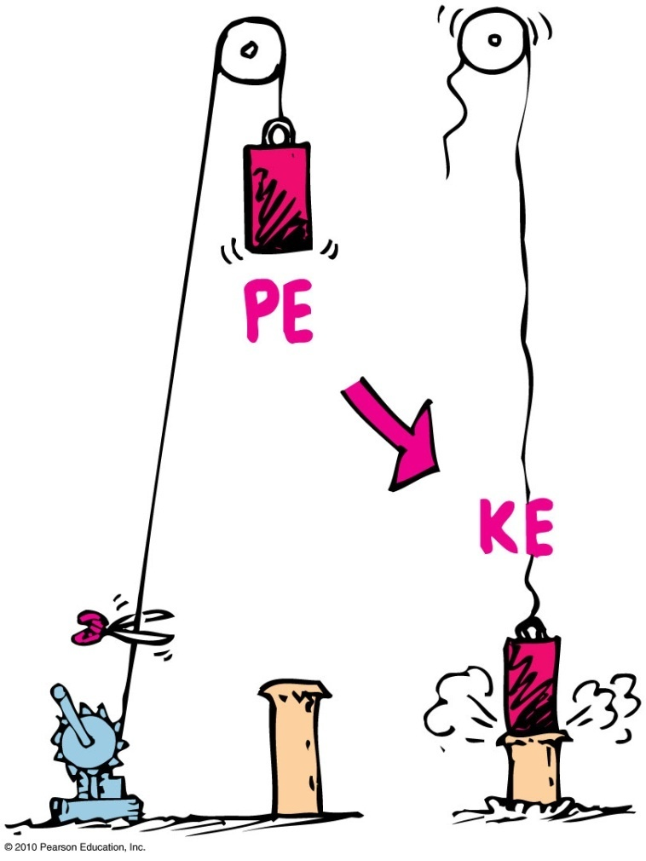
Conservation of Energy
Example: Energy transforms without net loss or net gain in the operation of a pile driver.

Slide 39
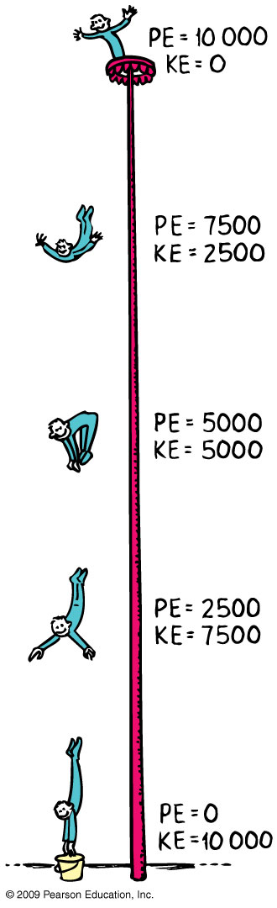
Conservation of Energy
Energy cannot be created or destroyed; it can only be transformed from one form to another.

Slide 40
Conservation of Energy
A situation to ponder…
Consider the system of a bow and arrow. In drawing the bow, we do work on the system and give it potential energy. When the bowstring is released, most of the potential energy is transferred to the arrow as kinetic energy and some as heat to the bow.

Slide 41
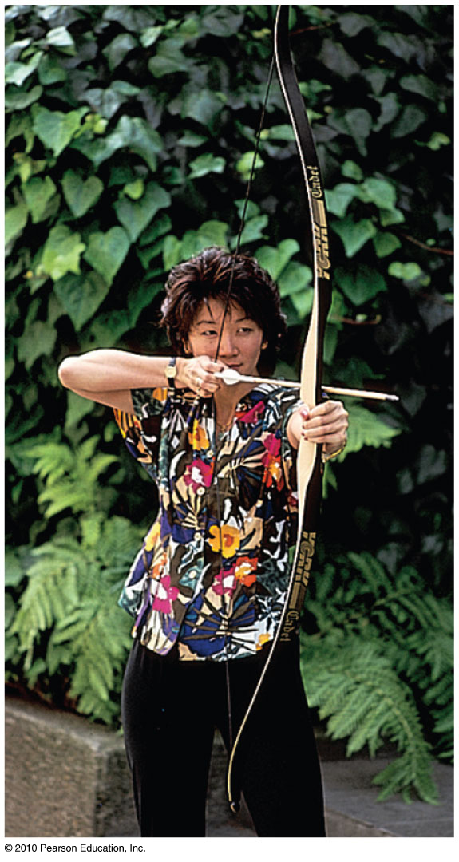
Suppose the potential energy of a drawn bow is 50 joules and the kinetic energy of the shot arrow is 40 joules. Then
A situation to ponder…
A. energy is not conserved.
10 joules go to warming the bow.
10 joules go to warming the target.
10 joules are mysteriously missing.
Notes:
B. 10 joules go to warming the bow.

Slide 42
Suppose the potential energy of a drawn bow is 50 joules and the kinetic energy of the shot arrow is 40 joules. Then
A situation to ponder…
A. energy is not conserved.
10 joules go to warming the bow.
10 joules go to warming the target.
10 joules are mysteriously missing.
Explanation:
The total energy of the drawn bow, which includes the poised arrow, is 50 joules. The arrow gets 40 joules and the remaining 10 joules warms the bow—still in the initial system.
Notes:
B. 10 joules go to warming the bow.

Slide 43
Kinetic Energy and Momentum Compared
Similarities between momentum and kinetic
energy:
Both are properties of moving things.
Difference between momentum and kinetic energy:
Momentum is a vector quantity and therefore is directional and can be canceled.
Kinetic energy is a scalar quantity and can never be canceled.

Slide 44
Kinetic Energy and Momentum Compared
Velocity dependence
  Momentum depends on velocity.
  Kinetic energy depends on the square of velocity.
  Example: An object moving with twice the velocity of another with the same mass, has twice the momentum but 4 times the kinetic energy.

Slide 45
Machines
Principle of a machine
Conservation of energy concept:
Work input = work output
Input force × input distance =
Output force × output distance
(Force × distance)_{input} = (force × distance)_{output}

Slide 46
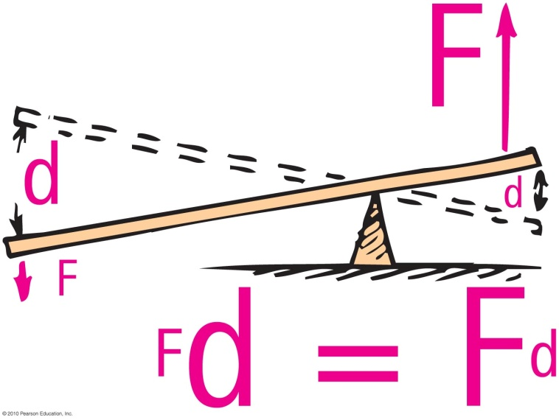
Machines
Simplest machine
Lever
  rotates on a point of support called the fulcrum
  allows small force over a large distance and large force over a short distance

Slide 47
Efficiency
Efficiency
Percentage of work put into a machine that is converted into useful work output
In equation form:
useful energy output
Efficiency =
total energy input

Slide 48
A certain machine is 30% efficient. This means the machine will convert
A. 30% of the energy input to useful work—70% of the energy input will be wasted.
70% of the energy input to useful work—30% of the energy input will be wasted.
Both of the above.
None of the above.
Notes:
A. 30% of the energy input to useful work—70% of the energy input will be wasted.

Slide 49
A certain machine is 30% efficient. This means the machine will convert
A. 30% of the energy input to useful work—70% of the energy input will be wasted.
70% of the energy input to useful work—30% of the energy input will be wasted.
Both of the above.
None of the above.
Notes:
A. 30% of the energy input to useful work—70% of the energy input will be wasted.

Slide 50
Chapter 7 Problems
Problem 1
The second floor of a house is 6 m above the street level. How much work is required to lift a 300 kg refrigerator
to the second-story level
W = F·d = m·g·h = 300kg 10 m/s² 6 m = 18000 Joules.

Slide 51
Chapter 7 Problems
Problem 2
How much work is done when you push a crate hori­zontally with 100 N across a 10 m factory floor?
W = F·d = 100 N·10 m = 1000 J.
(b) If the force of friction on the crate is a steady 70 N, show that the KE gained by the crate is 300 J.
ΔKE = W - F_{friction}·d = 1000J – 70 N·10 m = 300 J.
(c) Show that 700 J is turned into heat.
Heat = Energy loss to Friction = 70 N·10 m = 700 J.

Slide 52
Chapter 7 Problems
Consider an ideal pulley system. If you pull one end of the rope 1 m downward with a 50 N force, show that you can lift a 200 N load one-quarter of a meter high.
Work input = Work output
or F_{in} d_{in} = F_{out} d_{out}
then,
50 N 1 m = 200 N d_{out}
and
d_{out} = 50N 1m / 200N = ¼ m

Slide 53
Homework
Read Chapter 7 in Detail.
Do Ranking 1
Do Exercises 2, 6, 15, 24
Do Problems 3, 4, 8
Homework due: will be announced in class

