Slide 1
Optimum Location for a New Starbucks Store in California

Slide 2
Objective
Select the next reserve roastery Starbucks store in Californian within a county:
there are at least 100,000 households making $150,000 per year,
the median age is less than 38.5, and
the density of inhabitants is at least 285 (per square kilometer)
there are at least 500,000 households making $150,000 per year,
the median age is less than 35.5, or
the density of inhabitants is at least 1400 (per square kilometer)

Slide 3
Data Used
“full_starbucks.csv” containing the location of all Starbucks stores across California;
“CA_counties.shp” containing the boundary and shape of each county in the state of California
in addition, the demographics of California will be based on the following three datasets:
“CA_pop.csv” contains an estimate of the population of each county.
“CA_high_earners.csv” contains the number of households with an income of at least $150,000 per year.
“CA_median_age.csv” contains the median age for each county.
The local coffee shop competition is analyzed via Foursquare

Slide 4
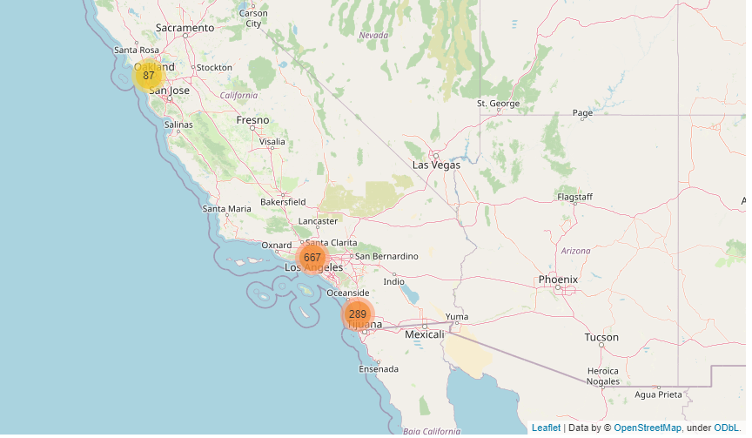
Results
There are 1043 stores meet our criteria and all the stores are in San Francisco (8%), Los Angles (64%) or San Diego (28%). Among them,
the store with the largest density and high-income population is at '3251 20th Ave, Ste 250F San Francisco CA’. And this is selected as our
Candidate.

Slide 5
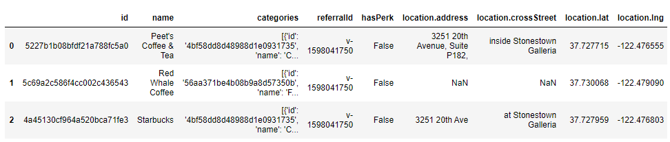
Local Competition among Coffee Shops
Via Foursquare, we learned that there are other two coffee shops with 500m radius of
Our selected store.
By looking at their reviews, we learn all of them received 7.0 score from their customers, which is pretty decent.

Slide 6
Conclusion
With the help of the data analysis, we decided to turn the Starbuck store at Stonestown Galleria, San Francisco, into the next Reserve Roastery. Because it is in an area with very large population and high-income earners, who will be very likely to be our customers. In addition, the store seems to be well-received already, thus guaranteeing its future success.

