Slide 1
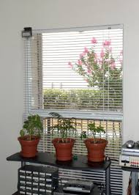


AUTOMATIC ROOM LIGHT INTENSITY BASED WINDOW BLIND CONTROL SYSTEM
Group Members:
Kush B. Patel (EC-50, A3)
Sahilkumar S. Katiriya (EC-26, A2)
Gurvir Singh Ratann (EC-22, A2)

Slide 2
PROJECT TIMELINE
WEEK | WORK DONE
1. | Project Definition
2. | Sensor Specification and Working
3. | Verification of Sensor and Assortment of Microcontroller
4. | Program Design Flow
5. | Circuit Diagram
6. | Selection of required peripherals of Microcontroller
7. | Implementation of Circuit in Proteus and Market Survey
8. | Coding in Arduino
9. | Debugging of Arduino Code
10. | Documentation
11. | Energy Calculations and Comparisons among different Motors
12. | Final Report

