Slide 1
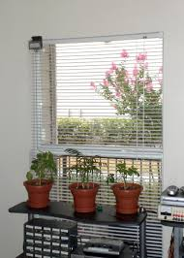
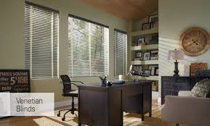
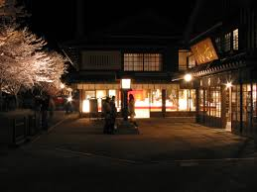
AUTOMATIC ROOM LIGHT INTENSITY BASED WINDOW BLIND CONTROL SYSTEM
Group Members:
Kush B. Patel (EC-50, A3)
Sahilkumar S. Katiriya (EC-26, A2)
Gurvir Singh Ratann (EC-22, A2)

Slide 2
Sensor Specifications
Arduino
Flowchart
Description
Circuit Diagram
Block Diagram
Arduino Code
Abstract
Working
CONTENTS

Slide 3
ABSTRACT
Typical mid income house-holds spend 1000-1500 Rs per month on electricity- 800 to 1000 kWh (kilowatts-hours). Most households could save 50 % to 70 % of this easily if we can use our technology and modern equipments and even more we can save if we can utilize the outside sunlight for lightening. In this project we have planned to develop an automatic blind control system in associate with outside sunlight to save the electricity. Whenever there is sunlight outside, blinds will be opened to utilize that light avoiding need of electricity. We can say that, opening of blinds is proportional to sunlight intensity. To control the blinds we planned to use stepper motor and intensity of sunlight is sensed using light dependent resistance interfaced to on -chip ADC of Arduino. It takes input from sensor and then decides the opening of curtains and activates the motor through motor driver.

Slide 4
BLOCK DIAGRAM
SUNLIGHT FALLS IN THE WINDOW
LDR
ARDUINO
MOTOR
DRIVER
SLIDING WINDOWS CURTAINS

Slide 5
DESCRIPTION
The aim of the project is to design such as sliding windows using blind control system. It will be using the intensity of the sunlight.
By providing the right amount of light.
By providing that light when it is needed.
So, whenever there is sunlight outside it will be opening according to it. So,we can say that intensity of light coming from the sun is proportional to opening of window. There is LDR used to automate the house. LDR used to control the window as open/close when sun lights falls on to the LDR. The basic concept of our automated system is that the position of the blinds is dependent on the intensity of light. Here, Arduino is used. So, we will be descripting more information and detailing and further we will be gradually increasing our work towards the modifications, which will imply our final touch-up.

Slide 6
OUTPUT SPECIFICATIONS
The sole output is opening of the Window Blinds based on the Intensity of Sunlight.
The curtain will get closed when enough sunlight is not present outside.

Slide 7
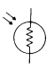
Sensor Specifications
Light Dependent Resistor
The NORPS-12 is a CdS (Cadmium Sulphide) photoconductive cell with a spectral response similar to that of the human eye, encapsulated in a moisture- resistant coating and enclosed in a plastic casing.
Circuit Symbol:

Slide 8
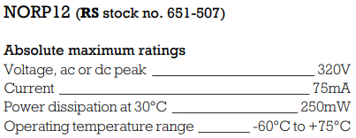
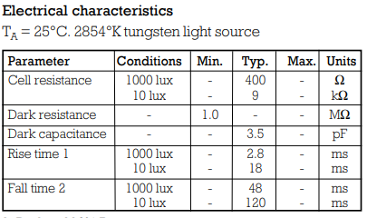

Slide 9
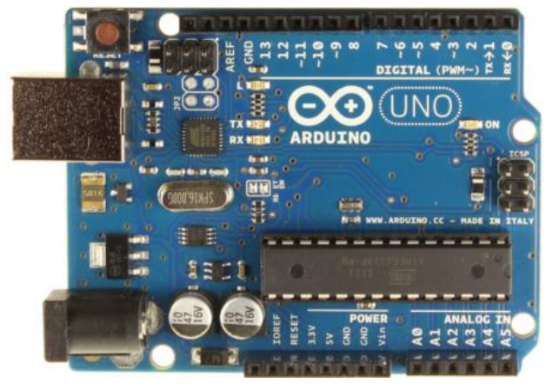
ARDUINO

Slide 10
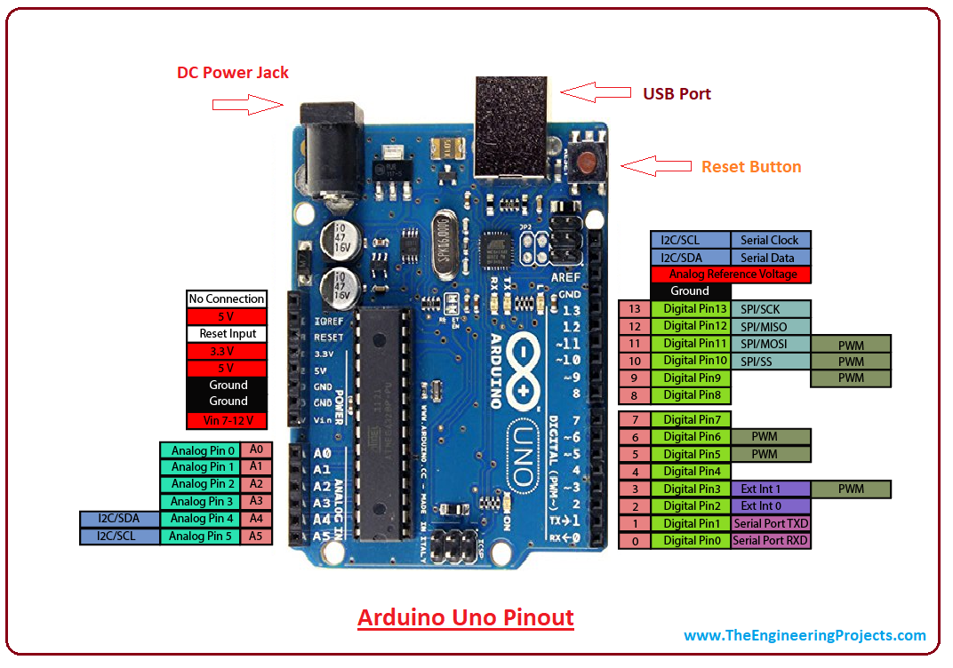
Arduino Pinout

Slide 11
ARDUINO SPECIFICATIONS
Microcontroller: ATmega328
Operating Voltage: 5V
Input Voltage: 7-12V
Digital I/O Pins: 14
Analog Input Pins: 6
DC Current per I/O Pin: 40 mA
Flash Memory: 32 KB (ATmega328)
Clock Speed: 16 MHz

Slide 12
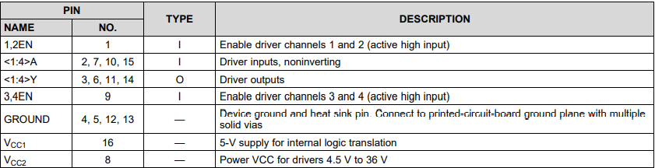
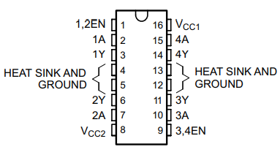
MOTOR DRIVER
IC L293D
Pin Diagram
Pin Functions

Slide 13
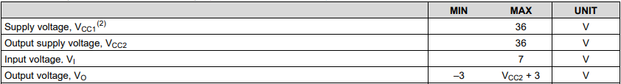
IC L293D Ratings

Slide 14
STEPPER MOTOR
28BYJ-48
Rated voltage ： 5VDC
Number of Phase : 4
Stride Angle : 5.625° /64
DC resistance : 50Ω±7%(25℃)
In-traction Torque : >34.3mN.m
Rise in Temperature: <40K

Slide 15
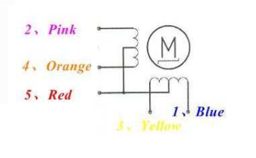
28BYJ-48 MOTOR DIAGRAM

Slide 16
Why Stepper Motor ?
STEPPER MOTOR | SERVO MOTOR | OBJECTIVE
High pole count | Low pole count | Effective
High torque at zero speed | Very high speed | High speed is not essential
Economical | Costly | -
Upto the mark accuracy and acceleration | High accuracy and acceleration | High accuracy and acceleration is not required

Slide 17
Why Stepper Motor ?
STEPPER MOTOR | DC MOTOR | OBJECTIVE
Precise positioning | Noisy | Good position of opening
Easy to control | Requires Specific controller/regulator | Can be replaced easily
Reliable | Constant Maintenance | Long Life

Slide 18
SELECTION OF STEPPER MOTOR
Stepper Motor can be selected by the Torque produced by the motor.
For general Households and Office purposes the curtains may weigh from 1.5 kg to 2.5 kg.
So it can be obtained that Torque produce = Mass of The Curtain * Radius of the Shaft
For example:
NEMA 14 Stepper Motor has torque of 7kg-mm and Radius of its shaft is 2.5mm
Therefore, 7 kg-mm = Mass * 2.5mm
Maximum Mass permissible is = 7/2.5
= 2.8 Kg

Slide 19
Flowchart
START
LDR
ARDUINO
MOTOR DRIVER
STEPPER MOTOR
CURTAINS
END

Slide 20
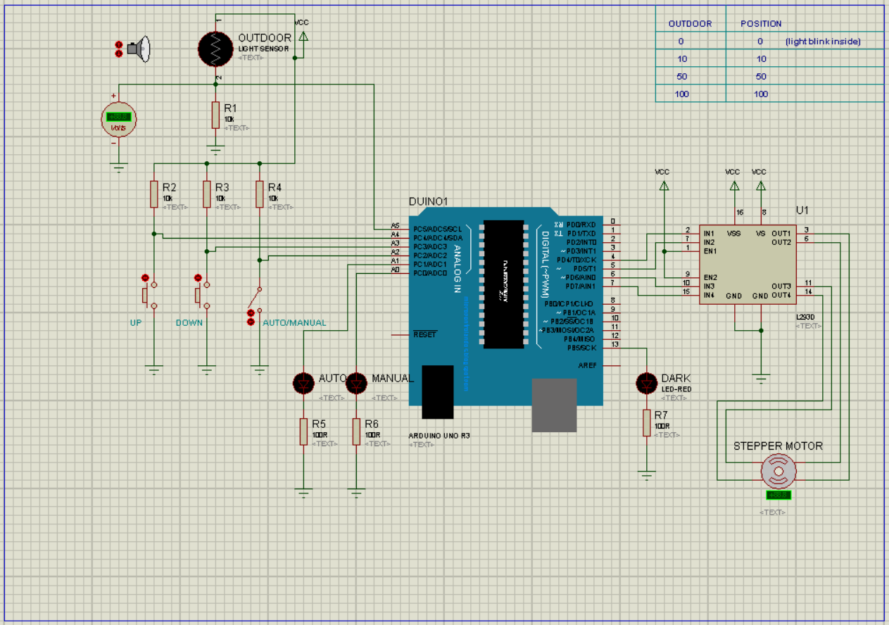

Slide 21
ARDUINO CODE
#define up A4
#define down A3
#define automanual A2
#define ledAuto A1
#define ledManual A0
#define led 13
#include <Stepper.h>
int previous = 0;
int val = 0;
const int stepsPerRevolution = 200;
Stepper myStepper(stepsPerRevolution, 4, 5, 6, 7);
void setup() {
myStepper.setSpeed(5);
pinMode(up,INPUT);
pinMode(down,INPUT);
pinMode(automanual,INPUT);
pinMode(ledAuto,OUTPUT);
pinMode(ledManual,OUTPUT);
pinMode(led,OUTPUT);
Serial.begin(9600);
}

Slide 22
void loop() {
// step one revolution in one direction:
if(digitalRead(automanual)==LOW){
digitalWrite(ledManual,HIGH);
digitalWrite(ledAuto,LOW);
digitalWrite(led,LOW);
if(digitalRead(up)==LOW){
myStepper.step(1);
while(digitalRead(up)==LOW);
delay(100);
}
else if(digitalRead(down)==LOW){
myStepper.step(-1);
while(digitalRead(down)==LOW);
delay(100);
}
}

Slide 23
else{
digitalWrite(ledManual,LOW);
digitalWrite(ledAuto,HIGH);
val = (analogRead(5)/20);
if(val<5){
digitalWrite(led,(!digitalRead(led)));
delay(500);
}
else{
digitalWrite(led,LOW);
}
myStepper.step(val - previous);
previous = val;
}
}

Slide 24
WORKING
The above descripted setup of Automatic Room Light Intensity Based Window Blind Control System works on the principle of Light dependency. The procedure goes through the following way:
The Sunlight outside is luminous and if its intensity is enough to light a room then the resistance of LDR (NORPS-12) on which the light is incident changes accordingly.
As the resistance of the LDR changes accordingly a signal is also generated proportionally to the change in Resistance.
The signal is then fed to the analog port of the Arduino.
It further converts the signal to Digital form and then feeds to the Motor Driver.
The Motor Driver feeds the respective signal to the Stepper Motor and it rotates and moves the curtains according to the luminance of the light outside.
Another part is that we can move the curtain manually as well.
A switch has been placed there that chooses which mode has to be applied.
Two Push Buttons have been placed one for opening and other for closing the curtains.

Slide 25
PROJECT TIMELINE
WEEK | WORK DONE
1. | Project Definition
2. | Sensor Specification and Working
3. | Verification of Sensor and Assortment of Microcontroller
4. | Program Design Flow
5. | Circuit Diagram
6. | Selection of required peripherals of Microcontroller
7. | Implementation of Circuit in Proteus and Market Survey
8. | Coding in Arduino
9. | Debugging of Arduino Code
10. | Documentation
11. | Energy Calculations and Comparisons among different Motors
12. | Final Report

Slide 26
CALCULATION OF ELECTRICITY BENEFIT
Power consumed by 1 Tubelight
(Working entire year for 10 hours each day)
55 W-h
0.055 kWh
0.055*10*365 //Units consumed in 1 year
=200.75 kWh
200.75 *2.62 // 2.62→ Cost per unit consumed
Rs. 526/year for 1 Tubelight

Slide 27
CALCULATION OF ELECTRICITY BENEFIT
Power consumed by Arduino Uno
40 mA/pin and 20 pins
=0.8 A
5V // Operating Voltage
0.8*5=4W
0.004kW*10*365 //Total number of Units consumed
=14.6 kWh
14.6 kWh*2.62
Rs. 38.25/year

Slide 28
CALCULATION OF ELECTRICITY BENEFIT
Power consumed by Stepper Motor (NEMA-14)
=0.75 A
9V // Operating Voltage
0.75*9=6.75W
=0.00675 kW
0.00675kW*10*365 //Total number of Units consumed
=24.67 kWh
24.67 kWh*2.62
Rs. 64.55/year

Slide 29
CALCULATION OF ELECTRICITY BENEFIT
Power consumed by Motor Driver
0.007 A
9V // Operating Voltage
0.007*9=0.063W
=0.000063kW
0.000063kW*10*365 //Total number of Units consumed
=0.22 kWh
022 kWh*2.62
Rs. 0.6/year

Slide 30
CALCULATION OF ELECTRICITY BENEFIT
Total = 64.55 + 38.25 + 0.6
= Rs. 103/year
Profit = 526-103
= Rs. 423/year for 1 Tubelight

Slide 31
THANK YOU

