Slide 1

java Programming Project Presentation
Project Title: DIGITAL NOTE ORGANIZER WITH FILE STORAGE
Course: Java Programming Mini Project
Student Name & Roll No: PRABHAKARAN S & 25BCS245
Department: B.Sc. Computer Science
Mentor / Guide: DHARANEESH.S

Slide 2
Introduction
java Programming Project Presentation
• This project is a Java-based application for managing digital notes • Helps users store, organize, and retrieve notes easily • Replaces traditional notebooks and scattered files • Provides a simple and efficient way to manage information

Slide 3
Objective
java Programming Project Presentation
To develop a note management system using Java • To store notes using file handling • To allow create, view, edit, and delete operations • To improve organization and accessibility of data • To demonstrate core Java concepts

Slide 4
Problem Statement
java Programming Project Presentation
• Notes may be lost in traditional systems • Difficult to organize large data • Searching notes is time-consuming • No proper storage or backup • Manual methods are inefficient

Slide 5
System Requirements
java Programming Project Presentation
Hardware: • Processor: i3 or higher • RAM: 4GB minimum • Storage: 500MB
Software: • OS: Windows/Linux • Language: Java • IDE: Eclipse / IntelliJ / NetBeans

Slide 6
System Design
java Programming Project Presentation
• User interacts with the application • Application processes data • Data stored using file handling
Include: • Flowchart • Module diagram

Slide 7
Module Description
java Programming Project Presentation
• Input Module – Accepts note content • Processing Module – Handles logic • File Storage Module – Saves notes in file • Display Module – Shows notes to user • Edit/Delete Module – Modify or remove notes

Slide 8
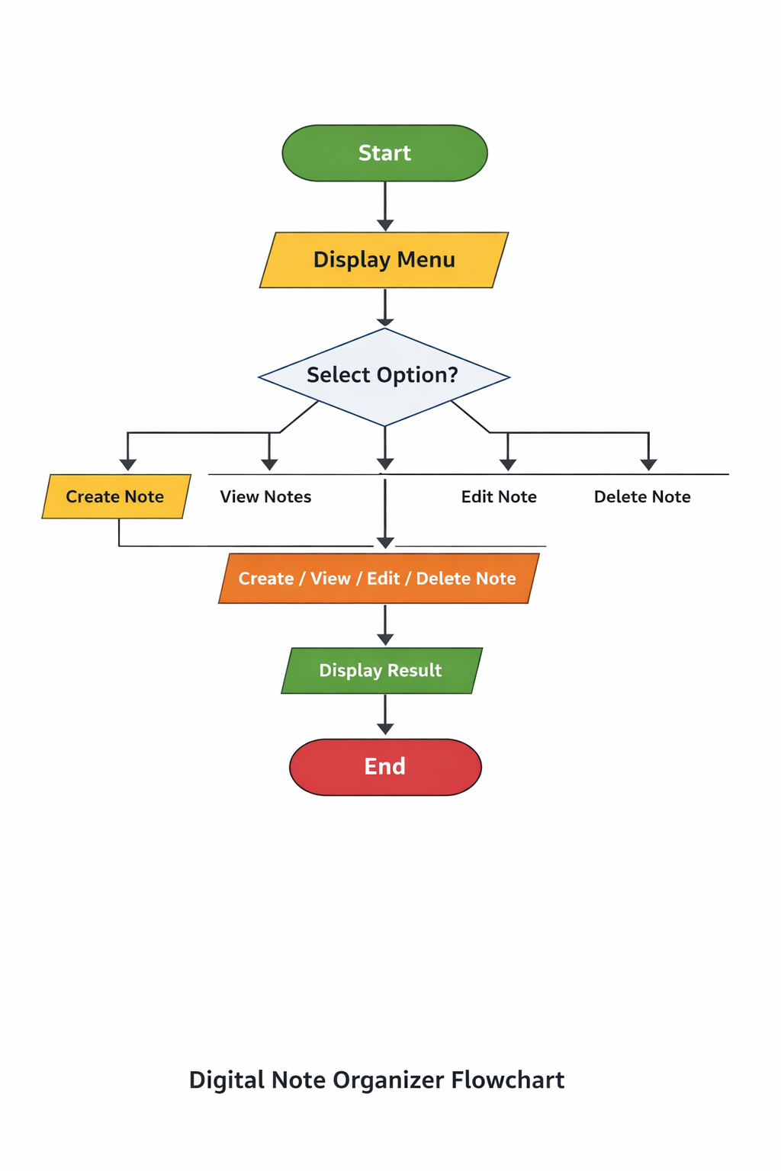
Algorithm / Flowchart
java Programming Project Presentation
Start
Display menu
Enter choice
Perform operation (Create/View/Edit/Delete)
Display result
End

Slide 9
Implementation
java Programming Project Presentation
• Used Core Java • File handling (FileWriter, FileReader) • Loops and conditions • Menu-driven program

Slide 10
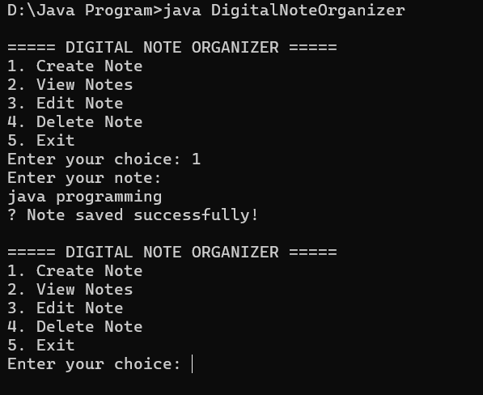
Output Screens
java Programming Project Presentation
• Menu screen • Create note • View notes • Output display

Slide 11
Results & Discussion
java Programming Project Presentation
• Notes stored successfully • Easy retrieval of data • Reduced manual effort • Improved organization • System works efficiently

Slide 12
Conclusion & Future Enhancement
java Programming Project Presentation
Conclusion: • Project achieved its objective • Easy and efficient note management • Demonstrates Java concepts
Future Enhancements: • Add GUI (Swing/JavaFX) • Add database • Add login system • Cloud storage

Slide 13
References / Acknowledgement
java Programming Project Presentation
• Java: The Complete Reference – Herbert Schildt • Programming with Java – Balagurusamy • Oracle Java Documentation • GeeksforGeeks, W3Schools

Slide 14
Thank You
Questions & Discussions

