Slide 1

Minor Project
By:
Pasang Gurung
Pramod Nepal
Rajendra Bdr. Thapa

Slide 2
Introduction
The Garatron are a race in the Animorphs series similar to Andalites.
They use a form of thought speech that is very fast and condensed compared to the standard Andalite form of communication.
Remote Meeting
Distant Education

Slide 3
Platform & Tools
Java (JDK 1.6)
Java Media Framework (JMF 2.1.1e)
Microsoft Office
Photoshop, Gimp, Mspaint

Slide 4
Objective
To provide an easy and cheap alternatives to the existing conferencing and remote meeting systems
To play distant media
To provide virtual class.
Communicate “face to face”.

Slide 5
Java Media Framework (why?)
It is the API to handle media in Java
It provides support for popular media formats (AIFF, GSM, MIDI, MPEG 2/3, Sun Audio, Wave, AVI, Flash, HotMedia, MPEG ¼, QuickTime)
Many more RTP formats

Slide 6
Time Based Media
Any data that varies in a meaningful manner with respect to time.
Time Based Media Properties
- data intended for presentation
- data in digital format(capturing)

Slide 7
Bandwidth, compression
The raw data suitable for presentation has a high bandwidth.
Overcome the challenge in the area of storing and transmitting media.
A 56K modem does not have that great bandwidth to send such files

Slide 8
compression, codec
The media is kept in a compressed format while being stored or transmitted.
The media is decompressed only before processing.
The compression and decompression of the media(codecs).
It can work in hardware or software.

Slide 9
Tracks, multiplexing, de-multiplexing
Tracks
-channel of time-based media
-Each track has its own format.
Multiplexing
-combining multiple tracks of data
De-multiplexing
-Separating individual tracks from a multi-track media
object

Slide 10
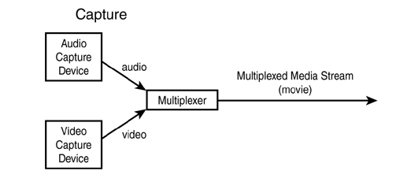
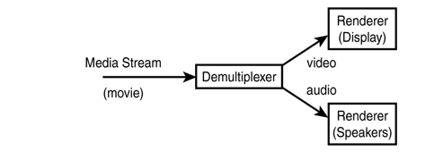
Fig. multiplexing
fig. de-multiplexing

Slide 11
Streaming
True streaming
-real time streaming
-when audio arrives from remote
site then it is presented
-TV broadcasting in BBC
Progressive streaming
-common in web
-media downloaded to system disk drive
Passive streaming
-audio and video can be streamed in real time
between sites
-video-conferencing

Slide 12
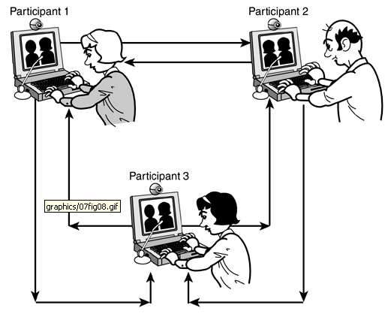

Slide 13
Streaming
Simultaneous, bi-directional streaming is required for applications such as video conferencing: both sites transmitting and receiving media simultaneously.
The data that forms the media stream, typically in fixed sized packets, suffers a delay, known as latency, between its transmission and receipt.
Transmission using appropriate protocols for communications such as RTP (Real-time Transfer Protocol) and RTCP (RTP Control Protocol) can aid the monitoring and, hence, detection of and possible compensation for such network induced problems.

Slide 14
Time
For time based media it takes five states (controller eg. Player from creation to being ready to start)
Unrealized
Realizing
Realized
Prefetching
Prefetched

Slide 15
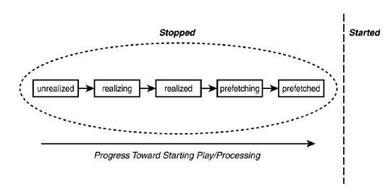
Time Central Concept
Controller state diagram

Slide 16
Creating Player
Convert the URL to a MediaLocator (if URL based method is used).
Create a DataSource for the MediaLocator (if DataSource based method isn't used).
Obtain the Player that can handle the DataSource.
Attach the DataSource to the Player.
Return the Player object.

Slide 17
Creating a Player
Eg
MediaLocator locator = new MediaLocator(***);
// ***Specify media location;
Player player = Manager.createPlayer(locator);
Alternatively, to create RealizedPlayer
MediaLocator = new MediaLocator(***);
Player player = Manager.createRealizedPlayer(locator);
MediaLocator = new MediaLocator(***); Player player = Manager.createRealizedPlayer(locator);

Slide 18
Creating a Processor
Convert the URL to a MediaLocator (if URL based method is used).
Create a DataSource for the MediaLocator (if DataSource based method isn't used).
Obtain the Processor that can handle the DataSource.
Attach the DataSource to the Processor.
Return the Processor object.

Slide 19
Creating a Processor
Eg
MediaLocator locator = new MediaLocator(***);
Processor processor=Manager.createProcessor(locator);
Alternatively to create Realized Processor
//Specify the model for processing ProcessorModel model = new ProcessorModel(...); // Create the processor Processor processor = Manager.createRealizedProcessor(model);

Slide 20
DataSource,Controls
Means by which Players, Processors, or DataSinks obtain their data.
Interface possesses a single method getControlComponent(),
Format— An abstraction of the format of media.
Format classes: AudioFormat, VideoFormat, and ContentDescriptor.
Buffer Class Handles the buffering of the media.
The Buffer object carries the media data metadata such as the media format, timestamps, length, and other header information.

Slide 21
Media Capture
CaptureDeviceManager manages the central registry of capture devices known to the JMF.
CaptureDeviceInfo - Information about a particular capture device, including the Formats it supports.
CaptureDevice - A further specialization of the DataSource produced by a capture device to include appropriate methods for control of the device and its output.

Slide 22
Media Capture
Process:
Obtain a CaptureDeviceInfo object (typically obtained by querying CaptureDeviceManager).
Get CaptureDeviceInfo's MediaLocator.
Create a DataSource from the MediaLocator.
Create a Player or Processor using the Manager class and the DataSource from the previous step.
Perform any necessary configuration or programming (for example, Processor programming or creation of DataSink).
Start the Player or Processor.

Slide 23
What's RTP?
Real-Time Transport Protocol, an Internet standard for the transport of real-time data
Provides end-to-end network transport functions .
Applications typically run RTP on top of UDP
RTP is augmented by a control protocol—RTCP (RTP Control Protocol).
RTCP provides information about the quality of service of an RTP connection by identifying the participants and relevant information about each.

Slide 24
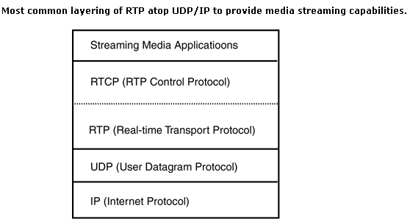
Layering of RTP

Slide 25
RTP going deep….
RTP Session - identified by a network address and a pair of ports between applications.
RTP Participant— An application taking part in an RTP Session.
RTP Port—integer number for differentiating different application on same machine.
RTP Formats –
Audio
- ULAW_RTP, GSM_RTP , DVI_RTP , G723_RTP
Video
- JPEG_RTP , H261_RTP, H263_RTP
Their compression is similar to non-RTP versions.

Slide 26
Multicasting
IP supports a number of addressing schemes: unicast, broadcast, and multicast.
Unicast, Multi-Unicast, Broadcast, and Multicast
Network addresses in the range 224.0.0.0 to 239.255.255.255, are assigned by IANA (Internet Assigned Numbers Authority) for multicast applications.
The addresses from 224.2.0.0 to 224.2.127.253 (inclusive) are currently assigned for multimedia conference calls.

Slide 27
Future Enhancement
the provision of saving the real time media for future documentation
The provision of multicasting the content of white board in real time.
To make Garatron for more general use

Slide 28
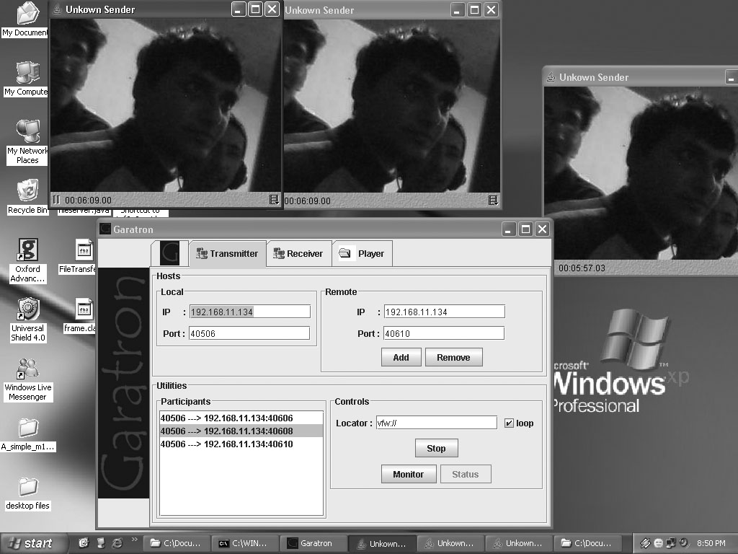
Output

Slide 29
Implementation
Security measures
Remote classes
Meeting and addressing

Slide 30
References
    www.sun.com/java
    jmf 2_0 guide (pdf)
    The Complete Reference Java J2SE TM 5 Edition By Herbert Schildt
    PRENTICE HALL - DEITEL How To Progaram JAVA
    Sams Java Media APIs
    Different java forums
    Many web articles.

Slide 31
THANK YOU
Have a nice day.
aratron Team

