Slide 1

Formal Verification of Clock Domain Crossing Using Gate-level Models of Metastable Flip-Flops
Ghaith Tarawneh, Andrey Mokhov and Alex Yakovlev
Newcastle University, UK
17th March 2016

Slide 2
Talk Outline
Clock Domain Crossing (CDC) Refresher
Sate-of-the-Art CDC Verification and its Limitations
Proposed CDC Verification Methodology
Testbench Verification Results

Slide 3
What is CDC?
Clock Domain Crossing (CDC) takes place when a signal is generated in one clock domain and latched in another.

Slide 4
Why is it problematic?
Incoming asynchronous transitions may violate the setup/hold time conditions of destination (receiver) flip-flops leading to metastability.

Slide 5
Why is it problematic?

Slide 6
Why is it problematic?

Slide 7
Why is it problematic?

Slide 8
Why is it problematic?

Slide 9
Why is it problematic?
Non-deterministic crossing latencies: transitions that are simultaneous at the sender’s end may arrive in different receiver clock cycles

Slide 10
Why is it problematic?
Transitions propagating through crossover combinational logic may cause temporary glitches to appear at the inputs of their destination flip-flops

Slide 11
Why is it problematic?
These problematic analogue phenomena may cause:
Irrecoverable state transitions
Data corruption
But are invisible in digital simulation … and so can escape conventional (digital) testbench and formal verification but manifest in silicon!

Slide 12
Talk Outline
Clock Domain Crossing (CDC) Refresher
Sate-of-the-Art CDC Verification and its Limitations
Proposed CDC Verification Methodology
Testbench Verification Results

Slide 13
Commercial CDC Verification Tools
Most commercial tools are linters for safe CDC design rules of thumb, e.g.:
RULE1: use synchronizers to latch control signals
RULE2: avoid implementing combinational logic in crossover paths (with exceptions)
RULE3: don’t synchronize data signals (with exceptions)
These rules are heuristics based on theoretical understanding of CDC issues – they guarantee that CDC failures don’t happen.

Slide 14
Commercial CDC Verification Tools

Slide 15
Limitations
State of the art commercial tools are reliable at spotting CDC errors but …
generate a considerable number of false positive warnings (reported figures from commercial SoCs: 100k CDC warnings out of which 90% were false positives*)
require the designer to specify how interface logic is supposed to behave and where exceptions to CDC rules must be made
are restricted to verifying stereotypical synchronization schemes and design patterns
cannot demonstrate the mechanics or consequences of failures
* Lee Y, Kim N, Kim JB, Min B. Millions to thousands issues through knowledge based SoC CDC Verification. InSoC Design Conference (ISOCC), 2012 International 2012 Nov 4 (pp. 391-394). IEEE.

Slide 16
Talk Outline
Clock Domain Crossing (CDC) Refresher
Sate-of-the-Art CDC Verification and its Limitations
Proposed CDC Verification Methodology
Testbench Verification Results

Slide 17
Proposed CDC Verification Methodology
Structural and functional rule-checking is really just a walk-around solution.
We propose to address the fundamental challenge at the heart of CDC verification …

Slide 18
making metastability and other problematic CDC phenomena observable in digital simulation
The (Real) Main Challenge of CDC Verification
No structural or functional heuristics to find out when unobservable problems may occur: just make problems visible in simulation.

Slide 19
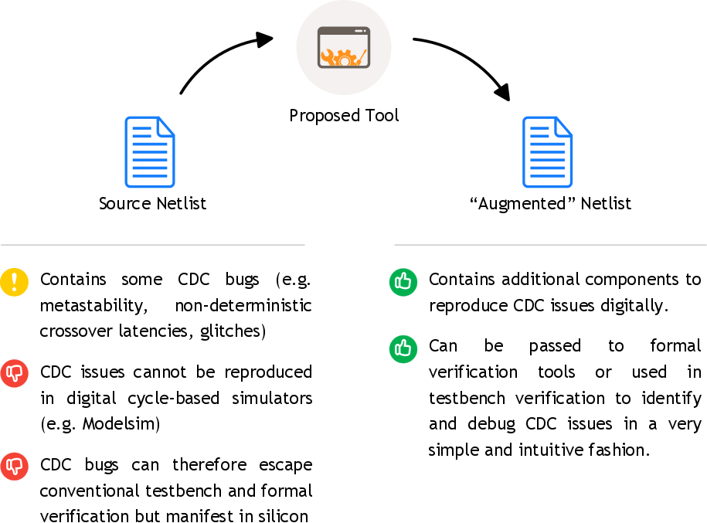
Proposed Verification Methodology
We developed a tool to apply this verification methodology. The basic idea:

Slide 20
How does the tool work?
Flip-flops are replaced with model cells that can simulate (1) setup/hold time violations, (2) non-deterministic inputs/outputs and (3) prolonged clk-to-q delays.
Ports:
D and Q are the data input/output pins (same as regular flip-flops)
V (input) indicates when the setup/hold time conditions are violated
M (output) indicates when the flip-flop is metastable
T (output) indicates when the output transitions
V, M and T use “active-x encoding” (x is active, 0 or 1 is inactive)

Slide 21
How does the tool work?
Combinational path duplicates are added to simulate logical masking and the transfer of timing violations between model flip-flops.

Slide 22
How does the tool work?
Combinational path duplicates are added to simulate logical masking and the transfer of timing violations between model flip-flops.

Slide 23
How does the tool work?
Combinational path duplicates are added to simulate logical masking and the transfer of timing violations between model flip-flops.

Slide 24
How does the tool work?
Combinational path duplicates are added to simulate logical masking and the transfer of timing violations between model flip-flops.

Slide 25
How does the tool work?
Combinational path duplicates are added to simulate logical masking and the transfer of timing violations between model flip-flops.

Slide 26
How does the tool work?
Combinational path duplicates are added to simulate logical masking and the transfer of timing violations between model flip-flops.

Slide 27
How does the tool work?
Combinational path duplicates are added to simulate logical masking and the transfer of timing violations between model flip-flops.

Slide 28
Talk Outline
Clock Domain Crossing (CDC) Refresher
Sate-of-the-Art CDC Verification and its Limitations
Proposed CDC Verification Methodology
Testbench Verification Results

Slide 29
Formal Verification Flow

Slide 30
Test Circuit
We used the following sender-receiver circuit as a test run.

Slide 31
Test Circuit - Verification Results
Synchroniser(s) | Assertion | Source Netlist
None | as_correct_transfer | ✓
 | as_sender_handshake | ✓
 | as_no_blocked_transfer | ✓
Sender Only | as_correct_transfer | ✓
 | as_sender_handshake | ✓
 | as_no_blocked_transfer | ✓
Receiver Only | as_correct_transfer | ✓
 | as_sender_handshake | ✓
 | as_no_blocked_transfer | ✓
Both | as_correct_transfer | ✓
 | as_sender_handshake | ✓
 | as_no_blocked_transfer | ✓
✓ = assertion received pass status (no counter-examples found)

Slide 32
Test Circuit - Verification Results
Synchroniser(s) | Assertion | Source Netlist | Augmented Netlist
None | as_correct_transfer | ✓ | -
 | as_sender_handshake | ✓ | -
 | as_no_blocked_transfer | ✓ | -
Sender Only | as_correct_transfer | ✓ | -
 | as_sender_handshake | ✓ | ✓
 | as_no_blocked_transfer | ✓ | -
Receiver Only | as_correct_transfer | ✓ | -
 | as_sender_handshake | ✓ | -
 | as_no_blocked_transfer | ✓ | -
Both | as_correct_transfer | ✓ | ✓
 | as_sender_handshake | ✓ | ✓
 | as_no_blocked_transfer | ✓ | ✓
✓ = assertion received pass status (no counter-examples found)

Slide 33
More Verification Tests …
We also used the tool to verify a number of multi-clock designs whose functional correctness we knew apriori (from theory).

Slide 34
More Verification Tests …
Testbench | Description | CDC Issue | Structural Checks | Proposed Tool
1 | Data transfer (4-phase handshaking and synchronizers) | (none) | ✓ | ✓
2 | Data transfer (4-phase handshaking, no synchronizers) | Data Corruption | - | -
3 | Data transfer (no handshaking, data synchronization, Gray coding) | (none) | - | ✓
4 | Data transfer (no handshaking, data synchronization, non-Gray coding) | Data Corruption | - | -
5 | Data transfer (no handshaking, no synchronization, quasi-stable data) | (none) | - | ✓
6 | Multiplexer in crossover path | (none) | ✓ | ✓
7 | Combinational logic in crossover path (glitch-prone) | Glitches | - | -
8 | Combinational logic in crossover path (glitch-free) | (none) | - | ✓
9 | Two synchronization points | Path Reconvergence | - | -
10 | Two synchronization points (not activated simultaneously) | (none) | - | ✓
False Positives |  |  | 4 | 0
False Negatives |  |  | 0 | 0

Slide 35
What are the benefits?
 | Structural/Functional Rule-checking (Conventional) | Simulating CDC Phenomena (Proposed)
False Positives | Many | Low/none
Designer Input | must specify adopted patterns and rule exceptions | Zero configuration
Applicability | Limited to known design patterns | General
Failure mechanisms and consequences | Unknown | Demonstrated in signal waveforms

Slide 36
What are the benefits?

Slide 37
Conclusion
Presented a new method to verify multi-clock designs
The method relies on reproducing CDC faults in digital simulation
In testing the method revealed an inherent ability to report many known CDC design issues (e.g. synchronization, non-deterministic latencies, glitches, path convergence, data corruption)
Offers several advantages on top of state-of-the-art commercial CDC verification (e.g. fewer false positives, zero configuration, applicability to non-stereotypical designs)

Slide 38
Thank you
There is a live demo of the tool starting NOW (10:00 – 12:00) at the University Booth UB09.4 – come and see the tool at work!

