Slide 1
AZURE API MANAGEMENT
Target Architecture
& Build-Out Design
This presentation has been prepared to support design discussions and decision-making. The proposed architecture and recommendations are presented for review for Edge Service, APIM hosting, ingress, egress and resilience decisions
01
02
03
04
05
Reference
Architecture
Hosting
Model
External
Ingress
External
Egress
HA & DR
Strategy
Notes:
Greenfield APIM build. Five decisions: reference architecture and edge, hosting model, ingress, egress, HA/DR.

Slide 2
REFERENCE ARCHITECTURE
1
Proposed APIM & Edge Service Component Selection
One policy-enforced front door for every external API. APIM itself holds no public endpoint.
CONSUMERS
EDGE — PUBLIC
API GATEWAY — PRIVATE
BACKENDS — PRIVATE
External
HTTPS
Azure Front Door Premium
Private
Link
APIM Premium V2 · Internal VNet
VNet
Systems of record & services
Partners / B2B
Third-party SaaS
WAF: managed DRS + bot rules
DDoS protection, TLS 1.2 / 1.3
Global anycast + caching
Only public entry point
OAuth2 / JWT validation
Products, versions, revisions
Quota, throttle, schema checks
Request / response shaping
Azure PaaS via Private Endpoint
Example
AKS / Container Apps
Functions & Logic Apps
EDGE DECISION Front Door Premium (WAF) → Private Link → APIM internal. No public IP on APIM.
Front Door Premium establishes a hardened security boundary in front of the API platform. WAF policies, DDoS protection, and centralised traffic control help ensure secure, reliable, and governed access to digital services
APIM DECISION Premium V2
Premium V2 delivers the network isolation, performance, and governance controls required for strategic API management. It enables consistent policy enforcement, secure connectivity, and future growth without architectural redesign.
Notes:
APIM is the single control point for external APIs. Front Door is the only public surface; APIM sits private behind Private Link and aligns to the SIF layering.

Slide 3
APIM HOSTING MODEL
2
Managed, VNet-Injected or Self-Hosted
Hosting model = Premium V2, Managed gateway, VNet injection in Internal mode.
OPTION A
NOT SUFFICIENT
OPTION B
TARGET MODEL
OPTION C
HYBRID ADD-ON
VNet Injection – External mode
VNet Injection - Internal mode
Self-Hosted Gateway
HOSTING MODEL
HOSTING MODEL
HOSTING MODEL
Managed gateway injected into the VNet · External mode · public inbound VIP
Managed gateway injected into the VNet · Internal mode · Premium V2
Gateway container on AKS / on-prem · control plane stays in Azure APIM
Private gateway deployed within the enterprise network boundary.
No public APIM endpoint; access is through approved private connectivity.
Direct connectivity to Azure services, spoke networks, and on-premises systems.
Full control of routing, security policies, and outbound traffic flows.
Infrastructure Overhead for maintenance of the Gateway
Local data plane next to the backend, removes hairpin round-trips
Keeps regulated traffic inside its own boundary
Managed as one logical APIM instance and policy set
Fully managed service with minimal operational overhead.
Supports Public IP resulting in public exposure.
Suitable for Public-facing APIs that need direct, secure access to private database backends.
Does not meet private first security posture as it retains a public attack surface
Provides the required private connectivity, network control, and security posture
Self-hosted gateways are intended for on-premises or data-residency scenarios
Notes:
Hosting model is Premium classic, managed gateway, VNet injection, Internal mode. Self-hosted gateway is an add-on for on-prem and data-residency backends only.

Slide 4
EXTERNAL API INGRESS
3
Layered Ingress with WAF
One L7 inspection point at the edge; every layer below adds identity and control, no secondary WAF.
INBOUND REQUEST FLOW
CLIENT
PUBLIC DNS
FRONT DOOR
PRIVATE LINK
APIM PREMIUM
BACKEND
external caller
CNAME → AFD
WAF · TLS · DDoS
no public inbound
authN · quota · schema
private endpoint
Front Door Premium
PRIMARY WAF
APIM Premium — Internal
ALWAYS
Managed WAF rules (DRS 2.1) with bot protection.
TLS termination, DDoS protection, rate limiting, and geo-filtering.
Single public entry point for all internet-facing APIs.
Global traffic routing and health-based failover.
Centralised security and access controls before APIM.
Authenticates and authorizes API access.
Applies rate limits and usage controls.
Validates requests before they reach backend services.
Routes traffic securely to backend systems over private connectivity.
WAF SUFFICIENCY
Blocks common web application attacks.
Filters malicious internet traffic before it reaches APIM.
Helps protect against bots and excessive request volumes.
Provides centralised monitoring and security logging.
Enforces consistent security controls across all APIs.
INGRESS DECISION Front Door Premium WAF covers OWASP top-10 and bot protection for external APIs.
Notes:
Single WAF at the edge, APIM for identity and quota. App Gateway only by exception. Palo Alto deliberately out of the HTTPS ingress path.

Slide 5
EXTERNAL API EGRESS
4
Egress via Palo Alto
Routing intent forces internet and private traffic through the NGFW; Azure PaaS stays on private endpoints.
OUTBOUND REQUEST FLOW
APIM GATEWAY
vWAN HUB
PALO ALTO NGFW
SNAT
PARTNER / SaaS
spoke subnet
routing intent
TLS proxy · FQDN
fixed egress IP
allow-listed
SPOKE — APIM VNET
VIRTUAL WAN SECURED HUB
DESTINATIONS
Injected Gateway subnet
Routing intent: Internet + Private
Deny by default, allow by exception
No public IP, no NAT gateway
Service endpoints off - private endpoints only
Palo Alto Cloud NGFW (SaaS) or VM-Series in the hub
TLS forward proxy, FQDN allow-list
One routing policy
Partner / SaaS APIs over allow-listed FQDNs
On-premises systems via ExpressRoute
Azure PaaS via Private Endpoint
DNS DESIGN
EGRESS CONTROLS
Private DNS is connected across the hub and all application networks.
DNS resolution works seamlessly between on-premises and Azure.
Internal users resolve the API endpoint to the private APIM address.
Approved outbound endpoints documented per API.
All outbound traffic is logged and auditable at firewall
Premium V2 isolates platform dependencies from Chaucer VNet and no firewall exemptions required
EGRESS DECISION Virtual WAN routing intent with Palo Alto in the secured hub.
Notes:
Routing intent removes per-spoke UDR management. Palo Alto inspects north-south egress and east-west. PaaS never hairpins through the hub or the internet.

Slide 6
HIGH AVAILABILITY & DISASTER RECOVERY
5
High Availability and DR Strategy
2 units across 2 zones in the primary region. Secondary-region cost is a straight trade against RTO.
SINGLE REGION- SINGLE UNIT
MULTIPLE REGION – MULTIPLE UNITS
BRONZE
GOLD
A single Azure API Management unit is deployed in one Azure region, with no secondary region or active-active configuration.
Service resilience relies on Azure platform recovery and standard restoration processes rather than cross-region or cross-zone failover.
No additional gateway units or regional replicas are provisioned, minimising infrastructure and operating costs.
This approach prioritises cost efficiency and aligns with Bronze-tier resilience requirements where extended recovery times are acceptable.
Region 1
Region 1
Region 2
ZONE 1
ZONE 1
ZONE 1
ZONE 2
SINGLE REGION – MORE THAN 1 UNIT
SILVER
API Management is deployed across multiple Azure regions, with multiple units provisioned in each region to provide both regional and platform resilience.
Service availability is maintained through geographic distribution, reducing the impact of infrastructure, availability zone, or regional failures.
Traffic can be routed between regions using approved failover or load-balancing mechanisms to support service continuity during disaster scenarios.
This approach represents the highest resilience tier, combining backup, zonal resilience, and cross-region redundancy for business-critical production services.
Azure API Management is deployed in a single Azure region with multiple units, providing increased capacity and resilience within the region.
Multiple units reduce the impact of underlying infrastructure failures and support continued service availability during platform maintenance events by using availability zones.
Restoration capabilities remain in place as part of the baseline resilience controls inherited from the Bronze tier.
This approach aligns with the Silver resilience tier, delivering enhanced availability for production services without the additional cost and complexity of cross-region deployment.
Region 1
ZONE 1
ZONE 2
Notes:
2 units means 2 zones. Warm standby is billed as a full unit 24/7, so the cheapest credible DR is rebuild-on-demand from IaC plus backups, validated by a quarterly drill.

Slide 7
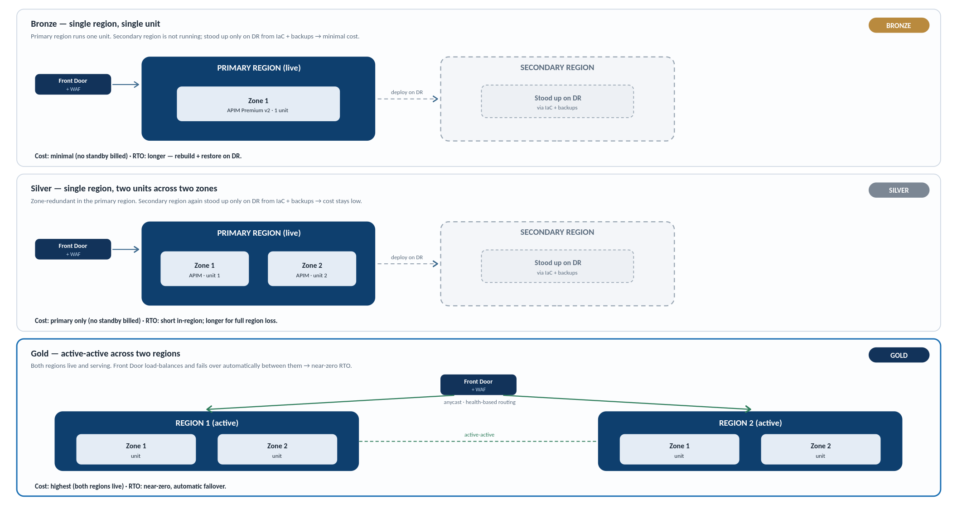
HIGH AVAILABILITY & DISASTER RECOVERY
6
Resilience Topology — Bronze, Silver, Gold
Bronze and Silver run the primary region only, standing up the secondary on DR via IaC to keep cost minimal. Gold runs active-active across both regions.

Slide 8
APPENDIX · EDGE SERVICE OPTIONS
A
Azure Front Door Tiers & Offerings
Front Door comes in several SKUs. Premium is the chosen tier because it adds the managed WAF and Private Link origin a governed API edge requires.
OPTION A
BASELINE
OPTION B
CHOSEN
Front Door Standard
Front Door Premium
SKU PROFILE
SKU PROFILE
CDN + global Layer 7 routing, no advanced security
Standard + managed WAF + Private Link origin
Managed WAF (DRS 2.1) with bot protection and rate limiting.
Private Link origin to an internal-mode APIM, so no public IP.
DDoS protection and enhanced security analytics.
The hardened, governed edge this design requires.
Anycast routing, caching, TLS termination and custom domains.
No managed WAF or bot protection, and no Private Link origin support.
Lower cost; suited to content delivery, not a secured API edge.
Not sufficient: no WAF and no Private Link origin for internal APIM.
Chosen: WAF plus Private Link origin gives a secure, private API edge.

Slide 9
APPENDIX · APIM GATEWAY TIERS
A
APIM Gateway Tiers & Offerings
APIM offers several tiers. Premium v2 provides the network isolation, scale and governance a strategic API platform needs.
ENTRY TIERS
NOT SUFFICIENT
TARGET TIER
CHOSEN
ALTERNATIVE
IF MULTI-REGION
Consumption / Developer / Basic / Standard
Premium v2
Classic Premium
TIER PROFILE
TIER PROFILE
TIER PROFILE
serverless, non-production and entry production tiers
VNet injection · internal mode · zones · scale units
established line · instance multi-region today
VNet injection in internal mode, with no public endpoint.
Inbound Private Link and availability-zone support.
Simplified networking versus classic Premium.
Scale units, workspaces and full policy governance.
The only tier with instance-level multi-region deployment today.
VNet injection and workspaces; established and mature.
Needs the control-plane bypass route that v2 removes.
Use where multi-region is needed on day one.
Consumption is serverless and per-call; Developer has no SLA (non-prod only).
Basic and Standard carry a production SLA but no VNet injection.
None provide the private networking or isolation this design needs.
Not sufficient: no VNet injection or private isolation for the platform.
Chosen: the isolation, scale and governance a strategic platform needs.
Alternative: use if instance multi-region is needed before v2 supports it.
ENVIRONMENT → TIER MAPPING
DEV
Non-prod
SIT
Non-prod
Developer tier
full features · no SLA
UAT
Prod-like
PROD
Production
Premium v2
VNet · internal · SLA

Slide 10
APPENDIX · GLOBAL ROUTING
A
Azure Front Door vs Traffic Manager
Both route across regions but at different layers. Azure Front Door is the chosen edge for HTTPS APIs; Traffic Manager only wins for non-HTTP or non-Azure routing.
OPTION A
CHOSEN
OPTION B
NOT CHOSEN
Azure Front Door
Azure Traffic Manager
LAYER & ROLE
LAYER & ROLE
Layer 7 · global anycast · edge WAF · Private Link origin
DNS layer · protocol-agnostic · no inline inspection
Resolves DNS to a healthy regional endpoint, then steps out of the path.
Works for any protocol, including non-HTTP and non-Azure endpoints.
No WAF, TLS offload or caching of its own.
Failover bounded by client DNS cache TTLs, so slower; cheaper per query.
Built-in WAF, TLS termination, DDoS and caching at the Microsoft edge.
Anycast routing with fast, sub-minute health-based regional failover.
One global hostname; Private Link origin into internal-mode APIM.
Chosen: every API is HTTPS and benefits from edge security and fast failover.
Not chosen: no edge security and DNS-TTL failover is too slow for the RTO.

