Slide 1
HOME REPAIR INTEGRATION PLATFORM
Repair & Work Order
End-to-End Sequence
Inbound, outbound, and every vendor operation routed through the centralized API
Inbound
Outbound
Vendor ops
customer raises repair in CRM
work order issued to vendor
all via the centralized API
Vendor authenticates once; the same token authorises every call

Slide 2
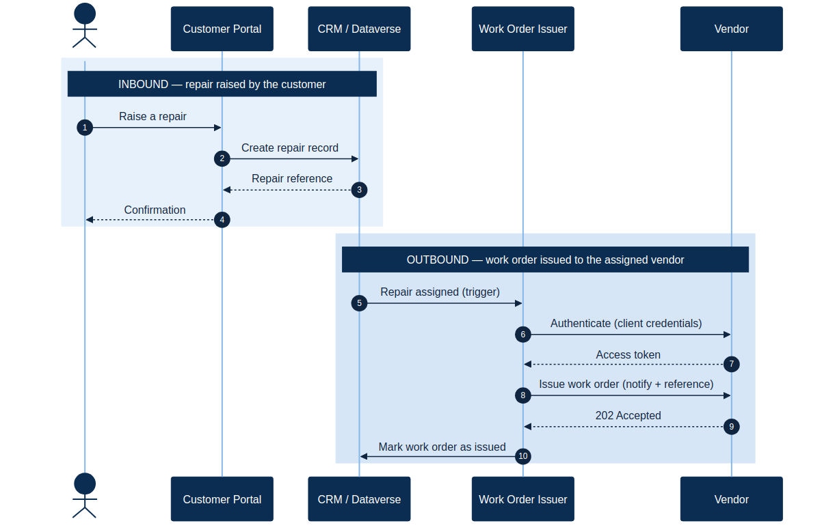
Sequence — inbound & outbound
phase 1
Customer raises a repair in CRM; the assignment triggers the issuer, which authenticates and issues the work order to the vendor.

Slide 3
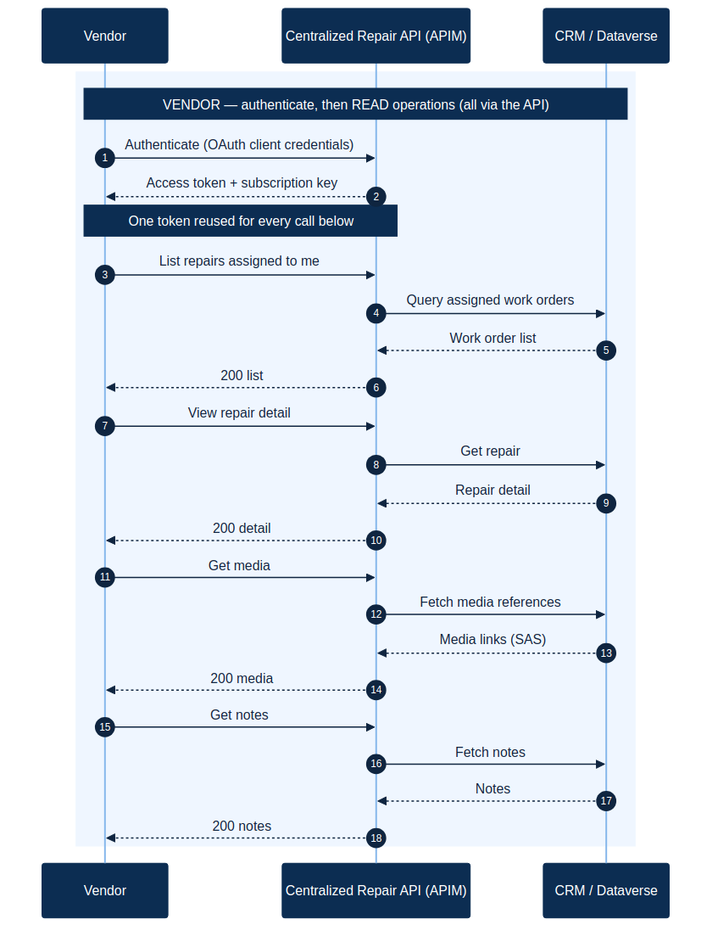
Sequence — vendor read operations
phase 2
Vendor authenticates once, then lists assigned repairs and reads detail, media, and notes — every call through the centralized API.

Slide 4
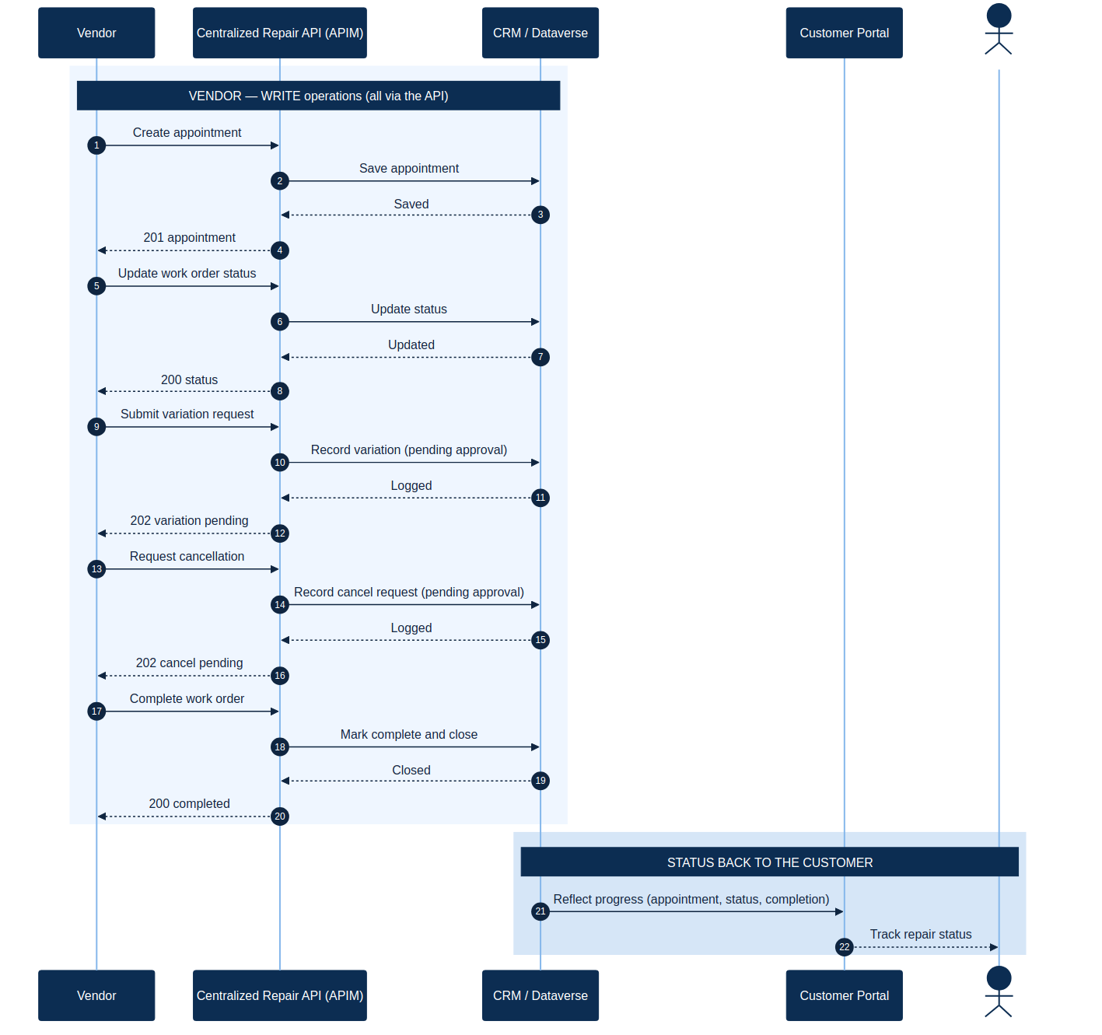
Sequence — vendor write operations
phase 3
Appointment, status, variation, cancellation, and completion — all via the API. Variation and cancel return pending (await approval).

