Slide 1
CUSTOMER PREDICTION
BA TECHNOLOGY, DATA, & INSIGHT

Slide 2
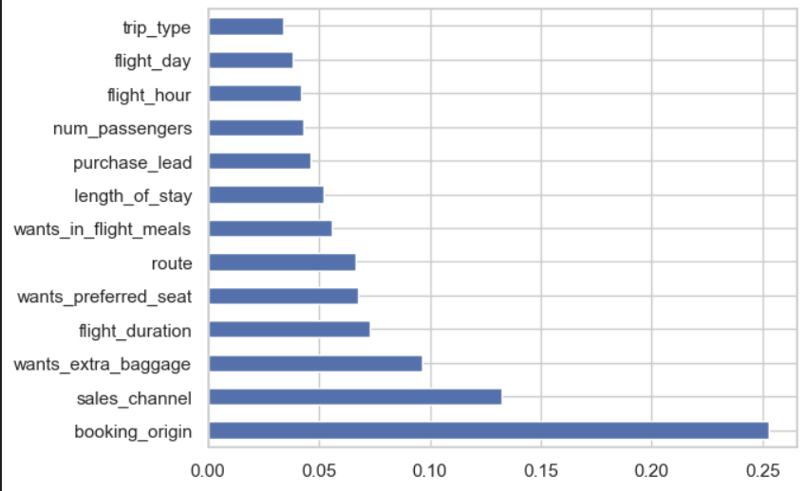
⭐ Key Findings from Feature Importance

Slide 3
Insights derived from XGBoost feature importance analysis on booking data.
- Booking origin and sales channel are top predictors.
- Extra baggage preference indicates high booking intent.

Slide 4
📊 Top Influential Features
1. Booking Origin: Strong regional influence on bookings.
2. Sales Channel: Digital channels drive more completions.
3. Wants Extra Baggage: Indicates serious intent to travel.
4. Route, Flight Duration, Preferred Seat: Linked to comfort.

Slide 5
🔻 Lower Impact Features
- Trip Type
- Flight Day
- Number of Passengers
- Flight Hour
- Purchase Lead
=> Less influence on booking completion.

Slide 6
📌 Business Recommendations
• Target campaigns by Booking Origin
• Enhance digital Sales Channels
• Upsell extras like baggage and seat preferences
• Focus on personalization, not just timing

Slide 7
🚀 Final Thought
Booking behavior is driven more by WHERE and HOW
customers book, than by WHEN they book.
Use this to design smarter, targeted strategies.

