Slide 1
British Airways Customer Reviews Analysis
A Data-Driven Review

Slide 2
Project Overview
This analysis examines customer reviews for British Airways. Key insights include sentiment trends, recurring themes, and customer concerns.

Slide 3
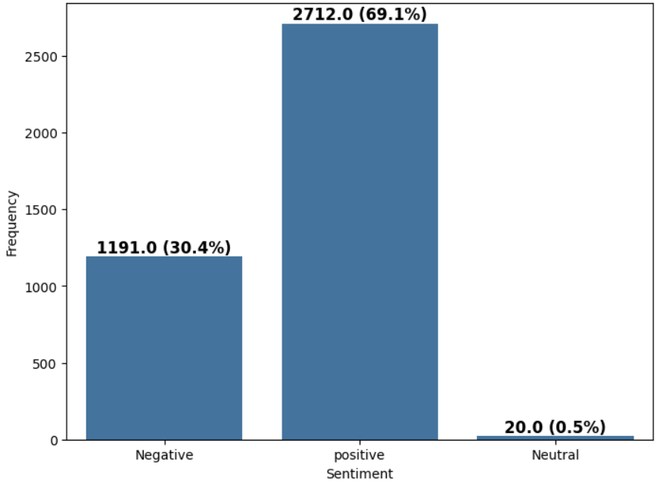
Sentiment Distribution
Out of 1000 reviews, 2712.0 were positive, 1191.0 were negative and 20.0 were neutral.
This means The Majority of reviews were Polarised as either positive or negative.

Slide 4

Most Common Words in Reviews

Slide 5
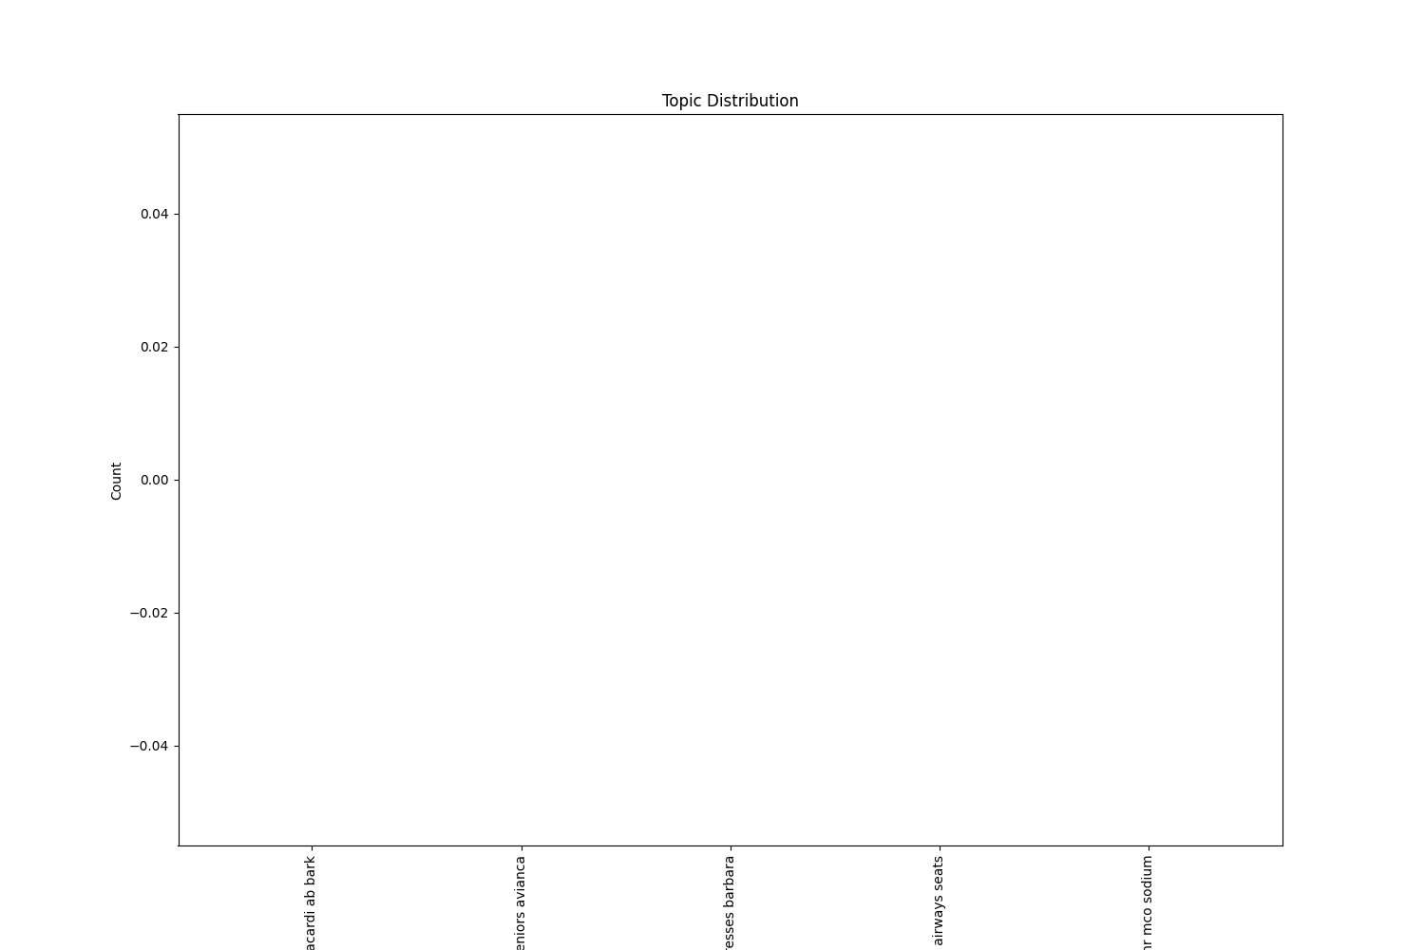
Topics Identified in Reviews

