Slide 1

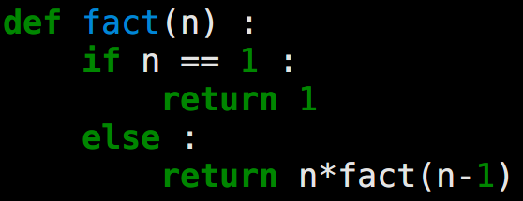
call
call
4
call
3
call
2
call
1

