Slide 1
Swin Transformer Hierarchical Vision Transformer using Shifted Windows
Xiangqiao MENG 22041201r

Slide 2
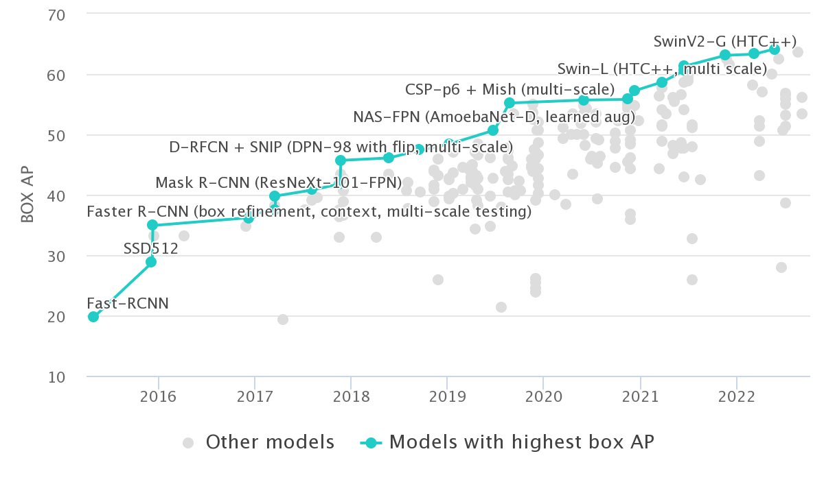
Excellent Performance in Object Detection
Rank | Model | Box AP | Year
1 | FD-SwinV2-G | 64.2 | 2022
2 | BEiT-3 | 63.7 | 2022
3 | DINO | 63.3 | 2022
4 | SwinV2-G | 63.1 | 2021
5 | Florence-CoSwin-H | 62.4 | 2021
6 | GLIPv2 | 62.4 | 2022
7 | GLIP | 61.5 | 2022
8 | Soft Teacher + Swin-L | 61.3 | 2021
9 | DyHead | 60.6 | 2021
10 | ViT-Adapter-L | 60.1 | 2022
Leaderboard on COCO test-dev
Top 10 Model on COCO test-dev
Image and Table Data Source: https://paperswithcode.com/sota/object-detection-on-coco

Slide 3
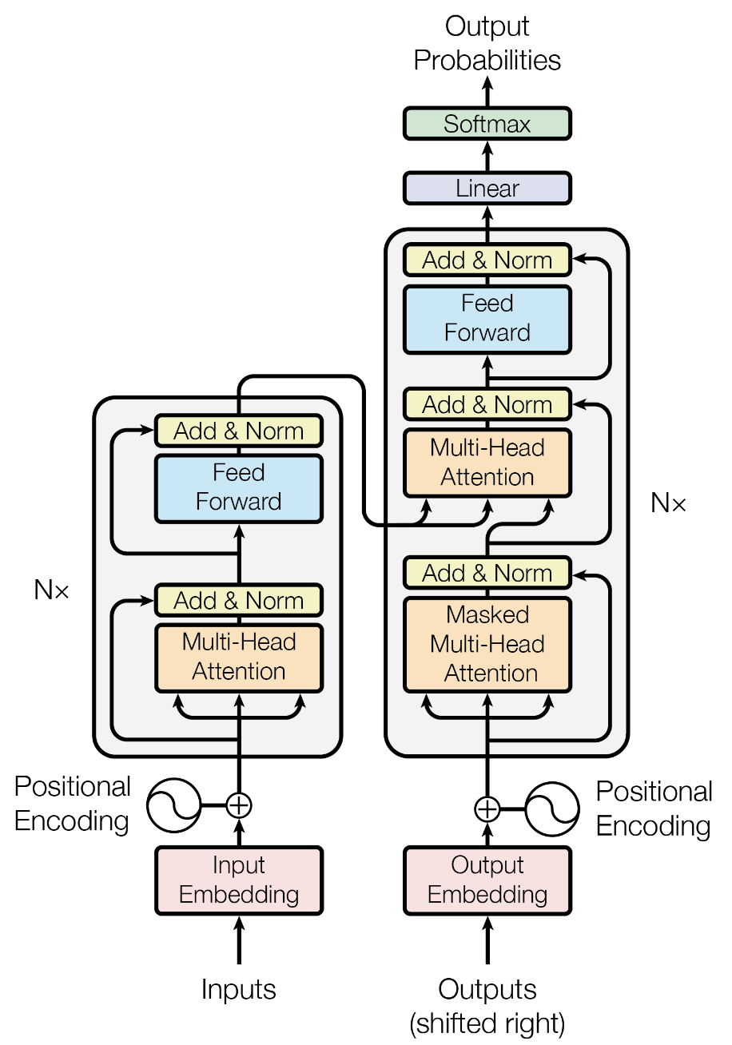
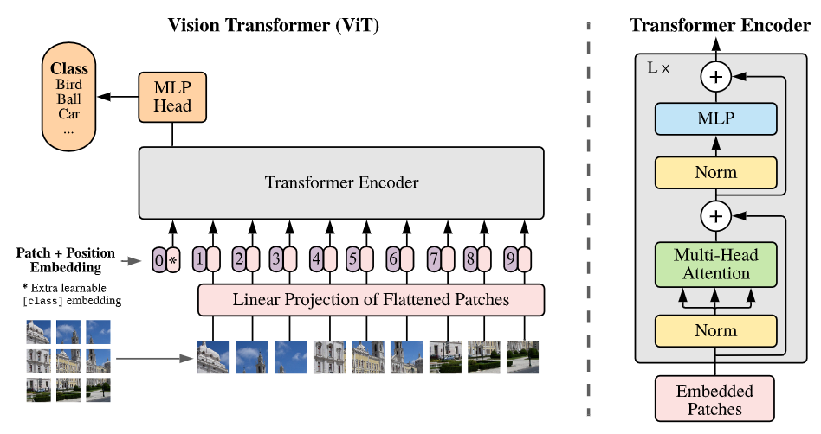
Transformer^{[1]} and ViT^{[2]}
Transformer^{[1]}
Vision Transformer (ViT)^{[2]}

Slide 4
Vision Transformer – ViT^{[2]}
Single-Scale Features
Low Resolution
Quadratic Complexity

Slide 5
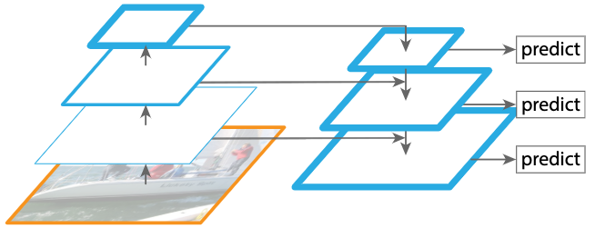
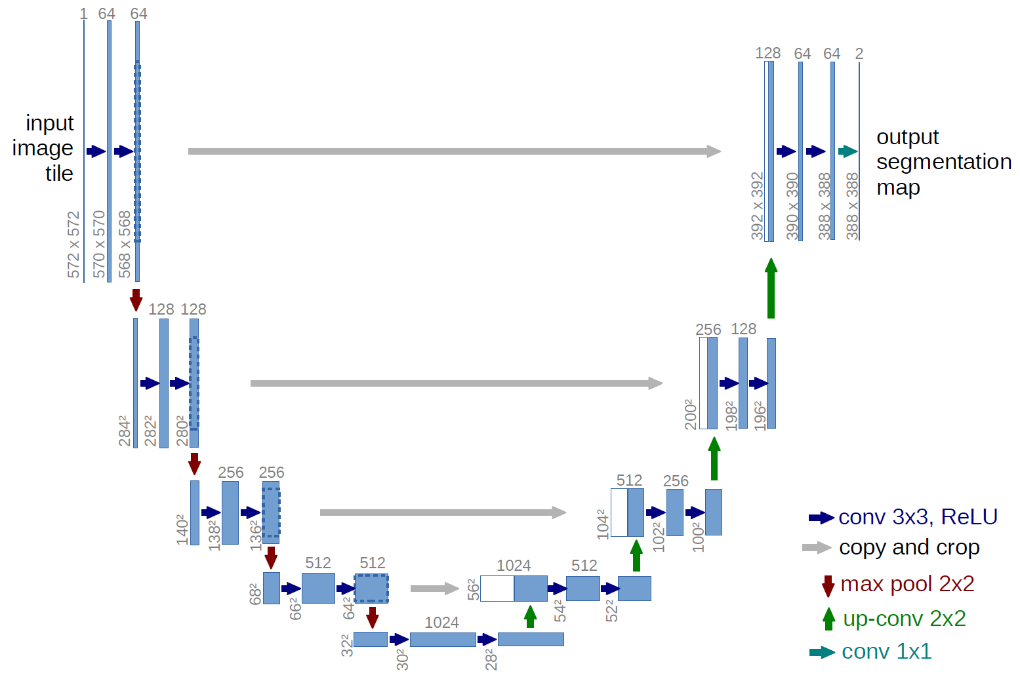
Multi-Scale Feature in CNN
Feature Pyramid Networks (FPN)^{[4]}
U-Net

Slide 6
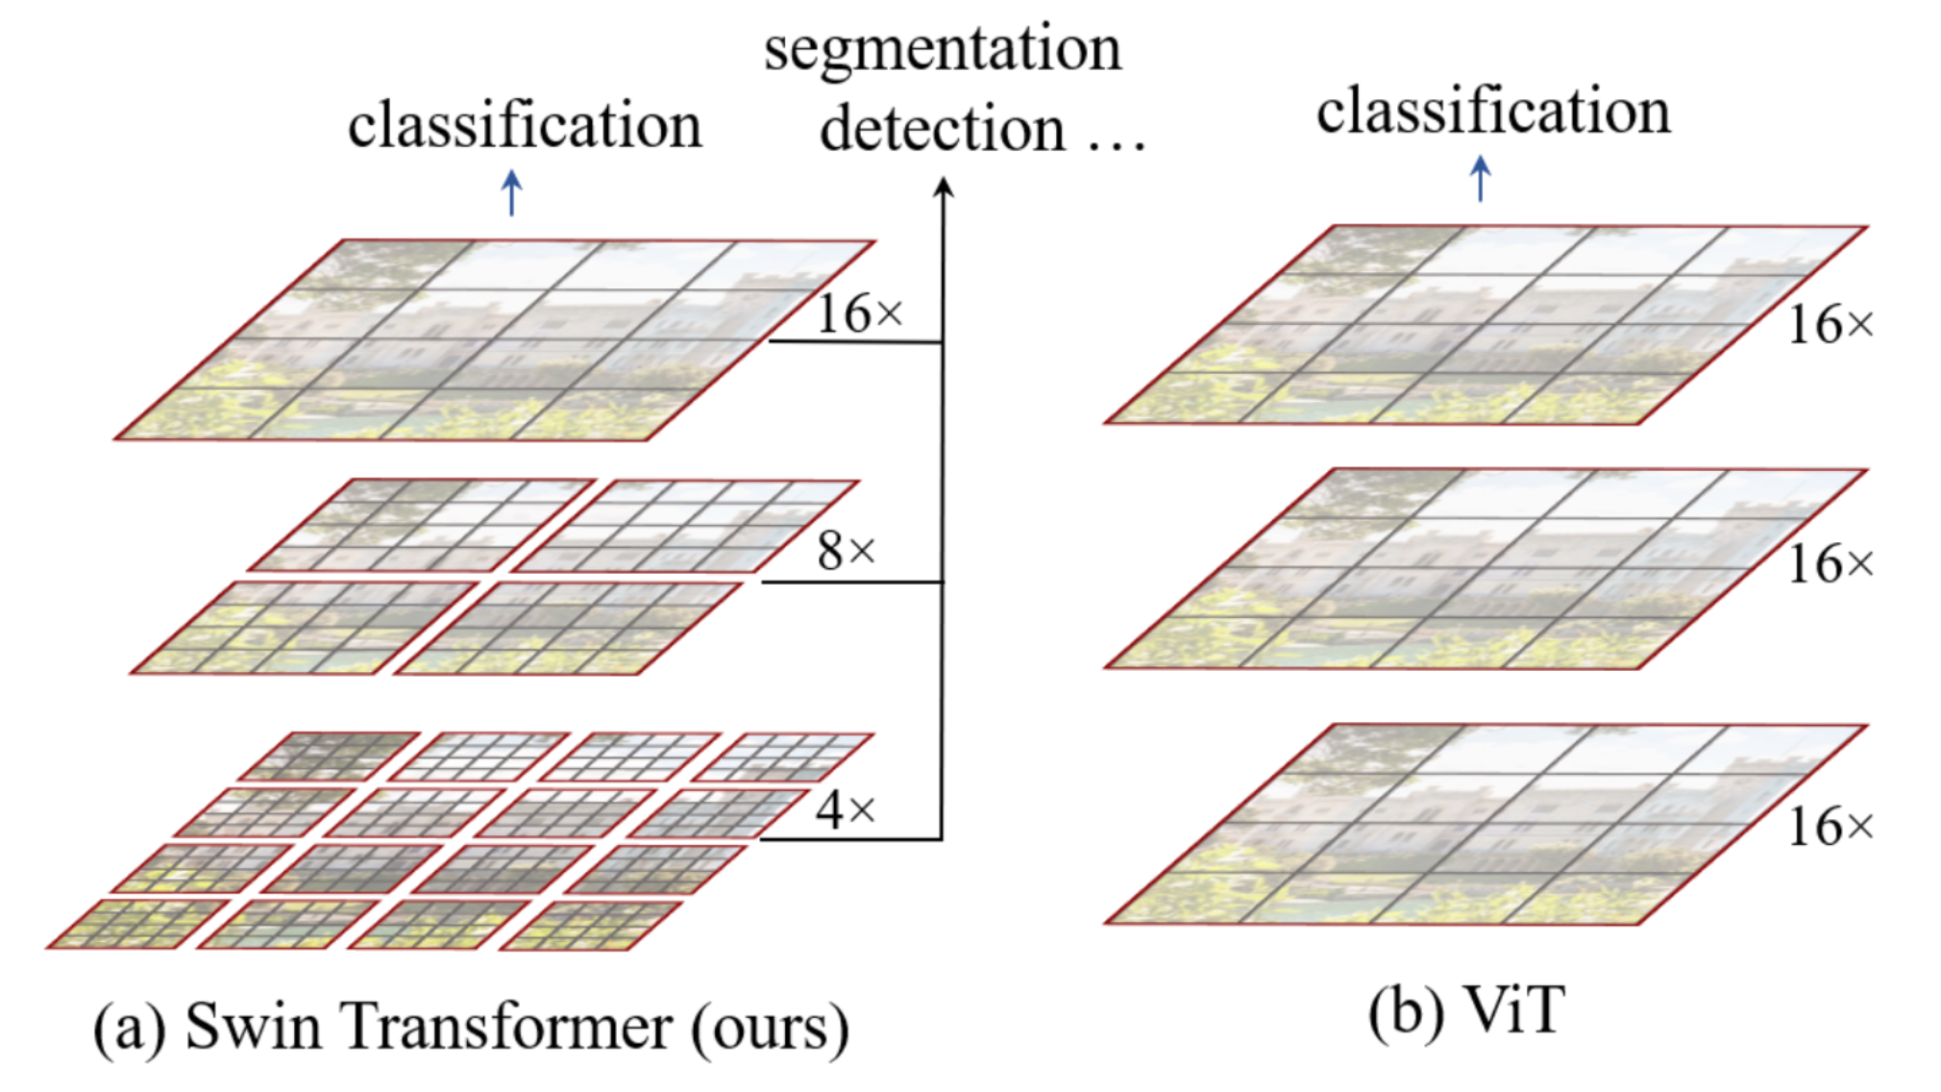
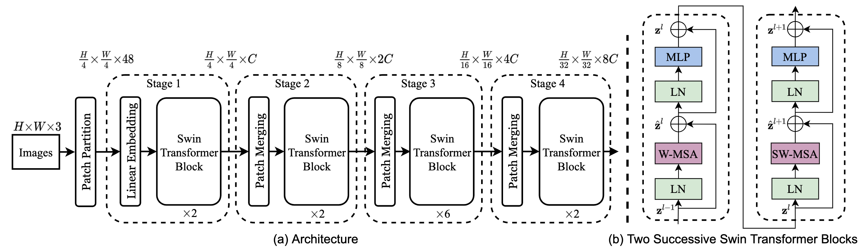
Swin Transformer
Backbone

Slide 7
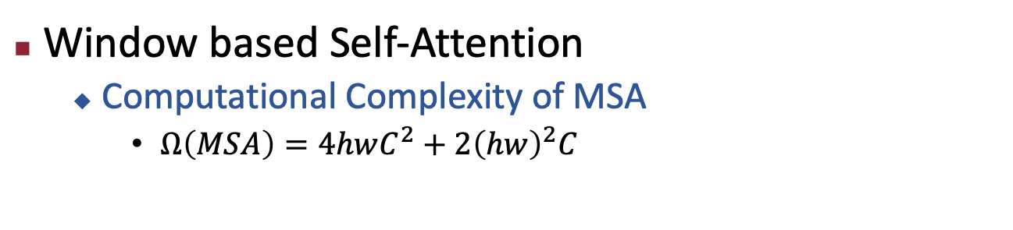
Swin Transformer
Window based Self-Attention
Computational Complexity of MSA
$Ω\left(MSA\right)=4hwC^{2}+2{\left(hw\right)}^{2}C$
C
hw
Q
hw
C
hw
A
C
C
hw
hw
hw
K
proj
(hw)²C
V
3hwC²
(hw)²C
hwC²

Slide 8
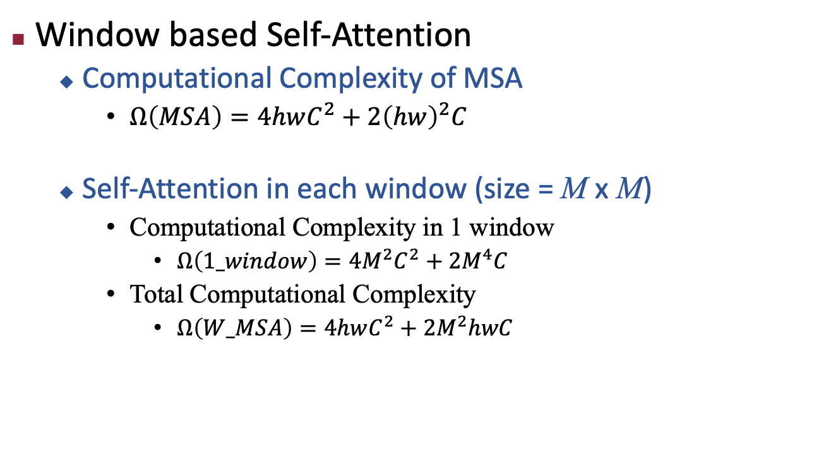
Swin Transformer
Window based Self-Attention
Computational Complexity of MSA
$Ω\left(MSA\right)=4hwC^{2}+2{\left(hw\right)}^{2}C$
Self-Attention in each window (size = M x M)
Computational Complexity in 1 window
$Ω\left(1_window\right)=4M^{2}C^{2}+2M^{4}C$
Total Computational Complexity
$Ω\left(W_MSA\right)=4hwC^{2}+2M^{2}hwC$
C
C
M
H
M
W

Slide 9
Swin Transformer
Backbone

Slide 10
Swin Transformer
Patch Merging
C
C
C
4C
2C
H
H
H/2
H/2
H/2
W/2
W/2
W
W
W/2

Slide 11
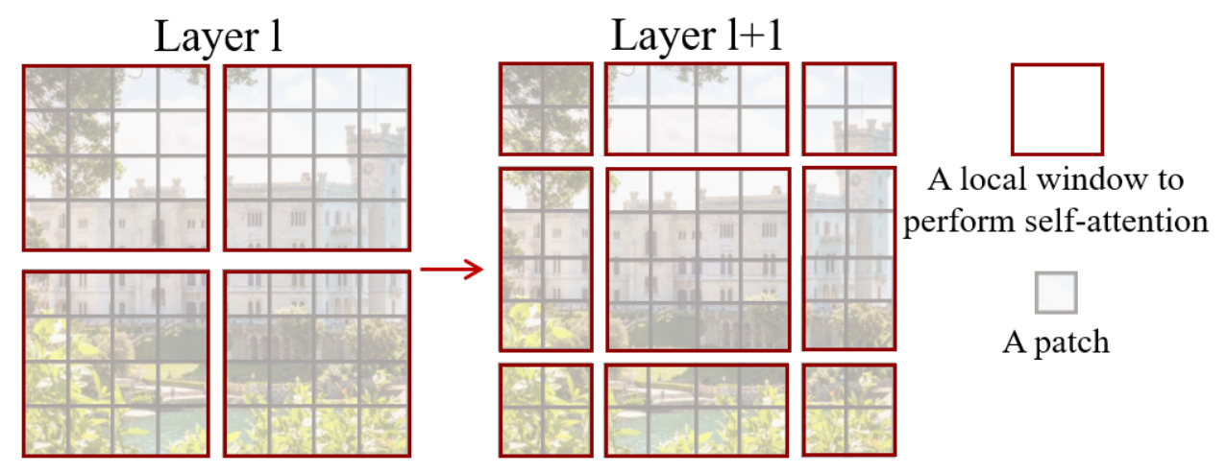
Swin Transformer
Shifted Window
Introduce cross-window connections while maintaining the efficient computation of non-overlapping windows

Slide 12
Swin Transformer
Shifted Window
The number of windows changed.
The size of each window is different.

Slide 13
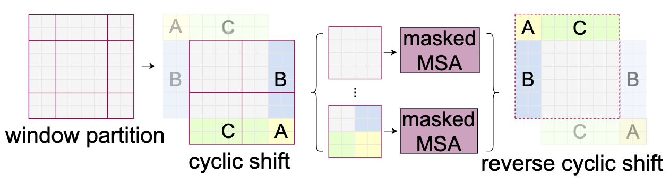


Swin Transformer
Shift Window – Masked MSA
C
C
h
hw
$$×$$
$$=$$
w

Slide 14
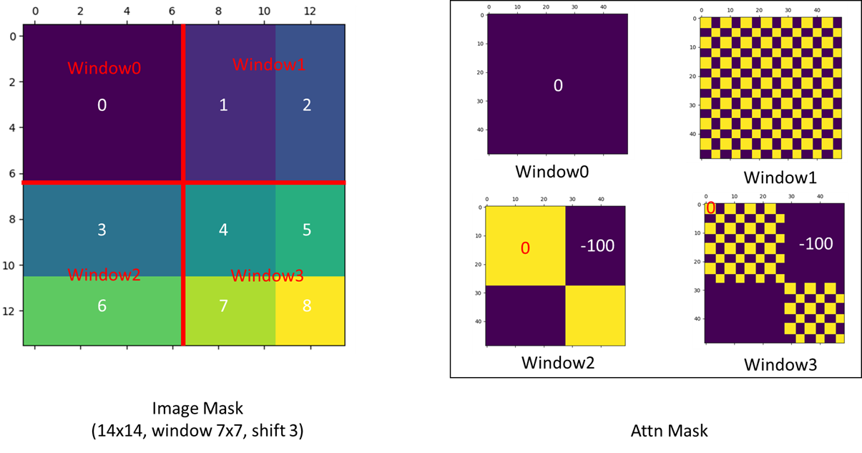
Swin Transformer
Shift Window – Masked MSA

Slide 15
Reference
[1] Vaswani A, Shazeer N, Parmar N, et al. Attention is all you need[J]. Advances in neural information processing systems, 2017, 30.
[2] Dosovitskiy A, Beyer L, Kolesnikov A, et al. An image is worth 16x16 words: Transformers for image recognition at scale[J]. arXiv preprint arXiv:2010.11929, 2020.
[3] Liu Z, Lin Y, Cao Y, et al. Swin transformer: Hierarchical vision transformer using shifted windows[C]//Proceedings of the IEEE/CVF International Conference on Computer Vision. 2021: 10012-10022.
[4] Lin T Y, Dollár P, Girshick R, et al. Feature pyramid networks for object detection[C]//Proceedings of the IEEE conference on computer vision and pattern recognition. 2017: 2117-2125.

Slide 16
Thank you!

