Slide 1

Northeastern University - Seattle
CS6650 Building Scalable Distributed Systems
Vishal Rajpal

Slide 2
Week 1 – Introduction to Scalable Systems
Introductions
Tell us your name
When did you start studying at NEU Seattle?
Where did you pursue your undergraduate studies and what was your major?
Exciting recent project

Slide 3
Week 1 – Introduction to Scalable Systems
Topics we will cover today:
What is Scalability?
Scalability – Basic Design Principles
Scalability And Costs
Course Outline

Slide 4
What is Scalability?
Notes:
Scalability in a system can mean different things depending on the system that we are dealing with.
In general terms, scalability of a system reflects its ability to handle tasks as the system grows in size.

Slide 5
What is Scalability
Scalability
The ability of a system to increase or decrease capacity in response to changing demands, while continuing to satisfying service level agreements (SLAs) for latency and availability
Notes:
* Important Note
SLA: Service Level Agreement is an agreement between a provider and the customer related to the quality and standard of service being provided. Example: https://aws.amazon.com/api-gateway/sla/?did=sla_card&trk=sla_card

Slide 6
What is Scalability
Gigabyte (GB) datasets were common around a decade ago.
Terabyte and Petabyte datasets not so much.
Today, large organizations store data at exascale or even more.

Slide 7
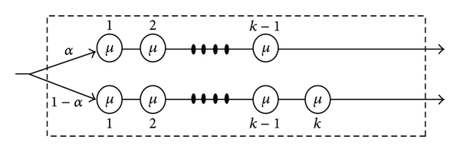
What is Scalability
Scalable Systems Examples
Facebook Scribe: collects, aggregates, and delivers petabytes of log data per hour
Notes:
Facebook’s engineering blog describes Scribe, their solution for collecting, aggregating, and delivering petabytes of log data per hour, with low latency and high throughput. Facebook’s computing infrastructure comprises millions of machines, each of which generates log files that capture important events relating to system and application health. Processing these log files, for example from a Web server, can give development teams insights into their application’s behavior and performance, and support fault finding. Scribe is a custom buffered queuing solution that can transport logs from servers at a rate of several terabytes per second and deliver them to downstream analysis and data warehousing systems.

Slide 8
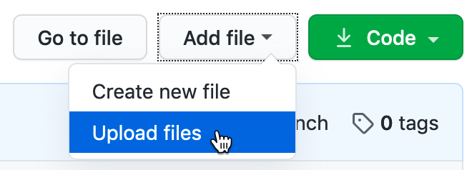
What is Scalability
Scalable Systems Examples
Google code repo (2016):
contains 86TBs of data,
approximately two billion lines of code
nine million unique source files
Notes:
In 2016 Google published a paper describing the characteristics of their code base. Amongst the many startling facts reported is: “The repository contains 86TBs of data, including approximately two billion lines of code in nine million unique source files.” Remember, this was 2016.

Slide 9
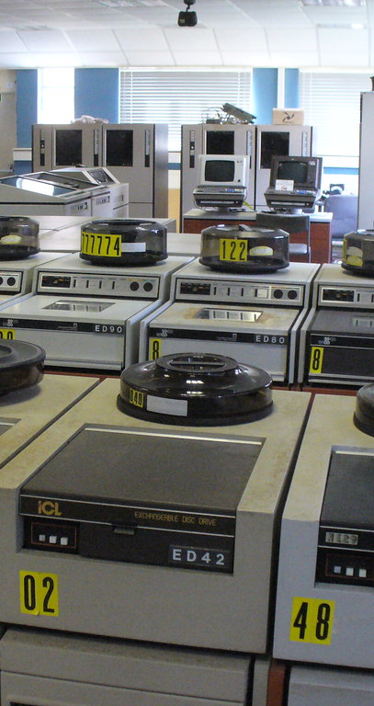
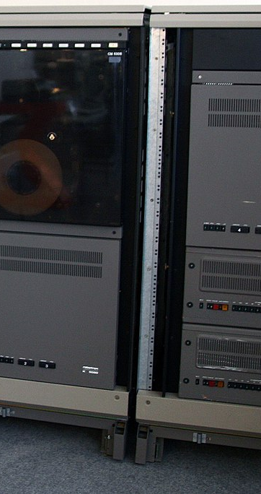
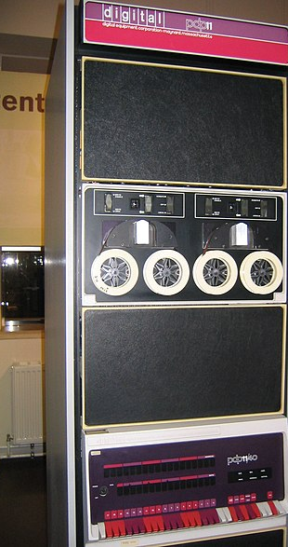
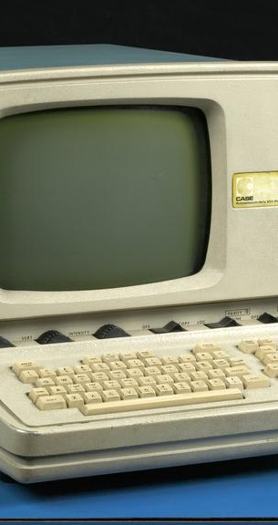
What is Scalability
History
1980s
This Photo by Unknown Author is licensed under CC BY-SA
This Photo by Unknown Author is licensed under CC BY-NC
Notes:
1980s was dominated by shared mainframes and mini computers.
PCs emerged in early 1980s and were standalone machines (no networks) that you worked on.
By the end of 1980s businesses, universities had access to primitive email and internet resources at slow speeds.

Slide 10
What is Scalability
History
1990-1995
Wide area networks (WANs) usage becomes more pervasive
Leading to creation of World Wide Web
1996-2000
Number of websites grew from 10K to 10 million globally.
With this, Global networking bandwidth and access also grew.
With businesses trying to exploit the idea of e-business scaling became important.
2000-2006
Number of websites grew from 10 million to 80 million.
2005 – Youtube launch, 2006- Facebook launch
2006 – AWS launch with S3 and EC2.
Notes:
World Wide Web started with utilizing HTTP and HTML technologies.
In 1995 the number of websites were tiny.
1996-2000 – Tech companies such as Google, Amazon were pioneering the design principles for scalable systems.

Slide 11
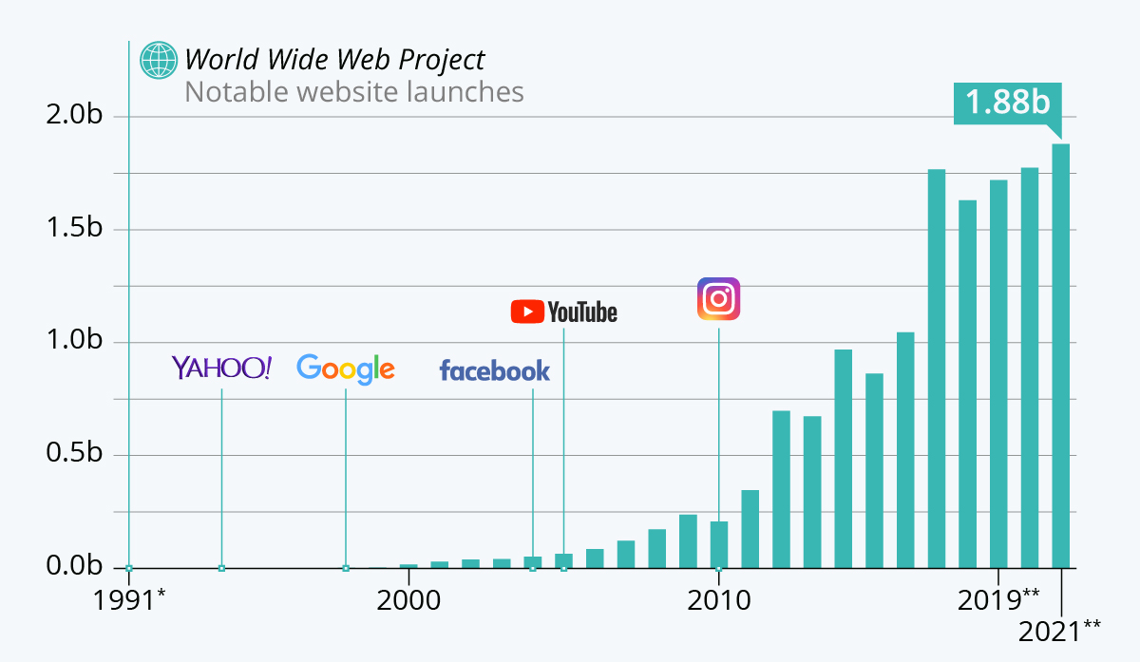
What is Scalability
History
2006-2022
2 Billion websites
4 Billion Internet Users
Huge data centers
(Public & Private)
Ability to manage and scale systems through cloud portals.
Notes:
Applications need to exploit scaling design principles and leverage highly scalable infrastructure platforms.
Use of tools within these platforms is very important as it can have a major impact in terms of latency, scalability and availability.
Once these tools are chosen and architectural decisions are made, its not easy to change.

Slide 12
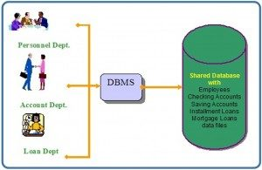
What is Scalability
Impact of Scale on Business System Design
Example: Bank System
Before Internet, easy to predict load on a system.
Post Internet, Imagine if thee bank has 5 million customers.
Notes:
Example of technical issues a system must confront when exposed to Internet.
It created a major shift in software architecture and design principles in 1990s.

Slide 13
What is Scalability
Think of any physical system
Transit system
Airport
Elevators
How we increase capacity is obvious.

Slide 14
What is Scalability
Scaling Software Systems
Not something you can point at, see, touch or feel and get a sense of how it behaves.
At its core software systems are a digital artifact with a stream of binary data.
Scalability for Software Systems is its capability to handle growth in some dimension.
The number of simultaneous requests a system can process
The amount of data a system can effectively process and manage
Maintain a stable, consistent response time as the request load grows

Slide 15
What is Scalability
Example – Supermarket Scaling
Imagine a supermarket chain is rapidly opening new stores
And Increasing the number of self-checkout kiosks.
What changes would its software systems need?
What is the systems do not scale?
Notes:
Changes to its software systems include:
Handle increased volume from item scanning without decreased response time.
Store the data volumes generated from increased sales.
Deliver real time sales data summaries.
Evolve stock ordering prediction subsystem to be able to correctly anticipate sales.

Slide 16
What is Scalability
Competing Forces
Early in system lifetime
Scalability not a primary requirement
Emphasis on new features.
If system becomes successful
More Users & More data
If a system prioritizes scaling early in a system lifetime, it can introduce additional complexity causing development inertia.

Slide 17
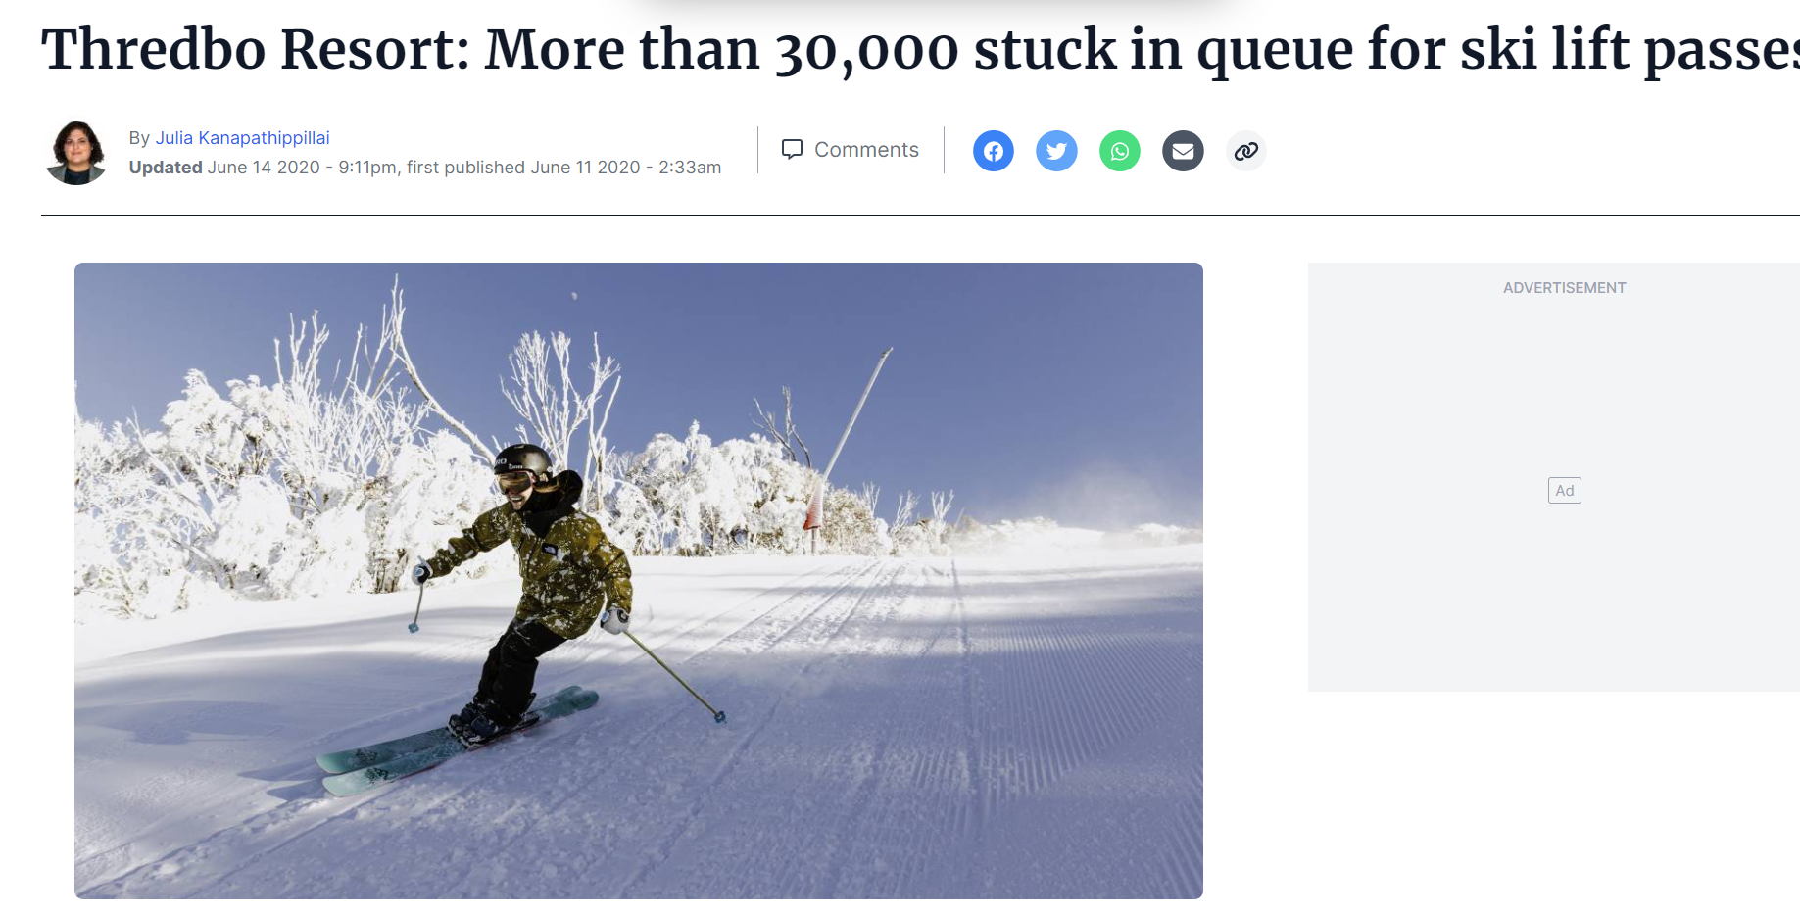
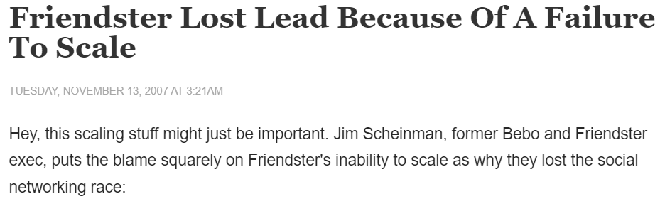
What is Scalability
Scalability Failures
Healthcare.gov was officially launched on 1 October 2013 covering residents of 36 states. High website demand (250,000 users [5 times more than expected]) caused the website to go down within 2 hours of launch.
Notes:
Its not uncommon where systems evolve into a state where enhanced performance and scalability become a matter of urgency.
Attractive features bring more requests to handle and more data to manage.

Slide 18
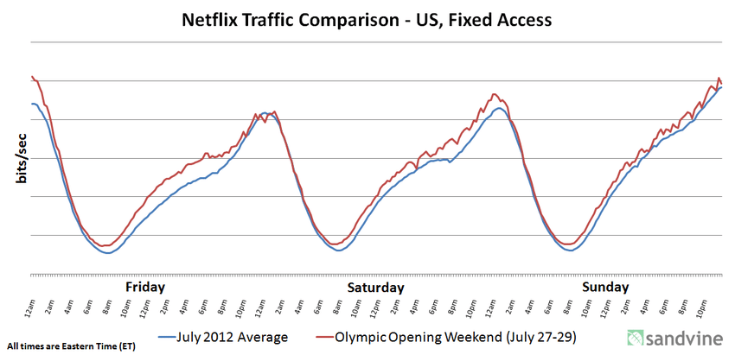
What is Scalability
Key Terms
Scaling Up or Scaling Out – Increasing a Systems’ capacity.
Scaling Down – Reduce System Costs
Example - Netflix
Notes:
Netflix has a predictable load that it needs to process regionally. More people are watching Netflix at 9PM than at 5AM. This enables it to reduce its processing resources during lower load. Saves the cost of running nodes in Amazon Cloud as well as reducing data center consumption.
Compare this to a highway where we don’t retract lanes when there is low traffic.

Slide 19
Scalability – Basic Design Principles
Aim is to increase capacity in some application specific dimension.
A common dimension is increasing the number of requests that a system can process in a given time period also known as throughput.

Slide 20
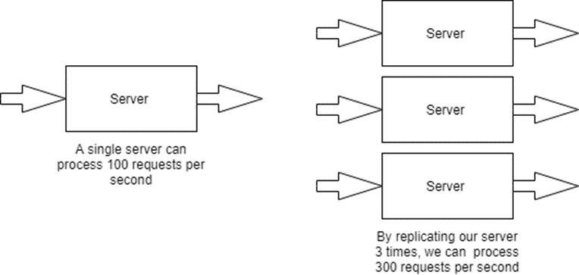
Scalability – Basic Design Principles
Increasing Capacity - Replication
Notes:
The above diagram illustrates the first strategy we have in software systems i.e. to increase capacity. We basically replicate the software processing resources to provide more capacity to handle requests and thus increase throughput.

Slide 21
Scalability – Basic Design Principles
Use Resources More Efficiently
Optimize processing to create more capacity
Using more efficient algorithms
Adding indexes to databases to speed up queries
Rewriting servers in a faster programming language
Example: Facebook’s creation of HipHop for PHP which increased speed of Facebook’s web page generation by up to 6 times by compiling PHP code to C++.
Notes:
Similar to express lanes on a highway which are opened in the direction where there is more traffic coming from, resources can be utilized more efficiently in software systems.

Slide 22
Scalability And Costs
Let’s examine relationship between scalability and costs.
Example – A Web based system than can service a load of 100 concurrent requests with a mean response time of 1 second.
Requirement to scale up this system to handle 1000 concurrent requests.
Without any changes, a simple load test reveals the below performance
10
Response
Time (secs)
1
1000
Number of requests

Slide 23
Scalability And Costs
As the request load increases, we see the mean response time steadily grow to 10 seconds.
Clearly this does not satisfy the requirement. Hence, the system does not scale with increasing traffic.
After some engineering effort to improve performance, below is the graph.
10
Response
time
1
1000
Number of requests

Slide 24
Scalability And Costs
What did the modification cost?
Maybe simple and low cost:
More powerful web server.
Multiple server replicas.
But what if it needed to be a
Redesign of server code.
Database schema and code changes
Rewrite server code using fast framework or language.
Notes:
A major question however is how much effort and resources were required to achieve this performance?
Scaling a system isn’t always so easy. The reasons vary
Web server code needs redesigning to reduce processing time per request.
Database needs redesigning to eliminate hot keys.
Web server framework emphasized ease of development over scalability. To use another framework to achieve scalability.

Slide 25
Scalability And Costs
Optimize server code = 100 hours dev
Database schema and code changes = 500 hours dev
Rewrite server code using fast framework or language = 10K hours dev
A software system not designed to scale will cost more to transform
But it’s probably doable
Economical?
Scalability = f( (effort * cost) + (deployment * cost)
At scale, costs are significant
10% reduction of $10m per month will make your organization happy
Notes:
We would never expect someone to scale up the capacity of a suburban home to become a 50 floor building. The home does not have the architecture, materials and foundations.
Similarly, we shouldn’t expect software systems that do not employ scalable architectures to be quickly evolved to meet greater capacity needs.
The foundation need to be built in from the beginning.

Slide 26
Scalability And Costs
Goal
Achieve the required capacity at lowest cost when scaling a system.
Software systems that can be scaled exponentially while costs grow linearly are known as hyperscale systems.

Slide 27
Course Outline
Web site: https://github.khoury.northeastern.edu/vishalrajpal/cs6650
In this course you’ll learn both theory and practical knowledge
To be able to engineer robust, scalable, efficient internet scale systems
The theory will be learned by:
Reading relevant materials/seminar
Lectures
Quizzes
The practical knowledge will be gained by:
In class exercises
Projects

Slide 28
Grading & Course Material
There will be three components to the grades
4 programming assessments (70%)
4 in class Quizzes (30%)
All course material will be available through Canvas
Piazza for discussions
We won’t be taking attendance, but you are expected to attend and actively participate in class

Slide 29
Assignments Overview
Assignment 1 – (Client -> Server) Multithreading, Measurement and Presentation (Using AWS)
Assignment 2 – (Client -> Server) Server thread models, State management, Messaging
Assignment 3 – Availability, Scalability, Caching and Monitoring
Assignment 4 – Group Project
Notes:
Assignment 1 -> A multithreaded client which can send load to a a no-op server .
Assignment 2 -> Introduce business logic in the server and a database. More write dominated system than read oriented which is much harder to scale. Lots of work involved
Assignment 3 -> Server integrated with a lot more services

Slide 30
How to succeed in course?
Do the reading
Study for the quizzes
Start the assignments early
Work consistently
Experiment
Be inquisitive and have fun
Expect to work hard!!!

Slide 31
At the end of course?
You will acquire a set of skills that is in very high demand right now
At Amazon, Google, Facebook, Microsoft and, well, everywhere really!
Projects should be useful in interviews
You will learn a lot about how computer systems really work

Slide 32
Disclaimer
This course is a unique offering and is always evolving.
The technology will be complex and finding help will be a little difficult.
But it will be fun.

Slide 33
Policies
Can we work on assignments together? No
Can I discuss assignments with others in general terms? Yes
Can I use code copied from Web? No
Can I ask questions about the assignment on Piazza? Yes

Slide 34
Questions?

